Slide 1
This
To
That
Sheetal Varshney Vibhor Taneja

Slide 2
This To That (Word-Ladder)
Often we have played a puzzle game begins with two words, and to solve the puzzle one must find a chain of other words to link the two, in which two adjacent words differ by one letter.
For example:
stale->state->slate->plate
2. stale->state->spate->slate->plate
We need to suggest a shortest path between the two words (starting and end word), by changing only one letter at a time. As shown in above example, to reach “plate” there can be two path, but we have to find the shortest one

Slide 3
Requirements and Scope of the Problem
Input and Output word to be entered by the user of equal length (In this case 5 letter)
To have the shortest path between two words.
Every intermediate word should have a difference of only one letter.
Path should be defined from the given words only.

Slide 4
Algorithm
Create all possible words combination of same length with all variation of one and only one character which are stored in an object.
Then take start and end word as input.
Compare the length of both the words.
Create a graph which links all the words between the start and end word by using BFS algorithm.
Now traverse from the end word to start word, with minimum nodes.

Slide 5
Pros
Shortest path is created between the entered words as the program iterates through all the words given in the dictionary.
BFS is useful in finding shortest path or shortest distance between some starting node and the remaining nodes of the graph.
BFS is more reliable and fast algorithm than DFS as DFS when performs traversal its makes the path as long as possible, and then go back (backtrack) to add branches also as long as possible.
The algorithm has time complexity of O(n) where n is number of nodes.
BFS is more memory consuming as it stores all the explored nodes in the memory.
Cons

Slide 6
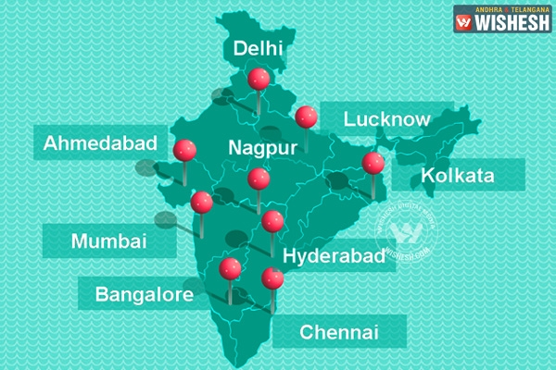
Future Scope
It can be used in NIIT travel domain projects.
In Airlines, to identify shortest path between two places to transfer cargo.
Cargo has to be transferred from point A to B with multiple hope-overs on various locations.
The shortest path can be determined with respect to number of hops it takes between the two points.





Slide 7
Stake Holders
Web Crawlers :They can be used to analyze what all sites you can reach by following links on a particular website.
Application to Find people : Treating each user profile as a node on the graph and two nodes are said to be connected if they are familiar. Any two people are connected with each other by atmost five nodes in between. To say, that you can reach any random person in the world by traversing 6 nodes.
GPS navigation system.

Slide 8
Example
Heath
Death
Heats
Heart
Beats
Hears
Bears
Heard
Heals

Slide 9
Demo
Start | End | Path | Length
Super | Heros | super >> surer >> serer >> seres >> heres >> heros | 4
Small | Short | small >> shall >> shale >> share >> shore >> short | 4
Happy | Anger | happy >> harpy >> harps >> hares >> lares >> lures >> luges >> luger >> auger >> anger | 8
Metro | Litre | metro >> metre >> mitre >> litre | 2
Novel | Swags | novel >> hovel >> hosel >> hoses >> hosts >> hests >> heats >> seats >> swats >> swags | 8

Slide 10
Limitation
It is not optimal until all the operations have the same cost.
Space Complexity

Slide 11
Conclusion
All the shortest path are calculated, by forming a chain of words already existing in the predefined dictionary.
The words are formed by replacing one letter at a time.
If middle words doesn’t exist in the dictionary, it will give an error message and the chain will not be formed.

