Slide 1
Can You identify cracks on mobile screen?
Sheetal Varshney Vibhor Taneja

Slide 2
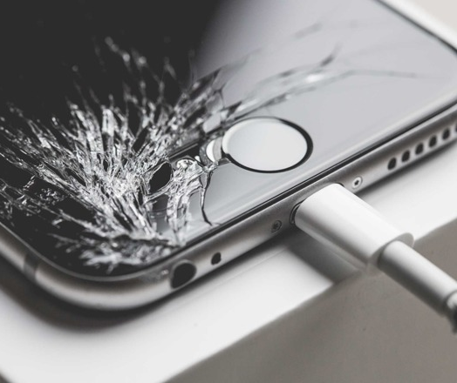
Can you identify cracks on mobile screen?
Using images of mobile phone, can you classify the extent of crack on the mobile screen? A suggested classification could be:
Heavily cracked
Moderately cracked
Free of any cracks

Slide 3
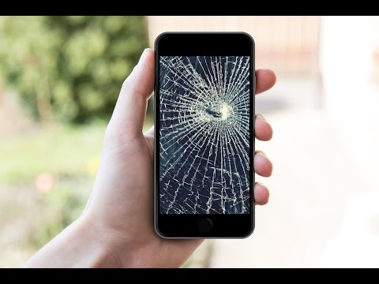
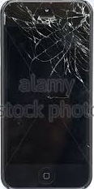
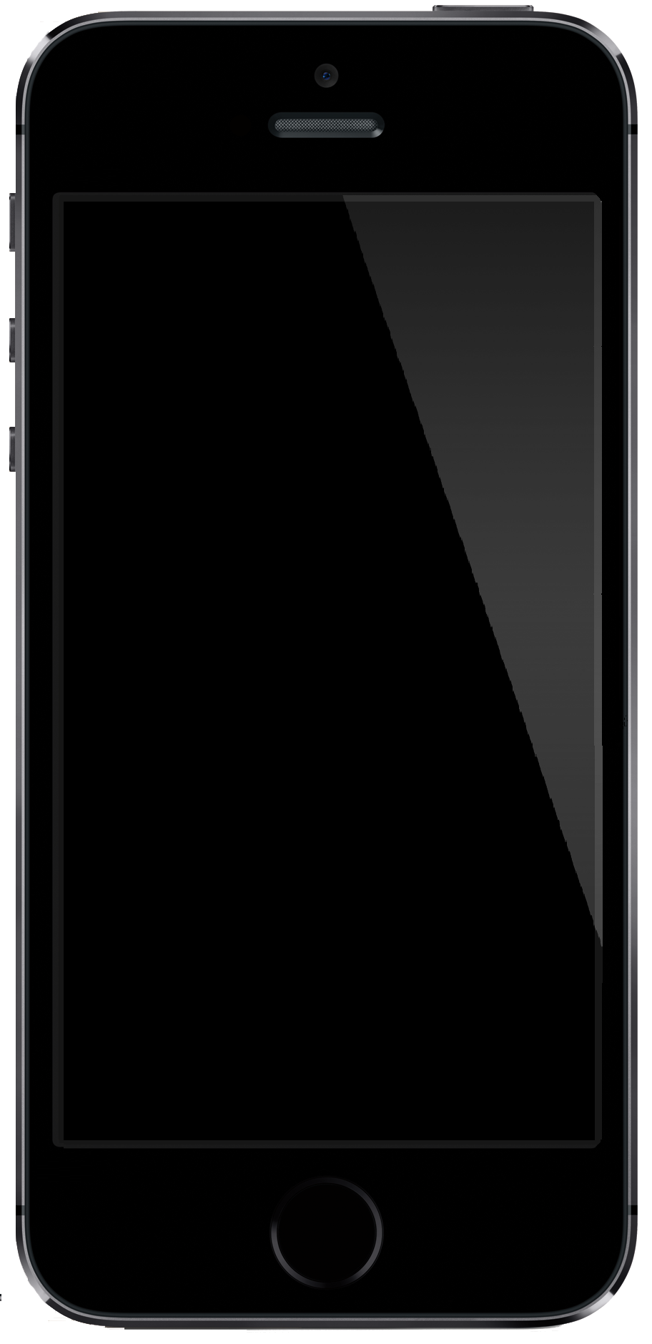
Requirements and Scope of the Problem
We are given with an image containing cracks as an input.
Find the extent of cracks on that image.
The image must be classified into three categories.
Heavily
cracked
Moderately
cracked
Free of any
cracks

Slide 4
Algorithm
Input is taken as an image. Which is converted into grey scale
Perform canny edge detection.
Reduce noise by blurring the image with Gaussian Blur.
Detect straight lines by Hough Lines.
These straight lines are then counted.
By these number of lines images can be categories.

Slide 5
Advantage
cvCanny is used to detect Edges, as well as increase contrast and remove image noise.
HoughLines which uses the Hough Transform is used to determine whether those edges are lines or not. Hough Transform requires edges to be detected well in order to be efficient and provide meaning results.
Application shows all the cracked lines by highlighting them.

Slide 6
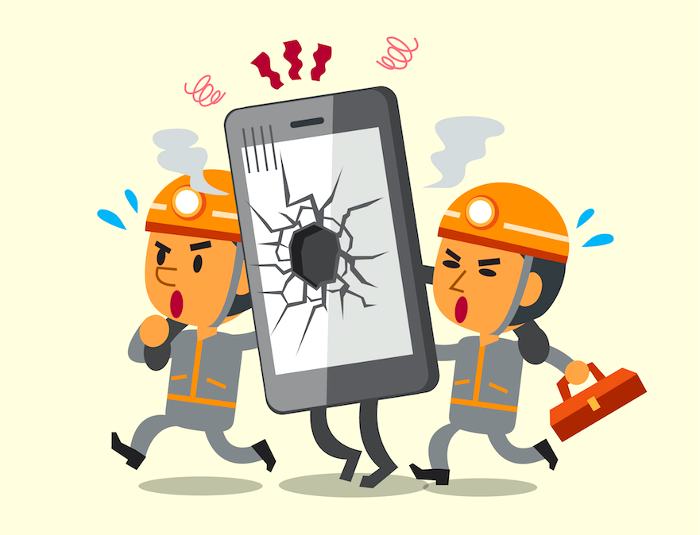
Future Scope
It can be used in NIIT for the clients whose requirement is to detect mobile screens by which appropriate solution can be found to repair that screen.

Slide 7
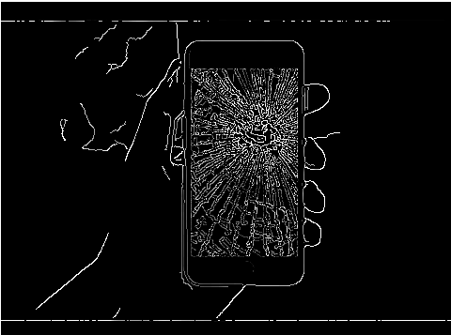
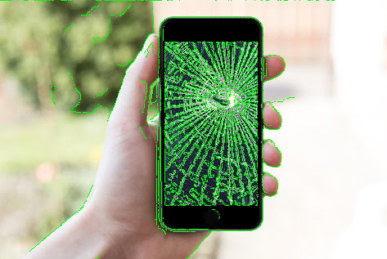
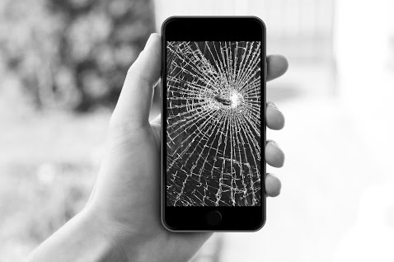
Example

Slide 8
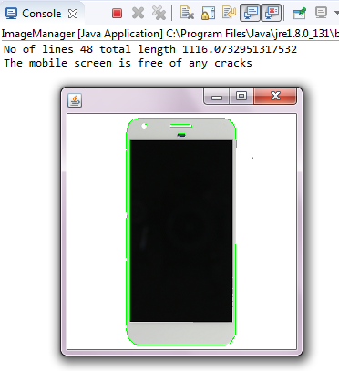
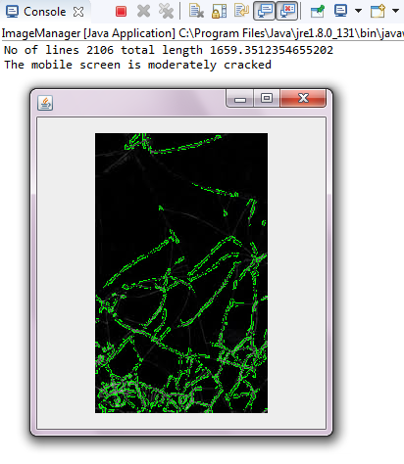
Demo

Slide 9
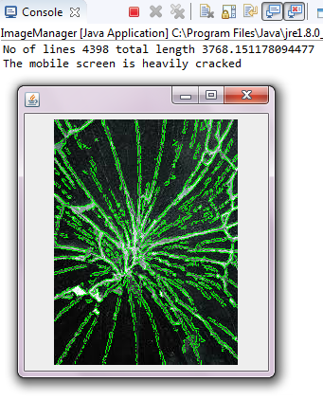
Demo
This is the heavily cracked mobile screen

Slide 10
Limitation
Time Complexity :The primary disadvantage of using Canny edge detector is that it consumes a lot of time due to its complex computation. O(mn log mn).
Canny edge detection method has problems with corners and junctions: The Gaussian smoothing blurs them out, making them harder to detect.
It gives a bias towards vertical and horizontal edges and does not give a good approximation of rotational symmetry.

Slide 11
Conclusion
The cracks are detected using canny edge detection which is an efficient algorithm for edge detection.

