Slide 1
What Twitter said about Demonetization
Sheetal Varshney Vibhor Taneja

Slide 2

What Twitter said about Demonetization
On November 8th, India’s Prime Minister announced that 86% of the country’s currency would be rendered null it will withdraw all 500 and 1,000 rupee while a new 2,000 rupee note added in.
It was positioned as a move to crackdown on corruption and the country’s booming under-regulated and virtually untaxed grassroots economy.

Slide 3
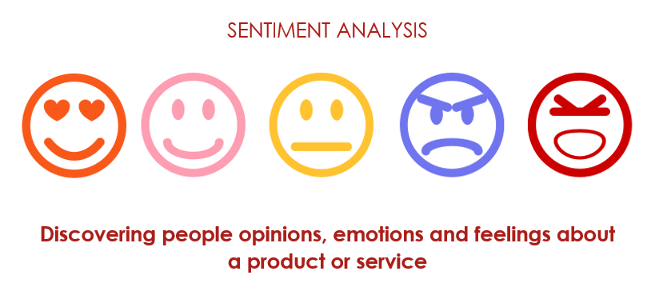
Requirements and Scope of the Problem
To Perform the Sentimental Analysis on the given dataset of tweets.
To plot the trend of sentiments over the period of tweets.
To map the sentiment with segment of users.
To plot and calculate all the possible insights from the given data.

Slide 4
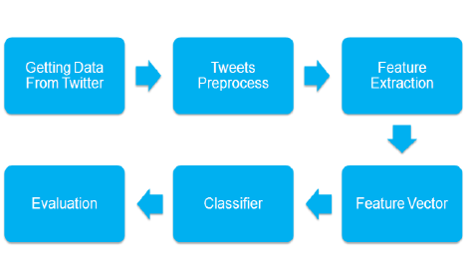
Algorithm
Gather tweets.
Cleansing of the data, removing all the redundancy in data set.
Summarizing the data to use only the informative part.
Sentiment identification on the basis of predefined NLP libraries.
Sentiment classification on basis of sentimental score.
Insight classification.
Plotting the results to define a outcome.

Slide 5
Advantage
Adjust marketing strategy by performing sentimental analysis on user input on social media platforms.
Sentimental analysis can help measuring the true ROI of your marketing campaign.
Helps in market research for launching a new product.
It improves customer service.
It helps in boosting sales revenue.

Slide 6
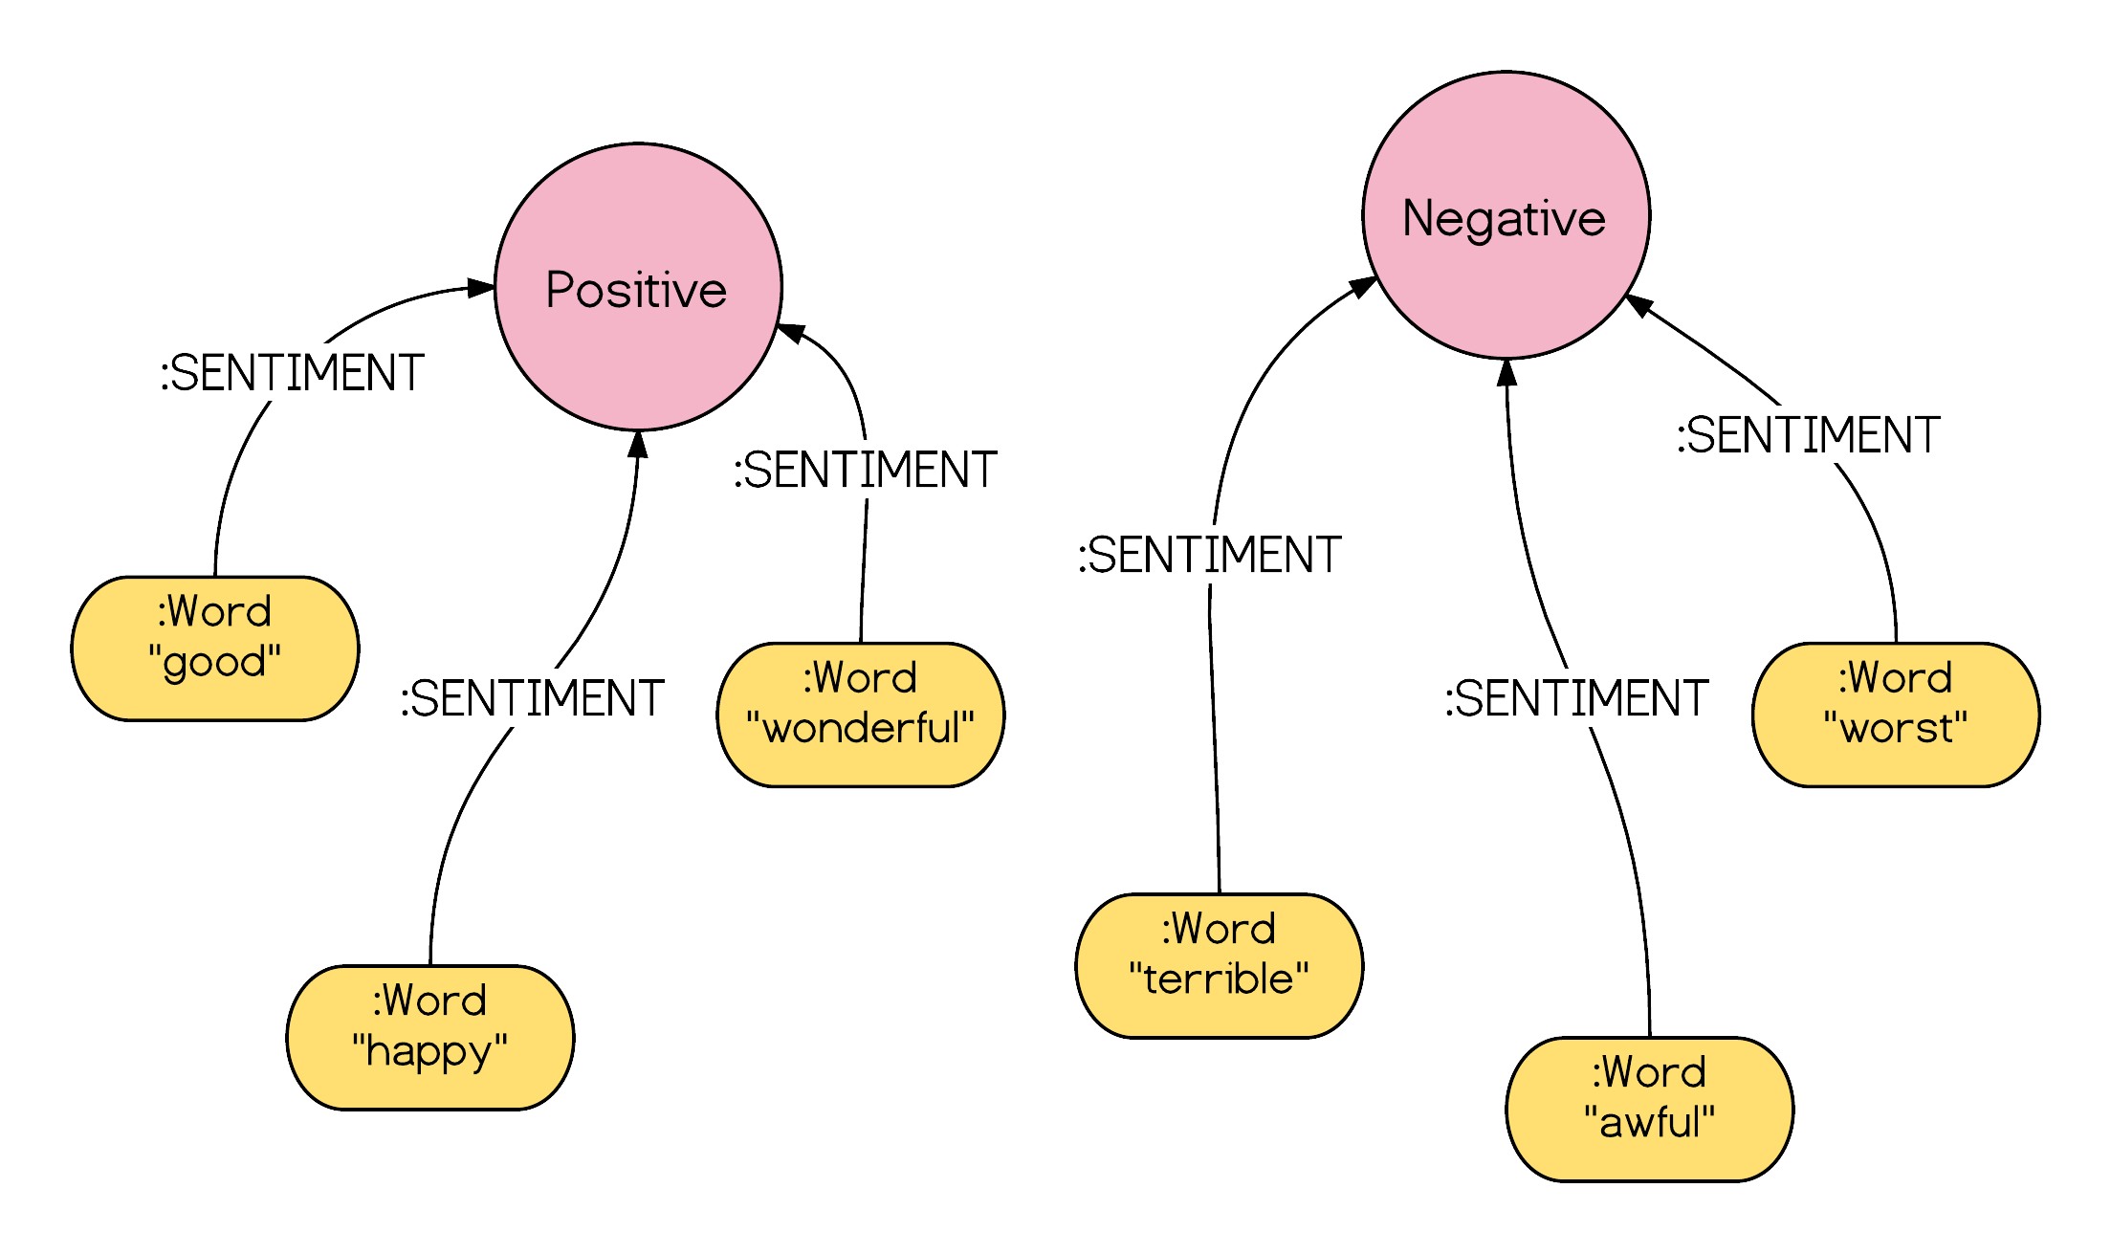
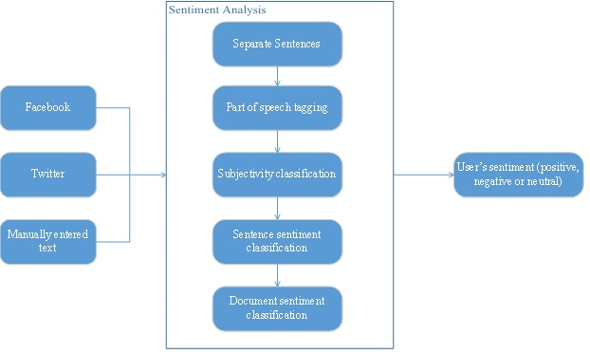
Example

Slide 7
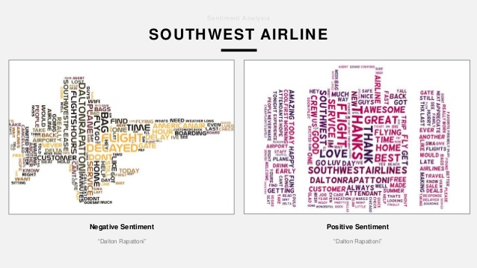
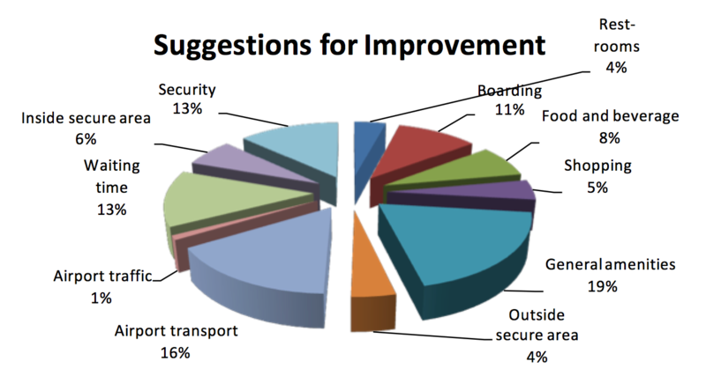
Future Scope
It can be used in NIIT travel domain projects.

Slide 8
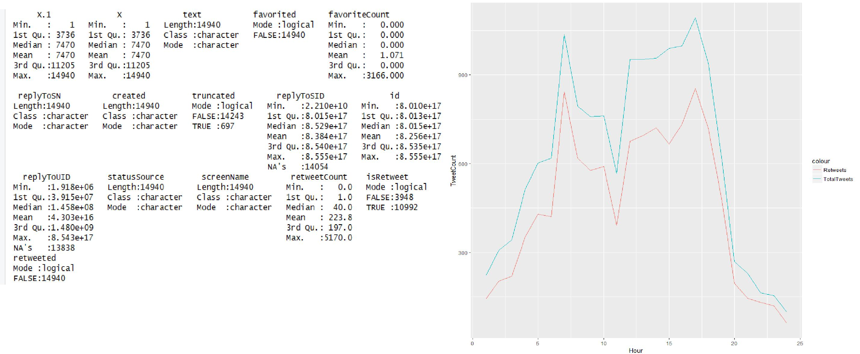
Demo

Slide 9
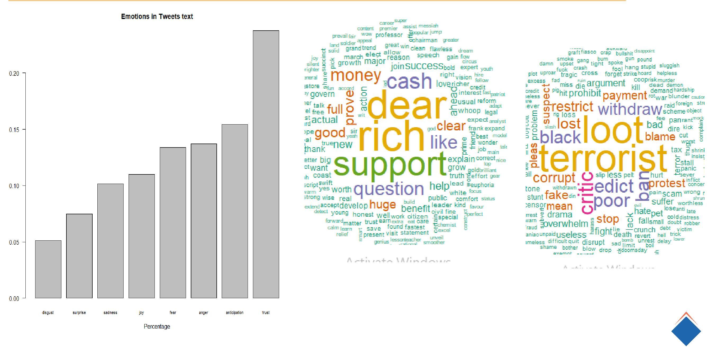
Demo

Slide 10
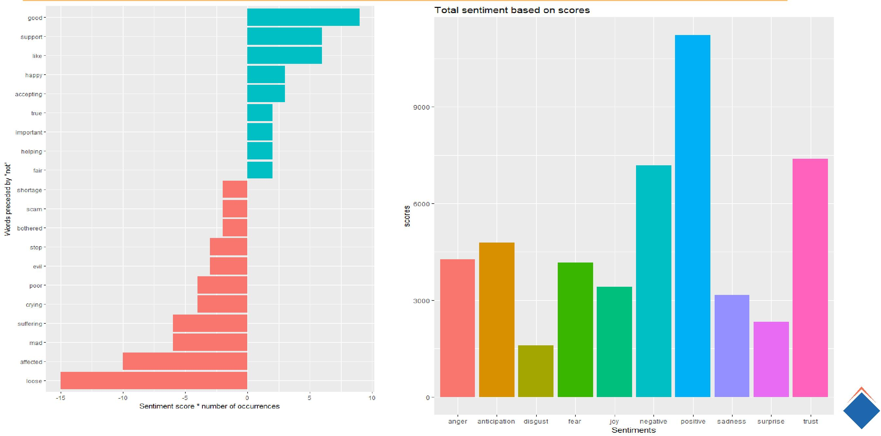
Demo

Slide 11
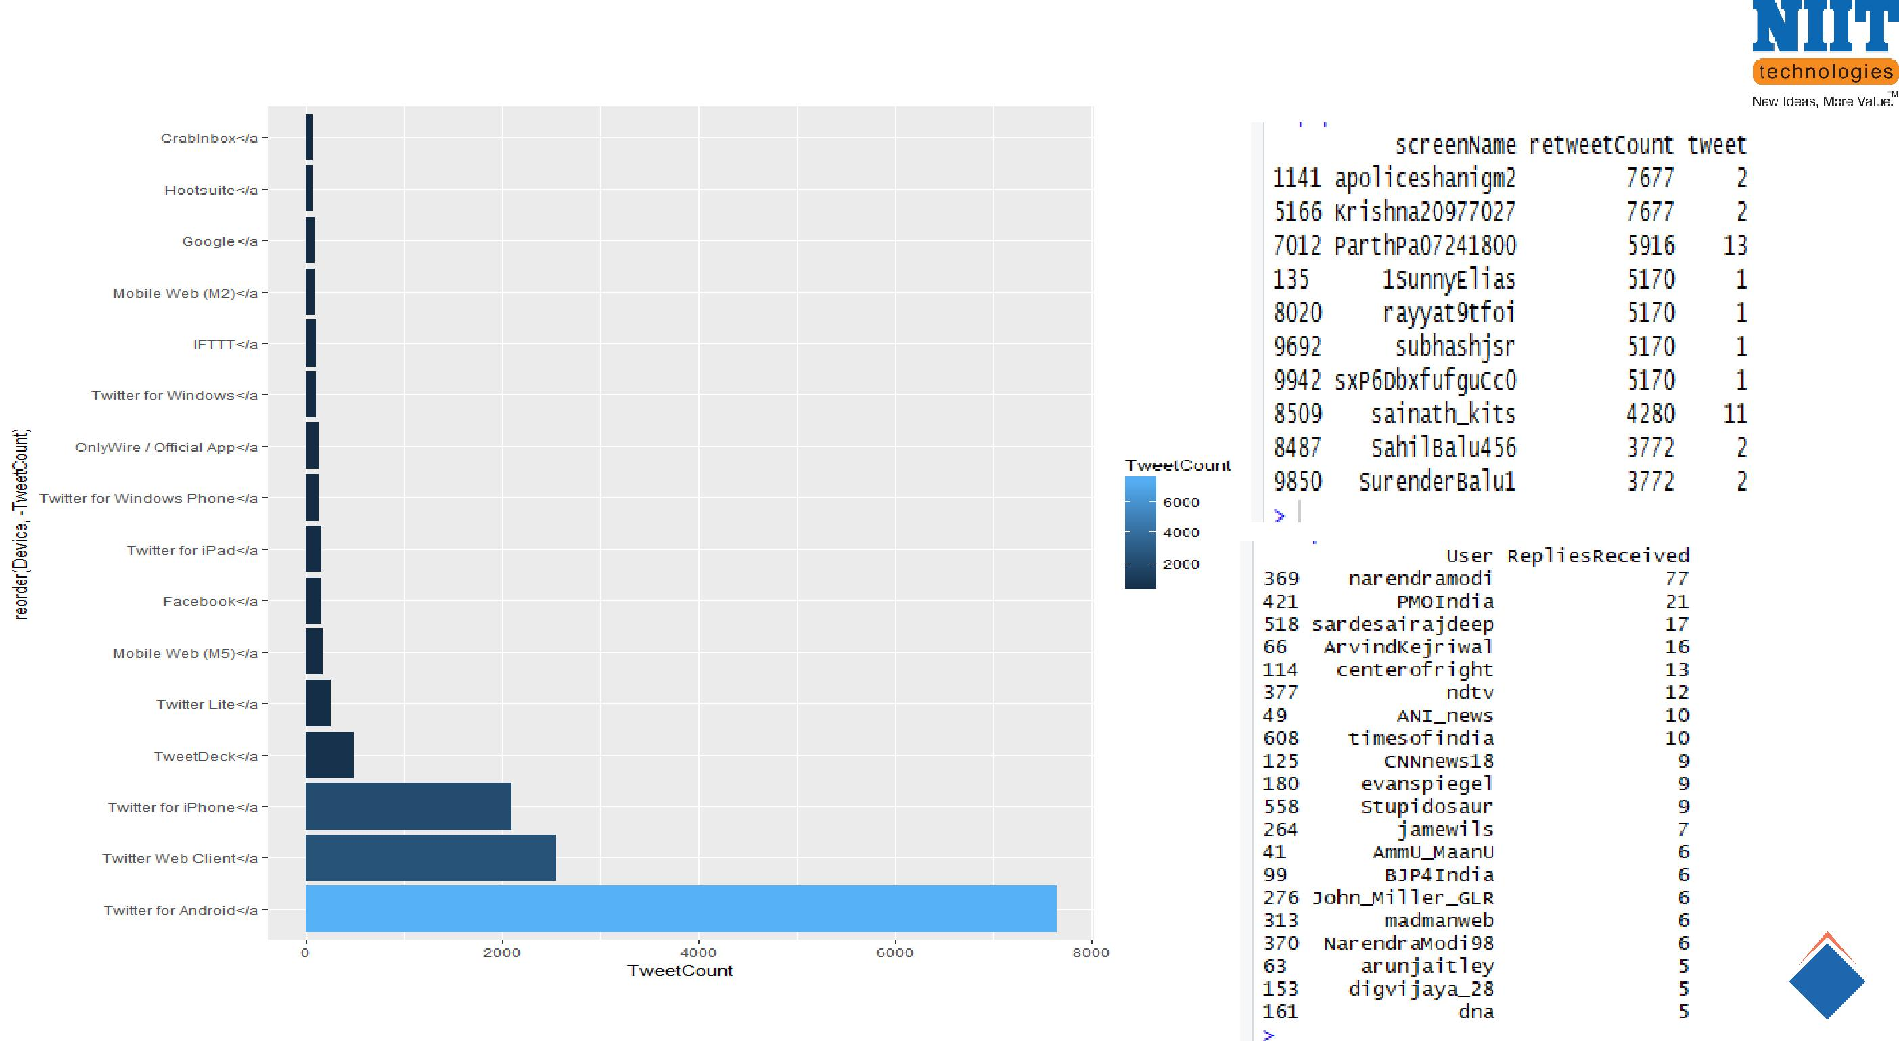
Demo

Slide 12
Limitation
Level of accuracy
Irony/sarcasm – It’s currently impossible to accurately assess posts that include ironic or sarcastic comments.
Languages – Pre-defined NLP libraries only operate in English, ignoring the other 6999 languages spoken in the world.
Geographical variations – Different countries and regions us different expressions and slang, even within the same language.

Slide 13
Conclusion
The most dominant emotion expressed in the tweets is trust, indicating the amount of trust Indians had at that time in the prime minister in taking on the black money in country.
There was fear related to the uncertainty and problems it would cause in the country. A significant percentage of people also showed emotions of disgust, sadness and anger in their tweets.
Trend chart shows that majority of the tweets at any given hour are retweets and number of tweets peaks up in the hours between 12 PM to 7 PM in the evening.
Another chart shows that tweet volume from Android Phones is much higher than any other device. This is expected in a country like India as Android has a huge user base in India and IPhones and Windows Phone do not have a high penetration in the market.

