Slide 1
Analysis on Stack-Overflow Data
Sheetal Varshney Vibhor Taneja

Slide 2
Analysis on Stack-overflow data
Every year, Stack Overflow conducts a massive survey of people on the site, covering all sorts of information like programming languages, salary, code style and various other information.
This year, they amassed more than 64,000 responses fielded from 213 countries.
Each information can be used to derive powerful insights.

Slide 3

Requirement
Find out the characteristics of people who contribute the answers to the stack overflow survey.
Calculate the insights on the basis of job satisfaction factor.
Calculate the insights on the basis of salary factor.
To plot and calculate all the possible insights from the given data.

Slide 4

Algorithm
Gather the data.
Cleansing of the data, removing all the redundancy in data set.
Summarizing the data to use only the informative part.
Running the queries with the help of sql libraries.
Text Analysis on the basis of predefined regression libraries.
Insight classification on the basis of general linear model.
Plotting the results to define a outcome.

Slide 5

Advantage
Regression analysis helps in establishing a functional relationship between two or more variables.
Linear regression implements a statistical model that, when relationships between the independent variables and the dependent variable are almost linear, shows optimal results.

Slide 6
Future Scope
Human Resource : An accurate estimation of demand by skills could be important measures to manage requirements at right cost.(Resource Demand).

Slide 7
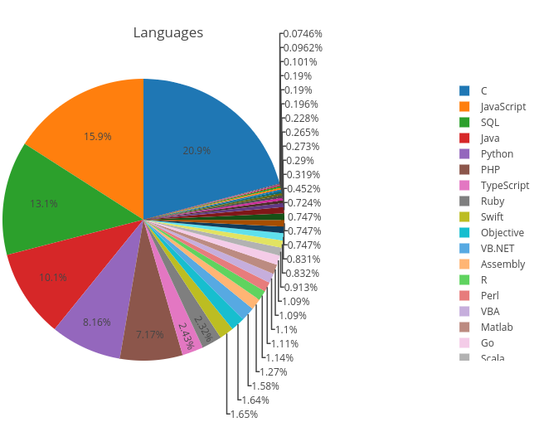
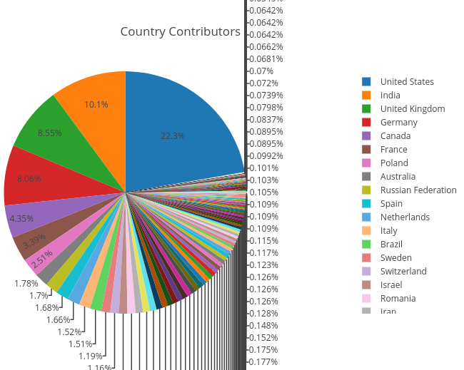
Demo

Slide 8
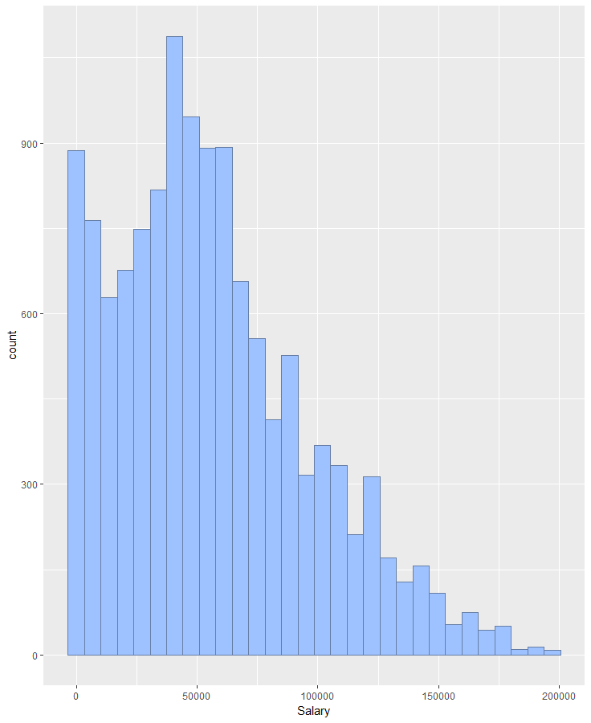

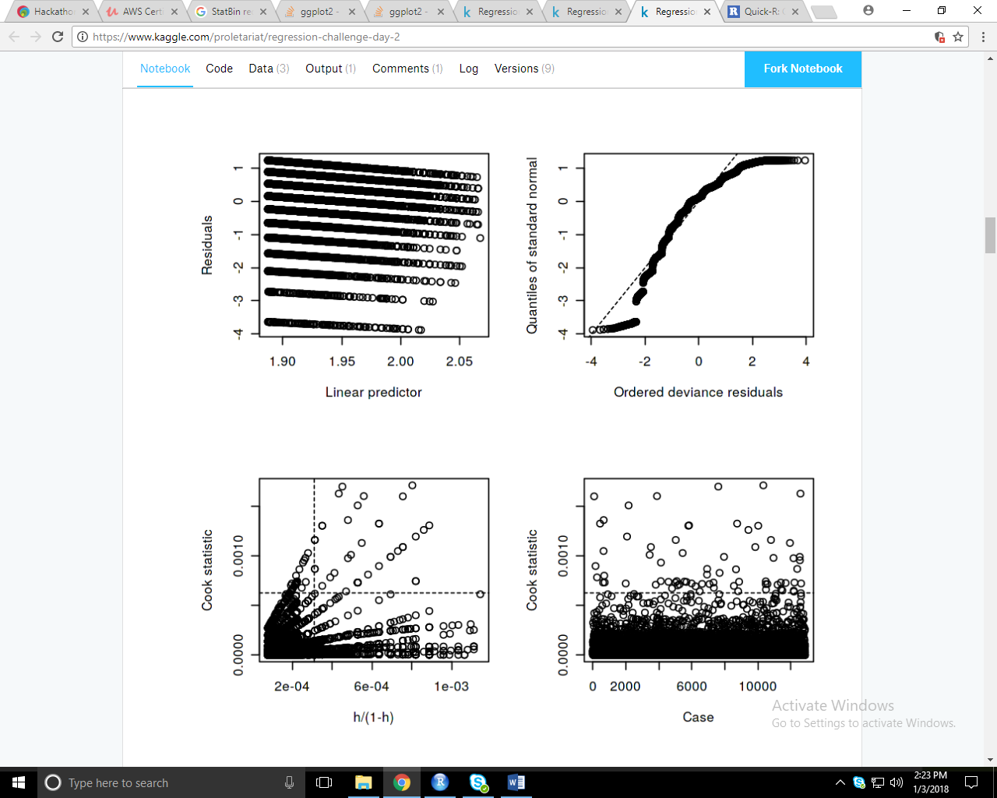
Demo

Slide 9
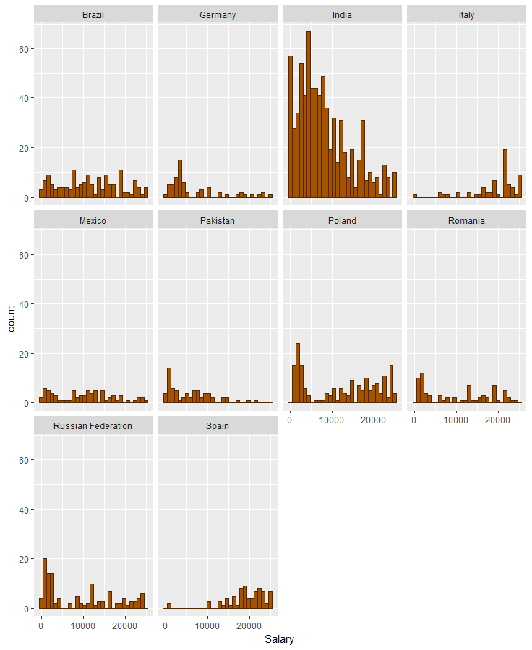
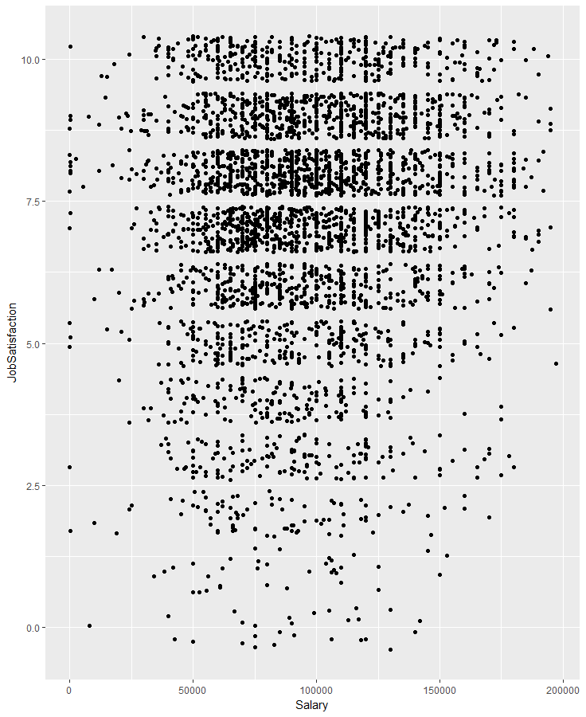
Demo

Slide 10
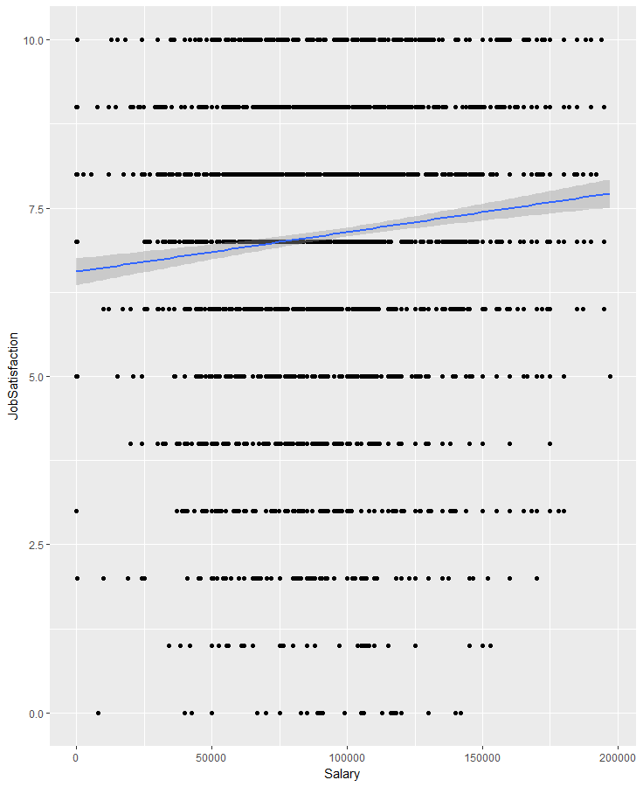
Demo

Slide 11
Limitation
Linear regression shows optimal results only when relationships between the independent variables and the dependent variable are almost linear
Linear regression cannot be used to model non-linear relationships.
Linear regression is limited to predicting numeric output.

Slide 12
Conclusion
People from US are major contributors to Stack Overflow community followed by India and United Kingdom.
On Stack Overflow people working on C and JavaScript are the major contributors to this community.
There is an upward trend, indicating that there is a correlation between making more money and a higher job satisfaction (with increased variability as you near the upper and lower end of the Salary spectrum.)

