Slide 1
Analysis on Stack-Overflow Data
Sheetal Varshney Vibhor Taneja

Slide 2
Analysis on Stack-overflow data
Every year, Stack Overflow conducts a massive survey of people on the site, covering all sorts of information like programming languages, salary, code style and various other information.
This year, they amassed more than 64,000 responses fielded from 213 countries.
Each information can be used to derive powerful insights.

Slide 3
Requirment

Slide 4
Algorithm

Slide 5
Advantage

Slide 6
Future Scope

Slide 7
Solution Overview
First analysis on the contributors is done by using sqldf R module.
Another analysis is done using two variables i.e. Job Satisfaction and Salary.
Filtering and removing all the redundant data.
Creating General linear Model for the solution.
Performing the regression analysis.
Plotting the same analysis on the graphs using ggplot2.

Slide 8
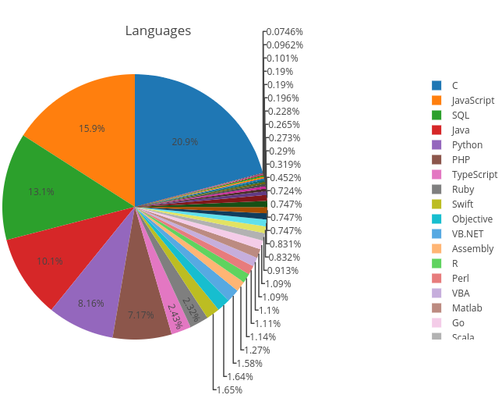
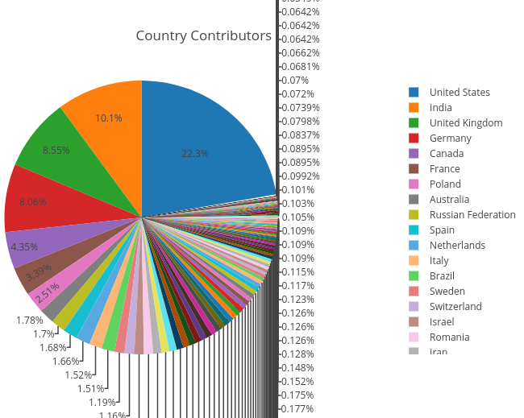
Demo

Slide 9
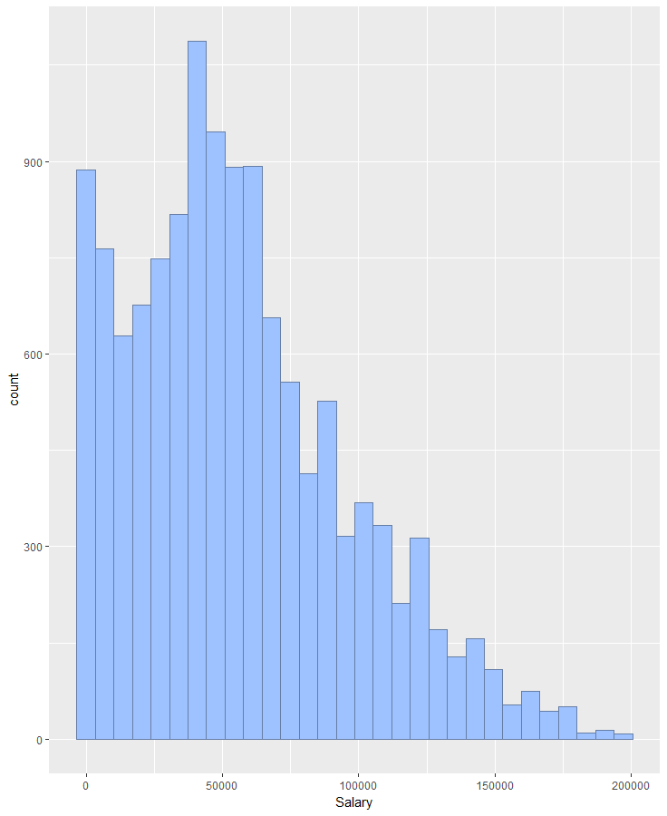
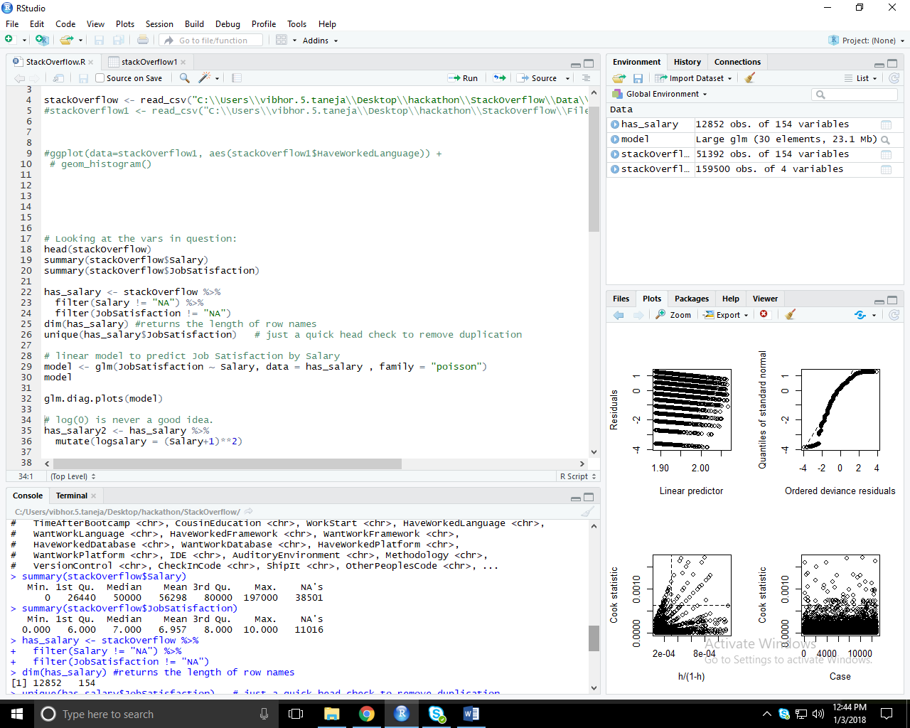
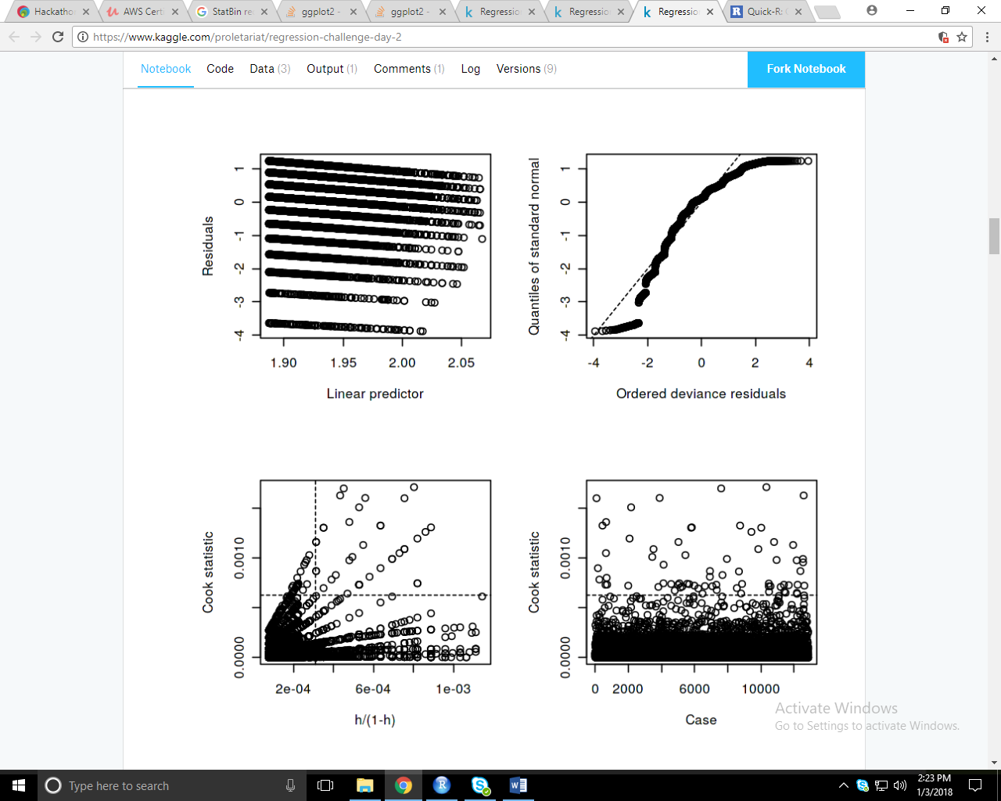
Demo

Slide 10
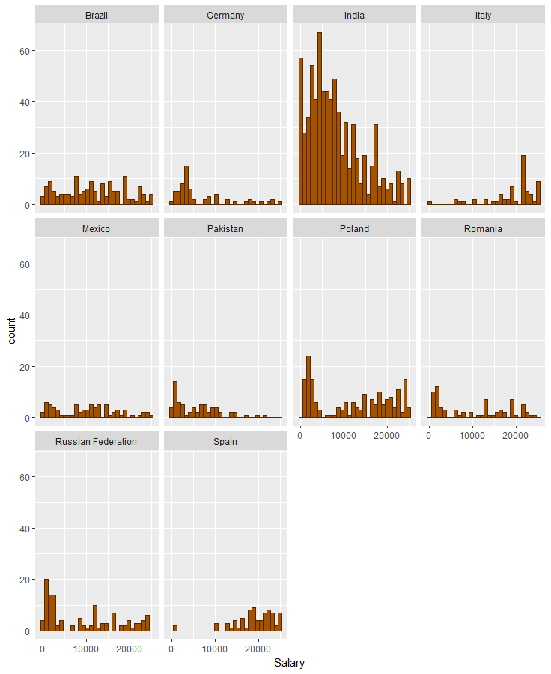
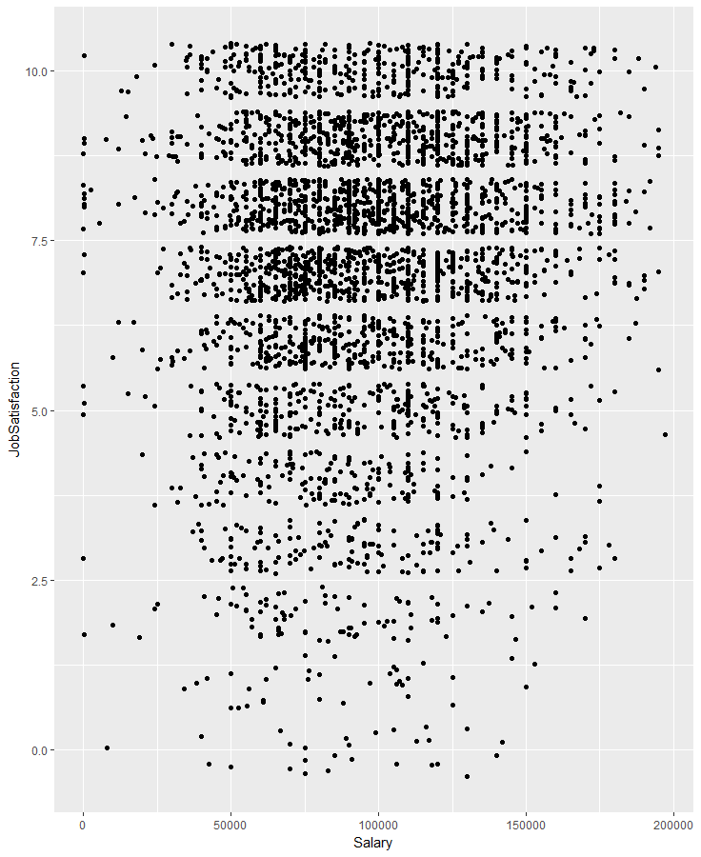
Demo

Slide 11
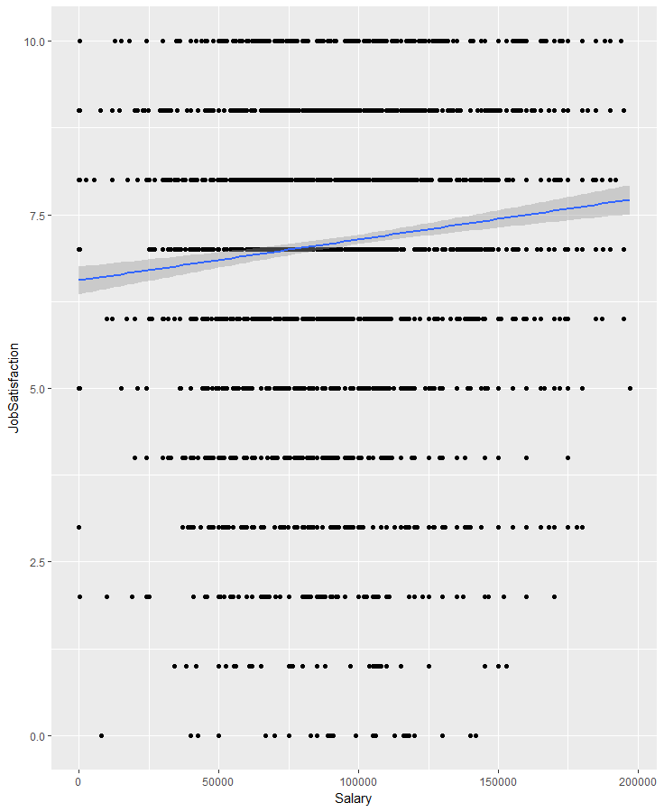
Demo

Slide 12
Limitation

Slide 13
Conclusion
People from US are major contributors to Stack Overflow community followed by India and United Kingdom.
On Stack Overflow people working on C and JavaScript are the major contributors to this community.
There is an upward trend, indicating that there is a correlation between making more money and a higher job satisfaction (with increased variability as you near the upper and lower end of the Salary spectrum.)

