Slide 3
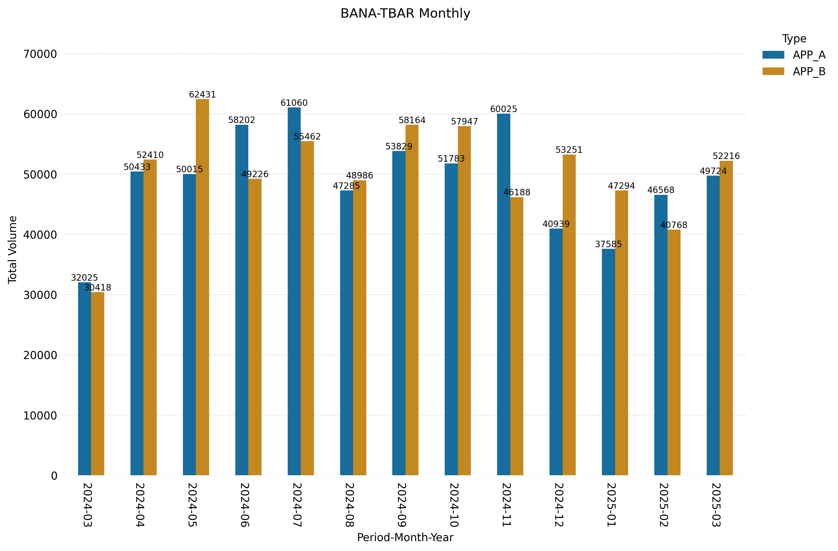
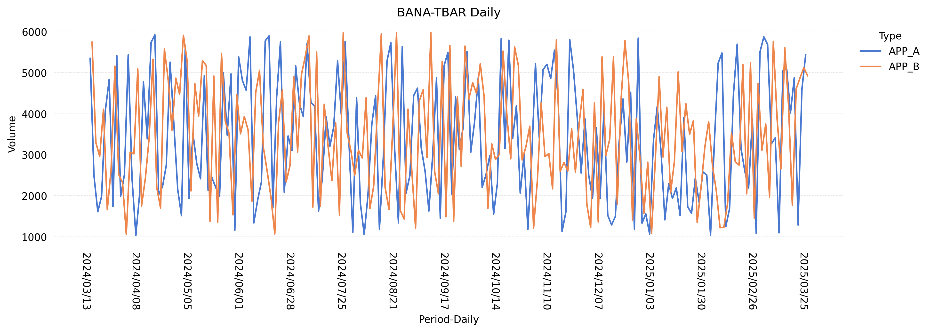
Capacity Planning Report: BANA-TBAR
Type | Metric | Baseline(13 Month) | Current Qtr | % Diff Baseline | Previous Qtr | % Diff QoQ
APP_A | Avg | 3373.0 | 3331.0 | -1.2 | 3256.0 | 2.3
APP_A | Peak | 5926.0 | 5878.0 | -0.8 | 5845.0 | 0.6
APP_B | Avg | 3464.0 | 3395.0 | -2.0 | 3336.0 | 1.8
APP_B | Peak | 5985.0 | 5768.0 | -3.6 | 5803.0 | -0.6
Peak - APP_A = 5926 (2024-04-16 00:00:00)
Peak - APP_B = 5985 (2024-08-21 00:00:00)

