Slide 3
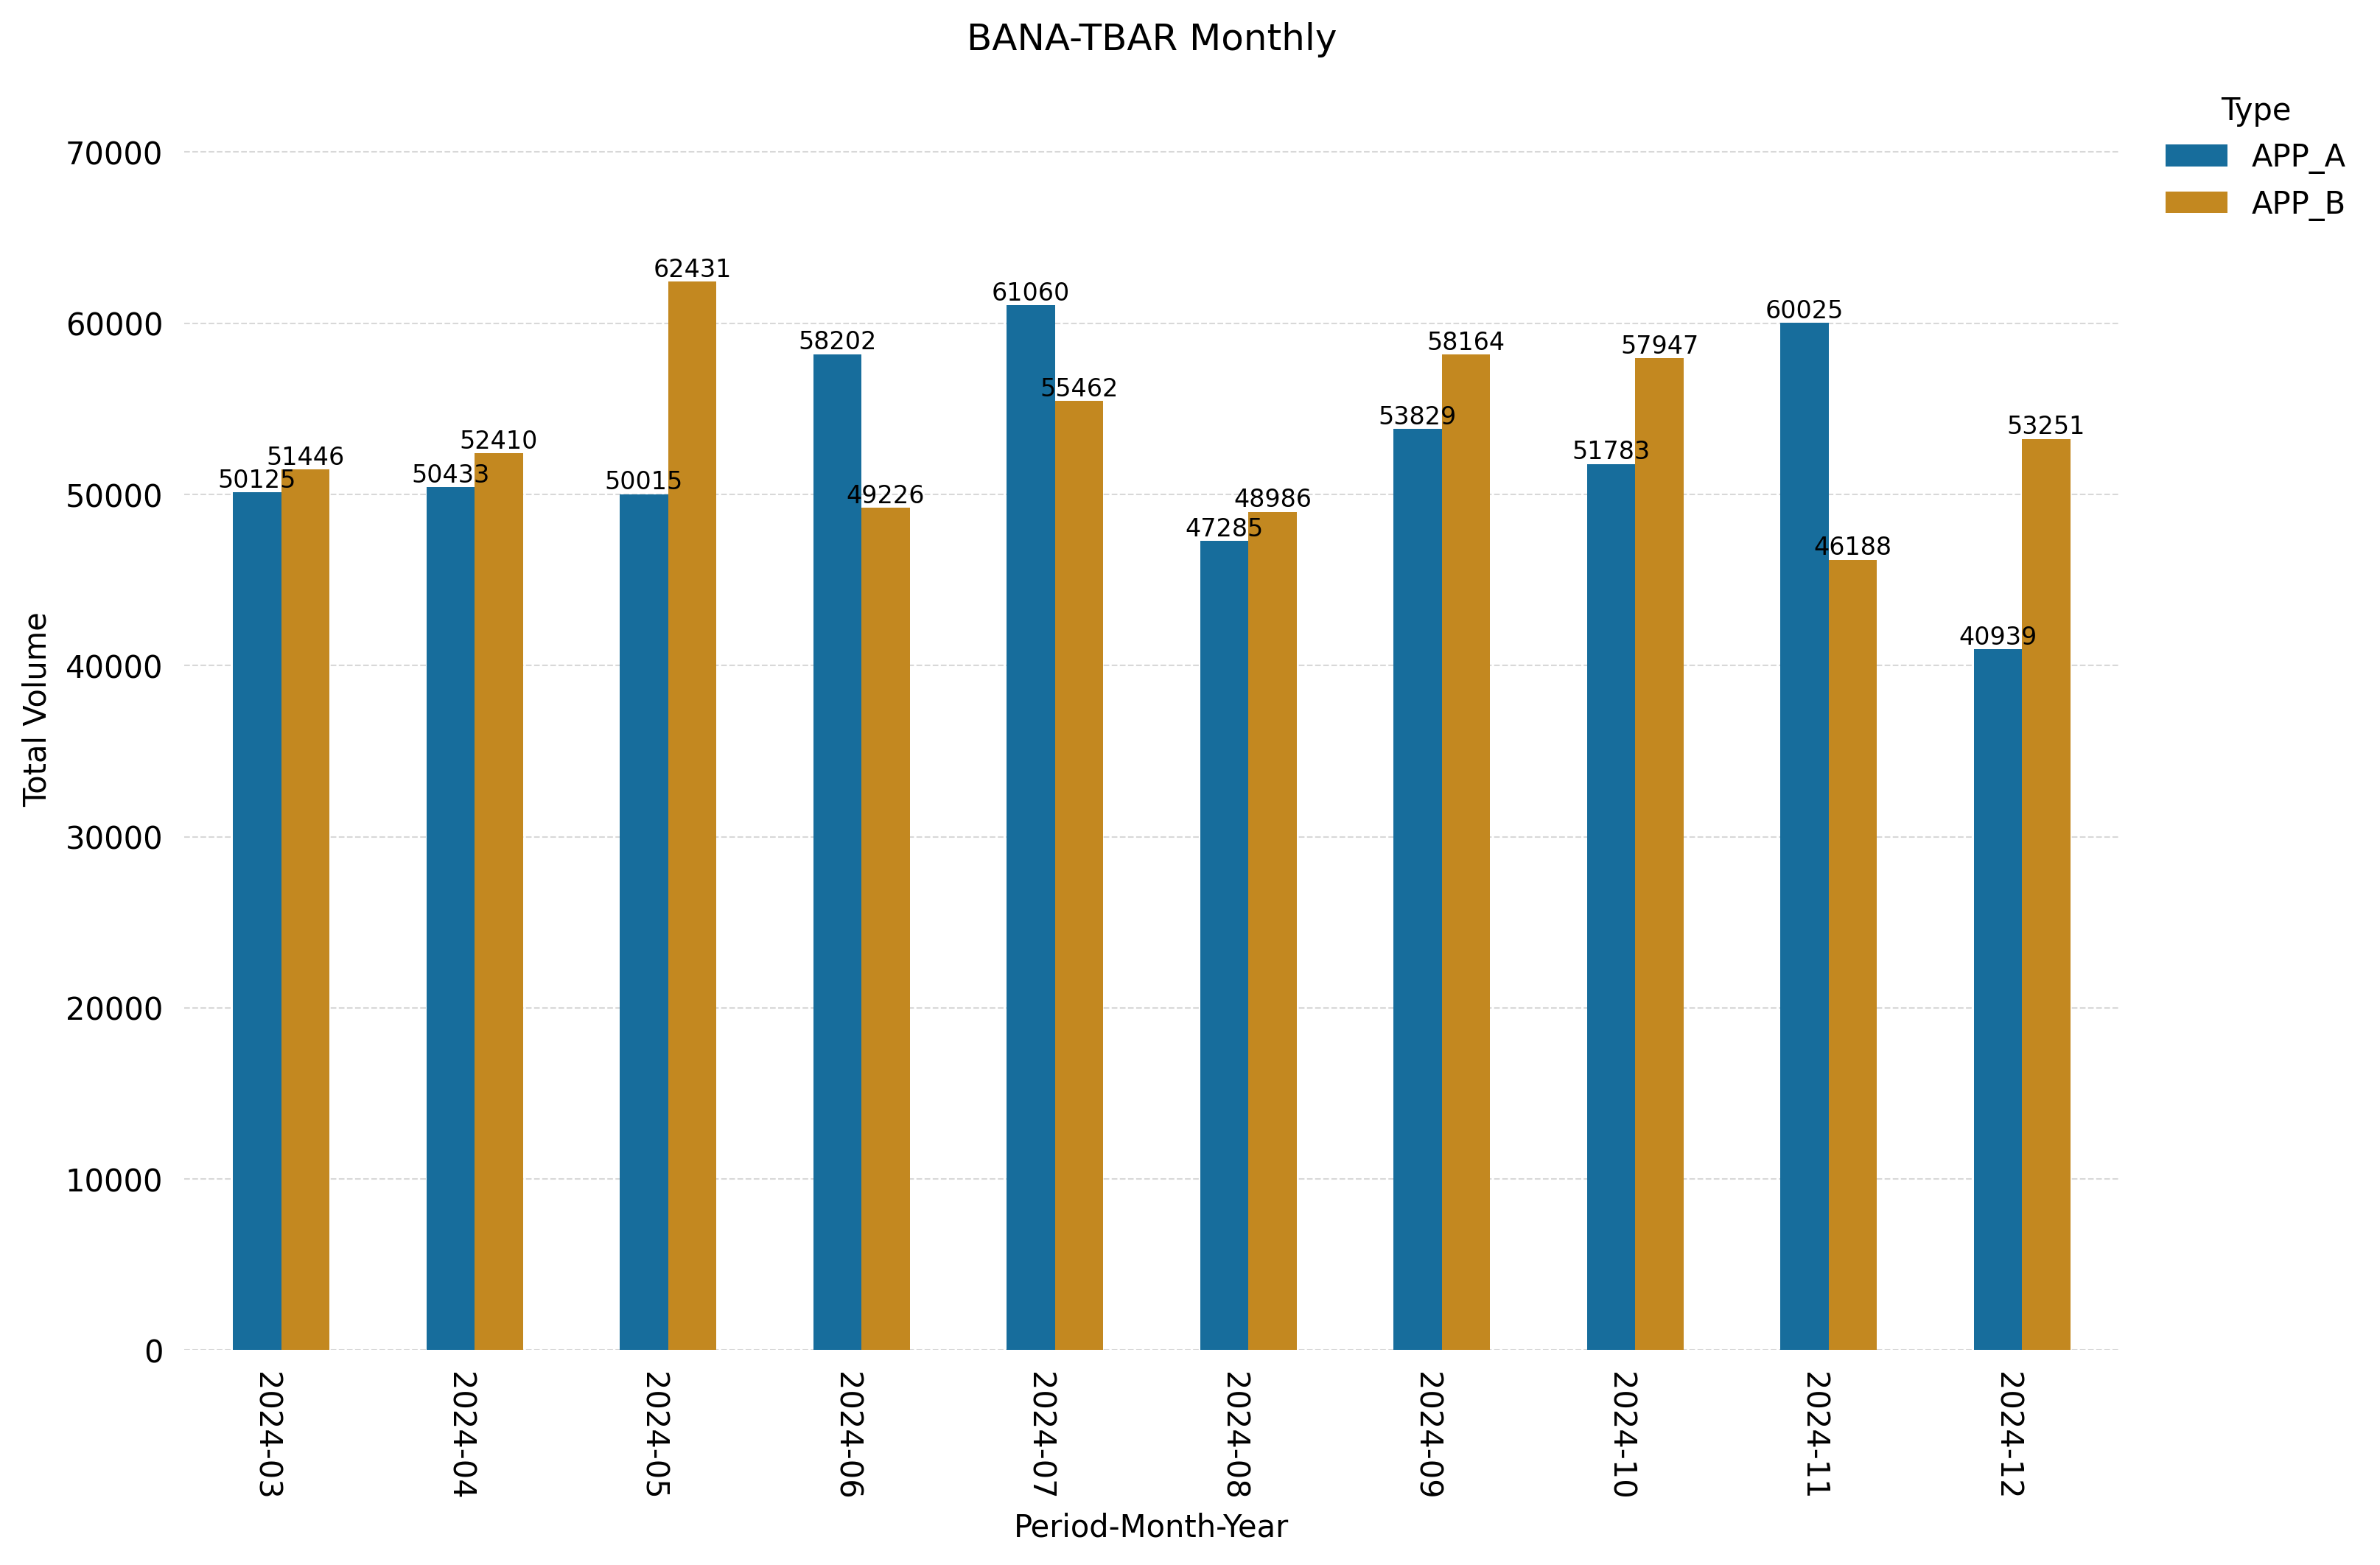
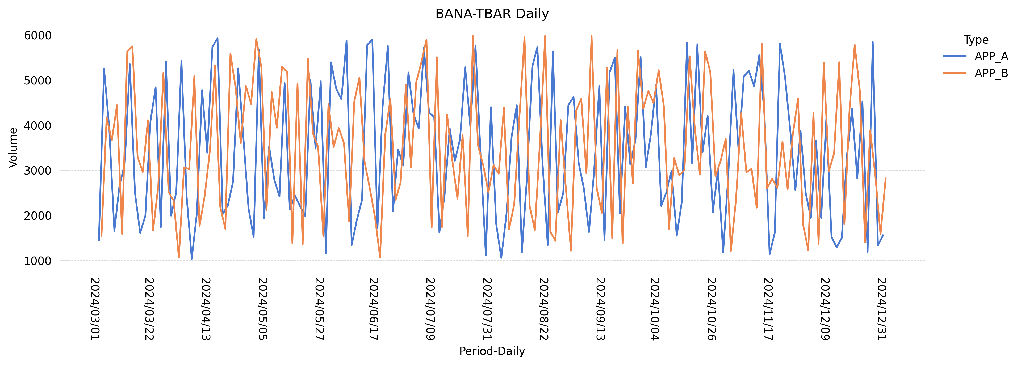
Capacity Planning Report: BANA-TBAR
Type | Metric | Baseline(13 Month) | Current Qtr | % Diff Baseline | Previous Qtr | % Diff QoQ
APP_A | Avg | 3372.0 | 3257.0 | -3.4 | 3526.0 | -7.6
APP_A | Peak | 5926.0 | 5878.0 | -0.8 | 5765.0 | 2.0
APP_B | Avg | 3466.0 | 3383.0 | -2.4 | 3535.0 | -4.3
APP_B | Peak | 5985.0 | 5803.0 | -3.0 | 5985.0 | -3.0
Peak - APP_B = 5985 (2024-08-21 00:00:00)
Peak - APP_A = 5926 (2024-04-16 00:00:00)

