Slide 3
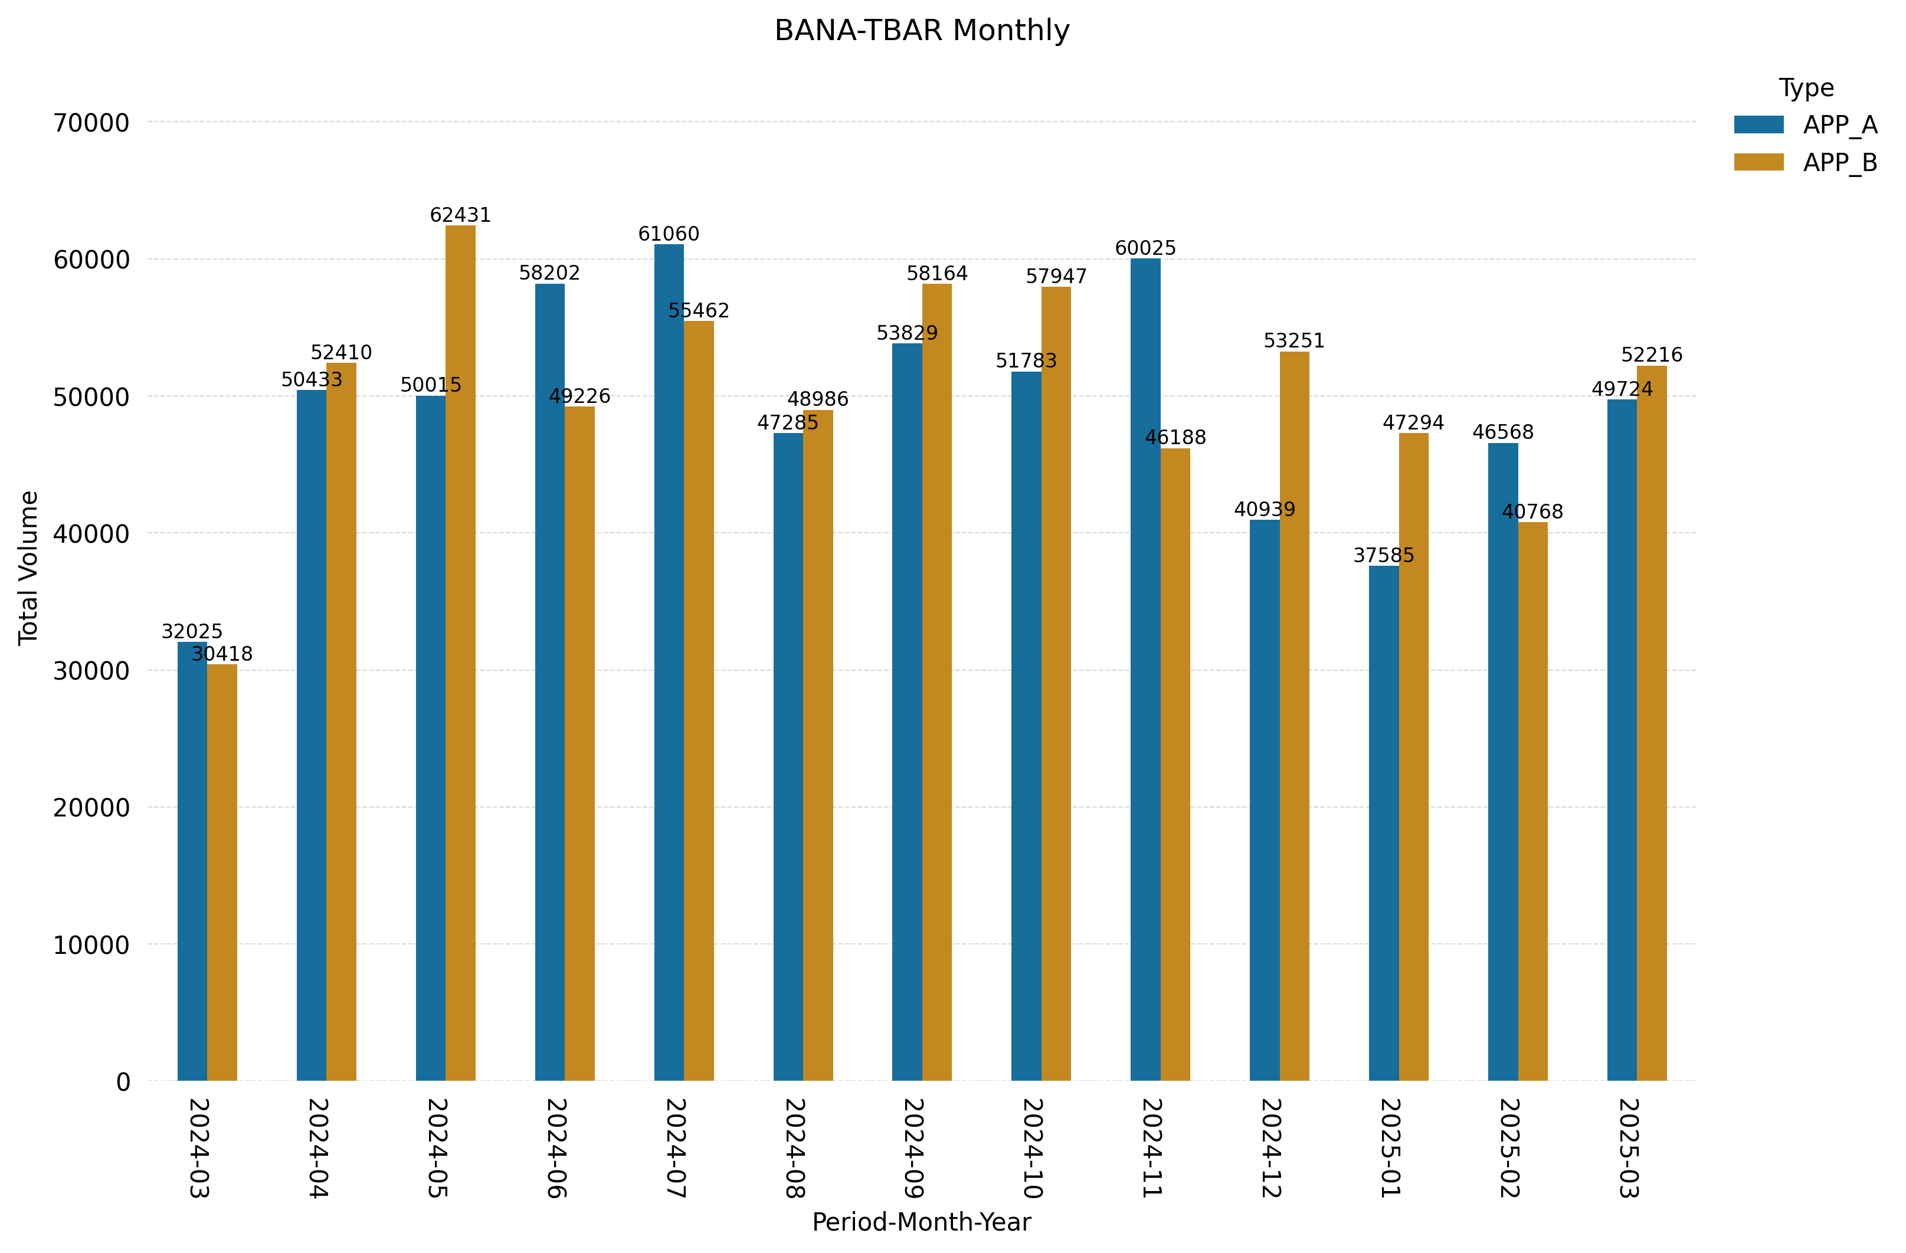
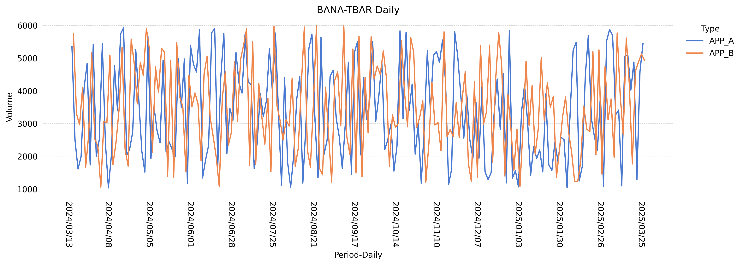
Type | Metric | Baseline(13 Month) | Current Qtr | % Diff Baseline | Previous Qtr | % Diff QoQ
APP_B | Avg | 5747.0 | 3395.0 | -40.9 | 3336.0 | 1.8
APP_B | Peak | 5747.0 | 5768.0 | 0.4 | 5803.0 | -0.6
Peak Summary
Peak - APP_A = 5926 (2024-04-16 00:00:00)
Peak - APP_B = 5985 (2024-08-21 00:00:00)

