Slide 1
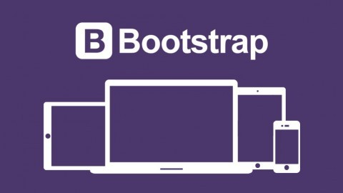

Slide 2
2
What is Bootstrap?
Bootstrap is a free front-end framework (HTML and CSS) for faster and easier web development
Bootstrap is famous for being developed with components that have the ability to follow the property of responsive designs
Responsive Design is about using CSS and HTML to resize, hide, shrink, enlarge, or move the content to make it look good on any screen
Responsive Design allow your page works for computer, tablets and mobile phones.

Slide 3
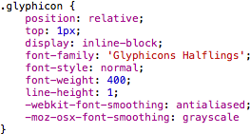
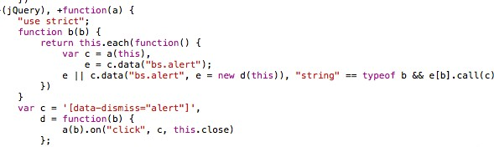
Bootstrap
3
What is Bootstrap?
In other words, bootstrap is a collection of CSS classes and JavaScript functions the you get ready to use and will not worry about write code like this:

Slide 4
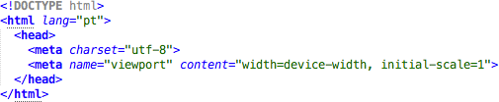
Bootstrap
4
First Bootstrap Page
Include the HTML5 doctype at the beginning of the page, along with the lang attribute and the correct character set

Slide 5
Bootstrap
5
First Bootstrap Page
Meta viewport tag ensure proper rendering and touch zooming
Width of the page to follow the screen-width of the device and initial zoom level to default zoom level of device
User will have a better experience, thus will not need zoom the page to view page information

Slide 6
Bootstrap
6
First Bootstrap Page
You will need to include three files:
bootstrap.min.css
jquery.min.js
bootstrap.min.js
You must download it and include in you page
For this example, we include from the Internet

Slide 7
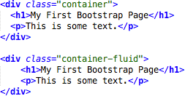
Bootstrap
7
First Bootstrap Page
Bootstrap has a concept of containing element to wrap site contents

Slide 8
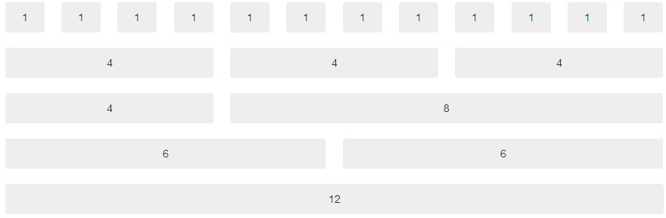
Bootstrap
8
Bootstrap Grids
Bootstrap's grid system allows up to 12 columns across the page
You can divide the container in rows and each row in columns with space multiple of the 12

Slide 9
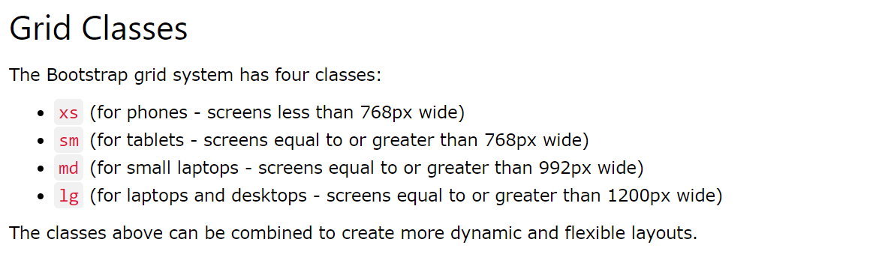
Bootstrap
8
Bootstrap Grid classes

Slide 10
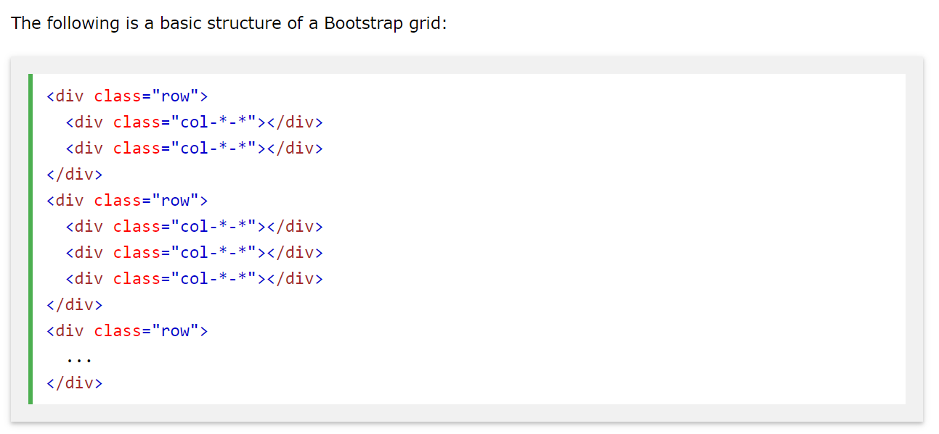
Bootstrap
8
Basic structure of Bootstrap Grid

Slide 11
Bootstrap
8
Basic structure of Bootstrap Grid

Slide 12
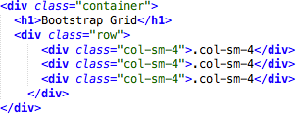
Bootstrap
9
Bootstrap Grids
In the bellow example, we divide the space inside the container in 1 row and this row in 3 columns with the same side. 4+4+4 = 12
You can use any combination that the sum be equal to 12.

Slide 13
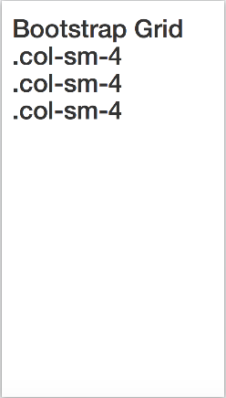
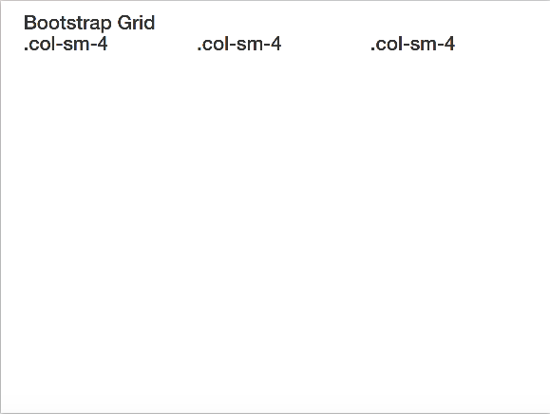
Bootstrap
10
Bootstrap Grids
Responsive Bootstrap's grid system with 3 columns
small screens
big screens

Slide 14
Bootstrap
11
Bootstrap Table
4 main classes:
.table
.table-striped
.table-bordered
.table-hover
5 contextual classes:
.active
.success
.info
.warning
.danger

Slide 15
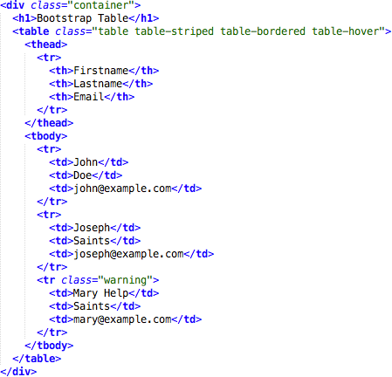
Bootstrap
12
Bootstrap Tables

Slide 16
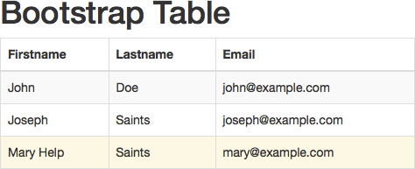
Bootstrap
13
Bootstrap Tables

Slide 17
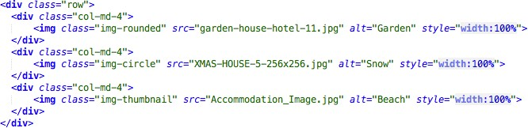
Bootstrap
14
Bootstrap Images
3 main classes:
. img-rounded
. img-circle
. img-thumbnail

Slide 18
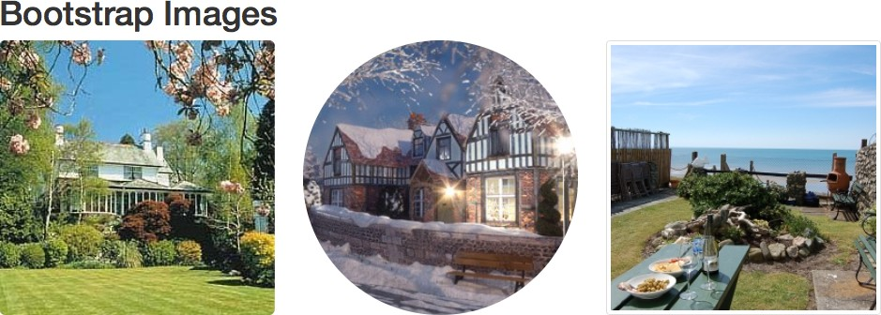
Bootstrap
15
Bootstrap Images

Slide 19
Bootstrap
19
Bootstrap Buttons
Bootstrap provides seven styles of buttons:
To achieve the button styles above, Bootstrap has the following contextual classes:
.btn-default
.btn-primary
.btn-success
.btn-info
.btn-warning
.btn-danger
.btn-link

Slide 20
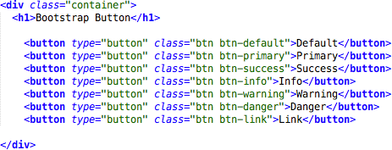
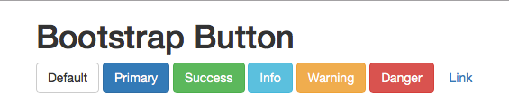
Bootstrap
20
Bootstrap Buttons

Slide 21
Bootstrap
24
Bootstrap Labels
Labels are used to provide information about something
Bootstrap create labels with colorful backgrounds to highlight the text inside de label
Use the .label class, followed by one of the six contextual classes .label-default, .label-
primary, .label-success, .label-info, .label-warning or .label-danger

Slide 22
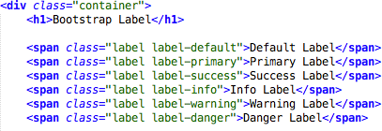

Bootstrap
25
Bootstrap Labels

