Slide 1
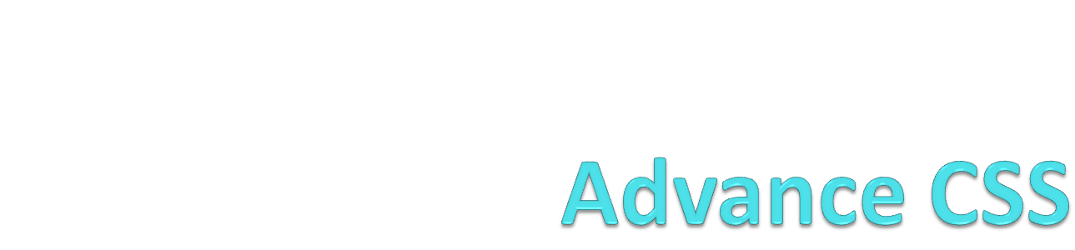
By: Vijayta Panchal

Slide 2
Introduction
Cascading Style Sheets (CSS) are a collection of formatting rules that control the appearance of content in a web page. They are very useful for maintaining a web site since its appearance (controlled by properties of HTML tags) can be managed from just one file. CSS Styles also enhance your site's look, accessibility and reduces file size. Another main advantage is reusability - instead of defining the properties of fonts, backgrounds, borders, bullets, uniform tags, etc. each time you use them you can just assign the corresponding css style in the class property. You can store CSS styles directly in each document or, for more control and flexibility, in an external style sheet.

Slide 3
Box Model
What is the CSS Box Model: The CSS box model describes the boxes that are formed around elements of content in a Web page. Every element in a Web page is in a box or is a box, even if it's an image of a circle. The boxes on Web pages are constrained by rules defined by the box model.

Slide 4
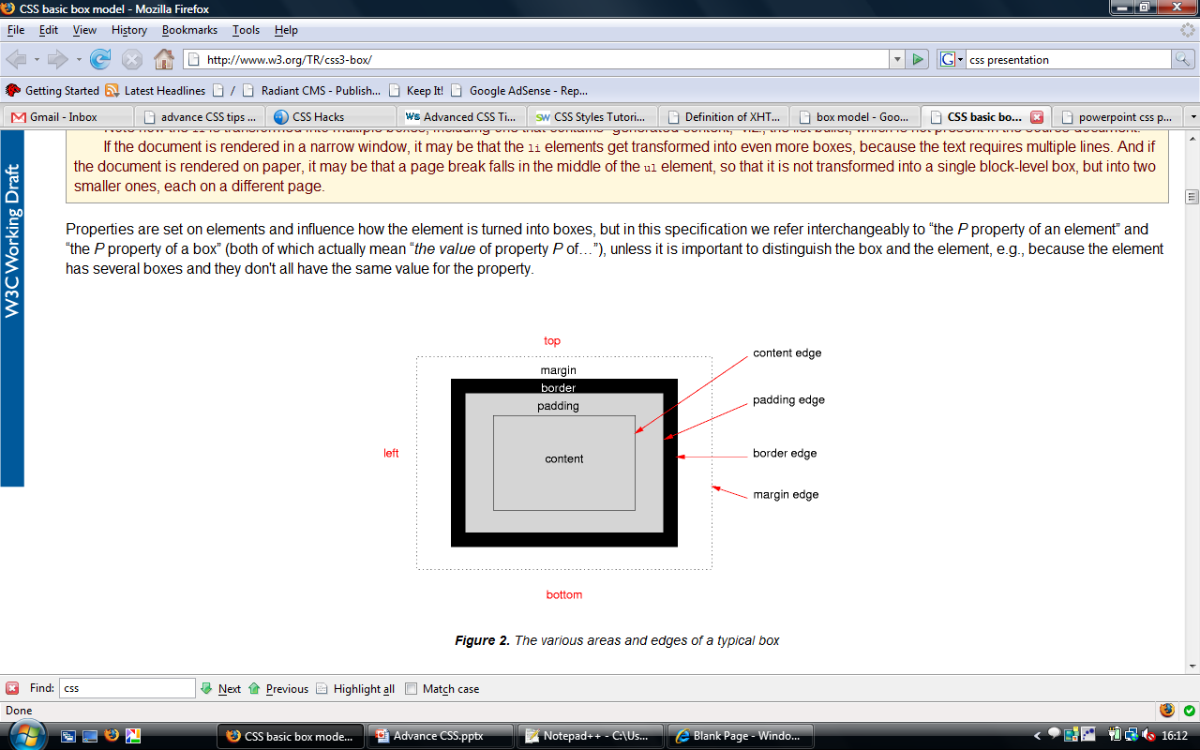
The CSS box model is made up of four parts:
margin
border
padding
content

Slide 5
Continue…
The margin is the outermost edge of the box. It is transparent and manifests as space between the element and others on the page. Margins can collapse into one another, so that the bottom margin of one element overlaps with the top margin of the element below it.
The border is the next thing surrounding the box. Borders can be colored or transparent. If the border is set to 0 it effectively disappears and the border edge is the same as the padding edge.
The padding is the space between the content and the border. Padding is the same color as the background color for the box. If the padding is set to 0, the padding border is the same as the content border.
The content is what most people think of as the element. This is the text or image or whatever is displayed inside the box.

Slide 6
Box Model Issues
The problem with the CSS box model is that not all Web browsers implement it the same way. In a nutshell, according to the W3C, width and height properties define the width and height of the content of the box. Items like padding, border, and margin surround that width and height.
Some versions of Internet Explorer instead define the width and height as the width and height of the entire element, including padding, and border.
If you want your designs to look the same in all browsers, you have to employ tricks and sometimes hacks to get IE to work correctly.

Slide 7
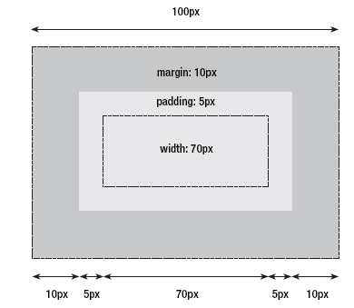
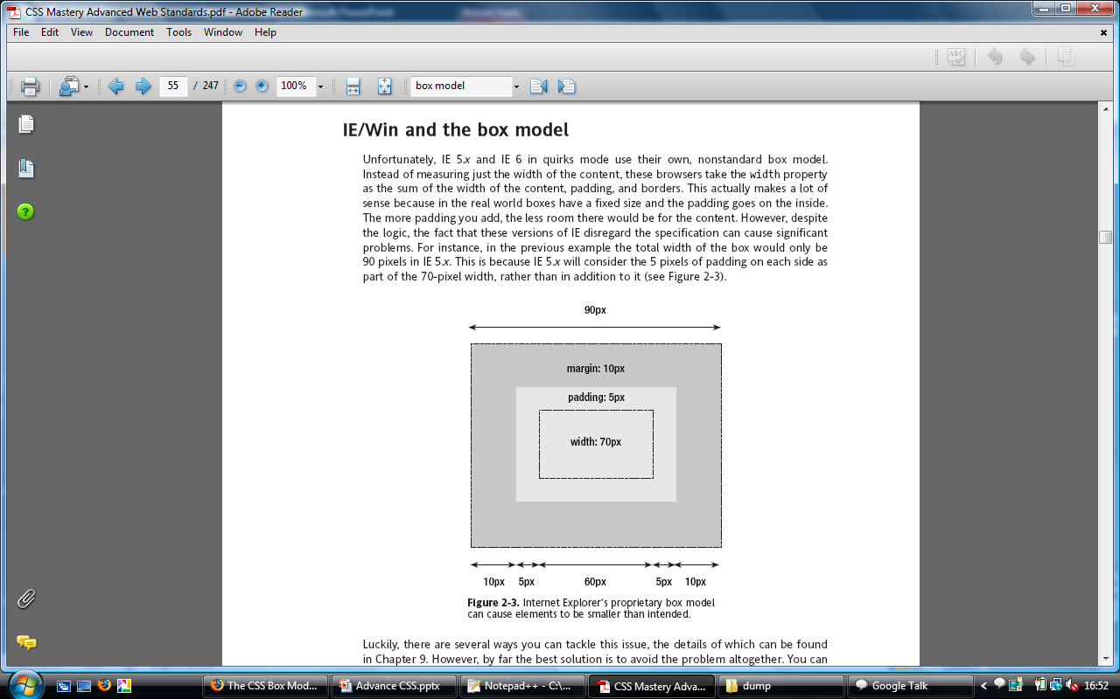
Box Model Issues

Slide 8
Styling List (CSS navigation)
HTML Code
<div id=”navigation”>
<ul>
<li><a href=“home”>Home</a></li>
<li><a href=“News”>News</a></li>
<li><a href=“how”>How to Work</a></li>
<li><a href=“about”>Aout Us</a></li>
</ul>
</div>
CSS Code
#navigation ul
{
margin-left:0;
}
#navigation ul li
{
display:inline;
list-type-style:none;
margin:0;
text-align:left;
}
#navigation ul li a #home
{
background: url(”images/btn_home.png”) no-repeat scroll left center;
height:28px;
width:70px;
float:left;
text-indent:-2000px;
}
#navigation ul li a:hover #home {
background: url(”images/btn_home.png”) no-repeat scroll right center;
height:28px;
width:70px;
float:left;
text-indent:-2000px;
}

Slide 9
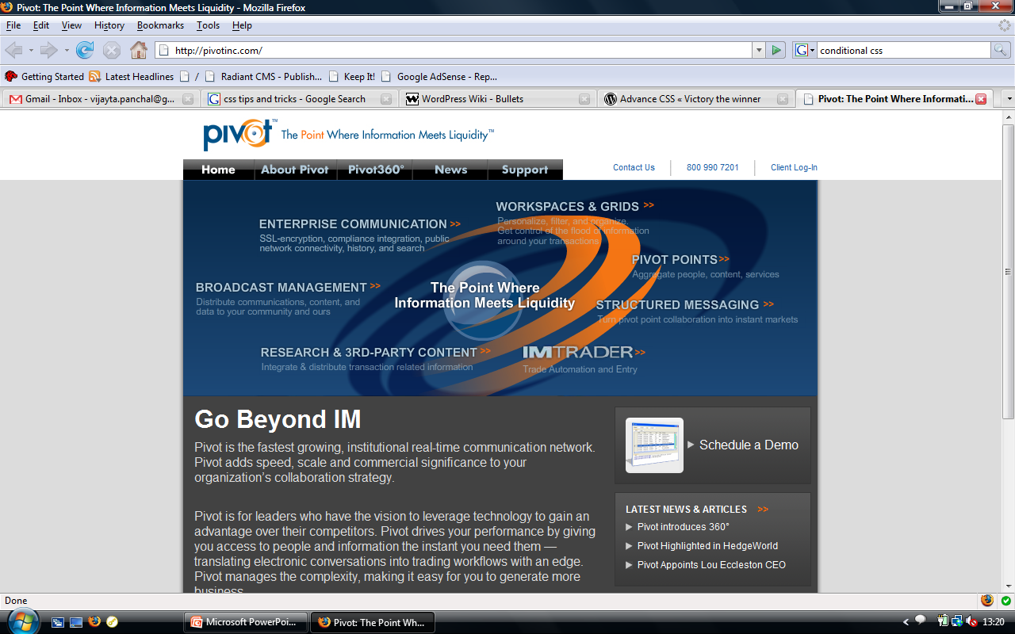
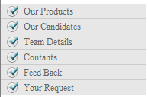
Output is

Slide 10
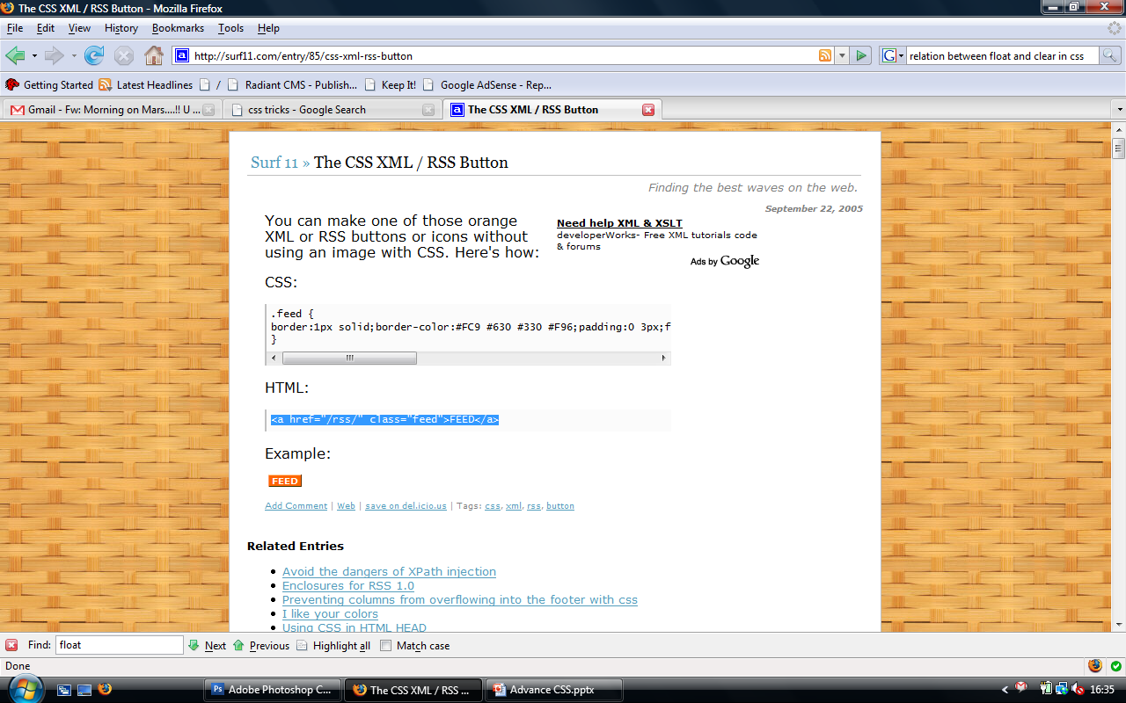
CSS button
You can make one of those orange XML or RSS buttons or icons without using an image with CSS. Here's how:
CSS:
.feed { border:1px solid; border-color:#FC9 #630 #330 #F96;
padding:0 3px; font: bold 10px verdana , sans-serif ;
color:#FFF;background:#F60;text-decoration:none;
margin:4px;
}
HTML:
<a href="/rss/" class="feed">FEED</a>

Slide 11
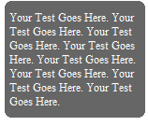
Rounded corner without images
Thought CSS3 we can have rounded corner box without using a single image.

Slide 12
<html>
<head>
<style>
#container p{background:red; padding:none; margin:0; width:100px}
.rtop, .rbottom{display:block}
.rtop *, .rbottom *{display: block; height: 1px; overflow: hidden; }
.r1{margin: 0 5px; background:#999;}
.r2{margin: 0 3px; background:#999;}
.r3{margin: 0 2px; background:#999;}
.r4{margin: 0 1px; height: 2px; background:#999;}
</style>
</head>
<body>
<div id="container">
<b class="rtop">
<b class="r1"></b> <b class="r2"></b> <b class="r3"></b> <b class="r4"></b>
</b>
<p>Your Test Goes Here.</p>
<b class="rbottom">
<b class="r4"></b> <b class="r3"></b> <b class="r2"></b> <b class="r1"></b>
</b>
</div>
</body>
</html>

Slide 13
Working with divs
The <div> tag was designed specifically to take over from tables as a layout tool. It is a block-level DIVsion element that can hold whatever you need inside it. You can have blocks of text in divs and then put them together in a layout. You have immense freedom, with the ability to add these blocks, or layers, on top of each other.
div#navigation {width: 200px; background: gray; padding: 10px; }

Slide 14
Float
Since divisions are block-level (i.e. they default to 100% of the available screen width and add line breaks between each other), they will all just stack up underneath one another unless you position them in some way. The simplest way to do this is to use the CSS float property, the backbone of most CSS layouts. You can float any element left or right, and it will align itself over to the side of whatever element it is contained within.
With these floating elements you can mimic a table structure, and have your page in a traditional layout without all the drawbacks of tables. But CSS wasn't content to merely emulate the layout mechanisms of the past, now you can control the position of elements on the page down to the pixel.

Slide 15
Clear
Image and text elements that appear in another element are called floating elements.
The clear property sets the sides of an element where other floating elements are not allowed.
Values are
  Left
  Right
  none

Slide 16
Tableless designs
DIVs can be an alternate to <table>
DIVs are a container like a table cell
CSS can position the DIV
<div id="article">xxx</div>
#article{
width:250px;
padding:5px;
float:right;}
Example of flexible tableless Design

Slide 17
CSS Hacks
The main problem with using CSS has been a lack of browser support. The problem is that sometimes browsers can interpret CSS commands in different ways.
A hack is a method of exploiting the way a web browser processes (parses) CSS instructions (rules), to control the styles a webpage receives (and in turn, the design of the page). ‘Control’ includes the ability to hide or change rules based on the browser type and/or version.

Slide 18
Some Important hacks
IE 6 and below * html {}
IE 7 and below *:first-child+html {} * html {}
IE 7 only *:first-child+html {}
IE 7 and modern browsers only html>body {}
Modern browsers only (not IE 7) html>/**/body {}
Recent Opera versions 9 and below html:first-child {}
Continue…

Slide 19
!important
Normally in CSS whichever rule is specified last takes precedence. However if you use !important after a command then this CSS command will take precedence regardless of what appears after it. This is true for all browsers except IE. An example of this would be:
margin-top: 3.5em !important;
margin-top: 2em
So, the top margin will be set to 3.5em for all browsers except IE, which will have a top margin of 2em. This can sometimes come in useful, especially when using relative margins (such as in this example) as these can display slightly differently between IE and other browsers.

Slide 20
CSS box model hack
The box model hack is used to fix a rendering problem in pre-IE 6 browsers, where by the border and padding are included in the width of an element, as opposed to added on. For example, when specifying the dimensions of a container you might use the following CSS rule:
#box
{
width: 100px;
border: 5px;
padding: 20px;
}
#box
{
width: 150px;
}
#box div
{
border: 5px;
padding: 20px;
}
Regular Code
Code with Hack

Slide 21
@import "non-ie.css" all;
Internet Explorer 7 and below don't support media selectors on @import rules, instead ignoring the entire rule when they are present. Therefore, you can create an entire stylesheet for non-IE browsers and import it into your main stylesheet by adding @import "non-ie.css" all;.
Future versions of Internet Explorer may support the @import rule correctly.
@import "stylesheet.css" all;

Slide 22
Grouping styles
You can give the same properties to a number of selectors without having to repeat them by separating the selectors by commas. It is a useful thing for reducing file size.
Example
h2, .thisOtherClass, .yetAnotherClass
{
color: red;
}
h2
{
color: red;
}
.thisOtherClass
{
color: red;
}
.yetAnotherClass
{ color: red; }
Grouped CSS
h1, h2, h3, h4, h5, h6
{
color: blue;
}
Normal CSS

Slide 23
Nested Styles
If the CSS is structured well, there shouldn't be a need to use many class or ID selectors. This is because you can specify properties to selectors within other selectors.
#top { background-color: #ccc; padding: 1em }
#top h1 { color: #ff0; }
#top p { color: red; font-weight: bold; }

Slide 24
Conditional CSS
a[href $='.pdf'] {
padding-right: 18px;
background: transparent url(icon_pdf.gif) no-repeat center right;
}
This would attach a pdf icon to the right of any hyperlink who's URL ended in '.pdf' like this. This was pretty exciting and heady stuff. It meant I could show the file type visually with that application's icon just by including a few lines in my master css file. I didn't have to worry about it at all in my html, css would add the icon for me automatically.

Slide 25
Another Example
span[id ^='google'] {
background-color: green;
}
Any span which has an id which starts with 'google' will be assigned a green background.
More Examples

Slide 26
Conditional CSS
.ie .example {
background-color: yellow
}
.gecko .example {
background-color: gray
}
.opera .example {
background-color: green
}
.konqueror .example {
background-color: blue
}
.webkit .example {
background-color: black
}
.example {
width: 100px;
height: 100px;
background-color: brown;
}

Slide 27
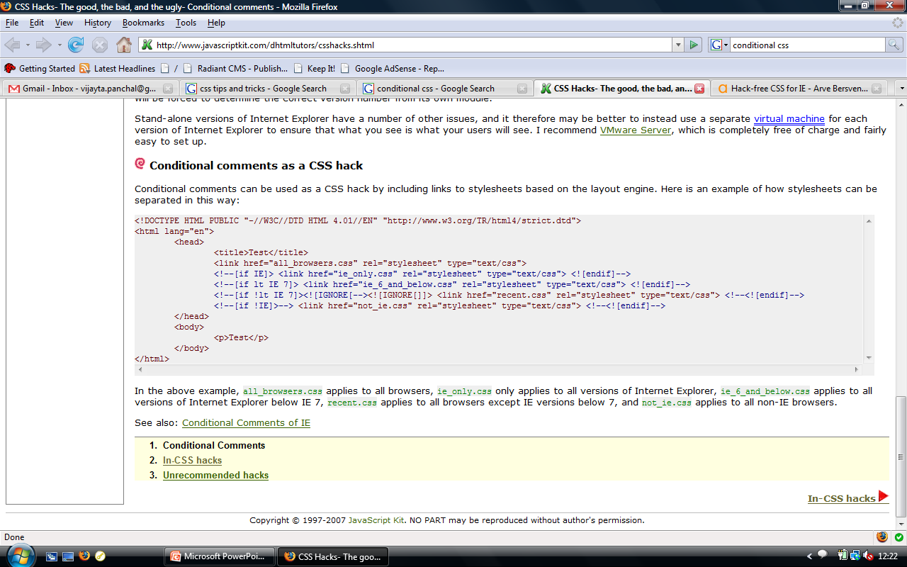
Continued…

Slide 28


