Slide 1
Bootstrap Components

Slide 2
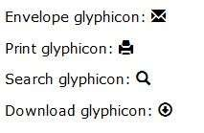
Glyphicons
Bootstrap provides 250 to 260 glyphicons from the Glyphicons Halflings set.
Glyphicons can be used in text, buttons, toolbars, navigation, forms, etc.
Example:
Glyphicon Syntax:
<span class="glyphicon glyphicon-name"></span>

Slide 3
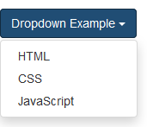
Dropdowns
A dropdown menu is a toggleable menu that allows the user to choose one value from a predefined list.
Example:
The .dropdown class indicates a dropdown menu.
To open the dropdown menu, use a button or a link with a class of .dropdown-toggle and
the data-toggle="dropdown" attribute.
The .caret class creates a caret arrow icon (), which indicates that the button is a dropdown.
Add the .dropdown-menu class to a <ul> element to actually build the dropdown menu.

Slide 4
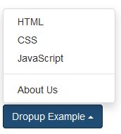
Dropup
The dropdown menu to expand upwards instead of downwards, change the <div>
element with class="dropdown" to “dropup”.
Example:
Syntax :<div class="dropup">…….</div>
Divider:
Add a divider to separate series of links in a dropdown menu.
Syntax:<ul class="dropdown-menu" >
...
<li role="separator" class="divider"> </li>
...
</ul>

Slide 5


Button Groups
 Bootstrap allows you to group a series of buttons together (on a single line).
 Use a <div> element with class .btn-group to create a button group.
 Syntax :
Button toolbar:
Combine sets of <div class="btn-group"> into a <div class="btn-toolbar"> for more complex components.
Example:<div class="btn-toolbar" role="toolbar" aria-label="...">
<div class="btn-group" role="group" aria-label="...">
</div> <div class="btn-group" role="group" aria-label="...">.
</div> <div class="btn-group" role="group" aria-label="...">
</div> </div>

Slide 6
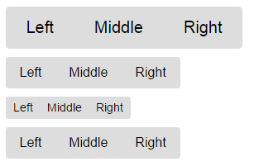
Sizing:
Instead of applying button sizing classes to every button in a group, just add .btn- group-* to each .btn-group, including when nesting multiple groups.
Example:
<div class="btn-group btn-group-lg" role="group" aria-label="...">
</div><div class="btn-group" role="group" aria-label="..."></div>
<div class="btn-group btn-group-sm" role="group" aria-label="..."></div>
<div class="btn-group btn-group-xs" role="group" aria-label="..."></div>

Slide 7

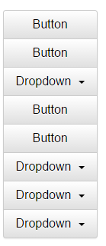
Nesting:
 Place a .btn-group within another .btn-group when you want dropdown menus mixed with a series of buttons.
Example:
Vertical variation:
Make a set of buttons appear vertically stacked rather than
horizontally.

Slide 8
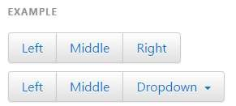

Justified button groups:
With <a> elements: Wrap a series of .btns in .btn-group.btn-group
justified.
With <button> elements: Justified button groups with
<button> elements, must wrap each button in a button group.

Slide 9

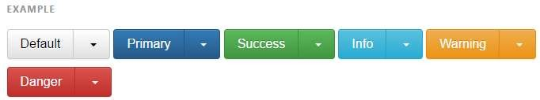
Button dropdowns:
Use any button to trigger a dropdown menu by placing it within a .btn- group and providing the proper menu markup.
Single button dropdowns:
Turn a button into a dropdown toggle with some markup changes.
Split button dropdowns:
create split button dropdowns with the same markup changes, only with a
separate button.

Slide 10
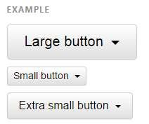

Sizing:
Button dropdowns work with buttons of all sizes.
Dropup variation:
 Trigger dropdown menus above elements by adding .dropup to the parent.

Slide 11
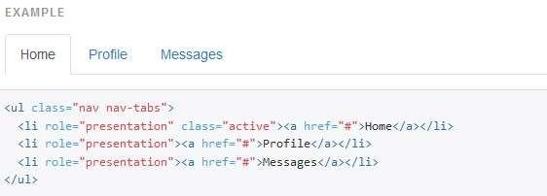
Navs
 Bootstrap provides an easy and quick way to create basic nav components like tabs and pills which are very flexible and elegant.
 All the Bootstrap's nav components—tabs and pills—share the same base markup and styles through the base .nav class.
Tabs
Tabs are created with <ul class="nav nav-tabs"> Also mark the current page with <li class="active">.

Slide 12
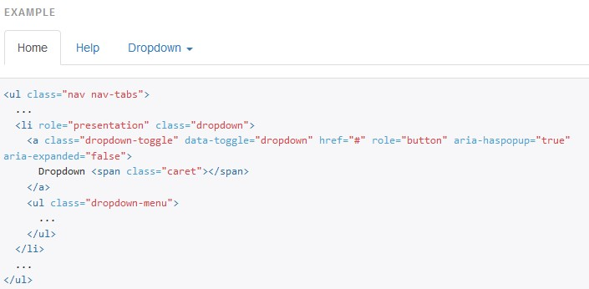
Using dropdowns:
Add dropdown menus for tabs and pills by using this syntax classes:
Tabs with dropdowns:

Slide 13
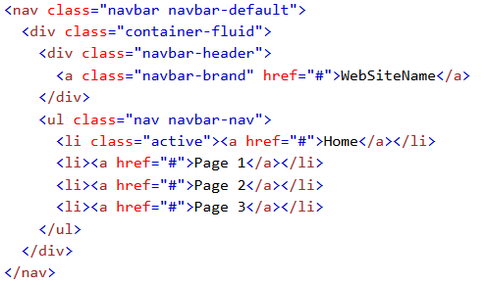
Navbar
A navigation bar is a navigation header that is placed at the top of the page.
With navigation bar can extend or collapse, depending on the screen size.
A standard navigation bar is created with <nav class="navbar navbar-default">
Example :
Syntax :

Slide 14

Inverted navbar
Just change the .navbar-default class into .navbar-inverse.
Example :
Syntax:

Slide 15
Fixed Navigation Bar
The navigation bar can also be fixed at the top or at the bottom of the page.
A fixed navigation bar stays visible in a fixed position (top or bottom)
independent of the page scroll.
Fixed to top
The .navbar-fixed-top class makes the navigation bar fixed at the top.
Fixed to bottom
The .navbar-fixed-bottom class makes the navigation bar fixed at the bottom.
Static top
navbar that scrolls away with the page by adding the class .navbar-static- top.

Slide 16
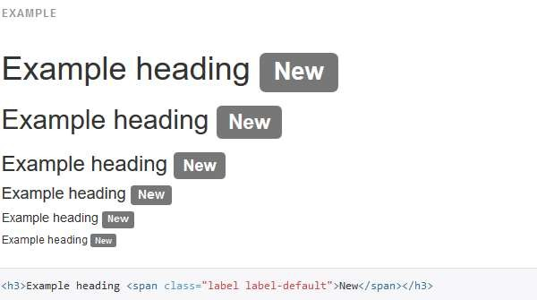
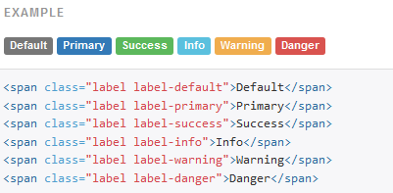
Labels
Labels are used to provide additional information about something.
Available variations:Add any of the below mentioned modifier classes to change the appearance of a label.

Slide 17
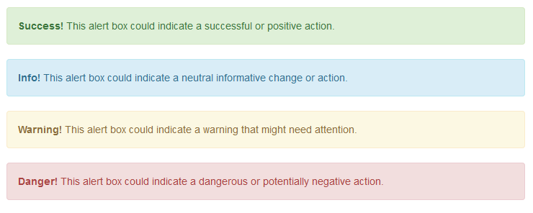

Alerts
Bootstrap provides an easy way to create predefined alert messages.
Alerts are created with the .alert class, followed by one of the four contextual classes . alert-success, alert-info, alert-warning or alert-danger.
•
Syntax:

Slide 18
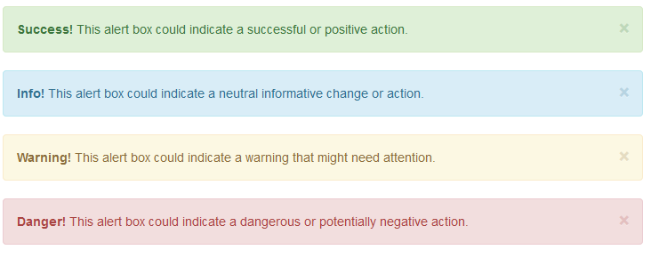

Dismissible alerts
To close the alert message, add a .alert-dismissable class to the alert container. Then add class="close" and data-dismiss="alert" to a link or a button element (when you click on this the alert box will disappear).
Example:

Slide 19
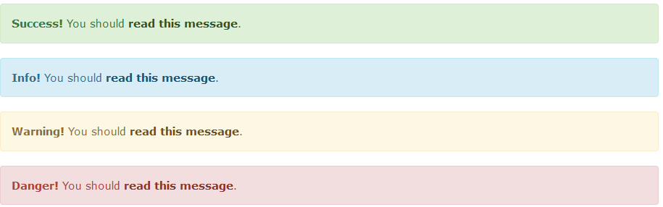
Links in alerts
Add the alert-link class to any links inside the alert box to create "matching colored links“.
Syntax:

Slide 20
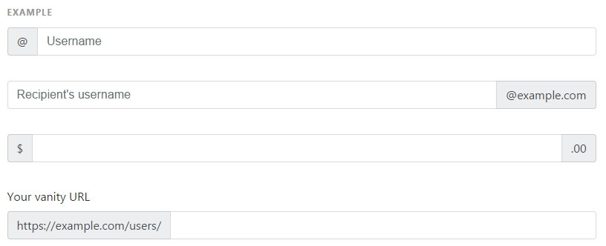
Input groups:
Extend form controls by adding text or buttons before, after, or on both sides of any text-based
<input>. Use .input-group with an .input-group-addon or .input-group-btn to prepend or append elements to a single .form-control.
Place one add-on or button on either side of an input. You may also place one on both sides of an input.

Slide 21
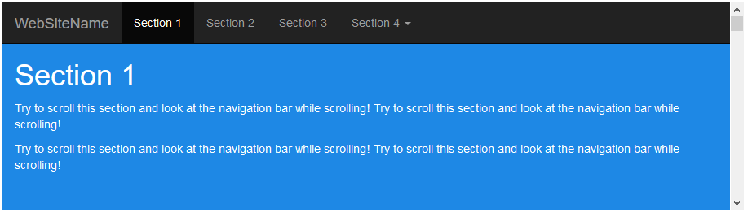
Scrollspy
The Scrollspy plugin is used to automatically update links in a navigation list based on scroll position.
Example:

Slide 22
Syntax:
<!-- The scrollable area -->
<body data-spy="scroll" data-target=".navbar" data-offset="50">
<!-- The navbar - The <a> elements are used to jump to a section in the scrollable area -->
<nav class="navbar navbar-inverse navbar-fixed-top">
...
<ul class="nav navbar-nav">
<li><a href="#section1">Section 1</a></li>
...
</nav>
<!-- Section 1 -->
<div id="section1">
<h1>Section 1</h1>
<p>Try to scroll this page and look at the navigation bar while scrolling!</p>
</div>
...
</body>

Slide 23
Example Explanation:
Add data-spy="scroll" to the element that should be used as the scrollable area (often this is the <body> element).
Then add the data-target attribute with a value of the id or the class name of the navigation bar (.navbar). This is to make sure that the navbar is connected with the scrollable area.
Note that scrollable elements must match the ID of the links inside the navbar's list items (<div id="section1"> matches <a href="#section1">).
The optional data-offset attribute specifies the number of pixels to offset from top when calculating the position of scroll. This is useful when you feel that the links inside the navbar changes the active state too soon or too early when jumping to the scrollable elements. Default is 10 pixels.

Slide 24
Carousel
The Carousel plugin is a component for cycling through elements, like a
carousel (slideshow).
<div id="myCarousel" class="carousel slide" data-ride="carousel">
<!-- Indicators -->
<ol class="carousel-indicators">
<li data-target="#myCarousel" data-slide-to="0" class="active"></li>
<li data-target="#myCarousel" data-slide-to="1"></li>
<li data-target="#myCarousel" data-slide-to="2"></li>
<li data-target="#myCarousel" data-slide-to="3"></li>
</ol>

Slide 25
<!-- Wrapper for slides -->
<div class="carousel-inner" role="listbox">
<div class="item active">
<img src="img_chania.jpg" alt="Chania">
</div>
<div class="item">
<img src="img_chania2.jpg" alt="Chania">
</div>
<div class="item">
<img src="img_flower.jpg" alt="Flower">
</div>
<div class="item">
<img src="img_flower2.jpg" alt="Flower">
</div>
</div>

Slide 26
 <!-- Left and right controls -->
<a class="left carousel-control" href="#myCarousel" role="button" data- slide="prev">
<span class="glyphicon glyphicon-chevron-left" aria- hidden="true"></span>
<span class="sr-only">Previous</span>
</a>
<a class="right carousel-control" href="#myCarousel" role="button" data-
slide="next">
<span class="glyphicon glyphicon-chevron-right" aria- hidden="true"></span>
<span class="sr-only">Next</span>
</a>
</div>

