Slide 1
MAJOR PROJECT PRESENTATION
Design of Ternary SRAM using CNTFET
Supervisor
Dr. BALWINDER RAJ
Co-Supervisor
Dr. AMANDEEP SINGH
ANKIT KUMAR(14104071)
VIBHU KUMAR(14104074)
ABHISHEK KUMAR(14104093)

Slide 2
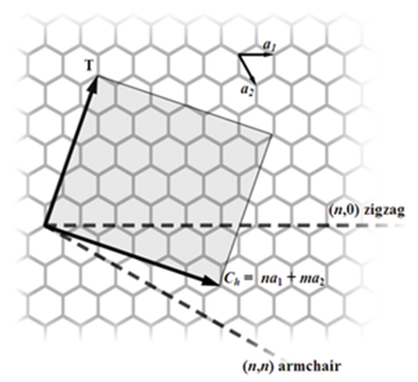


INTRODUCTION
A carbon nanotube field-effect transistor (CNTFET) refers to a field-effect transistor that utilizes a single carbon nanotube or an array of carbon nanotubes as the channel material instead of bulk silicon in the traditional MOSFET structure.
The fabrication process can yield either a metallic or semiconducting tube depending on the angle of the arrangement of carbon atoms along the tube.
The angle of arrangement of carbon atoms is referred to as the chirality vector (n1, n2).
The chirality vector determines the diameter, the threshold voltage (VTH).

Slide 3
Ternary logic
Ternary logic, a three-valued logic is any of several many-valued logic systems in which there are three truth values indicating true, false and some indeterminate third value.
A n-variable ternary valued function f (x1, . . . , xn) is a mapping f : S^n -> S, with the variable xi taking values from the set S ={0, 1, 2}.
However, the added complexity during fabrication and the overall unfamiliarity with multi-valued algebra has kept ternary computation a relatively smaller field.

Slide 4
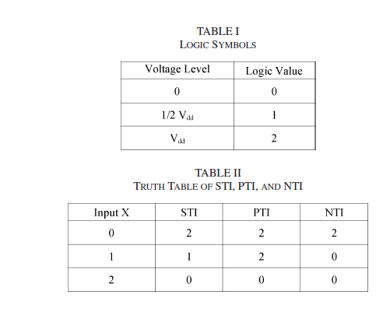
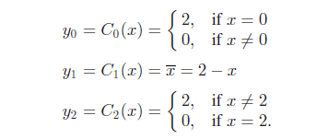
Ternary logic
y0=Negative Ternary Inverter
y1=Standard Ternary Inverter
y2=Positive Ternary Inverter

Slide 5
Objectives
Phase-1
Studying about the basics of Carbon Nanotubes and Carbon Nanotubes FET
Setting up of environment.
Getting familiar with the HSPICE .
HSPICE simulation of various design models of Standard Ternary Inverter using CNTFET and their comparison.
Phase-2
HSPICE simulation of ternary circuits using MOSFET.
HSPICE simulation of SRAM using various cross-coupled Standard Ternary Inverter using CNTFET.
Comparison Of the SRAM made using CNTFET varying the various parameters.

Slide 6
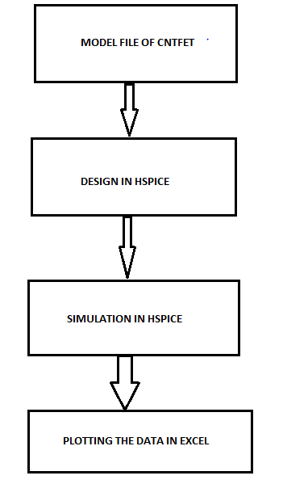
Methodology

Slide 7
Work done till Phase 1
Studying about the basics of Carbon Nanotubes and Carbon Nanotubes FET
Reading of research papers-
A Novel CNTFET-Based Ternary Logic Gate Design by Sheng Lin, Yong-Bin Kim and Fabrizio Lombardi
Design of a ternary static memory cell using carbon nanotube-based transistors by K. You, K. Nepal
HSPICE Simulation of Standard Ternary Inverter using six CNTFET.
HSPICE Simulation of Standard Ternary Inverter using two CNTFET and two resistor.

Slide 8
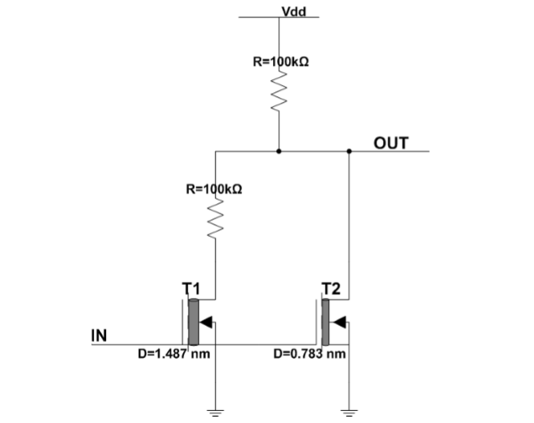
Standard Ternary Inverter using two CNTFET

Slide 9
HSPICE simulation of Standard Ternary Inverter using two CNTFET
Simulated Result
Paper Result

Slide 10
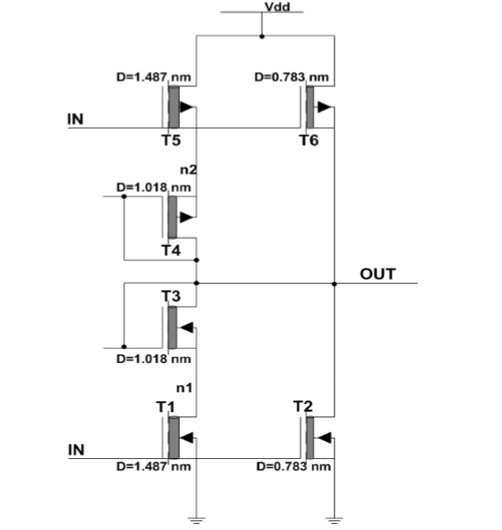
Standard Ternary Inverter using six CNTFET

Slide 11
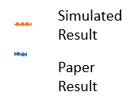
HSPICE simulation of Standard Ternary Inverter using six CNTFET

Slide 12
Comparison between the two design models of Standard Ternary Inverter
STI using 2 CNTFET
STI using 6 CNTFET

Slide 13
Phase 2 work done so far
Study about the writing and reading process of SRAM.
Implementation of the SRAM using Standard ternary inverter(6 CNTFET design model) .
Implementation of SRAM using Negative ternary inverter and Positive ternary inverter.
Implementation of SRAM using 3 transistor inverter.
By varying parameter (Gate Length) we compare the performance of various SRAM.
By varying parameter (temperature) we compare the performance of various SRAM.

Slide 14
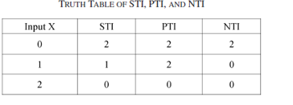
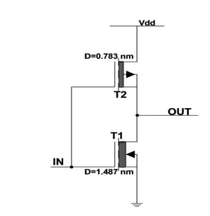
Positive Ternary Inverter
Vout(Volts)
Positive Ternary Inverter
Logic 0 logic 1 logic 2
Chirality vector-T2 (10,0) ,T1 (19,0)
Vin(Volts)

Slide 15
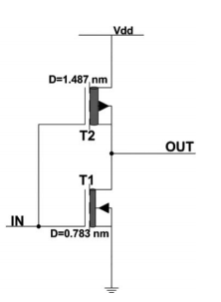
Negative Ternary Inverter
Vout(Volts)
Logic 0 logic 1 logic 2
Negative Ternary Inverter
Chirality vector-T2 (19,0) ,T1 (10,0)
Vin(Volts)

Slide 16
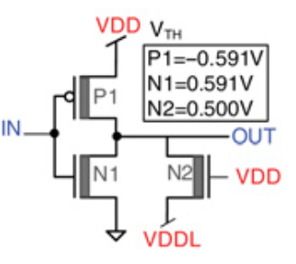
Ternary Inverter using 3 transistors
Lg of P1=32nm (9,0)
Lg of N1=32nm (9,0)
Lg of N2=64nm (11,0)
No of tubes
P1=8 tubes
N1=20 tubes
N2= 2 tubes
Vout(Volts)
Logic 0 logic 1 logic 2
Ternary Inverter using 3 transistors
Vin(Volts)

Slide 17
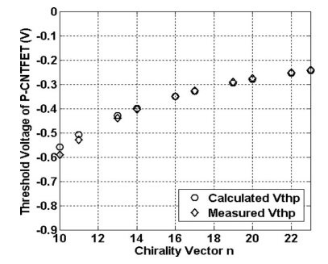
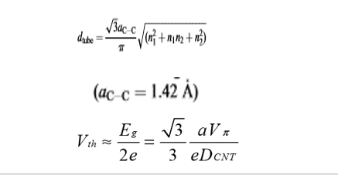
Threshold value for different chirality vector
Threshold Voltage
of P CNTFET(V)
Chirality vector
[1]

Slide 18
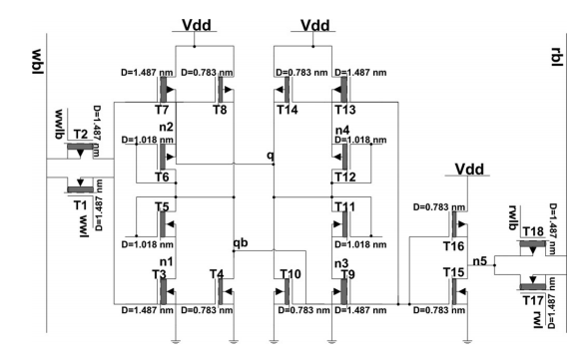
SRAM using 6 CNTFET Standard Ternary Inverter
CNTFET-based ternary memory cell using STI [1]
CNTFET-based STI design [1]

Slide 19
SRAM using 6 CNTFET STI write at Lg=20nm

Slide 20
SRAM using 6 CNTFET STI read at Lg=20nm

Slide 21
SRAM using 6 CNTFET STI write at Lg=32nm

Slide 22
SRAM using 6 CNTFET STI read at Lg=32nm

Slide 23
SRAM using 6 CNTFET STI write at Lg=45nm

Slide 24
SRAM using 6 CNTFET STI read at Lg=45nm

Slide 25
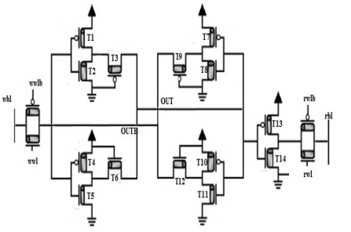
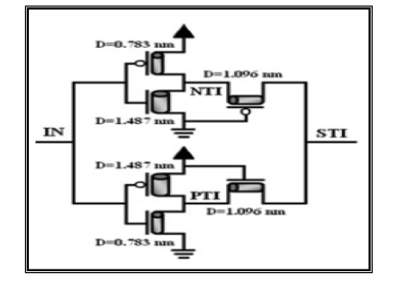
SRAM using Negative Ternary Inverter and Positive Ternary Inverter
Chirality vector (10,0) (19,0) (13,0)
CNTFET-based ternary memory cell using NTI and PTI [3]
CNTFET-based ternary inverter using NTI and PTI [3]

Slide 26
SRAM using NTI and PTI write at Lg=20nm

Slide 27
SRAM using NTI and PTI read at Lg=20nm

Slide 28
SRAM using NTI and PTI write at Lg=32nm

Slide 29
SRAM using NTI and PTI read at Lg=32nm

Slide 30
SRAM using NTI and PTI write at Lg=45nm

Slide 31
SRAM using NTI and PTI read at Lg=45nm

Slide 32
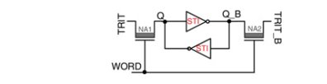
Lg of P1=32nm (9,0)
Lg of N1=32nm (9,0)
Lg of N2=64nm (11,0)
No of tubes
P1=8 tubes
N1=20 tubes
N2= 2 tubes
SRAM using 3 Transistor Inverter
CNTFET-based ternary memory cell using 3 transistor inverter [2]
CNTFET-based ternar inverter using 3 transistors [2]

Slide 33
SRAM using 3 Transistor Inverter write

Slide 34
SRAM using 3 Transistor Inverter read

Slide 35
Comparing SNM of SRAM using 6 CNTFET STI by varying the Gate length
Size(nm) | SNM(mV)
20 | 123.89
32 | 149.62
32(Paper)[1] | 154.2
45 | 160.87

Slide 36
Comparing SNM of SRAM using NTI and PTI by varying the Gate length
Size(nm) | SNM(mV)
20 | 134.27
32 | 157.82
45 | 180.38

Slide 37
Comparing SNM of different designs at Lg=32nm
Design | SNM(mV)
SRAM using 6T STI | 149.62
SRAM using NTI and PTI | 157.82
SRAM using 3T | 84.87
SRAM using SRAM using SRAM using
6 T STI NTI and PTI 3 T Inverter

Slide 38
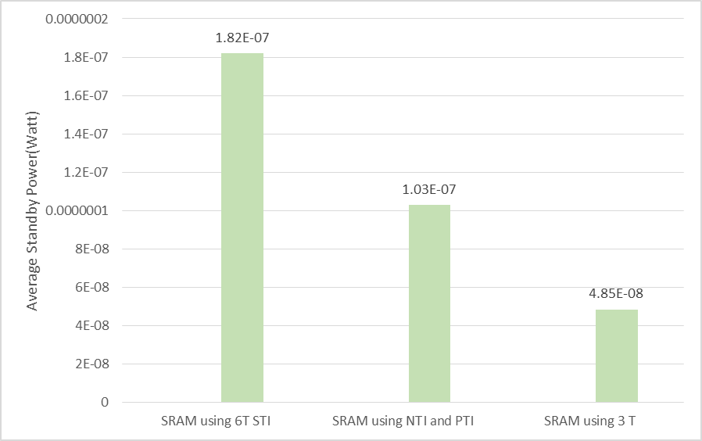
Comparing average standby power of different designs at Lg=32nm
Design | Average standby power(Watt)
SRAM using 6T STI | 1.82E-07
SRAM using NTI and PTI | 1.03E-07
SRAM using 3 T | 4.85E-08

Slide 39
Conclusion of different designs
Design | SNM(mV)
SRAM using 6T STI | 149.62
SRAM using NTI and PTI | 157.82
SRAM using 3T | 84.87
Design | Average standby power(Watt)
SRAM using 6T STI | 1.82E-07
SRAM using NTI and PTI | 1.03E-07
SRAM using 3 T | 4.85E-08
SRAM using NTI and PTI has the highest SNM amongst the three designs but has higher average standby power than SRAM using 3T so there exists a tradeoff between SNM and average standby power when using different designs of ternary SRAM.

Slide 40
Comparing SNM of SRAM at different Temperature
Type(size) | SNM in mV at 25C | SNM in mV at 100C
SRAM(20nm) | 123.89 | 104.80
SRAM(32nm) | 150 | 125
SRAM(45nm) | 160.87 | 132.59
SRAM using 3T | 85 | 49

Slide 41
Standby power of SRAM using 6 CNTFET STI by varying the Gate length at 25C
size | power in watt at 25C
20nm(0) | 3.60E-08
20nm(1) | 3.74E-07
20nm(2) | 7.76E-08
32nm(0) | 1.90E-09
32nm(1) | 1.90E-09
32nm(2) | 5.43E-07
45nm(0) | 1.02E-09
45nm(1) | 5.81E-07
45nm(2) | 1.21E-08

Slide 42
Standby power of SRAM using 6 CNTFET STI by varying the Gate length at 100C
Size | Power in watt at 100C
20nm(0) | 1.81E-09
20nm(1) | 6.57E-07
20nm(2) | 1.14E-08
32nm(0) | 3.02E-09
32nm(1) | 2.78E-09
32nm(2) | 3.02E-07
45nm(0) | 3.06E-09
45nm(1) | 8.58E-07
45nm(2) | 1.08E-08

Slide 43
Standby power of SRAM using NTI and PTI by varying the Gate length at 25C
Size | Power in at 25C
20nm(0) | 4.68E-09
20nm(1) | 2.45E-07
20nm(2) | 7.46E-09
32nm(0) | 3.02E-09
32nm(1) | 2.78E-09
32nm(2) | 3.02E-07
45nm(0) | 6.28E-08
45nm(1) | 7.40E-07
45nm(2) | 1.07E-07

Slide 44
Standby power of SRAM using NTI and PTI by varying the Gate length at 100C
Size | power in watt at 100C
20nm(0) | 1.35E-09
20nm(1) | 1.24E-06
20nm(2) | 1.73E-08
32nm(0) | 1.33E-08
32nm(1) | 9.70E-07
32nm(2) | 4.90E-09
45nm(0) | 2.88E-09
45nm(1) | 5.58E-07
45nm(2) | 1.04E-08

Slide 45
Standby power of SRAM using 3 transistor Inverter at 25C
Logic | Power in watt at 25C
0 | 6.93E-08
1 | 7.40E-08
2 | 2.20E-09

Slide 46
Standby power of SRAM using 3 transistor Inverter at 100C
Logic | Power in watt at 100C
0 | 1.89E-07
1 | 1.88E-07
2 | 1.89E-09

Slide 47
Conclusion of SRAM using 6 CNTFET STI
SIZE(nm) | SNM(mV)
20 | 123.89
32 | 149.62
32(Paper)[1] | 154.2
45 | 160.87
SIZE (nm) | Standby power in watt
20 | 1.63E-07
32 | 1.82E-07
45 | 1.98E-07
As we scale down technology SNM reduces which is a disadvantage but the standby power consumption also reduces so there exists tradeoff between SNM and power as we scale down technology

Slide 48
Conclusion of SRAM using NTI and PTI
Size(nm) | SNM(mV)
20 | 134.27
32 | 157.82
45 | 180.38
SIZE (nm) | Power in watt
20 | 8.57E-08
32 | 1.03E-07
45 | 3.03E-07
As we scale down technology SNM reduces which is a disadvantage but the standby power consumption also reduces so there exists tradeoff between SNM and power as we scale down technology

Slide 49
References
Design of a Ternary Memory Cell Using CNTFETs Sheng Lin, Student Member, IEEE, Yong-Bin Kim, Senior Member, IEEE, and Fabrizio Lombardi, Fellow, IEEE
Design of a ternary static memory cell using carbon nanotube-based transistors K. You, K. Nepal Department of Electrical Engineering, Bucknell University, Lewisburg, PA 17837, USA
2015 Interational Conference on Communication,Control and Intelligent Systems (CCIS) Design, Analysis and Comparison between CNTFET Based Terary SRAM Cell and PCRAM Cell
A Novel CNTFET-Based Ternary Logic Gate Design Sheng Lin, Yong-Bin Kim and Fabrizio Lombardi Department of Electrical and Computer Engineering Northeastern University Boston, MA, USA

Slide 50


