Slide 1



Data Visualization-Tableau
SE-Concept & Tool for Application Development – Spring 2021
Vibhu Badola
vibhu.badola@hof-university.de

Slide 2
Content
Introduction to Tableau.
Connecting to Data.
Dashboard and Stories.
Mapping & Competitors.
Main Project:- Titanic.

Slide 3
1
Introduction to Tableau

Slide 4
What is Tableau ?
We have to answer two important question:
What is Data Visualization?
Why is Data Visualization important?

Slide 5
What is Data Visualization?
Data visualization is the process of describing information through visual rendering.
It is also the best way to convey concepts.

Slide 6
Why is Data Visualization important?
Technological advances have made data visualization more prevalent and powerful then ever before.
Business purpose.

Slide 7
Insight for the Text below
With the estimated double-digit growth in online retail sales in the US this year, it looks to be a promising year for e-commerce retailers. Yet, while data from eMarketer shows that this growth is expected to be felt, at least to some extent, by all the top e-commerce retailers, it will do little in pushing Amazon out of the top spot anytime soon.
Amazon’s US e-commerce sales are expected to increase by 15.3% year-over-year (y-o-y) in 2021 to reach $367.19 billion, helping the company cement its position as the top retail e-commerce company in the US. Per eMarketer’s projections, Amazon’s share of total US e-commerce sales will increase to 40.4%, up from the 37.7% estimated last year.
Walmart is expected to have the second-highest estimated share of e-commerce sales again this year at 7.1%, up from 5.3% last year. The data shows that Walmart is predicted to see e-commerce sales grow by 21.2% y-o-y.
The discount retailer, which also ranks third on the list of top retail subscription services in the US, is followed by eBay (4.3% share) and Apple (3.7% share).
In the meantime, Best Buy, Target and The Home Depot are expected to account for 2.2% share each of total e-commerce sales, with estimated total e-commerce sales reaching $20.34 billion, $20.23 billion and $20.02 billion, respectively.
Long-time grocery giant, Kroger, climbed onto the top-10 list this year, ranking 8th with an estimated 1.7% share of e-commerce dollars, reflecting the growth of online grocery shopping spurred on by the pandemic.
Rounding out the top-10 list are Costco (1.6%) and Wayfair (1.5%), which fell to the #10 spot from #6 last year.
Without a doubt, Amazon’s share of e-commerce sales was only strengthened by last year’s events. eMarketer points out that, pre-pandemic, they had estimated Amazon’s sales to grow by 17.2% in 2020; however, sales grew by 44.1% to reach $318.4 billion last year.
About the Data: Results are based on the gross value of products or services sold online (browser or app) regardless of method of payment or fulfilment, excluding travel and event tickets.

Slide 8
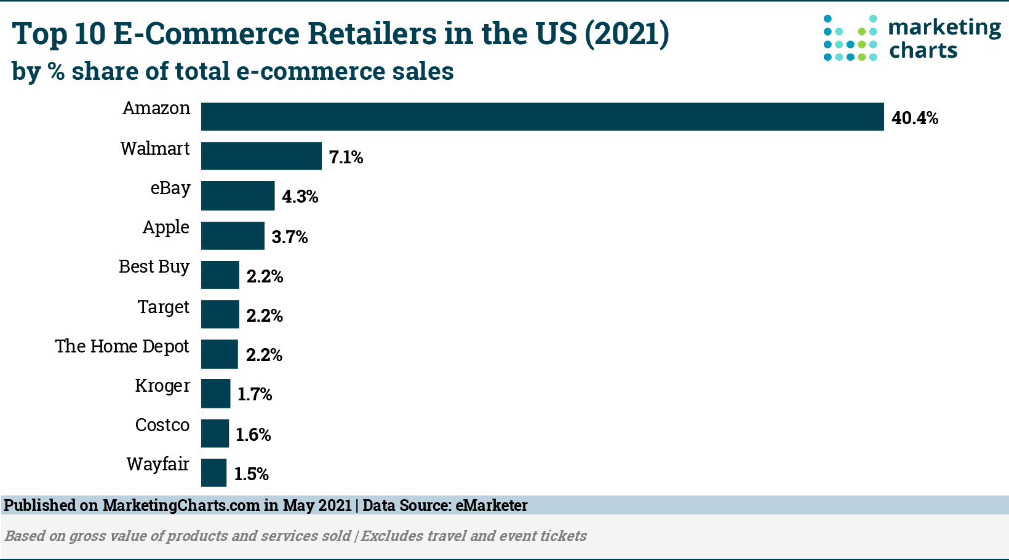
Insight get from the Chart below:

Slide 9
What is Tableau?
Tableau is groundbreaking data visualization software created by Tableau Software.
Tableau is a data connect and data analysis tool used for visualization.
Tableau allows for instantaneous insight by transforming data into interactive visualization called dashboards.

Slide 10
Why Tableau?
Great Visualization
Easy to use
Fast
Share in Seconds
Smart Dashboards
Big Data, Any Data

Slide 11






Tableau Features
Speed To Market
Easy to Use
Handle Big Data
Take any Data
Stunning & Interactive Plots
Industry Leader

Slide 12
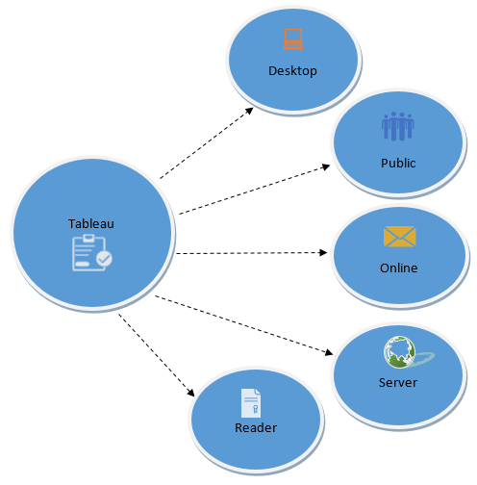
Types of Tableau

Slide 13
Connecting to Data
2

Slide 14





Easy Data Integration : Files

Slide 15




Easy Data Integration: Servers

Slide 16
A Note of File Type
Workbook (.twb): Workbooks hold worksheets, dashboards and stories.
Packaged workbook (.twbx): Archive containing a workbook along with all data sources and files.
Data extract (.tde): Local copy of a subset or entire data source to share and improve the performance.
Data source(.tds): Shortcut to often used data sources, containing information and modifications.

Slide 17
Dashboard and stories
3

Slide 18


What is Dashboard
Powerful tool for mixing multiple views in a unique one.
Allow us to create interactive and common filters for all the sheets grouped.
Excellent tool for generic views.

Slide 19
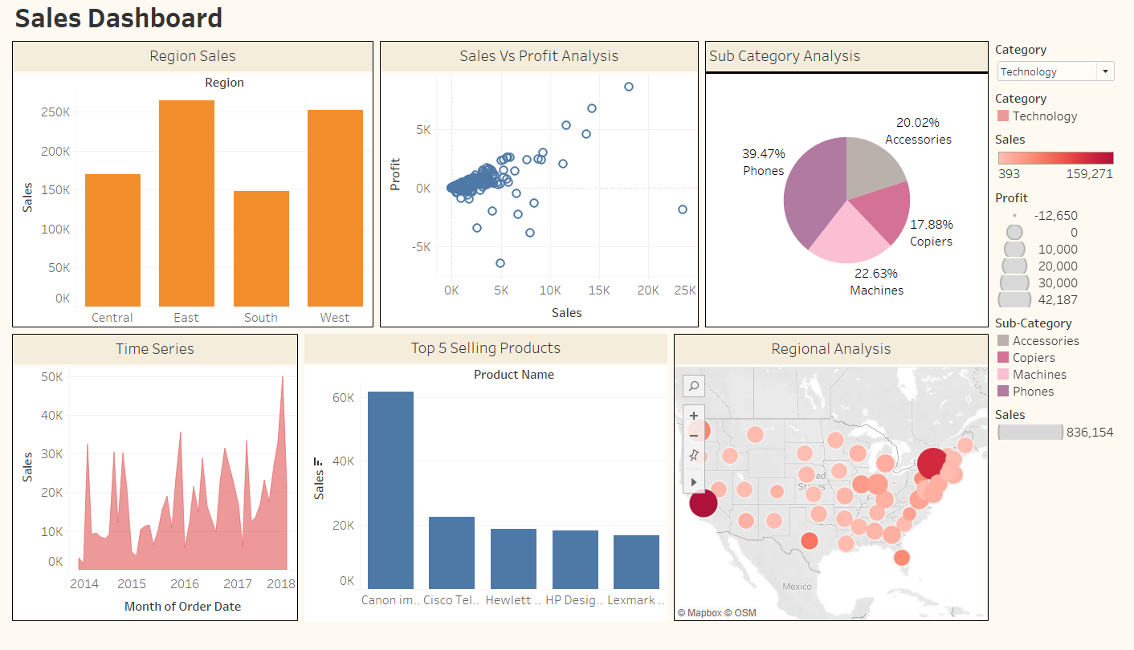
Dashboard Example

Slide 20
What is Story in Tableau
Sheet that contains a sequence of worksheets or dashboards that work together to convey information.
All methods that are able for datasheets and dashboards apply to stories.
Powerful navigation tool for presentations.

Slide 21
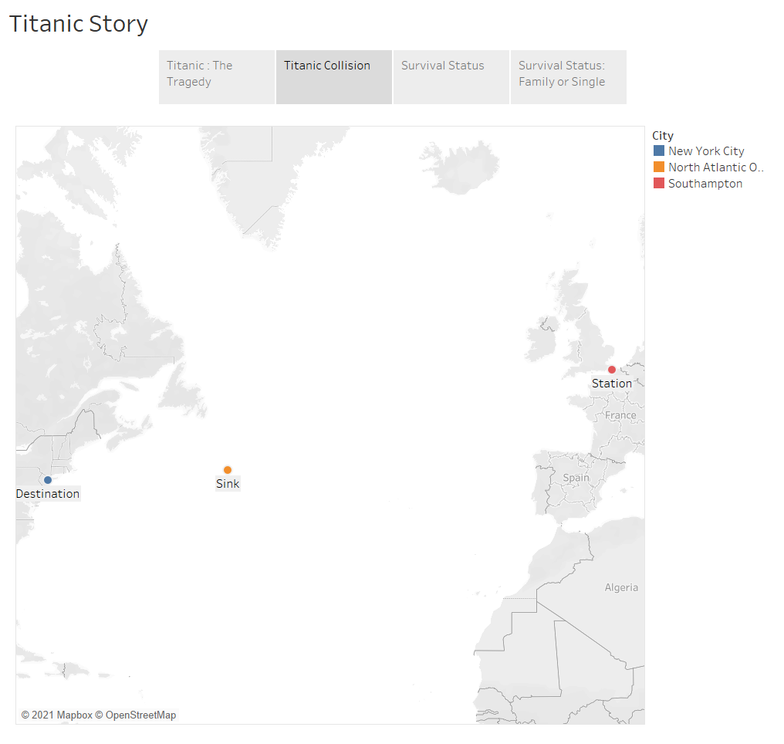
Story Example

Slide 22
Mapping & Similar Tools
4

Slide 23








Tableau Competitors
For the fourth year, Tableau is a leader in the Magic Quadrant for Business Intelligence and Analytics Platforms Report. - GARTNER

Slide 24
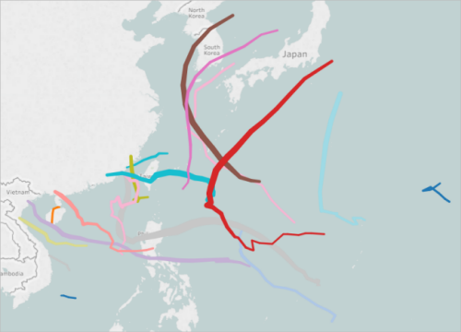
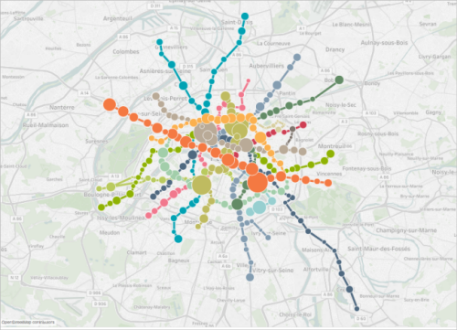
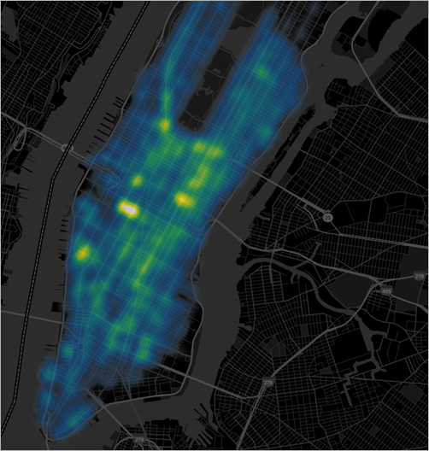
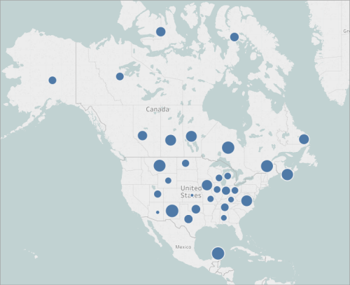
Mapping
Flow maps (path maps)
Spider maps (origin-destination maps)
Heatmaps (density maps)
Proportional symbol maps

Slide 25

Featured Companies that use Tableau
Tens of thousands of organizations in nearly every country choose Tableau to solve data problems, including Fortune 500 enterprises, small and medium-sized businesses, government agencies, universities, research institutions, and non-profits.

Slide 26






Data Visualization using Tableau
7 Steps
Step7
Step 6
Save viz on Tableau Desktop or share it with Tableau server/ tableau online
Step 5
Create a dashboard to show insights
Step 4
Create more viz to get more insights from the data
Step 3
Edit viz, add colors, labels, name, hide fields, sort group, add data labels, name worksheet, add filters
Step 2
Select the fields/variables and click on show me the required viz or drag and drop them in the row and column
Data Management
Rename Fields, change data types, hide or add new fields etc.
Step 1
Connect to the data source

Slide 27
Main Project : Titanic
5

Slide 28
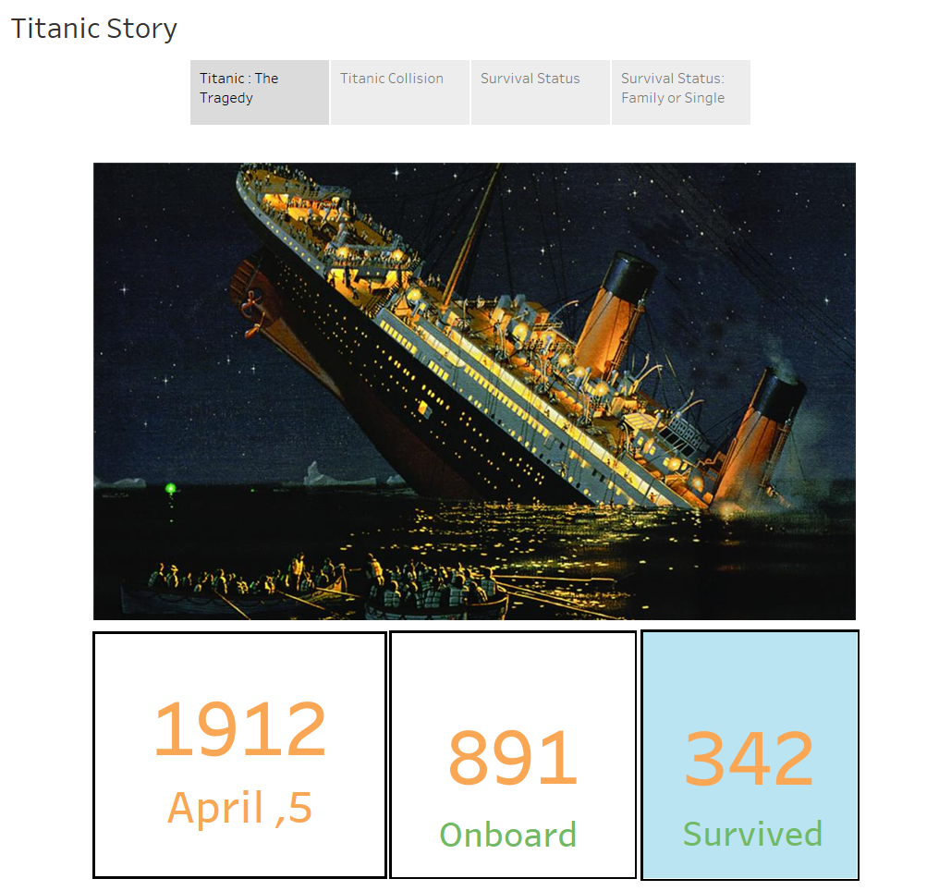

Slide 29
Reference
https://www.tableau.com/reports/gartner
https://www.marketingcharts.com/industries/retail-and-e-commerce-117225
https://help.tableau.com/current/pro/desktop/en-us/maps_build.htm
https://www.kaggle.com/c/titanic/data
Learn from- https://www.analytixlabs.co.in/

Slide 30

Thanks! Question
SE-Concept & Tool for Application Development – Spring 2021
Vibhu Badola
vibhu.badola@hof-university.de

