Slide 1
Financial Documents Processing
Router Pattern Architecture
Cost-Optimized Intelligent Document Processing for Financial Services
92.5% Cost Reduction | Serverless AWS Architecture | AI-Powered Classification

Slide 2
The Problem: Traditional Document Processing
💸
⏱️
🎯
📋
$4.50+/doc
Slow Processing
Low Precision
No Audit Trail
Brute force OCR on every page
of multi-hundred page documents
Sequential page-by-page
extraction wastes time
Generic extraction misses
financial document nuances
Difficult to trace which
page data came from
Result: Processing 1,000 documents/month costs $4,500+ with limited accuracy

Slide 3
The Solution: Router Pattern
1
2
3
ROUTER
EXTRACTOR
NORMALIZER
Classification
Targeted Pages
Refinement
Claude 3 Haiku analyzes
all pages, identifies key
documents & page numbers
Textract processes ONLY
identified pages with
Tables + Queries
Claude 3.5 Haiku normalizes
data, cross-validates,
produces schema JSON
~$0.006
~$0.30
~$0.03
Total: ~$0.34/document (vs $4.55 brute force)

Slide 4
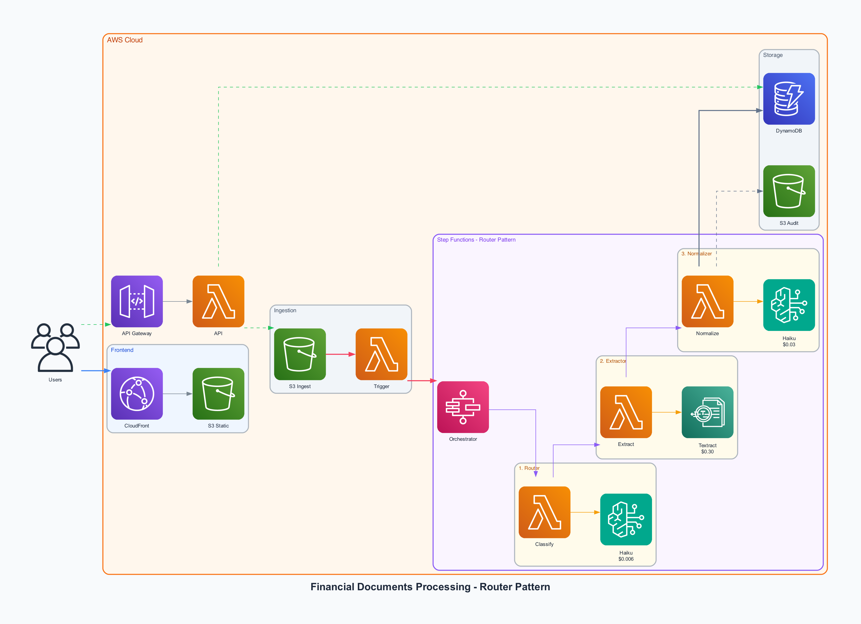
Architecture Overview

Slide 5
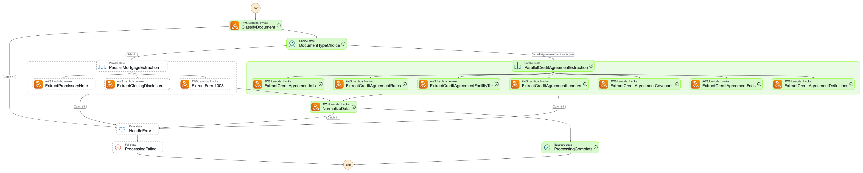
Step Functions Workflow
Smart Routing
Parallel Extraction
Error Handling
DocumentTypeChoice branches to Loan or Credit Agreement path
30 parallel Textract workers process pages in ~35s end-to-end
Built-in error handling with graceful failure recovery

Slide 6
Cost Comparison: 92.5% Savings
Approach | Cost/Doc | 1,000 Docs/Month | 10,000 Docs/Month
Brute Force OCR | $4.55 | $4,550 | $45,500
Router Pattern | $0.34 | $340 | $3,400
Monthly Savings | $4.21 | $4,210 | $42,100
Per-Document Cost Breakdown (300-page Credit Agreement)

Slide 7
Why Router Pattern? vs Alternatives
Approach | Cost/Doc | 10K Docs/Mo | Key Limitation
Claude Opus 4.5 (Tool Calling) | $15-25 | $150K+ | Context limits; cost prohibitive
Bedrock Data Automation (BDA) | $2-5 | $25K+ | No page selection; black-box
Full Textract OCR (Brute Force) | $4.55 | $45K | No intelligence; processes all pages
Router Pattern | $0.34 | $3,400 | Surgical precision; 92.5% savings
"Use a cheap model to figure out WHERE to look, then use specialized tools to extract WHAT you need."
Classification is CHEAP
OCR is SPECIALIZED
Normalization needs SOME intelligence
Claude Haiku excels at
document structure
Textract beats LLM
vision for tables
But not $75/M
output token intelligence
$0.006
$0.02/pg
$0.03

Slide 8
Key Differentiators
🧠
Intelligent Classification
🎯
Targeted Extraction
AI identifies document types & relevant pages before expensive OCR
Process only pages that matter - not the entire document
🔒
Content Deduplication
📊
Complete Audit Trail
SHA-256 hashing prevents reprocessing identical documents
Track exactly which page each data point originated from
✅
Review Workflow
☁️
Serverless & Scalable
Human-in-the-loop: Approve, Reject, or Correct extracted data
Zero infrastructure management, auto-scales to any volume

Slide 9
Supported Document Types
📄 Loan Packages
📋 Credit Agreements
Promissory Note - Interest rate, principal, borrower names, maturity date
Closing Disclosure - Loan amount, fees, cash to close
Form 1003 - Borrower info, property address, employment
Agreement Info - Type, dates, amendment number
Parties - Borrower, agent, arrangers, guarantors
Facility Terms - Revolving credit, LC commitments
Pricing Grid - SOFR spreads, ABR spreads, tiers
Lender Commitments - Per-lender allocations
Covenants - Financial ratios, requirements

Slide 10
Built on AWS
CloudFront + S3
API Gateway + Lambda
Step Functions
React Dashboard
REST API
Orchestration
Bedrock (Claude Haiku)
Textract
DynamoDB + S3
AI Classification
OCR Extraction
Data Storage
Get Started
GitHub: github.com/vibhupb/financial-documents-processing
Deploy: npm install && cdk deploy --all
~$0.34/doc | 92.5% savings | Production ready

