Slide 1
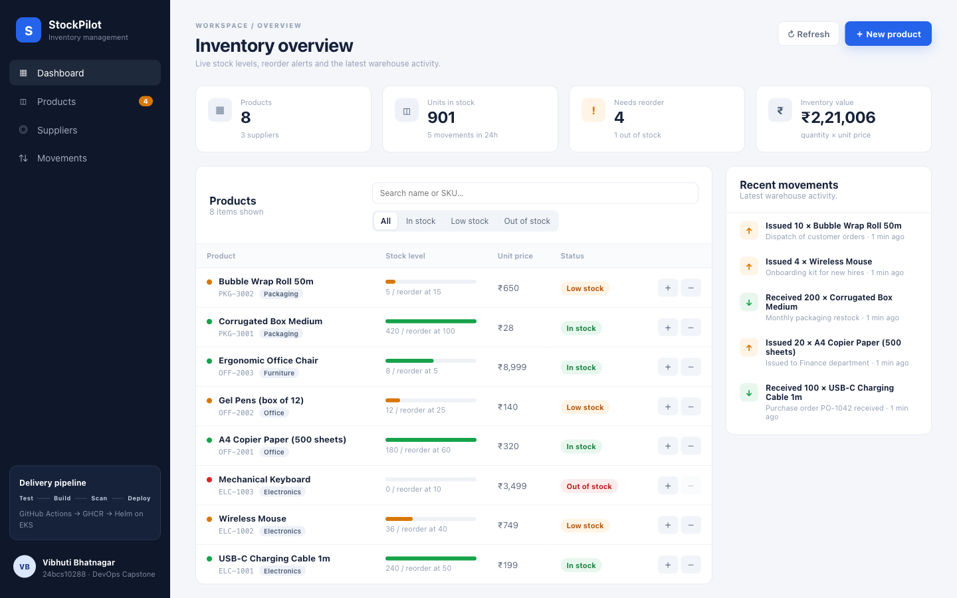
StockPilot
DEVOPS FINAL CAPSTONE · SESSION 21
Inventory management delivered on a production-style DevOps platform: Git → CI/CD → Trivy → GHCR → Terraform/EKS → Helm → Kubernetes → Prometheus & Grafana
Vibhuti Bhatnagar
Roll No 24bcs10288
Notes:
Introduce StockPilot: a small inventory-management SaaS built from scratch for the capstone. The application is intentionally simple; the point is the full journey from a laptop to a monitored, autoscaled Kubernetes environment.

Slide 2



What StockPilot does
Products
Suppliers
Stock movements
SKU, category, quantity on hand, reorder level, unit price. Derived status: In stock · Low stock · Out of stock.
Vendors with contact, phone and city. Deleting a supplier detaches its products instead of deleting them.
Append-only ledger of goods received (IN) and issued (OUT). Atomically updates quantity; over-issuing is rejected with 409.
14
3
28
4
REST endpoints
PostgreSQL tables · 2 Alembic migrations
automated tests (pytest)
dashboard views, responsive to phone width
Notes:
Three entities. The business rule worth calling out: a stock movement is the only way quantity changes, and issuing more than is in stock is refused. The domain is deliberately different from the TaskBoard reference project, as the rubric requires.

Slide 3








From a laptop to a monitored cluster
Git / GitHub
GitHub Actions
Trivy
GHCR
source of truth
ruff · pytest · npm build
HIGH/CRITICAL gate
images tagged :git-sha
Terraform
Helm
Kubernetes
Prometheus + Grafana
AWS VPC + EKS
upgrade --install
Ingress · HPA · probes
ServiceMonitor · dashboard
Every running Pod's image tag equals the Git commit that produced it: production traces back to source.
Notes:
Walk the pipeline left to right, top row then bottom row. Emphasise the traceability story: the image tag is the commit SHA, there is no mutable latest tag in production.

Slide 4
Application: React dashboard + FastAPI
React 19 + Vite 8 single-page app: KPI cards, searchable product table with stock-level bars, ledger, create / receive / issue modals, toasts
FastAPI + SQLAlchemy 2 + Pydantic v2; schema owned by Alembic migrations
PostgreSQL 17; Nginx proxies /api so the browser never learns backend hostnames
/health (liveness), /ready (checks the database), /metrics (Prometheus)
Responsive layout down to 390 px; loading and backend-error states
Notes:
Live demo point: create a product, issue stock, watch the KPIs and the ledger update. Mention the Swagger UI at /docs.

Slide 5
REST API (14 endpoints)
Method | Path | Purpose
GET / POST | /api/products | List (search, category, stock-status filters) / create; 409 on duplicate SKU
GET / PUT / DELETE | /api/products/{id} | Read, partial update, delete (cascades movements)
GET | /api/products/stats | Dashboard KPIs: totals, low / out of stock, inventory value
GET | /api/products/low-stock | Products at or below their reorder level
GET / POST | /api/suppliers | List / create suppliers
GET / PUT / DELETE | /api/suppliers/{id} | Read, update, delete (products are detached, not deleted)
GET / POST | /api/movements | Ledger (newest first) / receive IN or issue OUT stock
GET | /health · /ready · /metrics | Liveness, readiness (SELECT 1), Prometheus exposition
Validation with Pydantic (422), not-found (404), conflicts (409). Interactive docs at /docs.
Notes:
Minimum for the rubric was four endpoints with GET, POST, PUT and DELETE. StockPilot has fourteen, all exercised by tests.

Slide 6
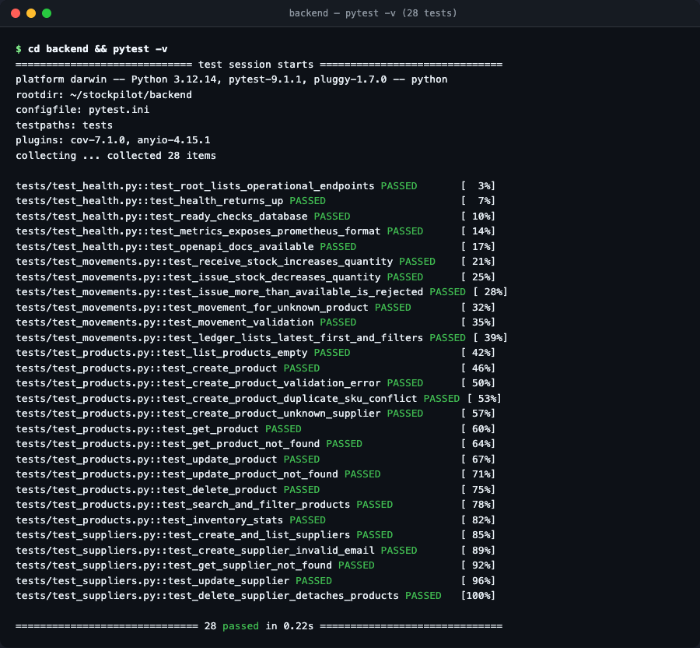


Testing is the first quality gate
28 pytest cases over every endpoint
Happy paths, validation (422), not-found (404), duplicate SKU and insufficient stock (409), filters, statistics, /metrics format.
Never touches the real database
conftest.py builds a fresh in-memory SQLite per test, injected via dependency_overrides. The whole suite runs in about 0.2 s.
ruff lint + format check before pytest
Both run locally and as the first CI job. A failing test stops the pipeline, so a broken image is never built or pushed.
Notes:
Bad code → pytest fails → pipeline stops → no broken image is promoted. That is why tests run before Docker.

Slide 7


Containers: small, non-root, one command
stockpilot-backend
stockpilot-frontend
python:3.12-slim, two stages: build a virtualenv, copy only the venv + code.
pip / setuptools removed from the runtime (fewer CVEs).
Runs as app (uid 10001); HEALTHCHECK on /health.
Entrypoint: wait for DB → alembic upgrade head → uvicorn.
node:24-alpine builds the Vite bundle; nginx-unprivileged:1.30-alpine serves it.
Listens on 8080 as user nginx (uid 101).
BACKEND_URL is templated at start-up, so the same image works in Compose and Kubernetes.
docker compose up --build
postgres:17-alpine (healthcheck) → backend (migrations + seed) → frontend on http://localhost:3000. Image sizes: backend 362 MB, frontend 91 MB.
Notes:
Both images run as non-root users; the frontend uses the unprivileged nginx image on port 8080. Compose starts all three services with health-based ordering.

Slide 8


CI/CD: GitHub Actions on every push to main
1 · Test
2 · Build · Scan · Push
3 · Deploy (main only)
ruff check + format
pytest -v with coverage
npm ci && npm run build
helm lint + template
docker build backend + frontend
Trivy HIGH/CRITICAL, exit-code 1
push ghcr.io/…:<git-sha>
SARIF to Security tab
decode KUBE_CONFIG_DATA
namespace + GHCR pull secret
helm upgrade --install --set tag=<sha>
kubectl rollout status
No secrets in Git
Tag = commit SHA, never only latest
GITHUB_TOKEN for GHCR, KUBE_CONFIG_DATA as a repository secret. Deploy skips with a warning if it is missing.
Pull requests run test + build + scan but never push or deploy. Buildx cache keeps builds fast.
Notes:
Three jobs, each gated on the previous one. The deploy job is defensive: without a kubeconfig secret it skips, so the pipeline stays green for classroom forks.

Slide 9
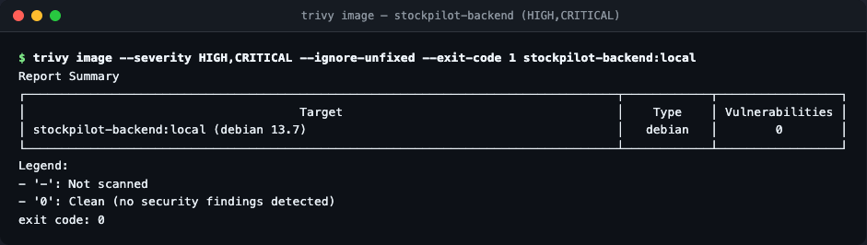

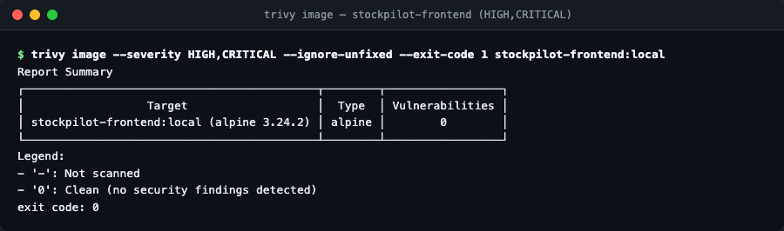
DevSecOps: Trivy findings and the fix
First scan: 4 HIGH in the backend
setuptools 70.3.0 (CVE-2025-47273 path traversal) plus urllib3 and msgpack vendored inside pip. None came from StockPilot's own requirements: all shipped with the python:3.12-slim installer tooling.
Fix: multi-stage image, no pip at runtime
Build the virtualenv in stage 1, copy only the venv into stage 2 and delete pip / setuptools. Result: 0 HIGH/CRITICAL on both images, smaller attack surface, and the CI gate (exit-code 1) stays enforceable.
Trivy scans the OS package database (Debian 13 / Alpine 3.24) and Python dist-info metadata. "Clean" means no known, fixable HIGH/CRITICAL CVE at scan time: one automated control, not a guarantee.
Notes:
This is the CVE explanation the rubric asks for. The vulnerable packages were the base image's bundled pip and setuptools, not application dependencies, and removing the installer from the runtime image was the right fix rather than suppressing the finding.

Slide 10
Infrastructure as code: AWS VPC + EKS
VPC 10.20.0.0/16 · ap-south-1 · Internet Gateway
terraform-aws-modules vpc 5.21 + eks 20.37; variables with validation, locals for tags, outputs incl. the kubeconfig command
terraform.tfvars.example committed, real tfvars and state git-ignored; optional S3 backend block
Offline test-suite (tests/plan.tftest.hcl) with a mocked AWS provider: 3 runs pass, plan of 67 resources, no credentials or cost
terraform destroy documented as a mandatory last step
Public subnet · 1a
10.20.101.0/24
NAT Gateway, ELB tags
Public subnet · 1b
10.20.102.0/24
Load balancers
Private subnet · 1a
10.20.1.0/24
EKS worker node (t3.medium)
Private subnet · 1b
10.20.2.0/24
EKS worker node (t3.medium)
67
3 / 3
EKS 1.31 control plane · managed node group 2–4 nodes · add-ons: CoreDNS, kube-proxy, VPC CNI, Pod Identity, EBS CSI (IRSA)
resources in plan
terraform tests pass
Notes:
Two public and two private subnets across two availability zones; nodes live in the private subnets behind a single NAT gateway to keep dev costs down. The terraform test suite proves the configuration plans without needing an AWS account.

Slide 11
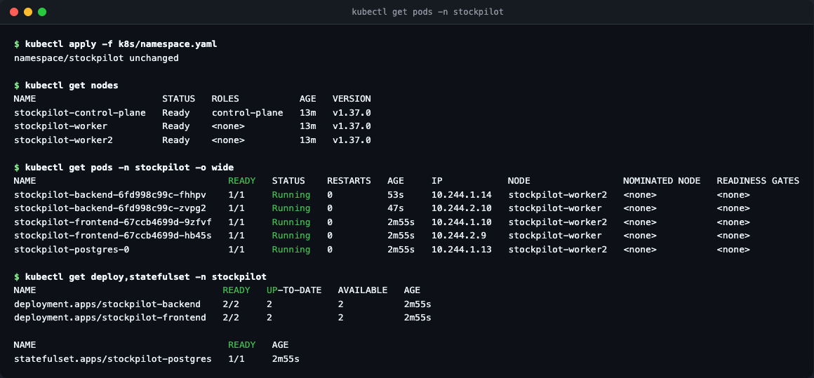
Kubernetes + Helm: one chart, 3 environments
Deployments
backend + frontend, 2 replicas each, readiness / liveness / startup probes, non-root security context
Services
ClusterIP for backend (8000) and frontend (80 → 8080); headless Service for PostgreSQL
StatefulSet + PVC
PostgreSQL 17 with a volumeClaimTemplate; postgres.enabled=false swaps in Amazon RDS
Ingress · HPA · ServiceMonitor
/api → backend, / → frontend; CPU-based autoscaling; Prometheus scraping
kind lab: backend ×2, frontend ×2, PostgreSQL StatefulSet, all Running · helm test passes
Values files
values-dev (stockpilot.local), values-kind (nip.io), values-prod (EKS, gp2, production host)
kubectl apply -f k8s/namespace.yaml · helm upgrade --install stockpilot ./helm/stockpilot -n stockpilot -f values-dev.yaml
Notes:
The chart carries standard app.kubernetes.io labels, builds DATABASE_URL from a Secret, and includes a helm test Pod that curls health, readiness and the API through both Services.

Slide 12
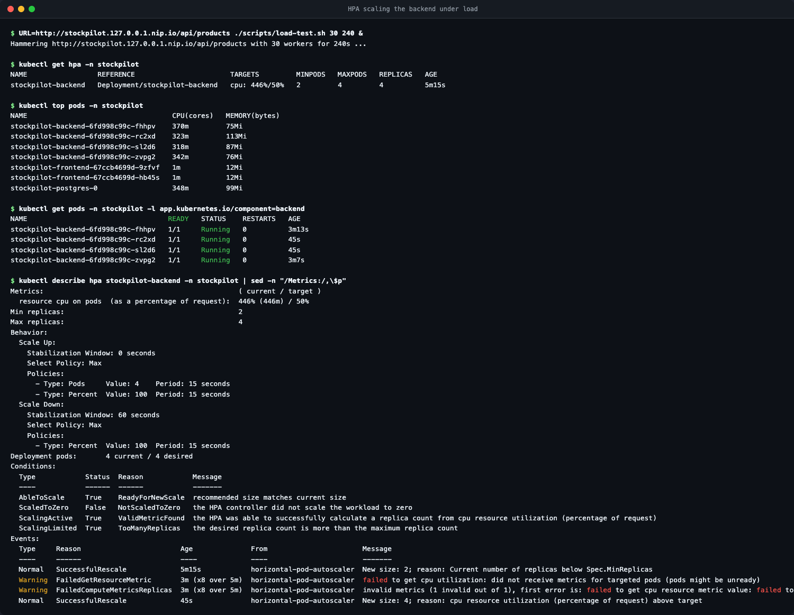


Ingress routing and autoscaling under load
Ingress (ingress-nginx)
Host stockpilot.local (or stockpilot.127.0.0.1.nip.io with no hosts entry)
/api, /docs, /openapi.json → backend Service :8000
/ → frontend Service :80
HorizontalPodAutoscaler
Targets 50–60 % CPU of the 100m request, 2–6 replicas, 60 s scale-down window.
Load test: 30 workers hitting /api/products.
CPU hit 446 % → scaled 2 → 4 in under a minute, back to 2 once load stopped.
Notes:
Demo: run the load test and watch kubectl get hpa -w. The Grafana replicas panel on the next slide shows the same 2 → 4 → 2 curve.

Slide 13
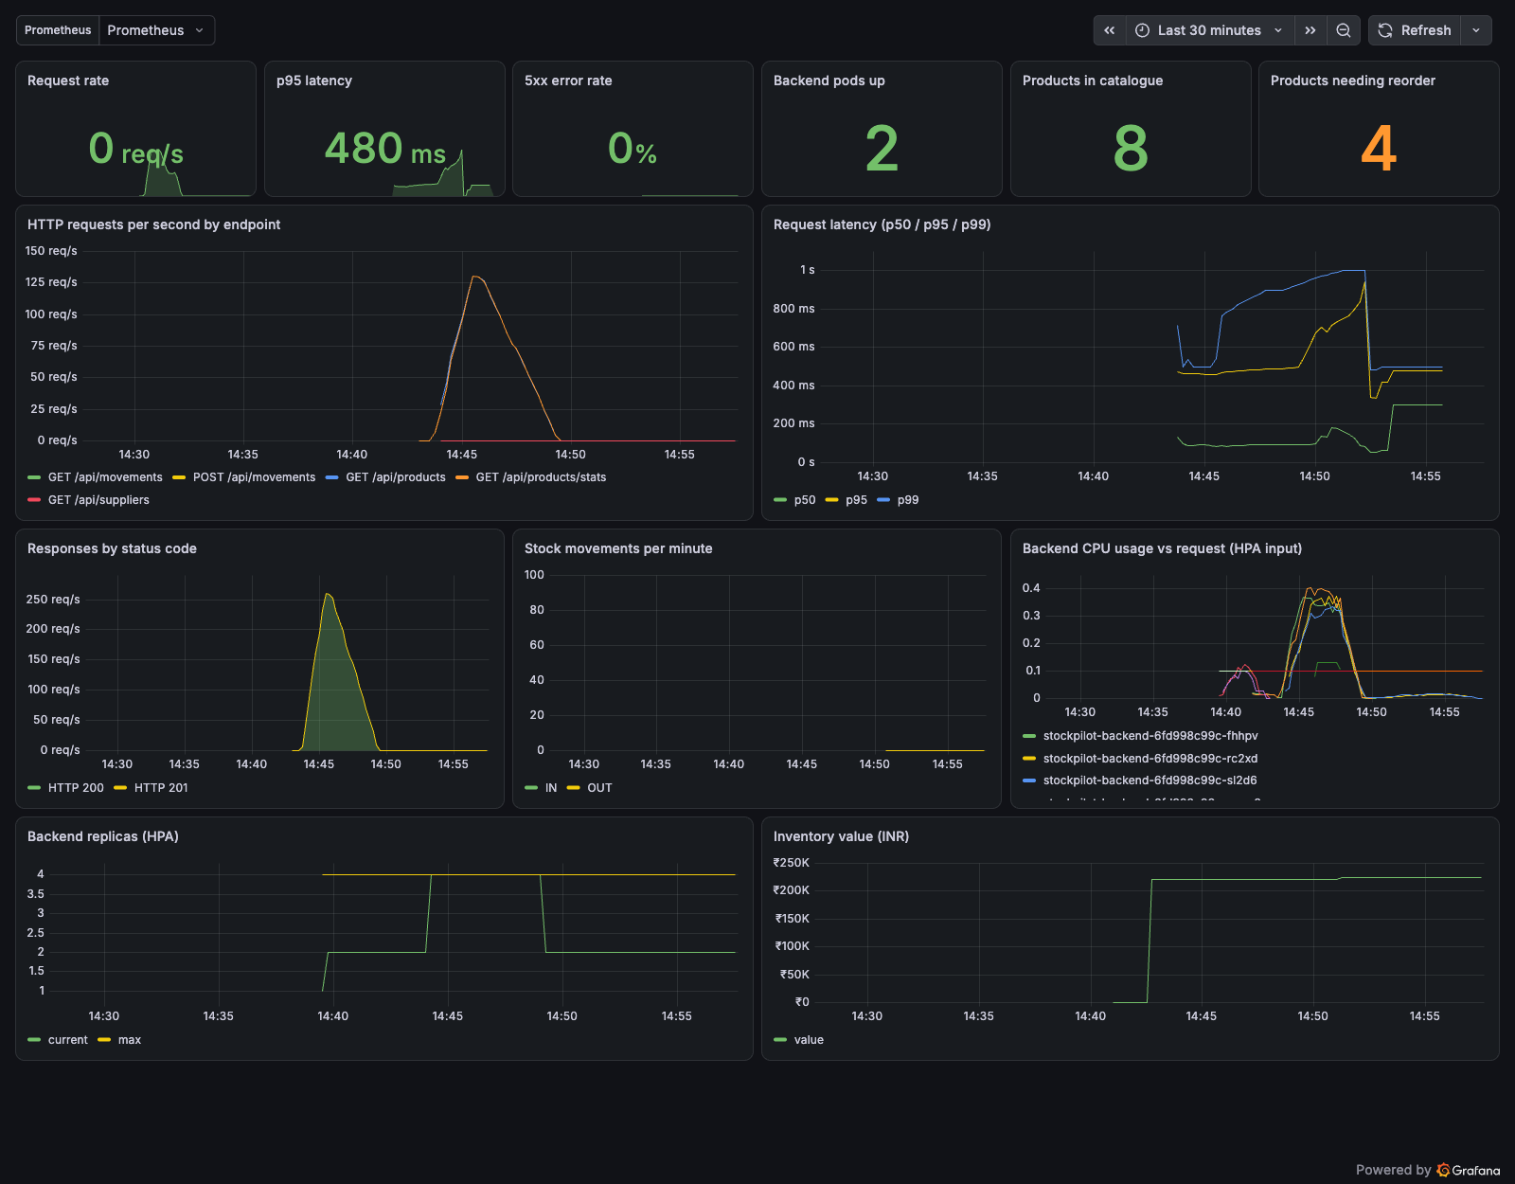
Observability: Prometheus + Grafana
kube-prometheus-stack (Operator, Prometheus, Alertmanager, Grafana) from monitoring/ values
ServiceMonitor in the chart → backend target UP in Prometheus (4/4 pods under load)
/metrics: http_requests_total, latency histograms + business gauges: products, low stock, inventory value, movements
Dashboard provisioned from a ConfigMap: request rate, p50/p95/p99, 5xx ratio, CPU vs request, HPA replicas
PrometheusRule alerts: backend down, error rate > 5 %, p95 > 500 ms, reorder backlog
Notes:
The dashboard was captured during the HPA load test: 133 requests per second peak, p95 latency rising then recovering as replicas doubled, zero 5xx. Business metrics make the dashboard about the product, not just HTTP.

Slide 14

Troubleshooting lab: break, diagnose, fix
ImagePullBackOff
Service with no endpoints
CrashLoopBackOff
Symptom: Pod never starts.
Signal: kubectl describe pod → Failed to pull image, tag does not exist.
Fix: kubectl set image to a valid tag; Pod goes Running.
Symptom: requests time out.
Signal: kubectl get endpoints → <none>; selector says component=backend-typo, Pods carry component=backend.
Fix: patch the selector; endpoints appear instantly.
Symptom: restarts climbing.
Signal: kubectl logs → could not resolve host no-such-database; migrations give up, container exits 1.
Fix: point DATABASE_URL at the stockpilot-postgres Service.
Investigation order: get pods → describe pod → logs (--previous) → get svc,endpoints → get events --sort-by=.lastTimestamp
Notes:
All three scenarios were applied to the kind cluster and fixed live; the screenshots are in the README. The key lesson of scenario two: a Service selects Pods purely by labels.

Slide 15
Demo flow and takeaways
1. Application
2. Git commit
3. CI pipeline
4. Docker image
5. Trivy scan
6. Registry
7. Terraform
8. Kubernetes
9. Helm
10. Ingress
11. Autoscaling
12. Monitoring
13. Troubleshoot
Quality gates before promotion: lint and tests stop broken code; Trivy stops vulnerable images
Immutable, traceable artefacts: image tag = commit SHA, chart values pin the exact build
Everything is code: infrastructure (Terraform), packaging (Helm), monitoring (values, dashboards, rules)
Observability and failure drills are part of delivery, not an afterthought
Thank you · Vibhuti Bhatnagar (24bcs10288) · github.com/vibhuti-scaler/stockpilot
Notes:
Close with the fifteen-step demo order from the brief, then the four takeaways. Invite questions.

