Slide 1
HADOOP ADMINISTRATION AND ANALYSIS

Slide 2
Big Data
The term “Big Data” can be defined as data that becomes so large that it cannot be processed using conventional methods.
Data which is beyond storage capacity beyond processing power.

Slide 3

Apache Hadoop
Apache Hadoop is a framework for running applications on a large cluster built of commodity hardware.

Slide 4
Why Hadoop?
The purpose of Hadoop is storing and processing large amount of data or big data.
So this project uses Hadoop framework for processing Aadhar data.

Slide 5
Specifications (Hardware & Software)
Software Requirements
Linux OS (Here CentOS distribution)
MySQL
Hadoop
Hardware Requirements
Hard Disk – 1 TB or Above
RAM required – 8 GB or Above
Processor – Core i3 or Above

Slide 6

Hadoop Administration

Slide 7
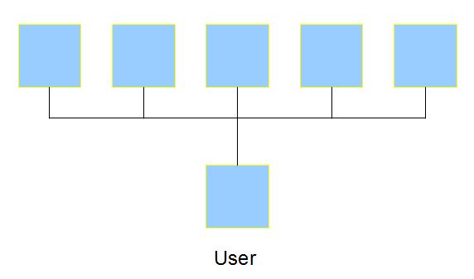
Cluster
A cluster is a set of loosely or tightly connected computers that work together so that, in many respects, they can be viewed as a single system.

Slide 8
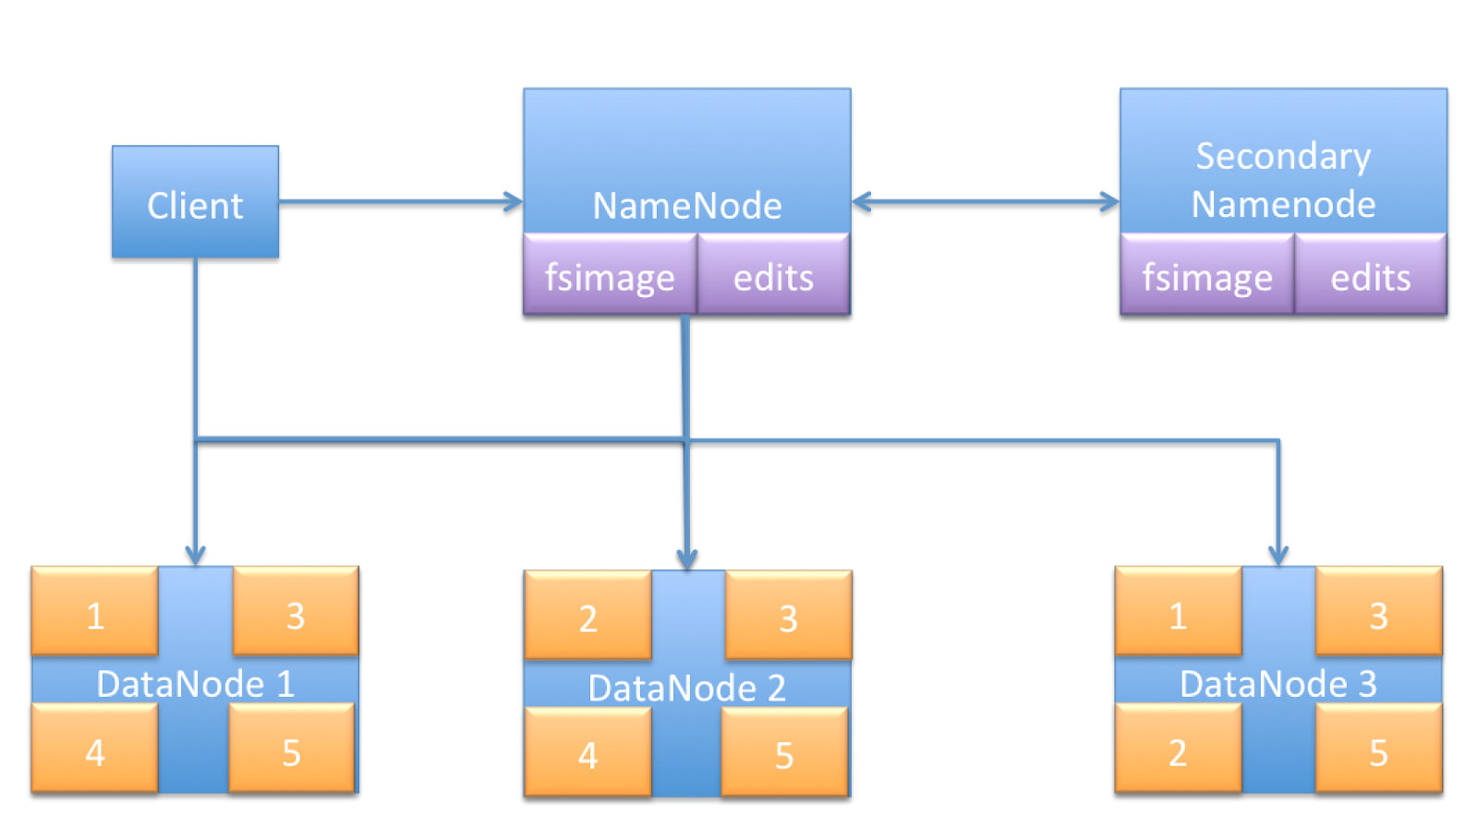
Non HA Cluster
Multi-node cluster
Combination of HDFS & YARN
HDFS – NameNode, Secondary NameNode, DataNode
YARN – ResourceManager, ApplicationMaster, NodeManager
Single point of failure

Slide 9
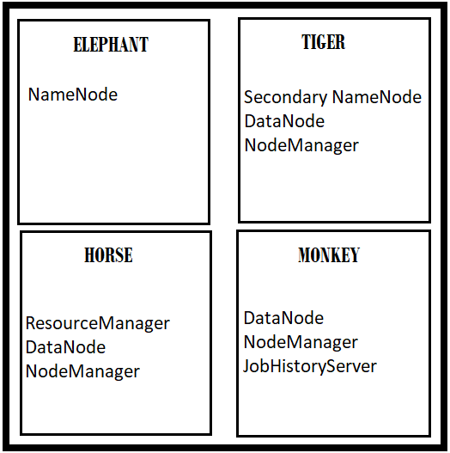
My Non HA Cluster
4 node cluster(Elephant, Tiger, Horse, Monkey)
Elephant – NameNode(Master)
Tiger – Secondary NameNode(Master), DataNode, NodeManager
Horse – ResourceManager(Master), DataNode, NodeManager
Monkey - DataNode, NodeManager, JobHistoryServer

Slide 10
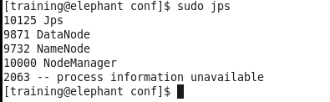
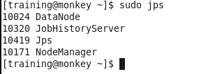
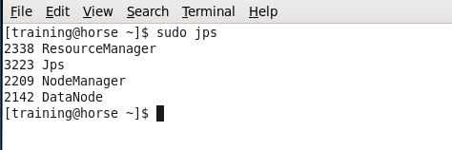
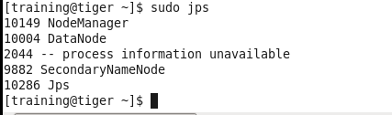
Final Daemons/Services on each Node in my Cluster

Slide 11

HDFS
Hadoop Distributed File System
NameNode – fsimage(Metadata)
Replication depends on replication factor

Slide 12

Apache Hive
SQL-based querying engine
Its own dialect of SQL called the Hive Query Language(HQL)

Slide 13
Queries to be solved
Find the names of district in each state.
How many number of enrolments of each gender were rejected?
List the names of enrolment agencies in each state.

Slide 14
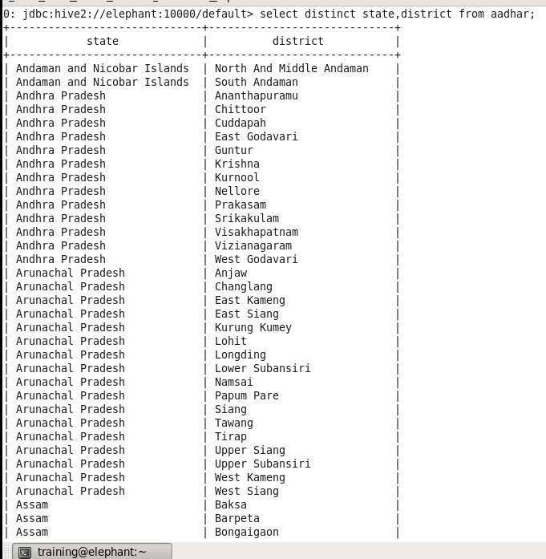
1. Find the names of district in each state.
Select distinct state, district from aadhar;

Slide 15
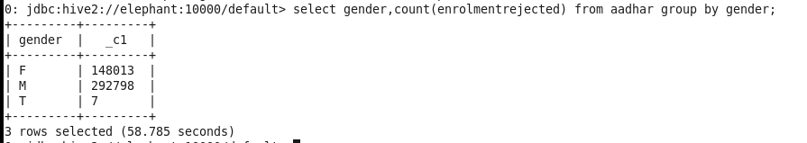
2. How many number of enrolments of each gender were rejected?
Select gender, count(enrolmentrejected) from aadhar group by gender;

Slide 16
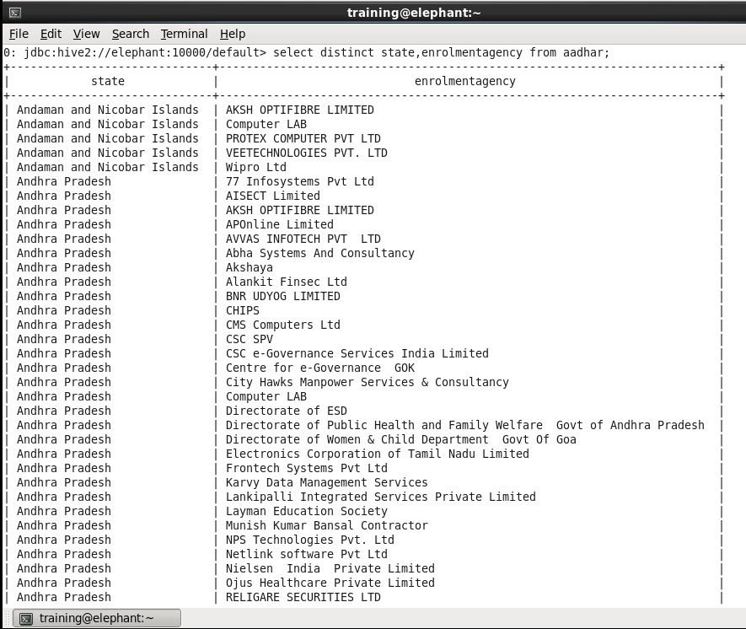
3. List the names of enrolment agencies in each state.
Select distinct state, enrolmentagency from aadhar;

Slide 17
THANK YOU…
SUBMITTED BY-
Vibhuti Maheshwari
170110048
1000009038

