Slide 1
SVM Classifier for Harvey Twitter Rescues
Homework 3 – Question 2
Gantaphon Chalumporn and Vibhuti Gupta
CS5331: Data Analytic Texas Tech University

Slide 2
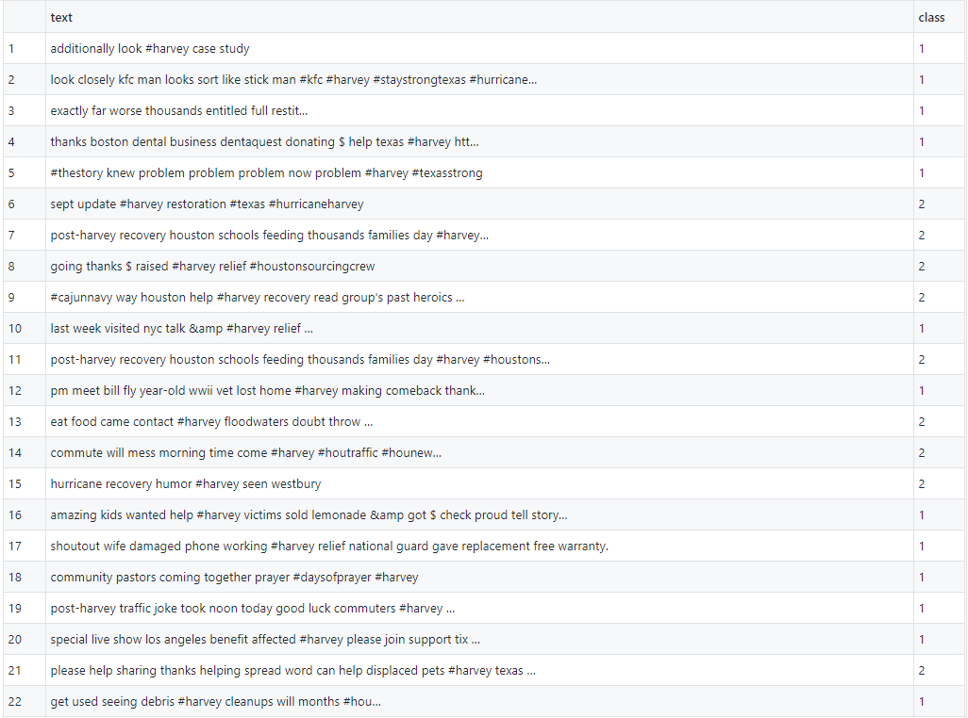
Our Dataset
150 tweets
571 Features
75 Rescue
75 Non-rescue
Notes:
We have divided our dataset in 80-20 ratio i.e. 80% training and 20% testing set. So out of 150 tweets, 120 are in training set and 30 are in testing set. Due to less training data, it might not perform well in this scenario

Slide 3
SVM performance
cost | Accuracy | Precision | Recall | F-measure
0.01 | 47 | 46.4 | 0 | 0
0.1 | 80 | 83.3 | 88 | 85.6
0.2 | 80 | 83.3 | 88 | 85.6
0.3 | 83 | 84.6 | 88 | 86.27
0.4 | 83 | 84.6 | 88 | 86.27
0.5 | 83 | 84.6 | 88 | 86.27

Slide 4
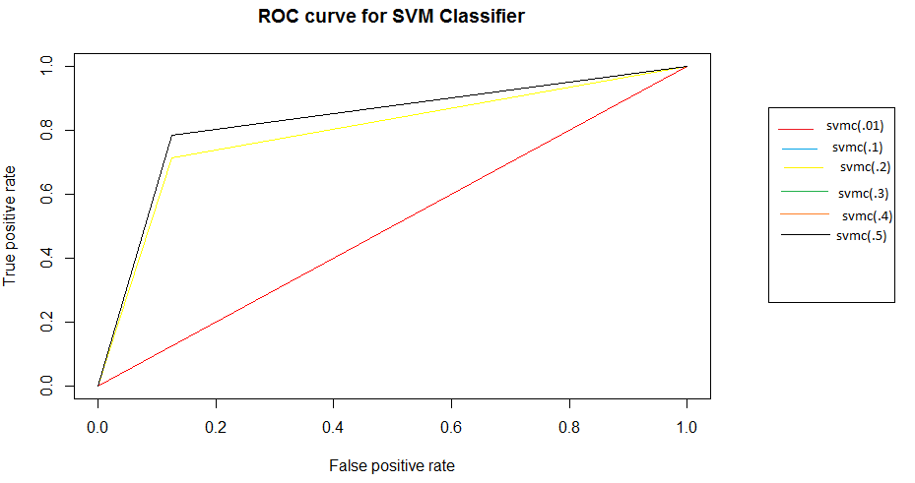
SVM – ROC Curve

Slide 5
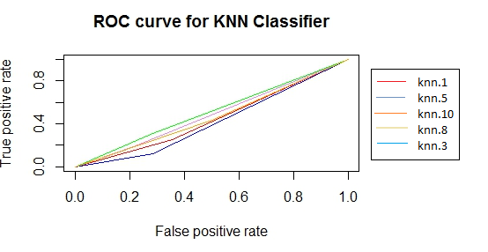
KNN and SVM
 | Accuracy | Precision | Recall | F-measure
KNN (best) | 50 | 60 | 86 | 70.6
SVM (best) | 83 | 84.6 | 88 | 86.27

Slide 6
Thank you
Code : https://github.com/vibhutittu/DataAnalyticsProject/tree/master/HW2

