Slide 1
LDA topic model on Harvey Twitter dataset
Homework 5
Gantaphon Chalumporn and Vibhuti Gupta
CS5331: Data Analytics Texas Tech University

Slide 2
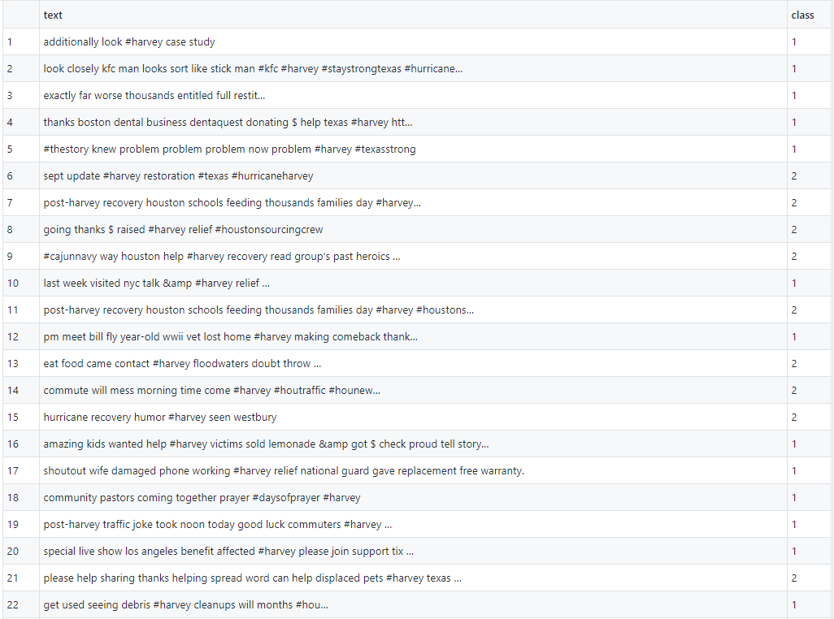
Our Dataset : Harvey Twitter
150 tweets
571 Features
75 Rescue
75 Non-rescue
Clean stop words
Bag of words
Notes:
We have divided our dataset in 80-20 ratio i.e. 80% training and 20% testing set. So out of 150 tweets, 120 are in training set and 30 are in testing set. Due to less training data, it might not perform well in this scenario

Slide 3
Finding Optimal Number of Topics
Harmonic mean method
Initially k from 2 to 100 is chosen randomly.
LDA topic modelling is run for all k.
Log likelihood values are computed for the model.
Harmonic means of models are computed for 2-100 topics.
Plot harmonic means with the number of topics.
Number of topics with highest harmonic mean is the optimal number of topics (i.e. k=17 in our case)

Slide 4
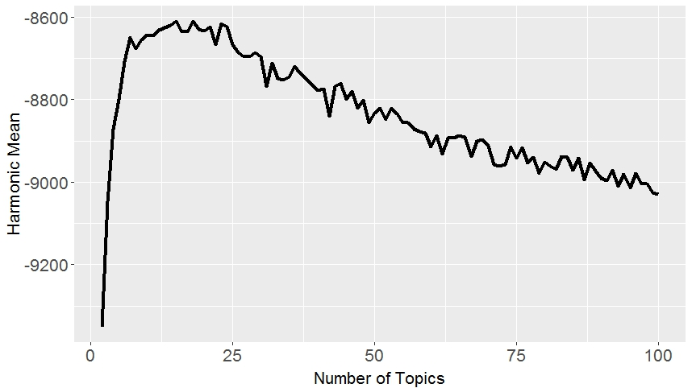
Number of Topics

Slide 5
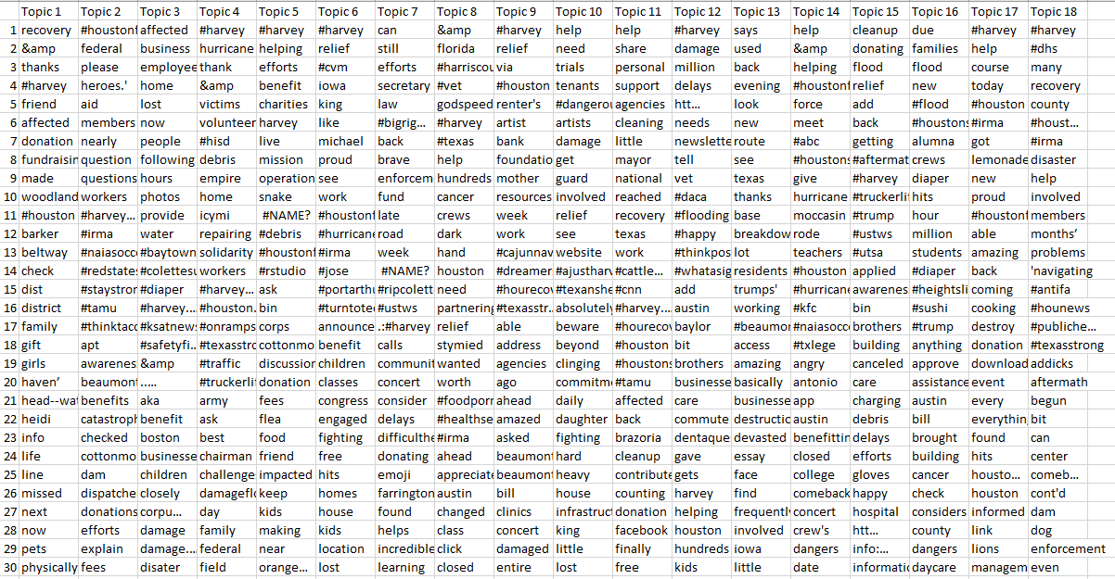
Result - Topics

Slide 6

Result Visualization

Slide 7
Thank you
Code : https://github.com/vibhutittu/DataAnalyticsProject/tree/master/HW5

