Slide 1

BAN 675 - Text Mining Project :
Sentiment Analysis on Amazon Fine Food Reviews
Presented by -
Group 5 : Team Members
Student ID | First Name | Last Name | Email
PD7644 | Apoorva | Nerkar | anerkar@horizon.csueastbay.edu
WS2865 | Mansi Mrugen | Shah | mshah41@horizon.csueastbay.edu
MA7835 | Rohit | Nagpal | rnagpal@horizon.csueastbay.edu
EG7732 | Shruti | Bhalotiya | sbhalotiya@horizon.csueastbay.edu
TI6557 | Vibhuti | Vadje | vvadje@horizon.csueastbay.edu

Slide 2
AGENDA
Project Background
Data Description
Summary Statistics
Research Questions
Importance of reviews and reviews analysis
Methodologies Required
Analysis result report and explanation

Slide 3

PROJECT BACKGROUND

Slide 4
Project Background
Current Situation
Based on product reviews
Objective
Project Plan
Use different algorithms to analyze user sentiments
Benefits
Quick Summary of Product reviews
Perform text mining on product review data to gather useful information for Product owners
Extract key messages from the reviews
User-friendly visualizations of KPIs using Word Cloud and other charts

Slide 5

RESEARCH QUESTIONS

Slide 6
Research Questions
Sentiment Analysis
- To study whether product review is becoming better or worse during the life cycle of the products
Visualization
- Dwell into specifics about the overall sentiment of the product and determine what customer likes or dislikes
- Sales Vs Count of reviews Trend

Slide 7

IMPORTANCE OF REVIEW ANALYSIS

Slide 8
Importance of reviews and review analysis
How reviews help customers and vendors :-
How review analysis helps vendors :-
Helps customers to decide the product/service
Shows whether vendor/seller is credible or not
Helps consumers feel more connected to the product/service
Evaluate product’s performance over the period of time
Understand customers concerns and needs
Impact on Sales and Purchase

Slide 9

DATA DESCRIPTION

Slide 10
Data Description (1/2)
DATA STATISTICS
Number of Reviews | 568,454
Number of Users | 256,059
Number of Products | 74,258
User with > 50 reviews | 260
Median no. of words per review | 56
Time span | Oct 1990 – Oct 2012
Obtained dataset from Kaggle
Dataset consists of reviews of fine foods from amazon
Key attributes used:
Product ID
Score
Time (in Unix seconds)
Text (Review of product)

Slide 11
Data Description – ETL (2/2)
Data Extraction
Data Pre processing
Data Cleaning
Exploratory Data Analysis
Sentiment Analysis (Vedar, Text Blob, Tf-Idf)
Accuracy
Word Cloud
Line Graph

Slide 12

SUMMARY

Slide 13
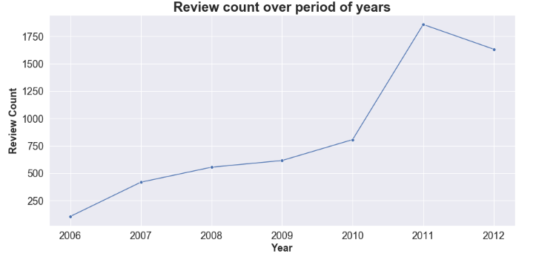
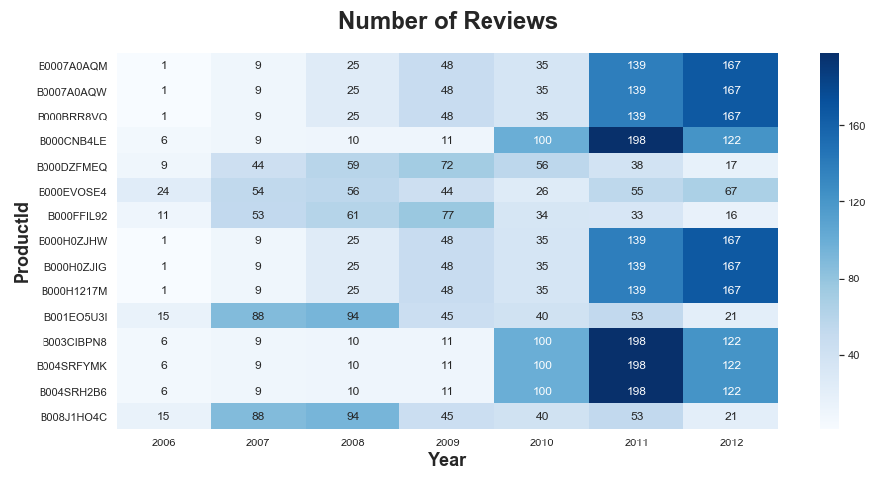
Summary (Exploratory Data Analysis) 1/3
Insights & Results:
********
********
********

Slide 14
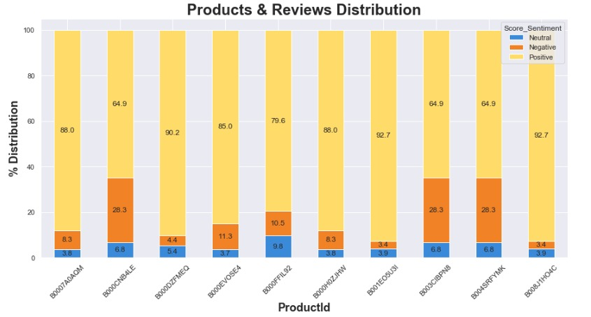
Summary (Exploratory Data Analysis) (2/3)
Insights & Results:
********
********
********

Slide 15
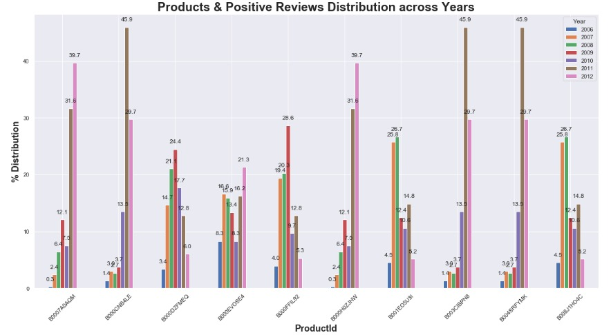
Summary (Exploratory Data Analysis) (3/)
Insights & Results:
********
********
********

Slide 16

METHODOLOGIES REQUIRED

Slide 17
Methodologies Required
Text Blob
Lexicon
Vedar

Slide 18
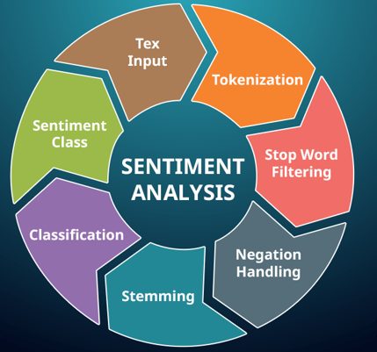
ANALYSIS RESULT

Slide 19
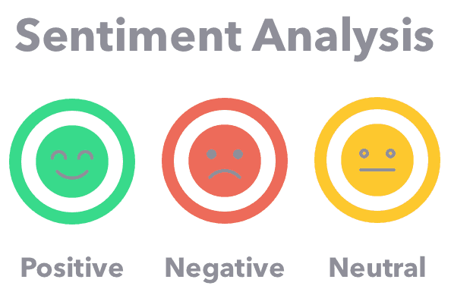
ANALYSIS RESULT

Slide 20
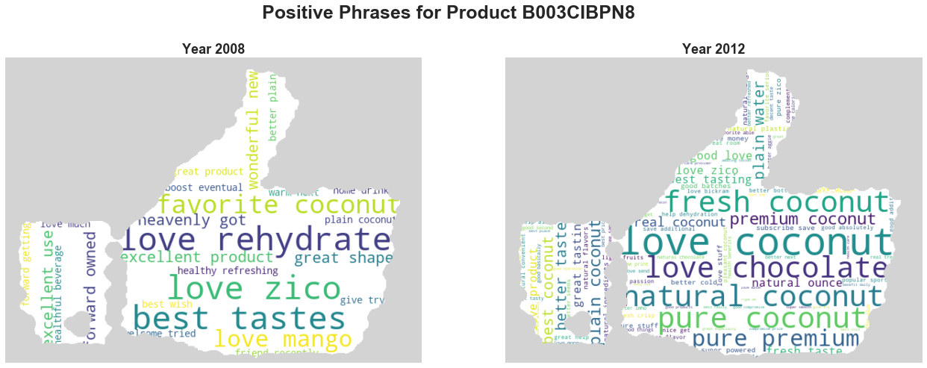
Analysis Result (1/3)

Slide 21
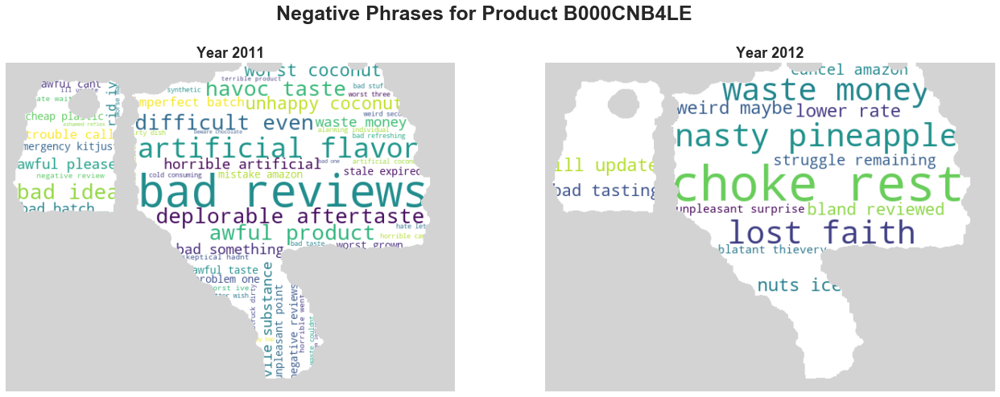
Analysis Result (2/3)

Slide 22
Analysis Result (3/3)

Slide 23
REFERENCE

Slide 24

QUESTIONS???

Slide 25
THANK YOU!

Slide 26


