Slide 1
MDF-DTA: A Multi-Dimensional Fusion Approach for Drug-Target Binding Affinity Prediction

Slide 2
Abstract
Drug-target affinity=DTA, Multi-Dimensional Fusion=MDF
In computational dta predition ,most of these prediction models focus on single feature encoding of drugs and targets, ignoring the importance of integrating different dimensions of these features.We propose a deeplearning-based approach called Multi-Dimensional Fusion for Drug Target Affinity Prediction(MDF-DTA) incorporating different dimensional features.
Ourmodel fuses1D, 2D, and3Drepresentationsobtained fromdifferentpretrainedmodelsforbothdrugsandtargets.WeevaluatedMDF-DTAontwostandardbenchmarkdatasets:DAVIS andKIBA.

Slide 3
Through Ablation studies and performance evaluation metrics,we evaluate the importance of individual representations and the impact of each representation on MDF-DTA
In the context of machine learning, ablation refers to a controlled experiment where parts of a model are removed or altered to study their individual impact on performance.

Slide 4
Introduction
There are two main ways computers help in predicting drug-target interactions: docking and other computational models.(LBDD ,SBDD)
But docking(SBDD) has downsides. Like Docking takes a lot of time and resourcesn, Docking fails if protein structure is unknown, ven if we spend an enormous amount of time using similarity models to predict the molecular structure of the protein, we might not have accurate structural data.
Machine learning is a good alternative to docking. This approach includes different models, which can be classified into two types: statistical machine-learning models and deep-learning models, which predict DTA by investigating the representations of drug molecules and target proteins.

Slide 5
Statistical machine learning-based computational approaches serve as a basis for predicting drug-target interaction
These models often predict only yes/no of binding.
Recently, there has been a trend toward predicting continuous binding affinity values using regression.
By applying different feature selection and extraction algorithms, these developments improve prediction accuracy.
The idea is to feed these extracted features into conventional statistical machine learning models to improve the prediction accuracy of the affinity score between drugs and target proteins.
To predict the binding affinities of drug-target pairings, two well-known statistical machine-learning algorithms that achieved remarkable performance are KronRLS and SimBoost.
KronRLS and SimBoost are popular ML models for DTA.
Kronecker Regularized Least Squares technique, KronRLS leverages knowledge of drug chemical structure and similarity score of target sequences

Slide 6
KronRLS can't model complex relationships well.(because it follows a linear approach to find affinity)
SimBoost, on the other hand, adopts a different strategy by taking into account network-based interaction aspects as well as similarities between drugs and targets.
SimBoost uses gradient boosting.
Our MDF-DTA approach attempts to address the aforementioned challenges of computational efficiency, cost-effectiveness, and improved prediction accuracy in DTA prediction.
These approaches use protein and drug sequences to extract highly informative features.
One such deep learning-based method, DeepDTA, uses a Convolutional Neural Network (CNN) based architecture to extract features from protein sequences and SMILES sequences.
To encode proteins and drugs, this method makes use of Smith-Waterman and CNN-based features.
DeepDTA has been trained on a relatively small collection of labeled sequence data, which can limit its performance despite its strengths in autonomous feature extraction.
WideDTA and Attention-based models improve accuracy but increase model complexity.
Few studies also used variational autoencoders (VAE) to extract molecular sequence features from SMILES and protein sequences, adding interaction paths among sequence pairs and establishing correlations between molecular substructures to predict affinity scores.
Transformers like MT-DTI and FusionDTA help reduce dependency on labeled data and generate better representations.(motivated by their good performance in NLP)

Slide 7
Pure transformer models miss structural info, so hybrids (like diffusion + graph methods) are introduced for richer feature capture.
To enhance the extraction of features, particularly in terms of topological information, researchers have introduced graph neural network (GNN) based methods.
These methods take advantage of the spatial, sequential, and structural properties of both drugs and proteins.
GraphDTA uses GNNs with multiple layers; it learns well but needs extra tools and is complex
Past work used 1–2 types of features; authors argue combining 1D/2D/3D gives a more complete picture.

Slide 8
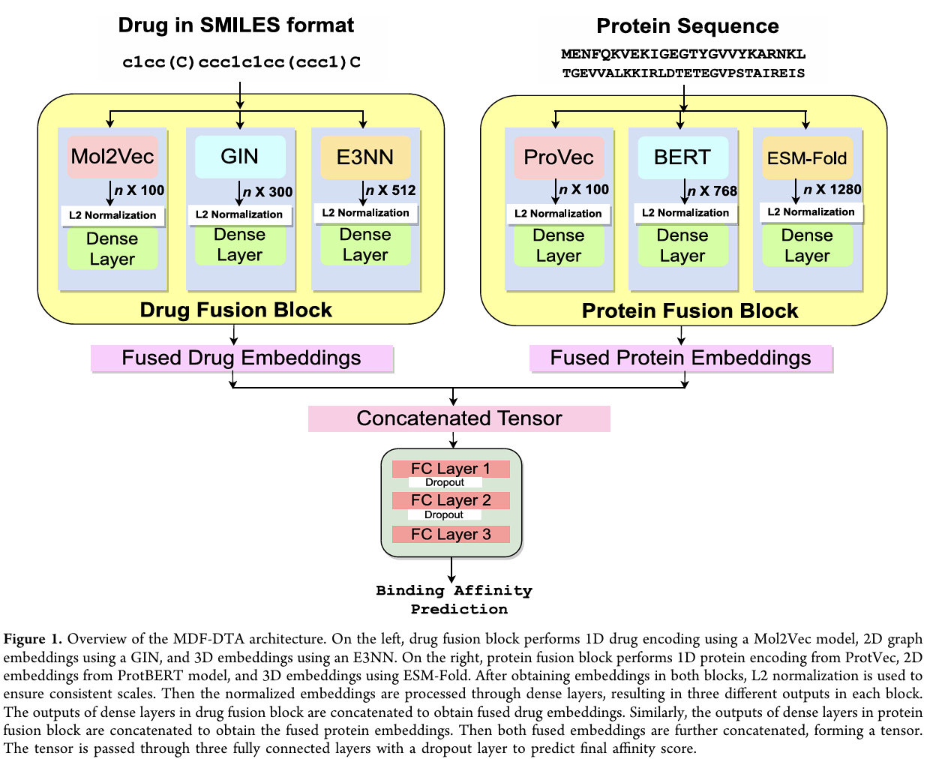
MDF-DTA incorporates multidimensional embeddings (i.e., 1D, 2D, and 3D) of drugs and proteins, including sequence, graph, and structure features.
The use of transfer learning leverages pretrained modelsfor feature generation for drugs and proteins.
The process that we refer to as
“fusion” is implemented using
two blocks to combine
embeddings generated from
pretrained models,
followed by L2 normalization
and then passing them through
a dense layer.

Slide 9
Strong results on prediction tasks
Protein features come from:
1D ProtVec (CNN on protein sequences)
2D ProtBERT (transformer model)
3D ESM-Fold (transformer-based 3D structure encoder)
Summary
A new multi-dimensional fusion model
Strong results on prediction tasks
Careful analysis of model parts
Use of modern pretrained models across 1D, 2D, 3D levels

Slide 10
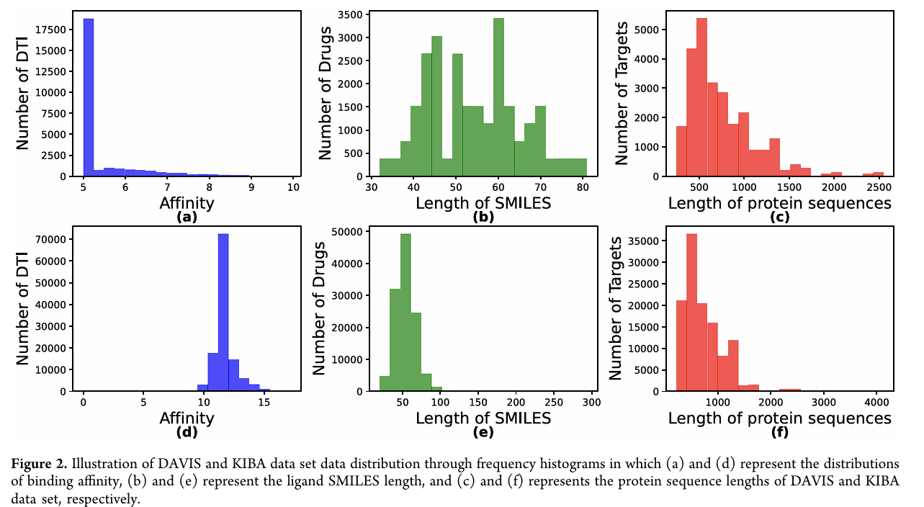
Davis and Kiba data sets

Slide 11
MATERIALS AND METHODOLOGY
DAVIS contains ~30k drug-target pairs. Binding strength is measured using Kd, then transformed
using pKd = -log10(Kd/1e9)
pKd scores lie between 5–10. Most proteins are ~500 amino acids long. Most interactions are weak
(pKd ~5).
KIBA is much larger than DAVIS. It combines Ki, Kd, and IC50 values into a single KIBA score, which reflects
binding strength.

Slide 12
MDF-DTA Architecture. Drug Fusion Block
Drugs are encoded in 3 formats:
1D: Mol2Vec on SMILES → 100-length vector
2D: GIN on graph → 300-length vector
3D: EGNN on 3D atom positions → 512-length vector
L2 normalization is applied to each embedding to scale them equally.
Each normalized vector is passed through a fully connected (dense) layer with 1024 neurons and ReLU activation.
Finally, the outputs from the three dense layers are concatenated to form one fused drug embedding vector.

Slide 13
MDF-DTA Architecture. Protien Fusion Block
Proteins are also encoded in 3 formats:
1D: ProtVec → 100
2D: ProtBERT → 768
3D: ESM-Fold → 1280
The fused drug and protein embeddings are concatenated into a single tensor.
This tensor is passed through three fully connected layers with 1024, 1024, and 512 neurons.
Dropout (rate 0.3) is used to prevent overfitting.
The final output is a single neuron with linear activation to predict the binding affinity.

Slide 14
Drug Embedding
SMILES → Mol2Vec (1D Drug Embedding):
The Mol2Vec model is based on Word2Vec (from NLP).
It treats molecular substructures in SMILES as words in a sentence.
It learns embeddings by predicting context substructures, just like Word2Vec does with word
Mol2Vec focuses on local sequence context and outputs a single vector summarizing the entire molecule.

Slide 15
SMILES → GIN (2D Drug Embedding):
GIN (Graph Isomorphism Network) is a type of Graph Neural Network (GNN).
It represents molecules as graphs: atoms = nodes, bonds = edges.
GIN is trained to reconstruct molecular graphs and learn their structure.
SMILES → EGNN (3D Drug Embedding):
EGNN (Equivariant GNN) extends GNNs to 3D space.
It includes 3D spatial coordinates (x, y, z) of atoms along with graph structure.
It’s trained to be invariant to rotations, translations — essential for chemistry.

Slide 16
Protien Embedding
ProtVec (1D Protein Embedding):
ProtVec is based on Word2Vec, similar to Mol2Vec.
It splits protein sequences into overlapping 3-grams of amino acids (like words).
Each 3-gram is embedded, and the entire sequence is represented as the average of these embeddings.
ProtBERT (2D Protein Embedding):
ProtBERT is a transformer-based model trained on millions of protein sequences.
Even though it takes 1D input, the attention layers capture 2D contact-like information between amino acids.
The output is a 768-length vector encoding rich relationships within the sequence.

Slide 17
ESM-Fold (3D Protein Embedding):
ESM-Fold is a transformer model pretrained to predict 3D protein structures from sequences.
It outputs a 1280-length vector embedding that reflects the full 3D structure of a protein.
This embedding is generated from the final hidden layers of the model

Slide 18
Training Setup
The MDF-DTA model is implemented using the Keras framework.
Data is split into training (80%) and test (20%) using scikit-learn, with consistent splits across models.
Adam optimizer is used with a learning rate of 0.0001.
Mean Squared Error (MSE) is used as the loss function (for regression).
Training runs up to 500 epochs with early stopping to prevent overfitting.
Batch size is 64.
5-fold cross-validation is used on the training set to tune hyperparameters.
Dropout rate of 0.3 is applied in all dense layers to reduce overfitting.(Dropout prevents the model from memorizing patterns (adds regularization).)

Slide 19
Evaluation metrics
They evaluate MDF-DTA using 4 metrics: MSE, CI, rm², and AUPR.
MSE (Mean Squared Error): measures average squared error — lower is better.
CI (Concordance Index): measures how well the model ranks pairs — higher is better (range: 0–1).
rm²: a modified squared correlation score — higher means better fit.
AUPR (Area Under Precision-Recall Curve): used for binary classification evaluation.

Slide 20
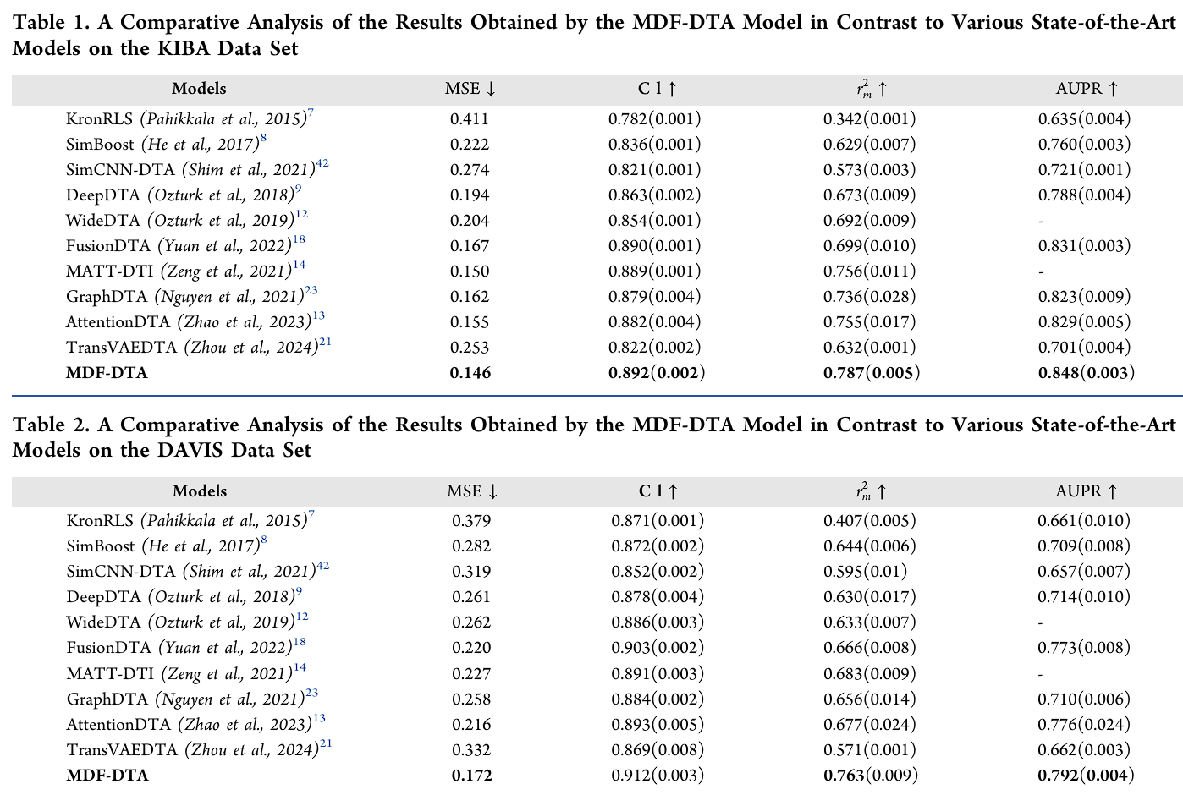

Slide 21
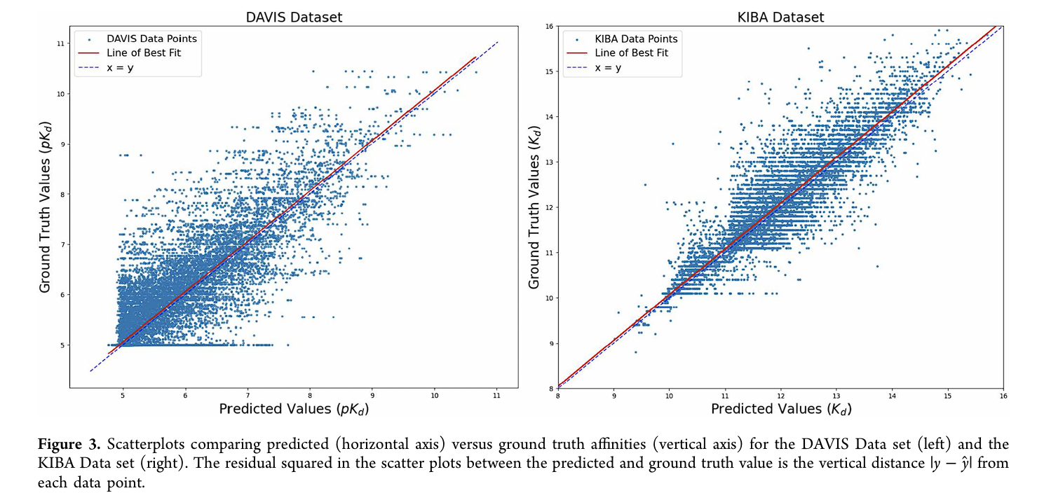
Scatterplots
Predicted vs. ground truth values are plotted for DAVIS and KIBA.
Data points cluster close to the diagonal line — indicating high prediction accuracy.
KIBA has a slightly
wider spread,
but performance
remains strong.

Slide 22
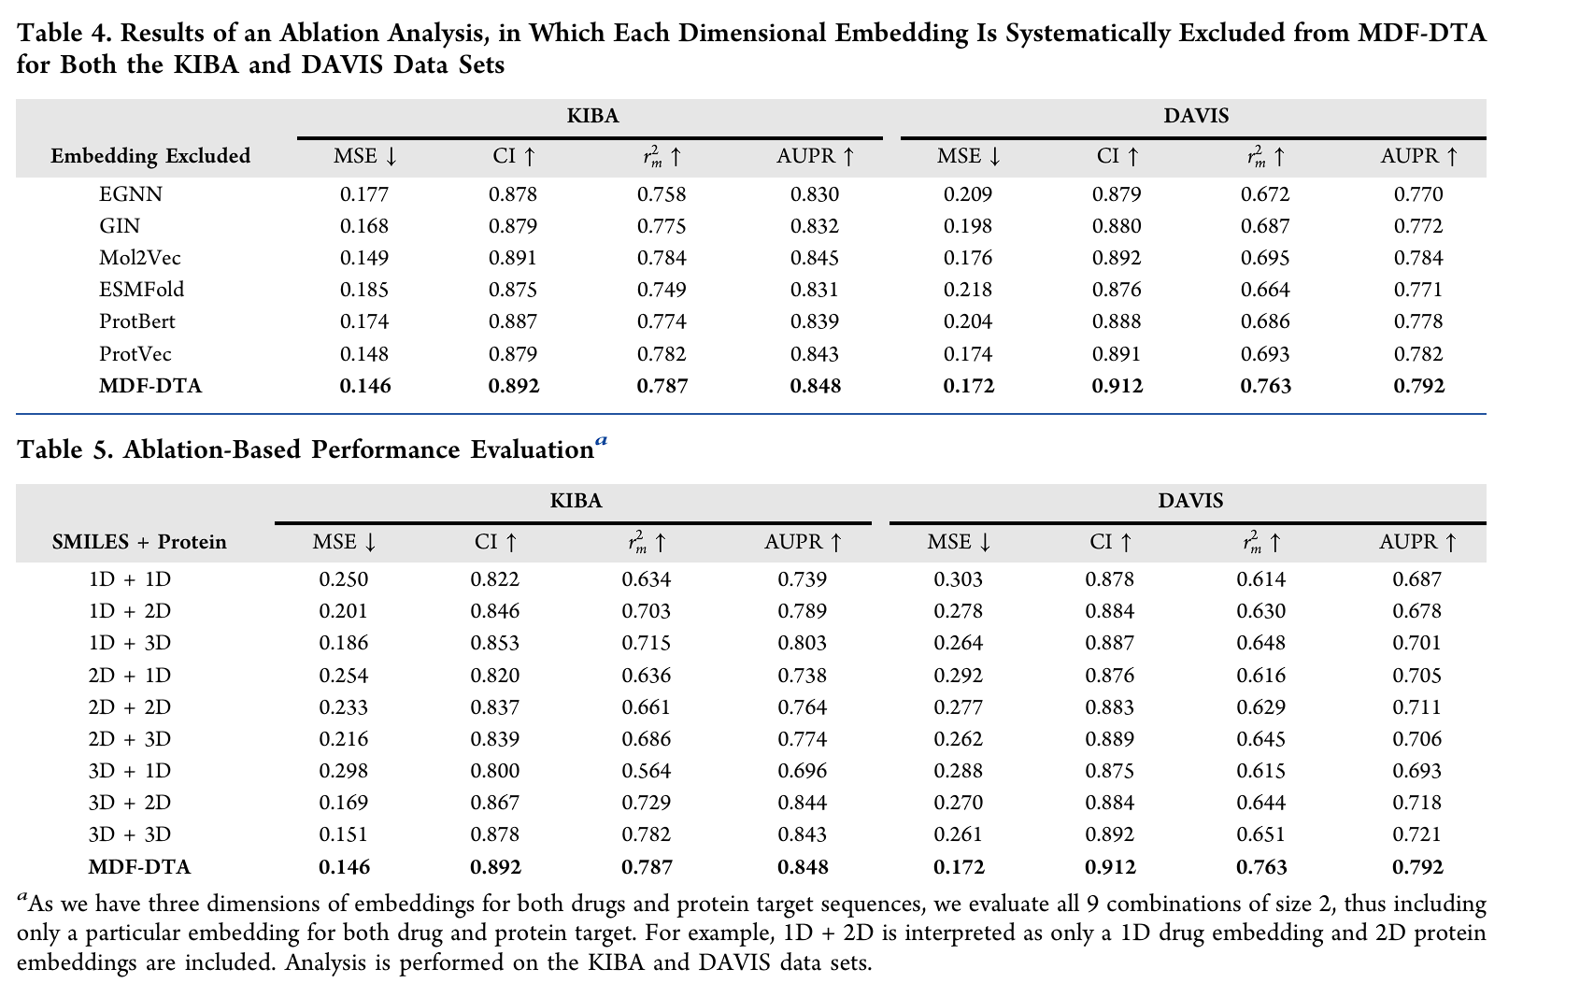
Ablation Studies.

Slide 23
Conclusion
in this paper, we proposed MDF-DTA, a multi-dimensional fusion framework for drug-target binding affinity prediction.
Our model incorporates 1D, 2D, and 3D embeddings of both drugs and proteins, generated using various pretrained models.
By combining these dimensions, MDF-DTA provides a rich, integrated representation for predicting affinity.
We evaluated MDF-DTA on two standard datasets, DAVIS and KIBA, and compared it to several state-of-the-art models.
The results show that MDF-DTA consistently outperforms all baselines across all evaluation metrics.

Slide 24
Ablation studies further validated that each embedding type—1D, 2D, and 3D—contributes uniquely to prediction quality.
The fusion of all three provides the most effective representation.
In future work, we aim to extend MDF-DTA to other drug discovery tasks such as drug repurposing and side effect prediction.
We also plan to improve the fusion mechanism using attention-based feature weighting.

