Slide 1
DATA ANALYTICS PROJECT DOCUMENTATION
Customer Shopping
Behavior Analysis
Turning 3,900 transaction records into product, pricing, and marketing insight
PYTHON
POSTGRESQL
POWER BI
Prepared for internal review • 2026

Slide 2
WHAT THIS DECK COVERS
Agenda
01
Project Overview
04
SQL Business Analysis
Goal, scope, and technology stack
10 questions answered in PostgreSQL
02
Data Summary
05
Power BI Dashboard
Shape and structure of the dataset
Interactive visual reporting layer
03
Python EDA & Cleaning
06
Recommendations
Loading, exploring, and preparing the data
What the business should do next
2

Slide 3
SECTION 01
Project Overview
GOAL
TECHNOLOGY STACK
Understand purchasing patterns, customer demographics, and behavior drivers — discounts, subscriptions, shipping preferences, and purchase frequency — to support decisions on marketing, retention, and inventory.
1
Python
Data cleaning & EDA
↓
2
PostgreSQL
Storage & querying
PROJECT TITLE
↓
Customer Shopping Behavior Analysis
3
Power BI
Dashboarding & visualization
3

Slide 4
SECTION 02
Data Summary
3,900 customer transaction records across 18 columns — demographics, purchase details, and shopping behavior.
3,900
18
$59.76
Transaction Records
Data Columns
Avg. Purchase Amount
3.75 / 5
27%
~1%
Avg. Review Rating
Customers Subscribed
Missing Values (Review Rating)
4

Slide 5
SECTION 03
Python: Exploratory Data Analysis Workflow
1
2
3
4
5
Load
→
Explore
→
Clean
→
Standardize
→
Engineer
Import the CSV with pandas
df.info() and df.describe()
Fill 37 missing ratings using category median
Rename columns to snake_case
Add age_group & purchase_frequency_days
Also verified discount_applied and promo_code_used carried the same signal — promo_code_used was dropped to reduce redundancy — then the cleaned data was loaded into PostgreSQL for SQL analysis.
5

Slide 6
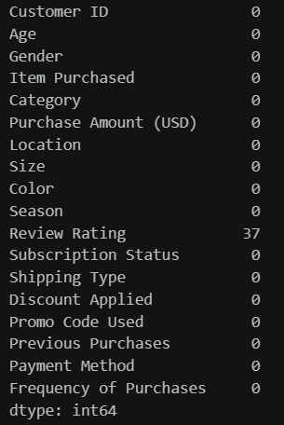
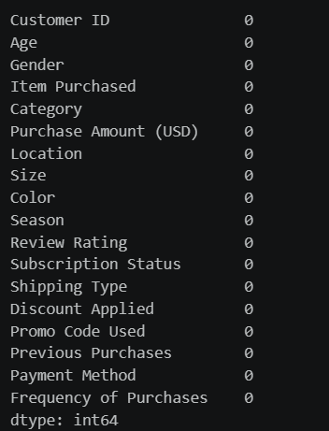
SECTION 03 · DATA CLEANING
Missing Data Handling
Review Rating had 37 missing values (~1% of records). Each was filled using the median rating of the product's category — preserving category-level rating patterns instead of a single global average.
BEFORE
AFTER
6

Slide 7
SECTION 03 · DATA PREPARATION
Feature Engineering & Consistency Checks
✓
age_group
New column created by binning customer ages into readable groups (e.g. Young Adult, Middle-aged, Senior).
✓
purchase_frequency_days
Derived from purchase date to quantify how often a customer buys.
✓
snake_case columns
All column names standardized for readability and downstream SQL/BI compatibility.
✓
Redundancy check
discount_applied and promo_code_used were found to carry the same signal — promo_code_used was dropped.
7

Slide 8
SECTION 04
SQL: 10 Business Questions Answered
Structured analysis performed directly in PostgreSQL
Revenue by Gender
Discount-Dependent Products
1
6
High-Spending Discount Users
Customer Segmentation
2
7
Top 5 Products by Rating
Top 3 Products per Category
3
8
Shipping Type Comparison
Repeat Buyers & Subscriptions
4
9
Subscribers vs. Non-Subscribers
Revenue by Age Group
5
10
8

Slide 9
SECTION 04 · KEY FINDINGS
What the Data Told Us
Revenue skews male
Express barely outsells Standard
Male customers generated $157,890 in revenue vs. $75,191 from female customers.
Avg. order value: $60.48 (Express) vs. $58.46 (Standard) — a marginal shipping-tier gap.
Non-subscribers drive more revenue
Most customers are “Loyal”
Non-subscribers total $170,436 vs. $62,645 from subscribers, despite similar avg. order size (~$59).
3,116 of 3,900 customers fall into the Loyal segment; only 83 are New and 701 Returning.
9

Slide 10
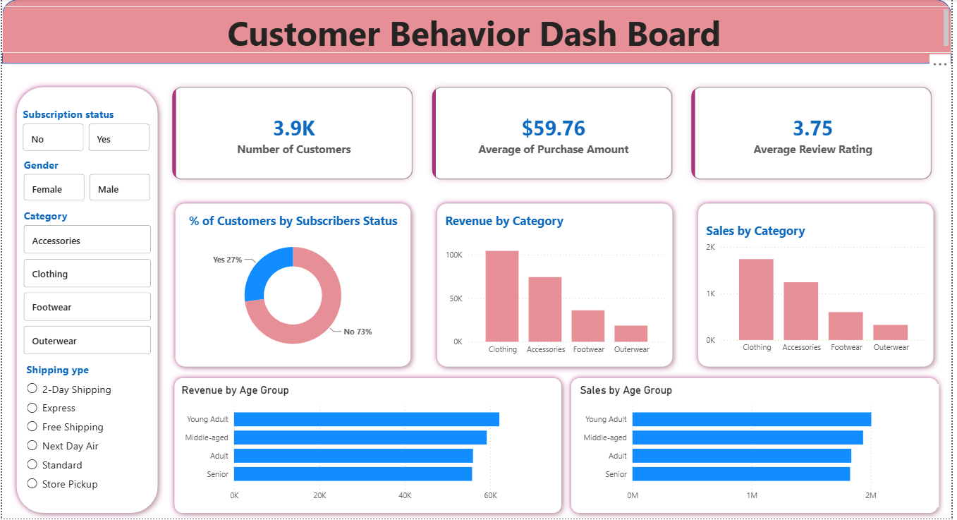
SECTION 05
Interactive Dashboard in Power BI
All findings were consolidated into a single interactive dashboard with slicers for subscription status, gender, category, and shipping type.
10

Slide 11
SECTION 06
Business Recommendations
1
Encourage More Subscriptions
Highlight special perks to attract more customers into the subscription program.
2
Reward Loyal Customers
Introduce a loyalty program that motivates repeat buyers to become long-term, loyal customers.
3
Reassess Discount Strategy
Fine-tune discount offers to drive sales without cutting too deep into profit margins.
4
Strengthen Product Marketing
Feature high-rated and top-selling items more prominently in promotional campaigns.
5
Focus Marketing Efforts
Direct marketing resources toward age groups that generate the most revenue and customers who prefer express shipping.
11

Slide 12
Thank You
Customer Shopping Behavior Analysis — Python · PostgreSQL · Power BI
Questions & discussion welcome.

