Slide 1



Teaching a language model to chat like you
Taught by Imad Saddik

Slide 2

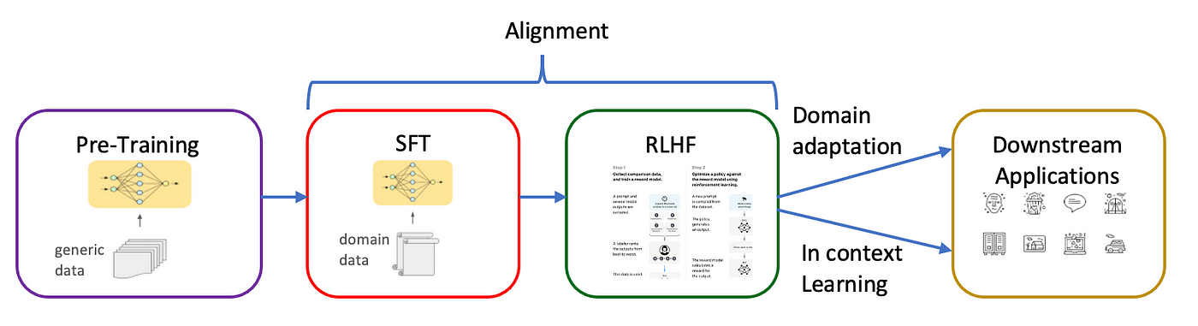
Why ?
See if we can mathematically simulate how a person talks.
Bring someone who died back to life? In the form of a language model.
Learn the full pipeline: data extraction, processing, and model training.
LLMs struggle with Moroccan Darija.
Medium article

Slide 3

How ?
Data extraction
Group chats.
Personal conversations.

Slide 4

How ?
Data extraction
Combine the extracted text
Sequence of text
Raw data

Slide 5



How ?
Data extraction
Combine the extracted text
BPE algorithm & text encoding
Wikipedia article
Hugging Face course
Andrej Karpathy’s video

Slide 6
How ?
Data extraction
Combine the extracted text
BPE algorithm
Text encoding
IDs
The
he
labas
Imad = 1
1
Mod = 2
I’
Imad
Fore = 3
Encode the
text
ello
mod
large
2
large = 4
model
...
fore
si
Vocabulary

Slide 7
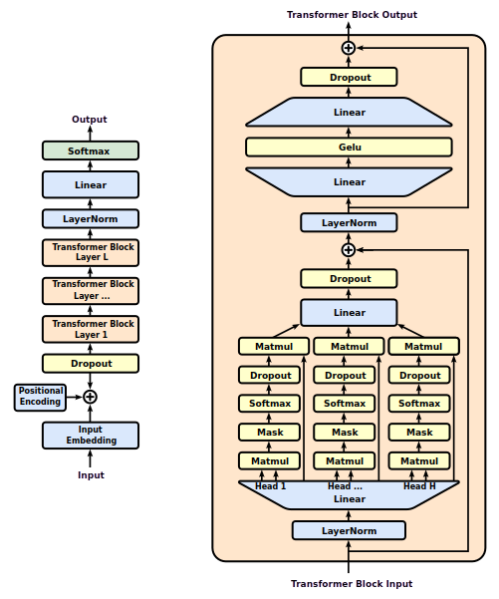
How ?
Data extraction
Combine the extracted text
BPE algorithm
Text encoding
Create the model
StatQuest video

Slide 8
How ?
Data extraction
Combine the extracted text
BPE algorithm
Text encoding
Create the model
Data splitting & model training

Slide 9
How ?
Data extraction
Combine the extracted text
BPE algorithm
Text encoding
Create the model
Data splitting & model training
Prepare the fine-tuning dataset
Base model
The model learned to simulate the training data.
It can only do next token prediction.
Not useful.
Fine-tuning dataset

Slide 10
How ?
Data extraction
Combine the extracted text
BPE algorithm
Text encoding
Create the model
Data splitting & model training
Prepare the fine-tuning dataset
Base model
The model learned to simulate the training data.
It can only do next token prediction.
Not useful.
The person you want to imitate
Fine-tuning dataset

Slide 11
How ?
Data extraction
Combine the extracted text
BPE algorithm
Text encoding
Create the model
Data splitting & model training
Prepare the fine-tuning dataset
Fine-tune the base model
Base model
Assistant
The model now is able to mimic the person we chose in the dataset.
The model is useful.

Slide 12
How ?
Data extraction
Combine the extracted text
BPE algorithm
Text encoding
Create the model
Data splitting & model training
Prepare the fine-tuning dataset
Fine-tune the base model
Base model
Assistant
The model now is able to mimic the person we chose in the dataset.
The model is useful.
Finding the best dataset is a challenging task.

Slide 13
Let’s start

Slide 14



DATA EXTRACTION

Slide 15
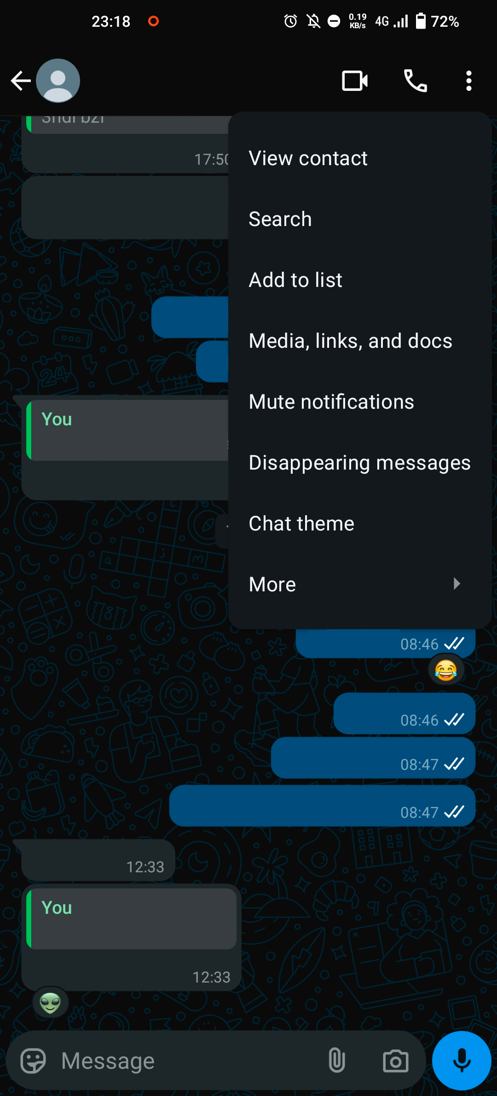


Data extraction
Extracting the data from WhatsApp is a manual process.
Follow these steps:

Slide 16
Data extraction
Export data
01/04/2069, 04:20 - You: Hello world!

Slide 17
Data extraction
Export data
Filters
Remove links
Remove special tags like <Media omitted>, <You deleted this message>
Remove email addresses
Remove tagging
...

Slide 18
Data extraction
Concatenate
Export data
Filters
One big sequence of text

Slide 19
Let’s code

Slide 20
TEXT ENCODING
Hello world
256, 99, 543

Slide 21


Text encoding
Language models don’t use text as input.
They work with numbers.
Encoding is turning text into numbers.
Methods for text encoding: Character level, Word level, BPE (Sub word level), ...
How are you?
Base model
[123, 99, ...]
Encoding

Slide 22
Text encoding
Methods for text encoding: Character level, Word level, BPE.
Input example: Text encoding is an important step that affects later stages in the pipeline.
You should find a compromise between the vocabulary size and the sequence length.
  ↑ Vocabulary size ↓ Sequence length
  ↓ Vocabulary size ↑ Sequence length
Tokenization | Vocabulary size | Example tokens | Sequence length
Character level | ~100-500 | "T", "e", "x", "t" | 78
BPE | ~10,000-50,000 | "Text", "enco", "ding" | 14
Word level | ~50,000+ | "Text", "encoding", "is" | 13
Computationally expensive

Slide 23
Text encoding
Methods for text encoding: Character level, Word level, BPE.
Input example: Text encoding is an important step that affects later stages in the pipeline.
You should find a compromise between the vocabulary size and the sequence length.
  ↑ Vocabulary size ↓ Sequence length
  ↓ Vocabulary size ↑ Sequence length
Tokenization | Vocabulary size | Example tokens | Sequence length
Character level | ~100-500 | "T", "e", "x", "t" | 78
BPE | ~10,000-50,000 | "Text", "enco", "ding" | 14
Word level | ~50,000+ | "Text", "encoding", "is" | 13

Slide 24
Text encoding - BPE
BPE (Byte Pair Encoding)
Compresses the text into a small sequence.
aaabdaaabac
[97, 97, 97, 98, 100, 97, 97, 97, 98, 97, 99]
(97, 97) : 4
(97, 98) : 2
...
[666, 97, 98, 100, 666, 97, 98, 97, 99]
Merge #1
[666, 97, 98, 100, 666, 97, 98, 97, 99]
(666, 97) : 2
(97, 98) : 2
...
[777, 98, 100, 777, 98, 97, 99]
Merge #2
...

Slide 25
Text encoding – Useful links
Wikipedia: https://en.wikipedia.org/wiki/Byte_pair_encoding
YouTube: https://www.youtube.com/watch?v=zduSFxRajkE&t
Medium: link
Tool: https://tiktokenizer.vercel.app/
minBPE: https://github.com/karpathy/minbpe

Slide 26
Let’s code

Slide 27
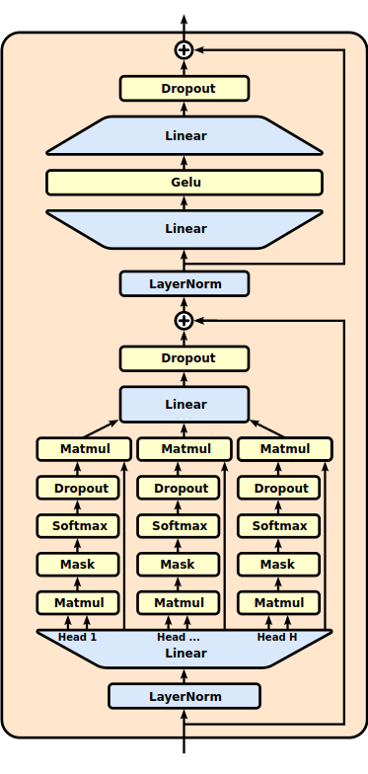
THE TRANSFORMER
MODEL

Slide 28
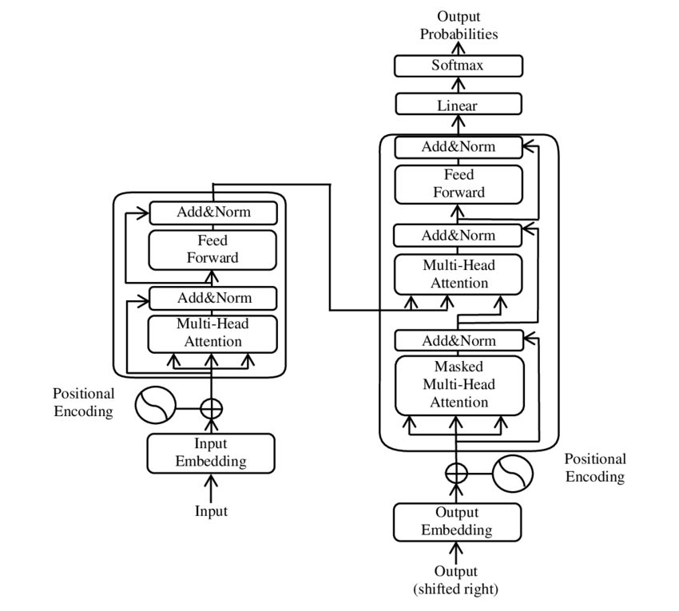
The transformer
The transformer architecture is used to train language models.
It is divided into 2 parts: The encoder and the decoder.
For tasks like machine translation you use both parts.
To imitate the training data, you can use just the decoder.
Decoder
Encoder

Slide 29
The transformer - Decoder
The decoder is composed of these components:
  Token embedding (Represents a token with a vector).
Embedding dimensions | 0 | 1 | 2 | ... | n-1
hel | 0.21 | -2.1 | 0.62 | ... | -0.33
imad | -2.81 | 0.1 | 0.23 | ... | 0.55
you | 0.71 | 0.11 | 1.77 | ... | -0.23

Slide 30
The transformer - Decoder
The decoder is composed of these components:
  Token embedding (Represent a token with a vector).
  Positional encoding (Preserves the token order).
Hi, how are you doing?
0
1
2
3
4
*The position encoding is a vector not a single value.

Slide 31
The transformer - Decoder
The decoder is composed of these components:
  Token embedding (Represent a token with a vector).
  Positional encoding (Preserves the token order).
  Self attention (Keeps track of the relationship between tokens).

Slide 32
The transformer - Decoder
The decoder is composed of these components:
  Token embedding (Represent a token with a vector).
  Positional encoding (Preserves the token order).
  Self attention (Keeps track of the relationship between tokens).
  Residual connections (Helps the gradient flow easily through the network).

Slide 33
The transformer - Decoder
The decoder is composed of these components:
  Token embedding (Represent a token with a vector).
  Positional encoding (Preserves the token order).
  Self attention (Keeps track of the relationship between tokens).
  Residual connections (Helps the gradient flow easily through the network).
  Layer normalization (Normalizes the input).

Slide 34
The transformer - Decoder
The decoder is composed of these components:
  Token embedding (Represent a token with a vector).
  Positional encoding (Preserves the token order).
  Self attention (Keeps track of the relationship between tokens).
  Residual connections (Helps the gradient flow easily through the network).
  Layer normalization (Normalizes the input).
  MLP layers (Expands the model’s capacity to learn).

Slide 35
The transformer - Decoder
The decoder is composed of these components:
  Token embedding (Represent a token with a vector).
  Positional encoding (Preserves the token order).
  Self attention (Keeps track of the relationship between tokens).
  Residual connections (Helps the gradient flow easily through the network).
  Layer normalization (Normalizes the input).
  MLP layers (Expands the model’s capacity to learn).
  Block

Slide 36
The transformer - Decoder
The decoder is composed of these components:
  Token embedding (Represent a token with a vector).
  Positional encoding (Preserves the token order).
  Self attention (Keeps track of the relationship between tokens).
  Residual connections (Helps the gradient flow easily through the network).
  Layer normalization (Normalizes the input).
  MLP layers (Expands the model’s capacity to learn).
  Block
  Final layers (To get the predictions).

Slide 37
The transformer - Parameters
Block size : Maximum sequence length.
Embedding size

Slide 38
The transformer - Parameters
Block size : Maximum sequence length.
Embedding size
Number of heads & head size

Slide 39
The transformer - Parameters
Block size : Maximum sequence length.
Embedding size
Number of heads & head size
Number of blocks (layers)

Slide 40
The transformer – Useful links
StatQuest playlist
Andrej Karpathy

Slide 41
Let’s code

Slide 42
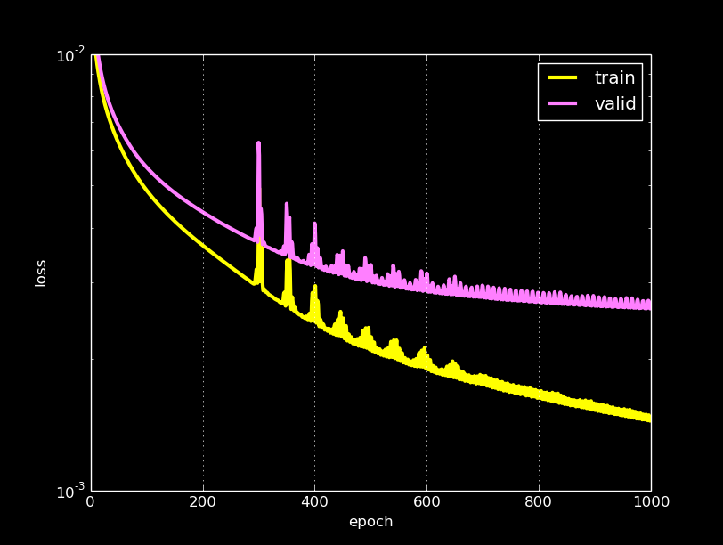
MODEL TRAINING

Slide 43

Model training
Training follows this process:
Tokenized
data
Data splitting
Data loaders
Training parameters
Evaluation
Saving the model

Slide 44


Model training – Data loaders
Data loaders are used during training and evaluation.
During training you can design your data loader in 2 ways:
  Random batches retrieval
  Use all the batches

Slide 45

Model training – Data loaders
Training set contains 4000 batches of size 64.
Number of training iterations is 1000.
Processing one batch takes 30 seconds.
We need to find a balance.
Case 1
Case 2
duration = 1000 * 1 * 30
duration = 8.33 hours
duration = 1000 * 4000 * 30
Duration = 1388.9 days

Slide 46
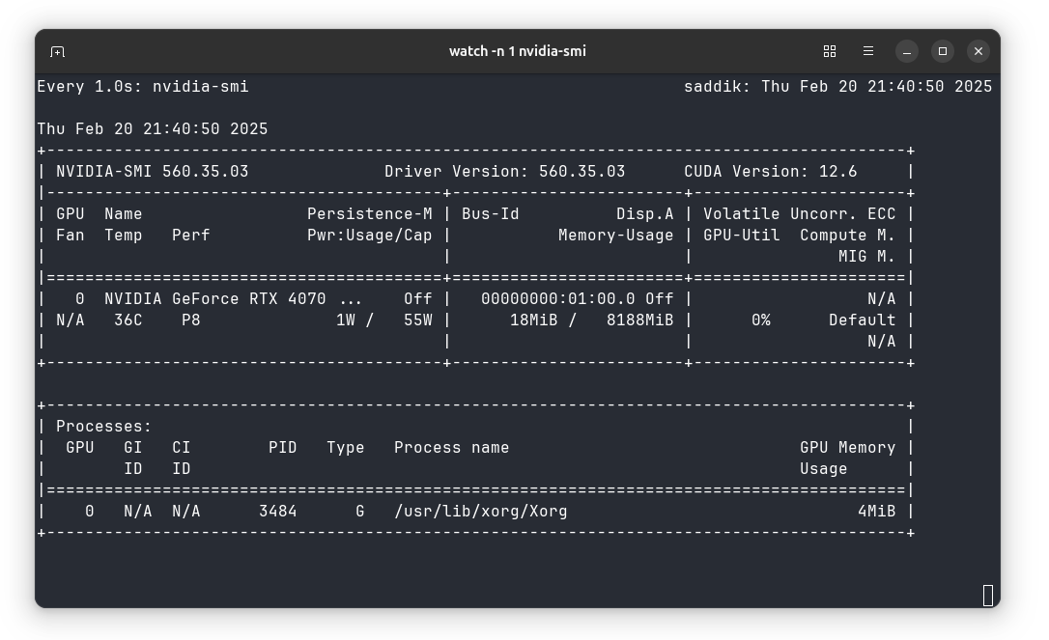
Model training – Training loop
Make sure that the memory is fully utilized > 90%

Slide 47
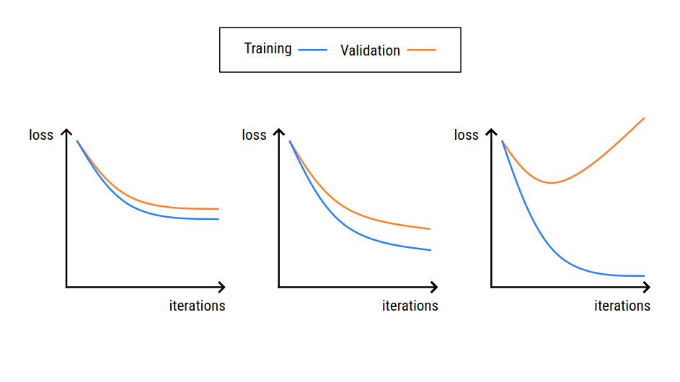
Model training – Training loop
Make sure that the memory is fully utilized > 90%.
Start with a small batch size and keep increasing until OOM (Out Of Memory).
Save the model regularly, every x iteration.
Monitor the loss.

Slide 48
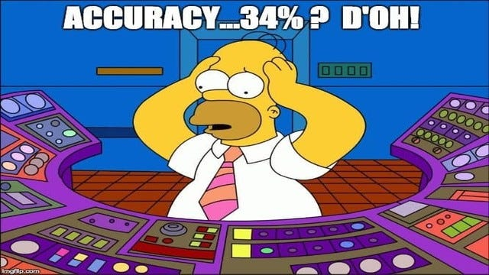
Model training - Evaluation
Generate from the model and evaluate it yourself.
Not satisfied? Repeat the process, this is how deep learning works.
See if the model is able to form coherent text or not.
The model does not need to be very very good.
Because it will be fine-tuned later.

Slide 49
Let’s code

Slide 50

FINE-TUNING DATASET

Slide 51
Fine-tuning dataset
This dataset is designed to teach the base model to be good at a specific task.
In our case, the dataset should mimic the way a person talks.
The special tokens are used here.
<|startoftext|>User<|separator|>Hi, how are you?<|endoftext|>
<|startoftext|>Assistant<|separator|>Good, is there anything I can help with?<|endoftext|>
...
Raw data
Fine-tuned data

Slide 52
Fine-tuning dataset
This dataset is designed to teach the base model to be good at a specific task.
In our case, the dataset should mimic the way a person talks.
The special tokens are used here.
The fine-tuning dataset does not need to be big.
Create a high quality dataset if you can.

Slide 53
Fine-tuning dataset
The input should not exceed the block size.
Think of showing the model multi-turn examples.
<|startoftext|>User<|separator|>Hi, how are you?<|endoftext|>
<|startoftext|>Assistant<|separator|>Good, is there anything I can help with?<|endoftext|>
<|startoftext|>User<|separator|>Hi, how are you?<|endoftext|>
<|startoftext|>Assistant<|separator|>Good, is there anything I can help with?<|endoftext|>
<|startoftext|>User<|separator|>I am preparing a new course.<|endoftext|>
<|startoftext|>Assistant<|separator|>Interesting! Can you tell me what does the course touch?<|endoftext|>
No context
Clear context

Slide 54
Let’s code

Slide 55

FINE-TUNING

Slide 56

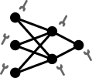
Fine-tuning
Fine-tuning is the additional training performed on the base model.
Assistant that excels at a specific task.
Methods of fine-tuning:
  Full fine-tuning (Instruction fine-tuning)

Slide 57

Fine-tuning
Fine-tuning is the additional training performed on the base model.
Assistant that excels at a specific task.
Methods of fine-tuning:
  Full fine-tuning (Instruction fine-tuning)
  PEFT (Parameter Efficient Fine-Tuning)
    LORA or QLORA (Low Rank Adaptation)
Adapter

Slide 58
Fine-tuning – Efficient training
Training on one example at a time is inefficient.
<|startoftext|>User<|separator|>Hi, how are you?<|endoftext|>
<|startoftext|>Assistant<|separator|>Good, is there anything I can help with?<|endoftext|>
Input sequence = 43
<|startoftext|>User<|separator|>Hi, how are you?<|endoftext|>
<|startoftext|>Assistant<|separator|>Good, is there anything I can help with?<|endoftext|>
<|startoftext|>User<|separator|>What does 42 mean?<|endoftext|>
Input sequence = 86

Slide 59
Fine-tuning – Efficient training
Training on one example at a time is inefficient.
We want to train on batches.
Solution: Add padding tokens to make the sequences have the same size.
Block size = 256
<|startoftext|>User<|separator|>Hi, how are you?<|endoftext|>
<|startoftext|>Assistant<|separator|>Good, is there anything I can help with?<|endoftext|>
[12, 543, 689, 430, 69, 44, 189]
<|startoftext|>User<|separator|>Hi, how are you?<|endoftext|>
<|startoftext|>Assistant<|separator|>Good, is there anything I can help with?<|endoftext|>
<|startoftext|>User<|separator|>What does 42 mean?<|endoftext|>
[12, 543, 689, 430, 69, 44, 189, 890, 1000, 321, 33, 543, 765, 89]

Slide 60

Fine-tuning – Efficient training
Training on one example at a time is inefficient.
We want to train on batches.
Solution: Add padding tokens to make the sequences have the same size.
Block size = 256
<|startoftext|>User<|separator|>Hi, how are you?<|endoftext|>
<|startoftext|>Assistant<|separator|>Good, is there anything I can help with?<|endoftext|>
[12, 543, 689, 430, 69, 44, 189, -1, -1, -1, -1, -1, -1, -1, -1, -1, -1, -1, -1, -1, -1, -1, -1, -1, -1, -1, -1, -1, -1, -1, -1]
[-1, -1, -1, -1, -1, -1, -1, -1, -1, -1, -1, -1, -1, -1, -1, -1, -1, -1, -1, -1, -1, -1, -1, -1, 12, 543, 689, 430, 69, 44, 189]
<|startoftext|>User<|separator|>Hi, how are you?<|endoftext|>
<|startoftext|>Assistant<|separator|>Good, is there anything I can help with?<|endoftext|>
<|startoftext|>User<|separator|>What does 42 mean?<|endoftext|>
[12, 543, 689, 430, 69, 44, 189, 890, 1000, 321, 33, 543, 765, 89, -1, -1, -1, -1, -1, -1, -1, -1, -1, -1, -1, -1, -1, -1, -1]
[-1, -1, -1, -1, -1, -1, -1, -1, -1, -1, -1, -1, -1, -1, -1, 12, 543, 689, 430, 69, 44, 189, 890, 1000, 321, 33, 543, 765, 89]

Slide 61
Fine-tuning – Efficient training
Training on one example at a time is inefficient.
We want to train on batches.
Solution: Add padding tokens to make the sequences have the same size.
The padding tokens are not considered when calculating the loss.

Slide 62
Fine-tuning – X & Y
Each pair (x, y) is formed like the first stage.
<|startoftext|>User<|separator|>Hi, how are you?<|endoftext|>
<|startoftext|>Assistant<|separator|>Good, is there anything I can help with?<|endoftext|>
[12, 543, 689, 430, 69, 44, 189, -1, -1, -1, -1, -1]
X = [12, 543, 689, 430, 69, 44, 189, -1, -1, -1, -1, -1]

Slide 63
Fine-tuning – X & Y
Each pair (x, y) is formed like the first stage.
Repeat the process & create the data loaders.
<|startoftext|>User<|separator|>Hi, how are you?<|endoftext|>
<|startoftext|>Assistant<|separator|>Good, is there anything I can help with?<|endoftext|>
Y = [543, 689, 430, 69, 44, 189, -1, -1, -1, -1, -1, -1]
[12, 543, 689, 430, 69, 44, 189, -1, -1, -1, -1, -1]
X = [12, 543, 689, 430, 69, 44, 189, -1, -1, -1, -1, -1]

Slide 64
Let’s code

Slide 65
Low Rank Adaptation
(LoRA, QLoRA)

Slide 66
Low Rank Adaptation
This is a form of fine-tuning.
It is efficient and trains few parameters.
It generates adapters that can be attached to the base model.
Adapter

Slide 67
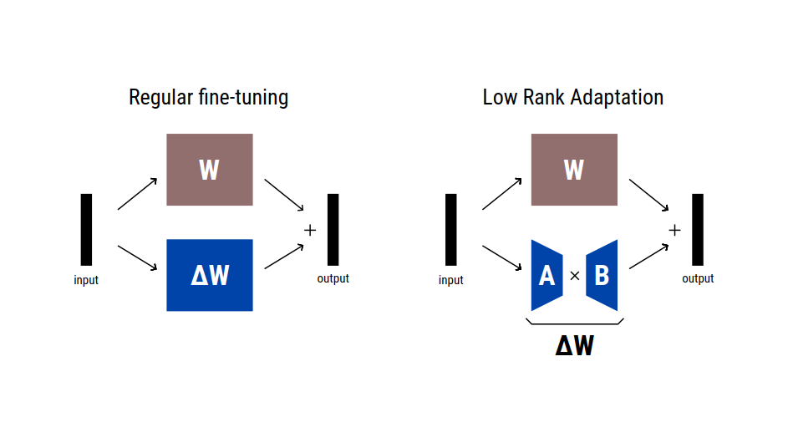
Low Rank Adaptation
In instruction fine-tuning we update all model weights.
During backpropagation, we learn a ΔW matrix.
If W is a 2048x2048 matrix, then ΔW has 4,194,304 parameters.

Slide 68
Low Rank Adaptation
The LoRA method aims to approximate ΔW as AB.
Matrix A has dimensions n × r, while Matrix B has dimensions r × m.
r represents the rank and determines the number of additional parameters.
If r = 2 and W is a 2048 × 2048 matrix, the number of parameters to train would be 2 × 2 × 2048 = 8,192.

Slide 69
Let’s code

Slide 70
Let’s scale

Slide 71

Let’s scale - data
We started with a small example.
I will use the AtlaSet corpus.
This is 600 times bigger.
It contains 1.17M rows in the train set and 2.68K rows in the test set.
1.5M
~900M
characters
characters

Slide 72
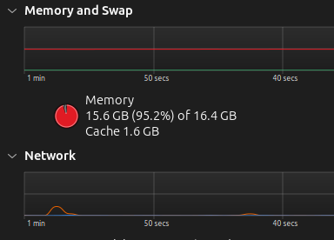
Let’s scale - challenges
We started with a small example, we didn’t need a lot of resources.
But, trying to load the big dataset will require a lot of RAM.

Slide 73

Let’s scale - challenges
We started with a small example, we didn’t need a lot of resources.
But, trying to load the big dataset will require a lot of RAM.
Training the tokenizer on 900M characters will crash your program.

Slide 74
Let’s scale - challenges
We started with a small example, we didn’t need a lot of resources.
But, trying to load the big dataset will require a lot of RAM.
Training the tokenizer on 900M characters will crash your program.
  Train on a sample data (1-5%) to estimate the data distribution.
  Training might take hours, in my case it took 6h.

Slide 75
Let’s scale – file formats
After encoding the text data, you need to save it to disk so that you don’t repeat this operation.
What file format do we need to use?
Maybe .pkl ?
NO

Slide 76

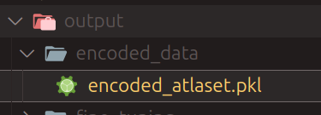
Let’s scale – file formats
After encoding the text data, you need to save it to disk so that you don’t repeat this operation.
What file format do we need to use?
Maybe .pkl ?
Stored data
Load data
OOM

Slide 77

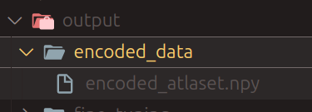
Let’s scale – file formats
After encoding the text data, you need to save it to disk so that you don’t repeat this operation.
What file format do we need to use?
Maybe .pkl ? NO.
We use Memory-mapped file objects.
Stored data
Load portions
of the data
RAM is happy :)

Slide 78

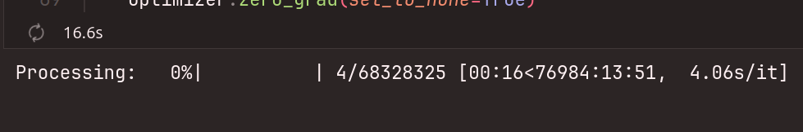
Let’s scale - training
Training will take forever to finish.

Slide 79



Let’s scale - training
Training will take forever to finish.
Rent a GPU and do the training on the cloud.

Slide 80
Let’s code

Slide 81
END OF COURSE 1

Slide 82
The Transformer Journey 2017 to 2025

Slide 83
Introduction

Slide 84
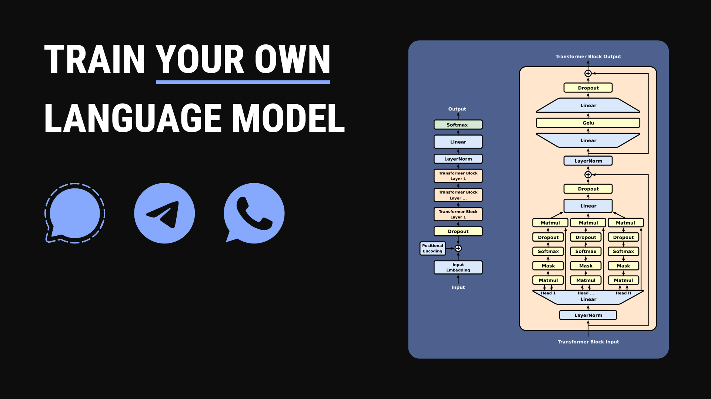
Introduction
In the previous course, I used the techniques from the 2017 paper Attention is All You Need.

Slide 85

Introduction
In the previous course, I used the techniques from the 2017 paper Attention is All You Need.
Over the past 7 years, researchers have improved original transformer architecture a lot.
In this course, I will explain to you those improvements.

Slide 86
Positional encoding

Slide 87
Positional encoding
Why do we need positional encoding in the first place?
Without positional encoding the output is identical for the same token in different positions.
The self attention layer needs to determine relationships between words encoded by their positions.
How do we achieve that?
0
1
0
1
0
1
1
1
0
1
0
1
0
0
0
1
Hi Imad! Hi Najma!
Embedding

Slide 88

Positional encoding
We have many techniques to apply positional encoding:
  Absolute positional encoding
  Relative positional encoding
Embedding
0
1
0
1
0
1
1
1
0
1
0
1
0
0
0
1
Hi Imad! Hi Najma!
Embedding
+
1
1
1
1
1
0
0
0
0
1
0
1
0
0
0
1
Positional encoding

Slide 89
Positional encoding
Absolute positional encoding:
Learning from data:
  Consider position encodings as trainable parameters.
  The model learns the best position vector for each position during training.
  It is limited to representing sequences that are not longer than the block size.
Positions
(Block size)
Positions
(Block size)
Embedding
size
Embedding
size

Slide 90
Positional encoding
Absolute positional encoding:
Learning from data:
  Consider position encodings as trainable parameters.
  The model learns the best position vector for each position during training.
  It is limited to representing sequences that are not longer than the block size.
  The embedding vectors are independent of each other.
Position 5
Position 20
Position 1000
Embedding
size

Slide 91
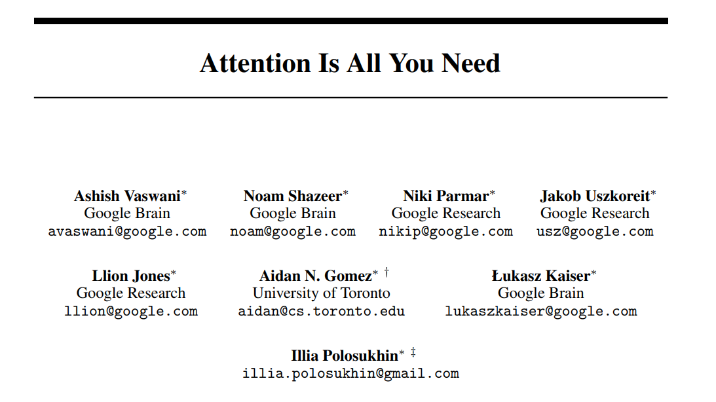
Positional encoding
Absolute positional encoding:
Sinusoidal:
  Uses fixed sine and cosine waves of different frequencies to create unique position vectors.
  Used in the original Transformer paper.
  It's not learned, can handle longer sequences than seen in training.

Slide 92
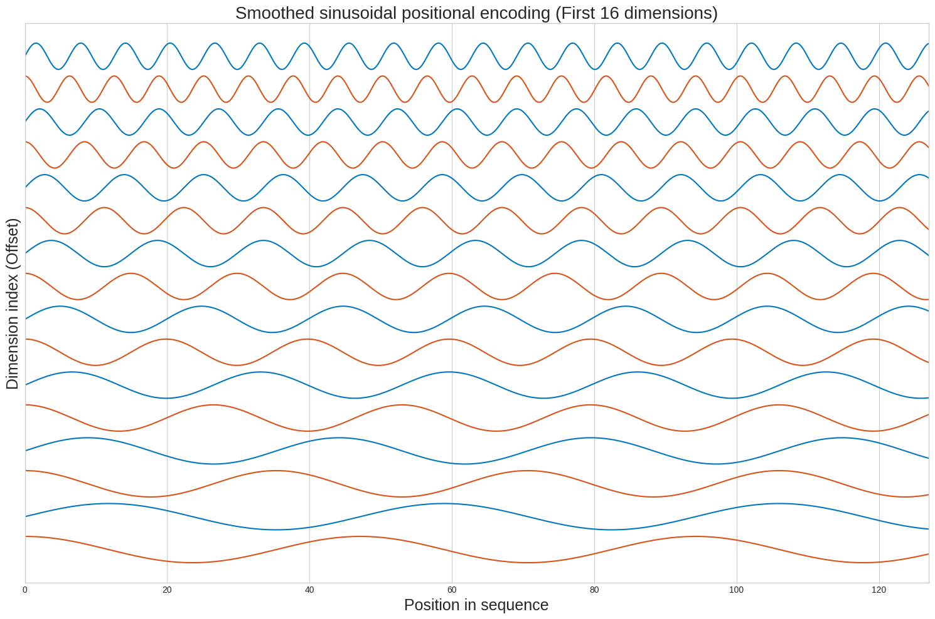
Positional encoding
Position 20
Embedding
size

Slide 93
Positional encoding
Relative positional encoding:
Focuses on the relationship between words, rather than just their absolute positions.
This method does not add a position vector to the word embedding vector directly.
It alters the attention mechanism to incorporate relative positional information.
Hi Imad! Hi Najma!
Hi Imad! Hi Najma!
0
1
2
3
-2
-1
0
1

Slide 94
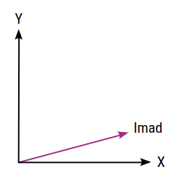
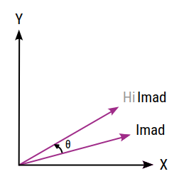
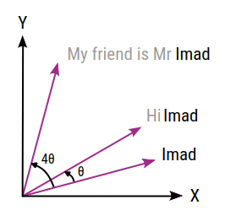
Positional encoding
Rotary Position Embedding (RoPE):
Combines both absolute position of tokens and their relative distances.
Each position in the sequence is represented by a rotation in the embedding space.
θ is the rotation angle.

Slide 95
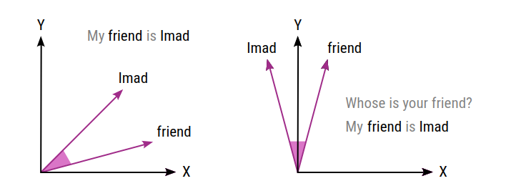
Positional encoding
Rotary Position Embedding (RoPE):
Combines both absolute position of tokens and their relative distances.
Each position in the sequence is represented by a rotation in the embedding space.
θ is the rotation angle.
Relative position of words is preserved.

Slide 96


Positional encoding
Resources
Jake Tae (Relative encoding)
Efficient NLP (RoPE)
Christopher Fleetwood
My GitHub repository

Slide 97

Positional encoding
Resources

Slide 98
Positional encoding – The experiment
Create a small model and train it for 1 epoch on AtlaSet.
Do that for every method:
  No positional encoding.
  Absolute positional encoding.
  Relative positional encoding.
  Sinusoidal positional encoding.
  Rotary positional encoding.
Store the training and validation losses at the end of training.

Slide 99
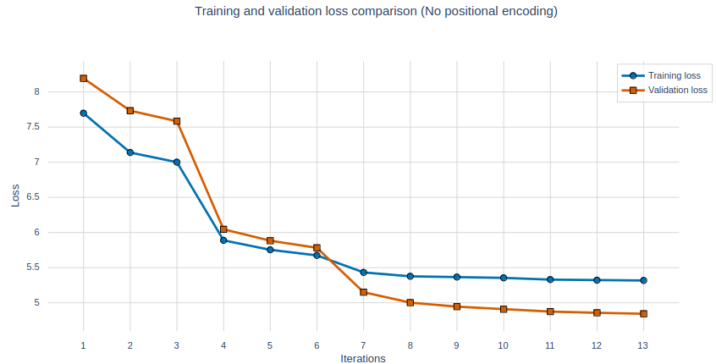
Positional encoding – The experiment
No positional encoding
Don’t add positional encoding to the embedding tensor.
Training time ~ 2h:10m.

Slide 100
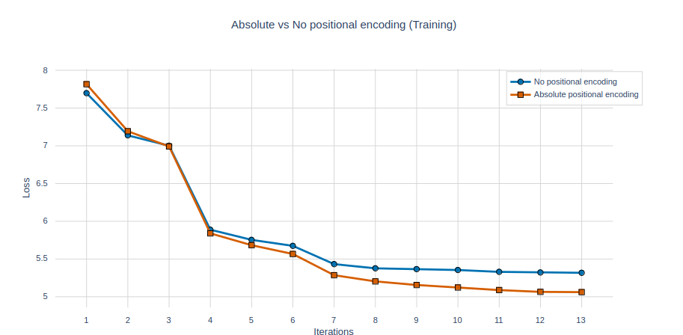
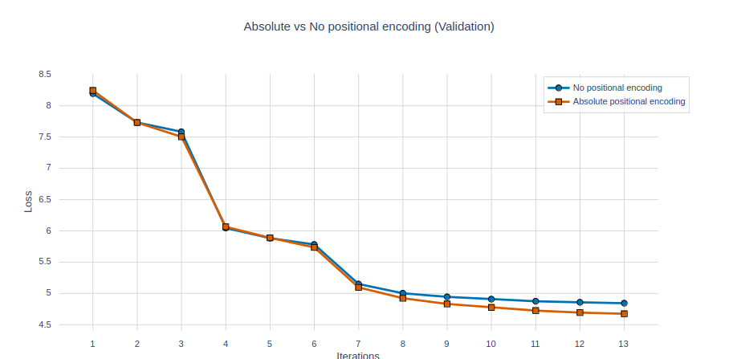
Positional encoding – The experiment
Absolute positional encoding (learnable)
No change is needed.
Training time ~ 2h:10m.

Slide 101
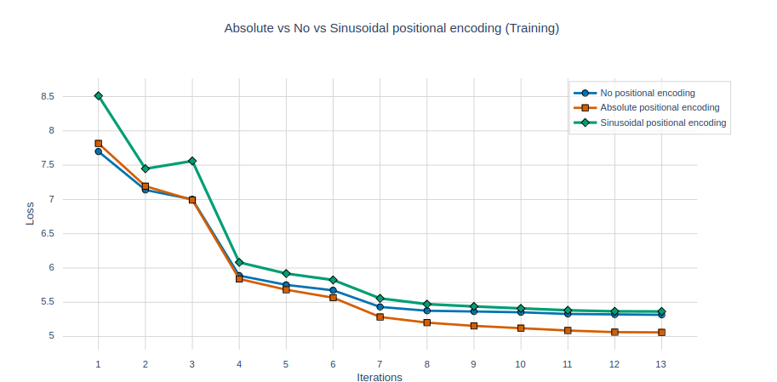
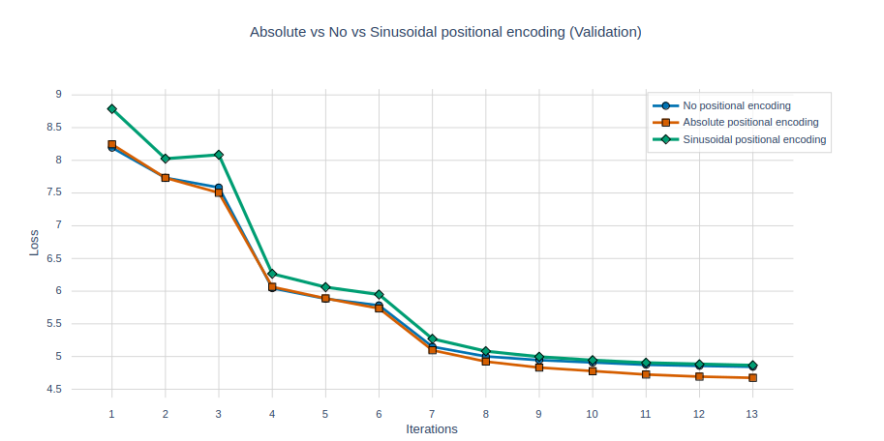
Positional encoding – The experiment
Absolute positional encoding (sinusoidal)
No learnable parameters are needed.
Training time ~ 2h:10m.

Slide 102
Positional encoding – The experiment
Relative positional encoding (learnable)
Learnable parameters are present in this method.
Works by defining the number of buckets for relative distances (max_relative_distance).
max_relative_distance = 4
-4
+4
..… Machine learning is not hard. You can learn it …….
Shared bias
Unique learned bias values =
Number of buckets
Shared bias

Slide 103
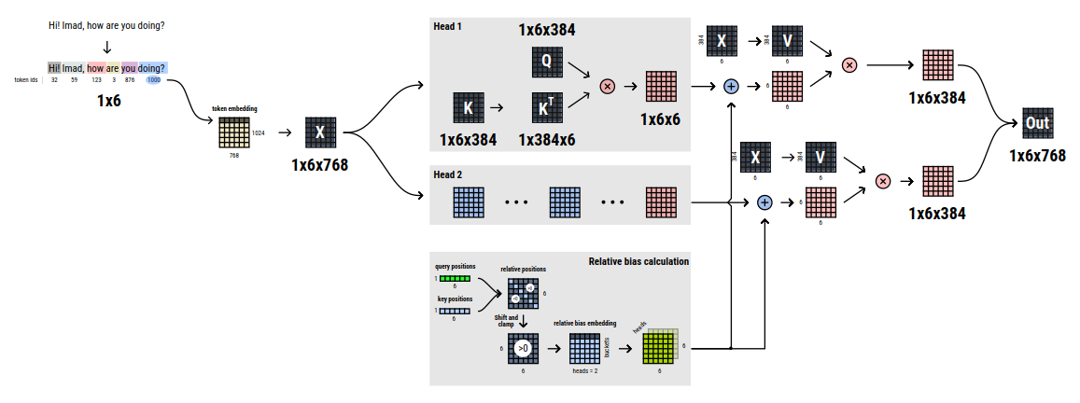
Positional encoding – The experiment

Slide 104
Positional encoding – The experiment

Slide 105
Positional encoding – The experiment

Slide 106
Positional encoding – The experiment

Slide 107
Positional encoding – The experiment

Slide 108
Positional encoding – The experiment

Slide 109
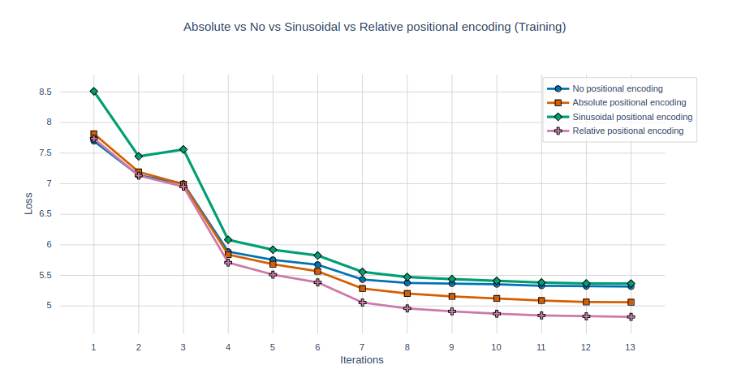
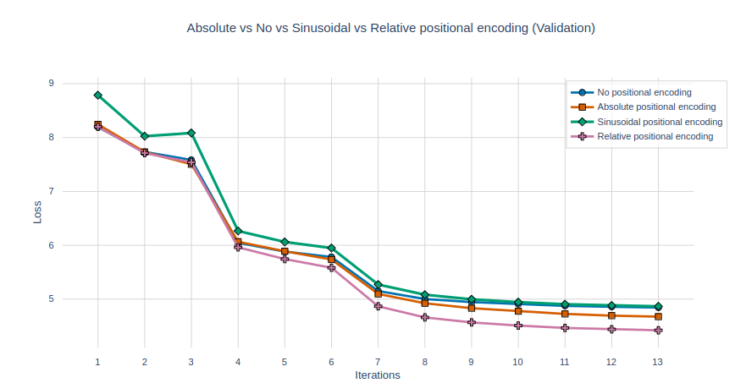
Positional encoding – The experiment
Relative positional encoding (learnable)
Training time ~ 5h.

Slide 110
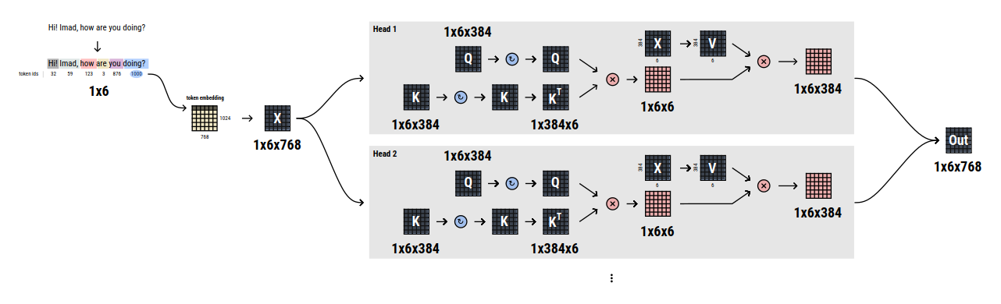
Positional encoding – The experiment
Rotary positional encoding (RoPE)
No learnable parameters are needed.

Slide 111
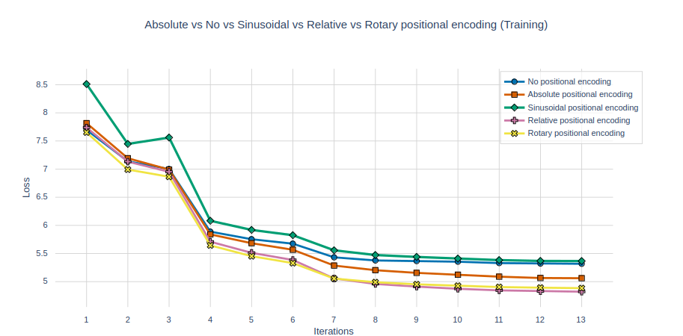
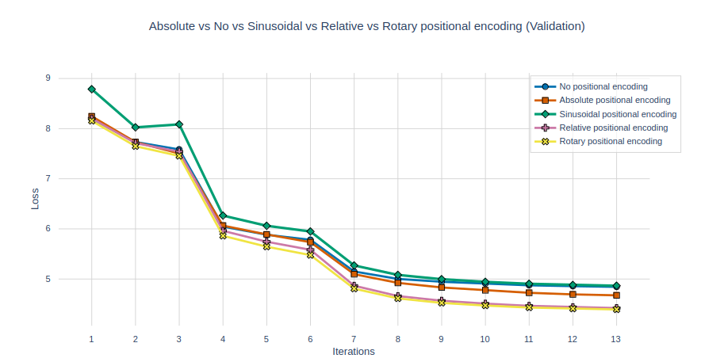
Positional encoding – The experiment
Rotary positional encoding (RoPE)
No learnable parameters are needed.
Training time ~ 2h.

Slide 112
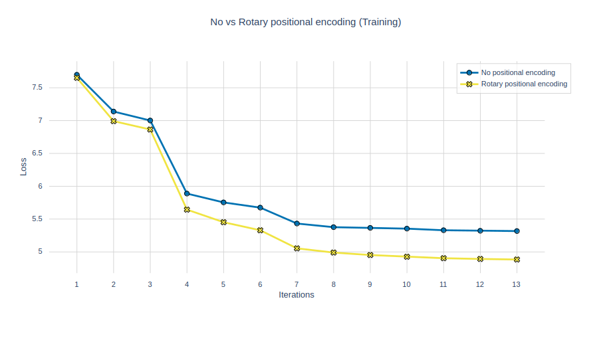
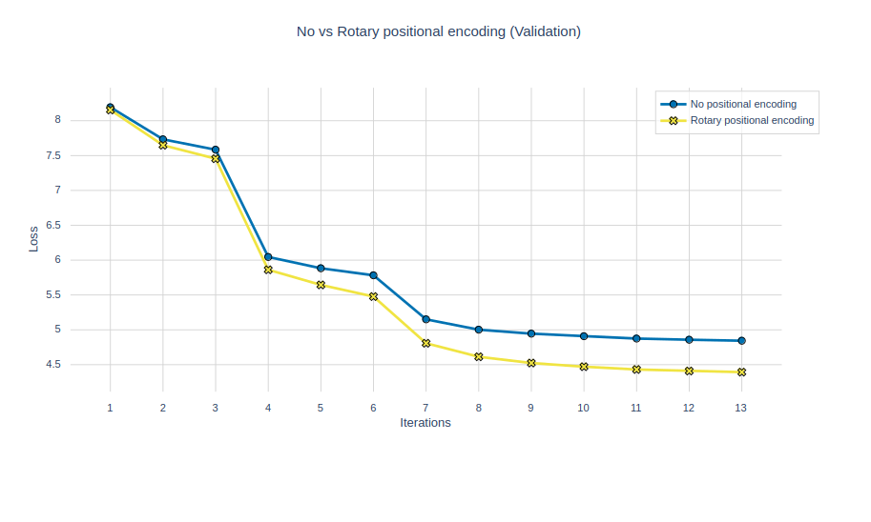
Positional encoding – Conclusion
Positional encoding definitely helps the model learn better.

Slide 113
Attention layer

Slide 114

Attention layer
Attention helps the model focus on the most relevant pieces of information in the input.
We will compare the following methods:
Sparse attention (Big Bird)
Grouped Query Attention (GQA)
Local Attention
Multi Head Attention (MHA)
Linear Attention
Latent Attention

Slide 115

Attention layer – Multi Head Attention
MHA was introduced in the Attention Is All You Need paper.

Slide 116
Attention layer – Multi Head Attention
MHA is the foundational attention mechanism from the Attention Is All You Need paper.
MHA computes attention scores independently across multiple heads in parallel.
It learns diverse representations by allowing different heads to focus on various input aspects.

Slide 117
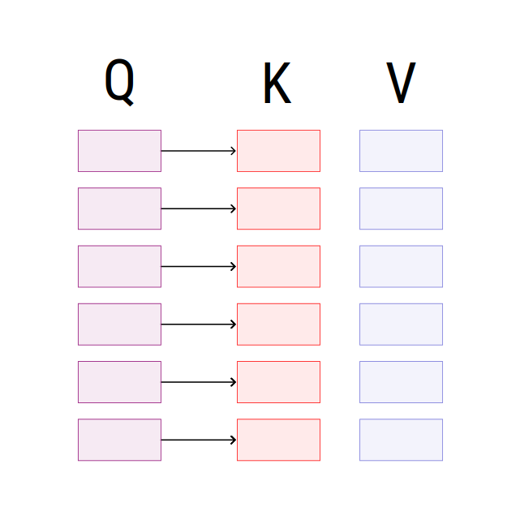
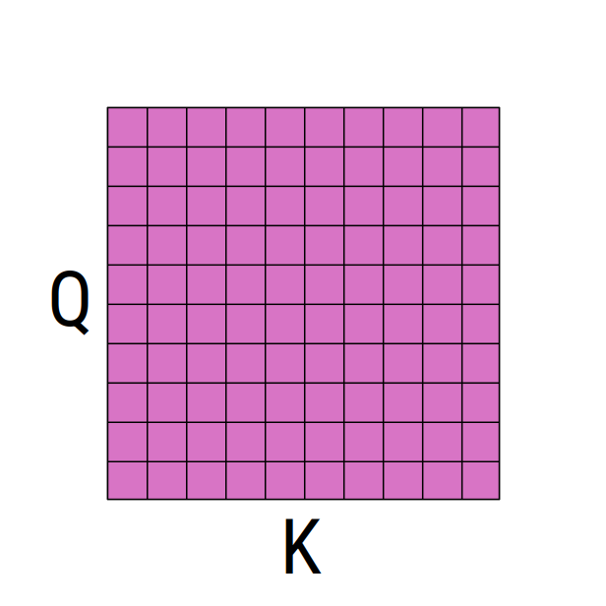
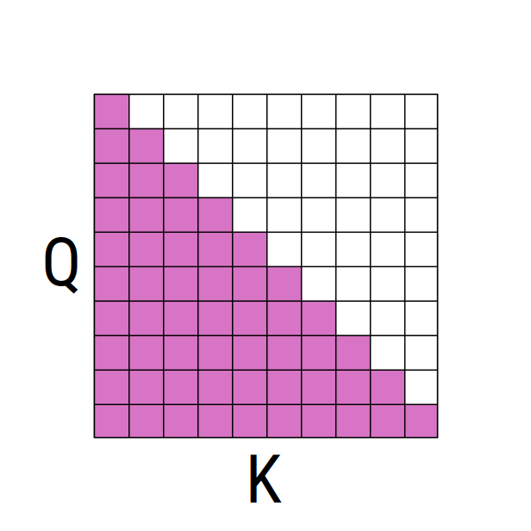
Attention layer – Multi Head Attention
Within each attention head, input is projected into query (Q), key (K), and value (V) matrices.
Each query vector is then compared with all key vectors in that head to measure similarity.
This comparison yields an attention score matrix.
In the decoder, we use a mask to prevent queries from attending to future keys. (Masked attention)

Slide 118
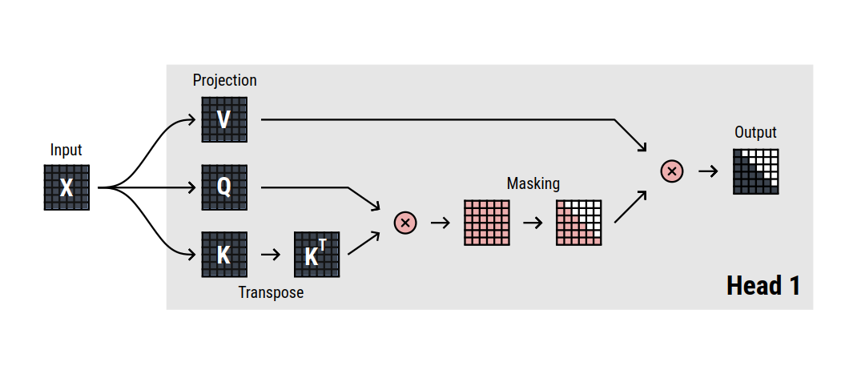
Attention layer – Multi Head Attention

Slide 119
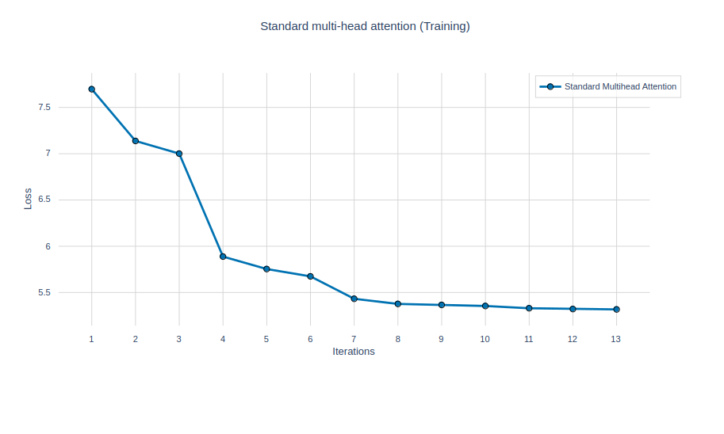
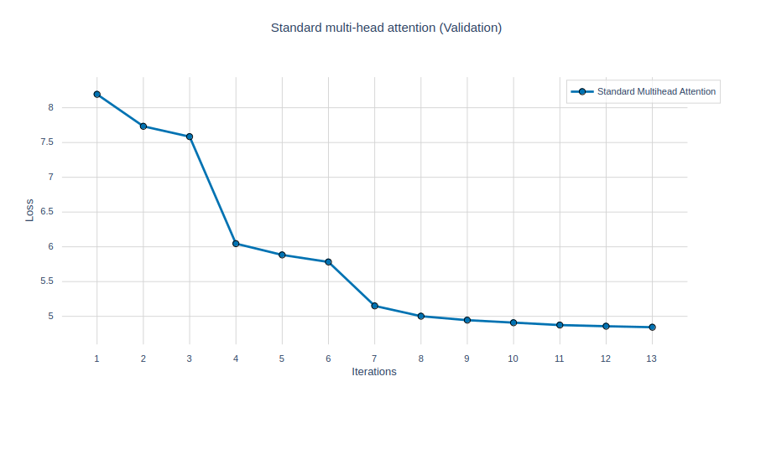
Attention layer – Multi Head Attention
Baseline = Performance of the model with MHA

Slide 120
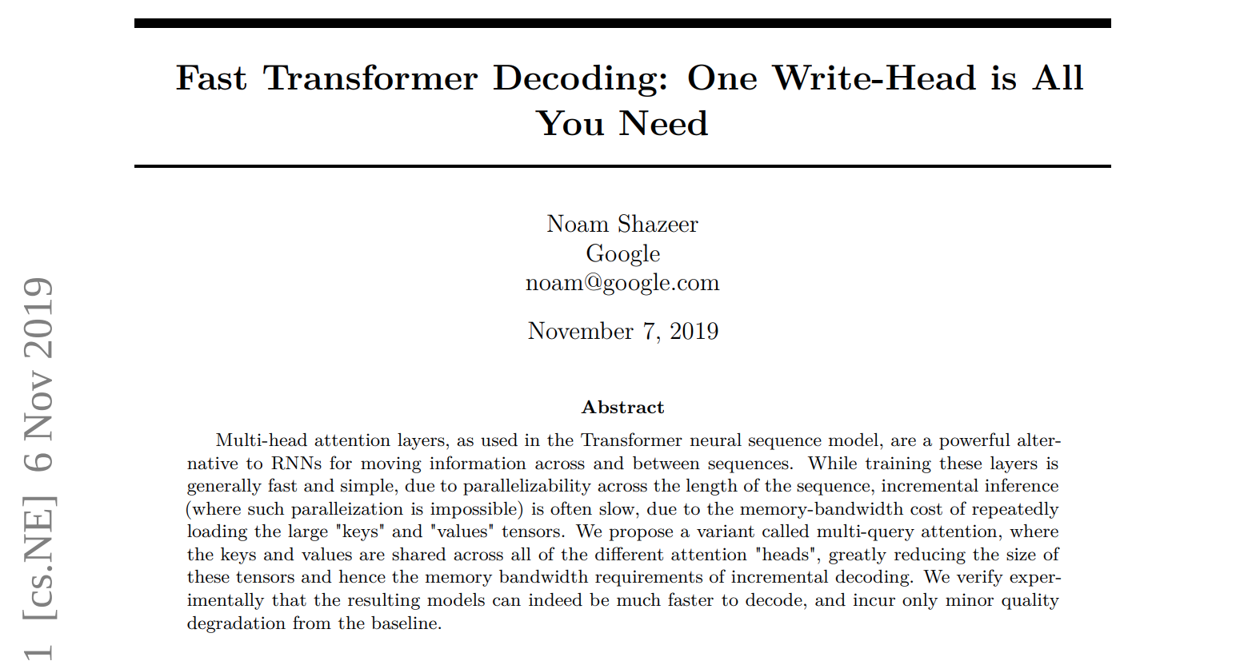
Attention layer – Multi Query Attention
MQA was introduced in the Fast Transformer Decoding paper.

Slide 121
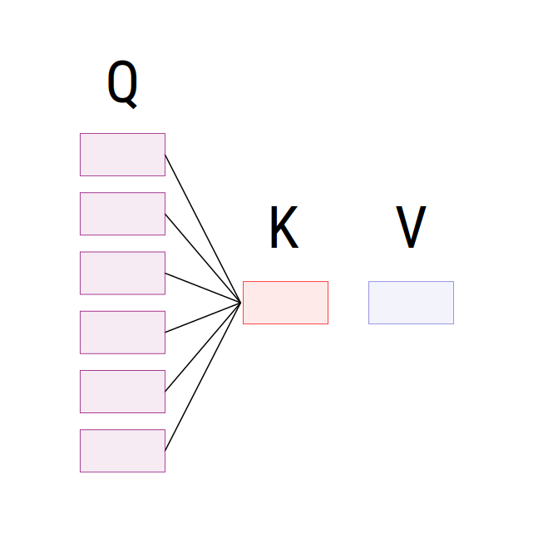
Attention layer – Multi Query Attention
MQA simplifies MHA to reduce memory usage (shrinks the KV cache).
Uses one key (K) and value (V) for all query heads.
K and V are calculated only once.
MQA’s performance degrades slightly compared to MHA.
MQA is faster than MHA in inference.

Slide 122
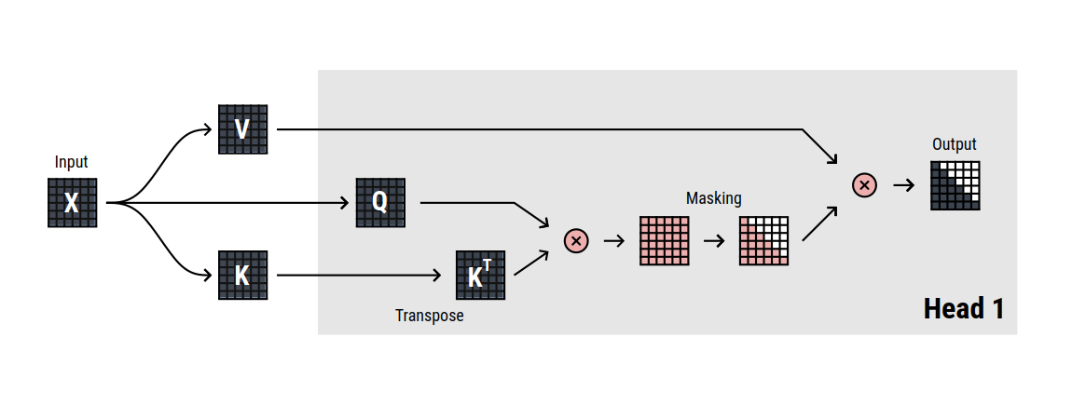
Attention layer – Multi Query Attention

Slide 123
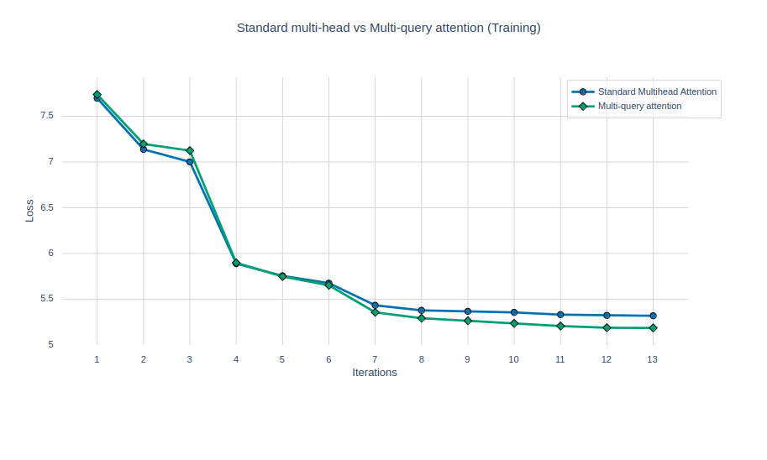
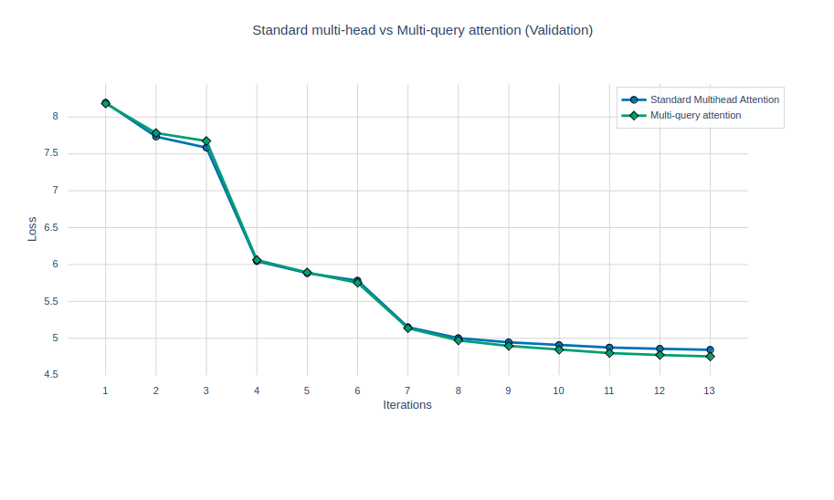
Attention layer – Multi Query Attention
Comparison

Slide 124
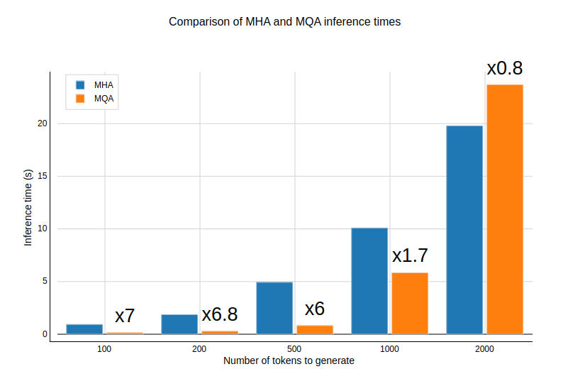
Attention layer – Multi Query Attention
Inference speed

Slide 125
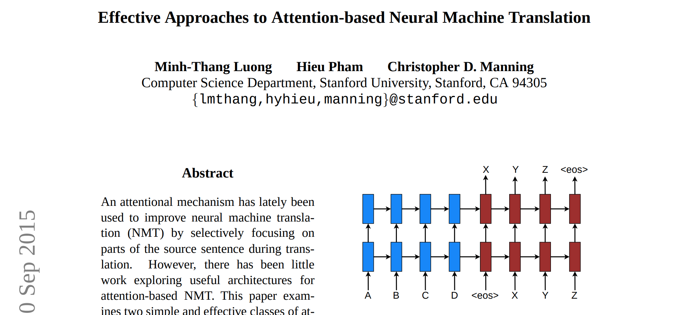
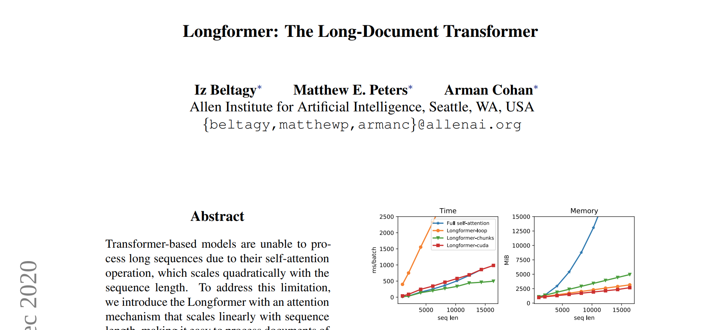
Attention layer – Local Attention
Local Attention was mentioned in these 2 papers.

Slide 126
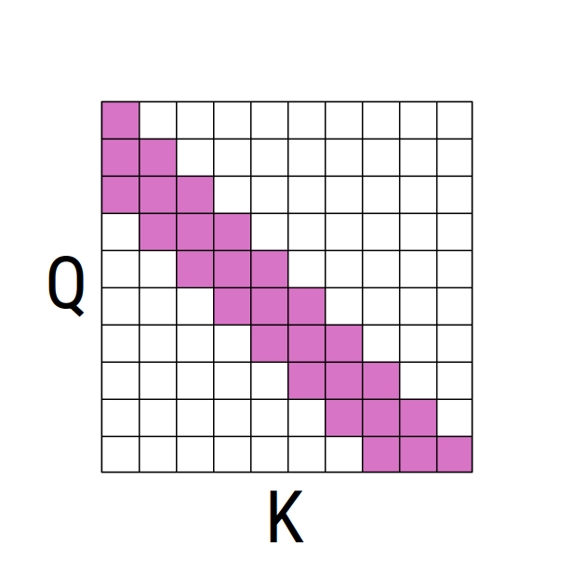
Attention layer – Local Attention
Local Attention limits the attention span of each token to a fixed-size window.
Local Attention is computationally efficient.
Long range dependencies are not captured because the model focuses on the local context.
Local Attention may lead to degradation in performance.

Slide 127

Attention layer – Local Attention

Slide 128


Attention layer – Local Attention
Comparison

Slide 129

Attention layer – Local Attention
Inference speed

Slide 130



Attention layer – Local Attention
Other variants:
Dilated sliding window.
Chunked sliding window.
Global + sliding window.

Slide 131

Attention layer – Grouped Query Attention
GQA was mentioned in this paper.

Slide 132

Attention layer – Grouped Query Attention
GQA is the generalization of MHA and MQA.
GQA groups queries together.
GQA offers an ideal trade-off between performance and speed.
GQA reduces the number of calculations.

Slide 133

Attention layer – Grouped Query Attention

Slide 134


Attention layer – Grouped Query Attention
Comparison

Slide 135

Attention layer – Grouped Query Attention
Inference speed

Slide 136


Attention layer – Linear Attention
Read the following papers to understand Linear Attention.

Slide 137

Attention layer – Linear Attention
MHA scales badly with long sequence lengths.
Linear Attention solves this issue by using less memory and approximating (1) with (2).
Linear Attention can give you good performance even with that approximation.

Slide 138

Attention layer – Linear Attention

Slide 139




Attention layer – Linear Attention
Comparison

Slide 140

Attention layer – Linear Attention
Inference speed

Slide 141

Attention layer – BigBird (Sparse Attention)
Read about BigBird in this paper.

Slide 142



Attention layer – BigBird (Sparse Attention)
BigBird is designed to process large sequences of text.
Sparse attention reduces the computational and memory complexity to O(n).
BigBird = Global + Random + Window attention.
BigBird captures the global and local dependencies in the sequence.

Slide 143

Attention layer – BigBird (Sparse Attention)

Slide 144




Attention layer – BigBird (Sparse Attention)
Comparison

Slide 145

Attention layer – BigBird (Sparse Attention)
Inference speed

Slide 146

Attention layer – Multi-head Latent Attention
MLA was introduced in the DeepSeek V2 paper.

Slide 147

Attention layer – Multi-head Latent Attention
MLA is an efficient method that compresses the KV cache.
MLA does not sacrifice performance for faster inference.
MLA incorporates latent representations into the attention mechanism.
MLA is very fast compared to MHA.

Slide 148

Attention layer – Multi-head Latent Attention

Slide 149




Attention layer – Multi-head Latent Attention
Comparison

Slide 150

Attention layer – Multi-head Latent Attention
Inference speed

Slide 151

Attention layer – The end
Before vs After

Slide 152
Small refinements

Slide 153

Small refinements
Experiment with different activation functions.

Slide 154
Small refinements
Experiment with different activation functions.
Play with the normalization methods.
LayerNorm
BatchNorm
RMSNorm

Slide 155


Small refinements
Experiment with different activation functions.
Play with the normalization methods.
Where to put the normalization layer?
Pre-LN
Post-LN

Slide 156
Small refinements
Experiment with different activation functions.
Play with the normalization methods.
Where to put the normalization layer?
Should we use dropout?

Slide 157

Activation functions
The most common practice was to just use ReLU in deep learning.
Now, every fancy LLM uses a different activation function.
Why ReLU is not used much?
The problem is that negative values are clamped to 0.
This limits the representational capacity of ReLU.

Slide 158


Activation functions
LeakyReLU mitigated the issue by allowing some negative values to pass through to the next layer.
However, with LeakyReLU, negative values can continue to grow uncontrollably.
SiLU and similar activation functions help by controlling the extent of negative value propagation.

Slide 159
Activation functions
SwiGLU is an activation function that is used by the Llama model.
SwiGLU is composed of 2 parts: Swish and GLU.
Swish has been shown to outperform ReLU in many applications.
GLU enables the network to focus on important features by either passing or blocking information.

Slide 160

Activation function benchmark
Use ReLU as the baseline activation function for evaluation.
Evaluate the performance of GeLU and SwiGLU in comparison to ReLU.
All three functions show similar convergence, but SwiGLU achieved the lowest loss value.

Slide 161

Normalization methods
Normalization play a crucial role in stabilizing and accelerating the training process.
It helps mitigate the issues of vanishing gradients.

Slide 162


Normalization methods
Normalization play a crucial role in stabilizing and accelerating the training process.
It helps mitigate the issues of vanishing gradients.

Slide 163

Normalization methods
Normalization play a crucial role in stabilizing and accelerating the training process.
It helps mitigate the issues of vanishing gradients and exploding gradients.

Slide 164

Normalization methods
Normalization play a crucial role in stabilizing and accelerating the training process.
It helps mitigate the issues of vanishing gradients and exploding gradients.
Normalization adjusts the scale of the data without changing its shape.

Slide 165

Normalization methods
There are many normalization methods: LayerNorm, BatchNorm, RMSNorm, etc.
LayerNorm (LN) is the method used in the original Transformer.
LN normalizes the activations of each layer across the feature dimension.
LN is suitable in scenarios where the mini-batch size is small.

Slide 166
Normalization methods
BatchNorm (BN) normalizes across the mini-batch dimension.
BN uses learnable parameters, allowing the model to adaptively scale and shift the normalized activations.

Slide 167
Normalization methods
RMSNorm normalizes activations based on the Root Mean Square of the activations themselves.
Unlike LN, RMSNorm does not center the activations before normalization.
RMSNorm reduces computational complexity without sacrificing performance.

Slide 168

Normalization methods benchmark
Use LayerNorm as the baseline normalization method for evaluation.
Evaluate the performance of RMSNorm in comparison to LayerNorm.
LayerNorm performed better by 0.07%.

Slide 169
Normalization positioning
Normalization can be placed before or after the attention or feed forward layers.
Post-LN can encounter stability issues as the number of layers grow.
Post-LN can achieve better final performance but finding the right hyper-parameters is hard.
Pre-LN offers better training stability.
Pre-LN is less sensitive to hyper-parameters choices.
Pre-LN works well where the number of layers is big.
Pre-LN
Post-LN

Slide 170

Normalization positioning benchmark
Use Pre-Normalization as the baseline for evaluation.
Evaluate the performance of Post-Normalization in comparison to Pre-Normalization.
Post-Normalization performed better than Pre-Normalization.

Slide 171

Dropout
Dropout is useful when you want to avoid overfitting.
Dropout should be used if training on a small dataset for few epochs.
LLMs train for one epoch because the dataset size is enormous. In this case, dropout is not needed.
Read the paper

Slide 172

Dropout benchmark
Use Dropout as the baseline for evaluation.
Evaluate the performance of No Dropout in comparison to Dropout.
No Dropout performed better than Dropout.

Slide 173
Putting everything together

Slide 174






Putting everything together
We will build the best possible model using the knowledge we've gained so far.
The model will be gradually refined through successive improvements.
After each step, we will plot the loss curves to track the progress.

Slide 175
Putting everything together – Phase 0
Phase 0: Positional encoding + MHA + ReLU + Pre-Normalization + LayerNorm

Slide 176

Putting everything together – Phase 1
Phase 0: Positional encoding + MHA + ReLU + Pre-Normalization + LayerNorm
Phase 1: Positional encoding + MLA + ReLU + Pre-Normalization + LayerNorm
The loss decreased from 4.8434 to 4.6633, representing a 3.72% reduction.

Slide 177

Putting everything together – Phase 2
Phase 0: Positional encoding + MHA + ReLU + Pre-Normalization + LayerNorm
Phase 2: RoPE + MLA + ReLU + Pre-Normalization + LayerNorm
The loss decreased from 4.8434 to 4.4283, representing a 8.57% reduction.

Slide 178

Putting everything together – Phase 3
Phase 0: Positional encoding + MHA + ReLU + Pre-Normalization + LayerNorm
Phase 3: RoPE + MLA + ReLU + Post-Normalization + LayerNorm
The loss decreased from 4.8434 to 4.3943, representing a 9.27% reduction.

Slide 179

Putting everything together – Phase 4
Phase 0: Positional encoding + MHA + ReLU + Pre-Normalization + LayerNorm
Phase 4: RoPE + MLA + SwiGLU + Post-Normalization + LayerNorm
The loss decreased from 4.8434 to 4.3242, representing a 10.72% reduction.

Slide 180

Putting everything together – Phase 5
Phase 0: Positional encoding + MHA + ReLU + Pre-Normalization + LayerNorm
Phase 5: RoPE + MLA + SwiGLU + Post-Normalization + LayerNorm + No dropout
The loss decreased from 4.8434 to 4.2894, representing a 11.44% reduction.

Slide 181

Putting everything together – Phase 0 vs 5
Phase 0: Positional encoding + MHA + ReLU + Pre-Normalization + LayerNorm
Phase 5: RoPE + MLA + SwiGLU + Post-Normalization + LayerNorm + No dropout
4.8434
4.2894

Slide 182
Conclusion

Slide 183
Conclusion
We began with the original Transformer architecture introduced in 2017.
We examined the advancements and proposals made between 2017 and 2025.
We observed that these developments significantly enhanced the Transformer architecture across various aspects.

Slide 184
Conclusion
We also saw a consistent decrease in the loss as each new idea was integrated into the Transformer.
The Transformer architecture will continue to evolve in the coming months and years, so it’s important to stay updated with ongoing research.

Slide 185
Thank you

