Slide 1
Cancer incidence models
19 June, 2018

Slide 2
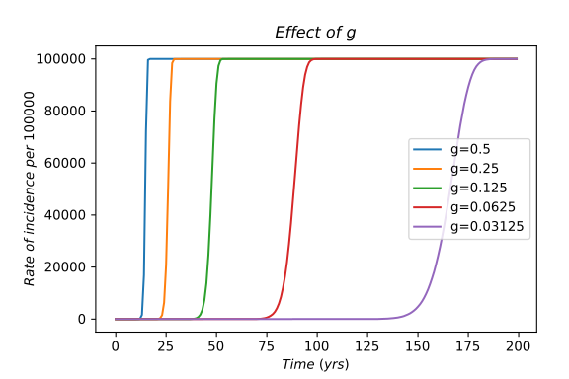
Linear-V1: Context-independent
Cumulative incidence

Slide 3
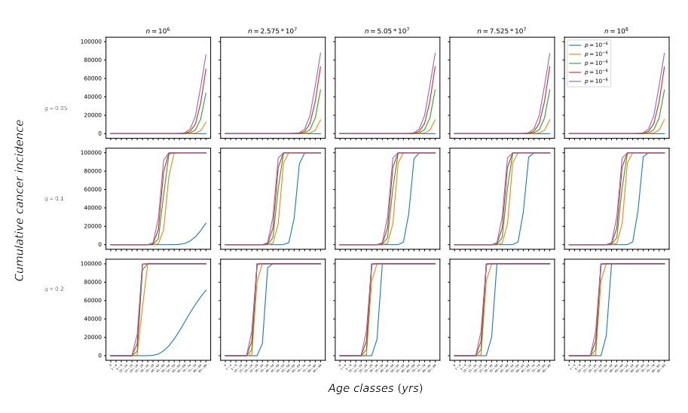

Slide 4
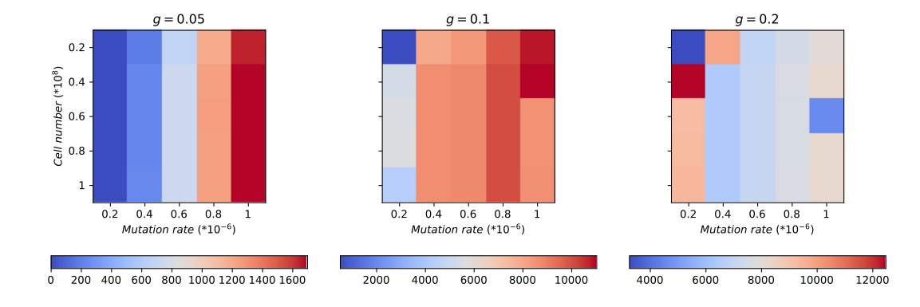
Linear-V1: Context-independent
Age-adjusted rate of incidence (per 100000)

Slide 5
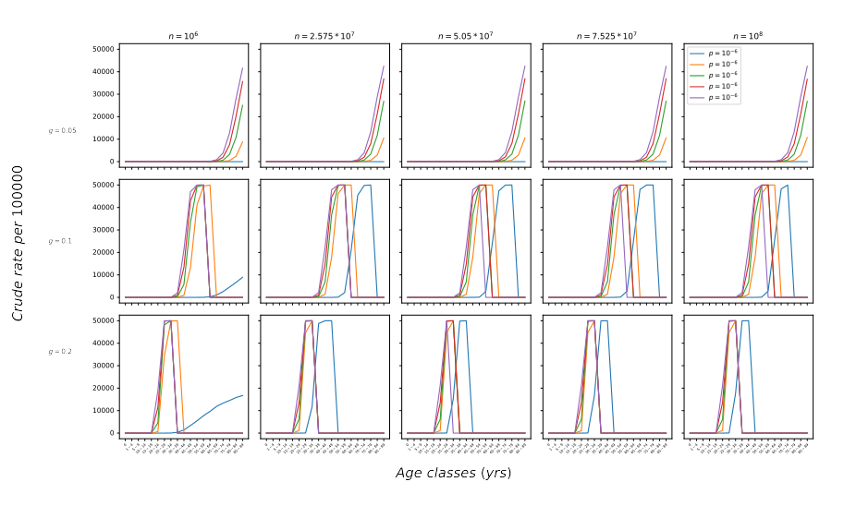
Linear-V1: Context-independent

Slide 6
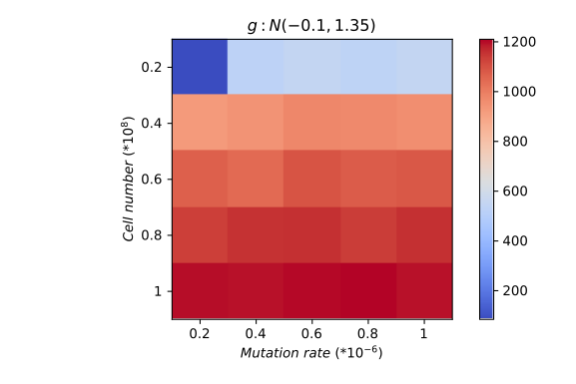
Linear-V2: Context-dependent
Age-adjusted rate of incidence (per 100000)

Slide 7
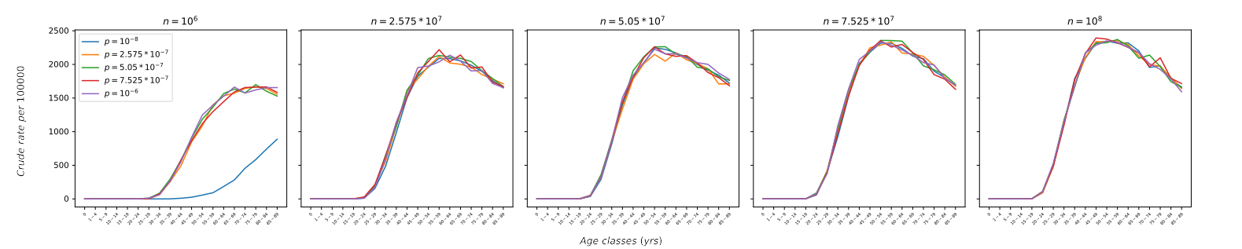
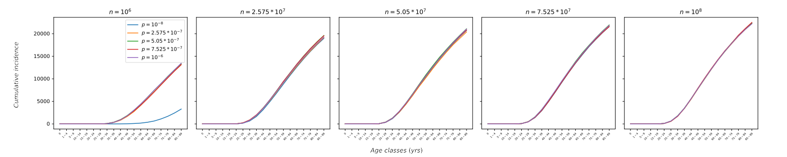
Linear-V2: Context-dependent

Slide 8

Linear-V3: Context + Age
Age-adjusted rate of incidence (per 100000)

Slide 9
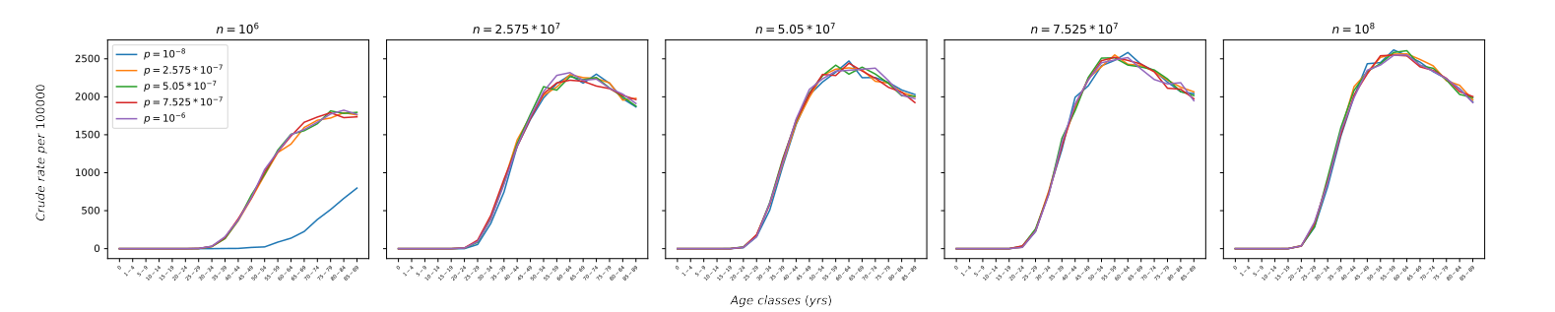
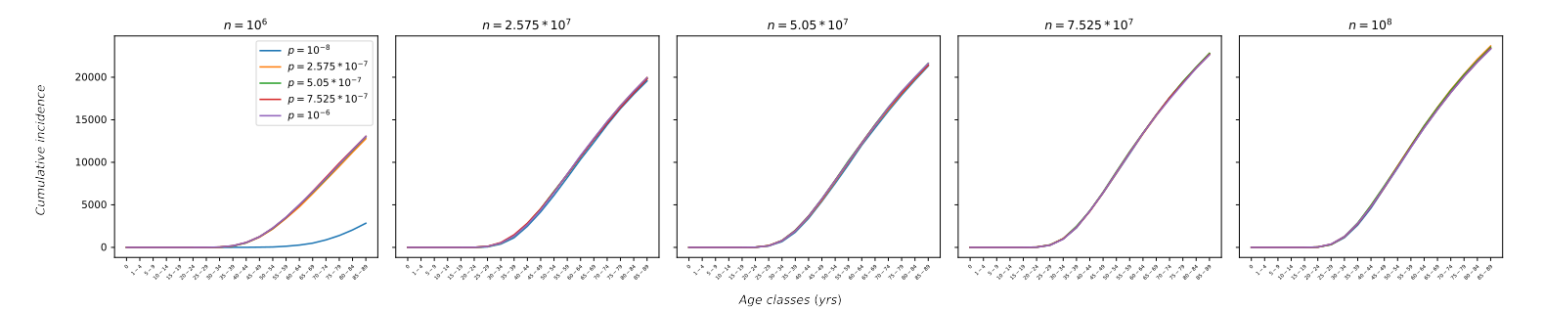
Linear-V3: Context + Age

