Slide 1
Cancer incidence models
29 June, 2018

Slide 2
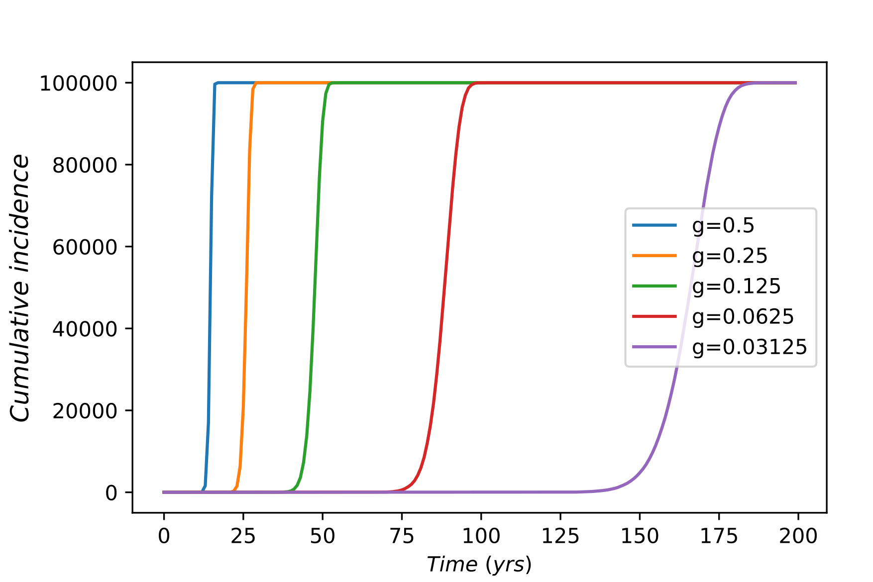
Linear-V1: Context-independent
Notes:
Direct counts of cancer cases at each age, instead of age classes, as would be done in later graphs.
This graph is cumulative incidence curves, which is the sum of crude rates per 100000 at each age up to the current point, for different values of g.
In each of the above curves, the simulation was run until cumulative incidence reaches 100000, which the size of the hypothetical population. This shows that when the value of g is the same for an entire population, it have sharp effects on the incidence patterns with age. Importantly, under the CI regime, any population can reach 100% cumulative incidence given enough time, and the age and sharpness of the inflection is determined by g.

Slide 3
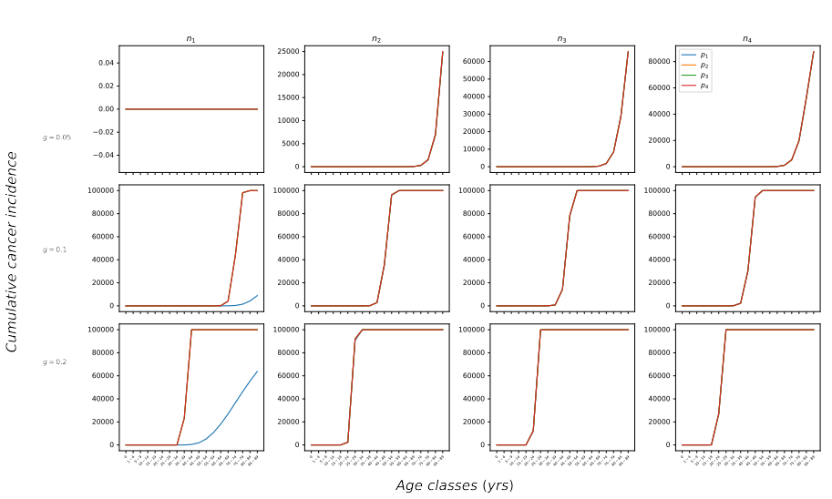
Linear-V1: Context-independent
Notes:
The effect of g on the point and steepness of inflection is again clear across the three rows.
Saturation with both n and p.
Values of n1-4 and p1-4

Slide 4
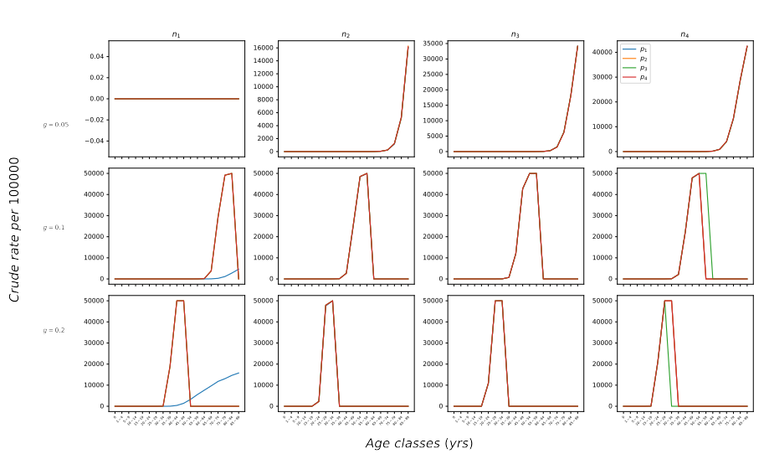
Linear-V1: Context-independent
Notes:
Same values of n1-4 and p1-4 as slide 3
Point of inflection corresponds to where crude rate per 100000 drops to zero.

Slide 5
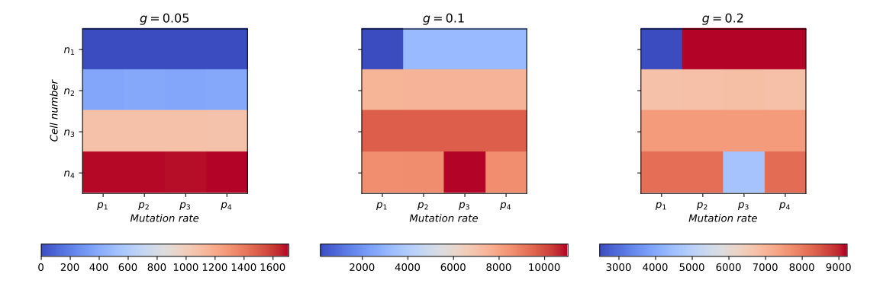
Linear-V1: Context-independent
Age-adjusted rate of incidence (per 100000)

Slide 6
Linear-V2: Context-dependent

Slide 7
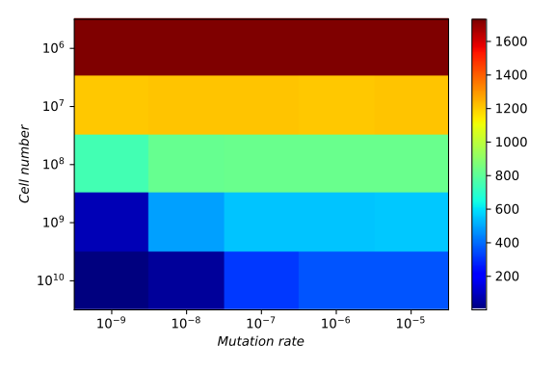
Linear-V2: n and p effects
Age-adjusted rate of incidence (per 100000)

Slide 8
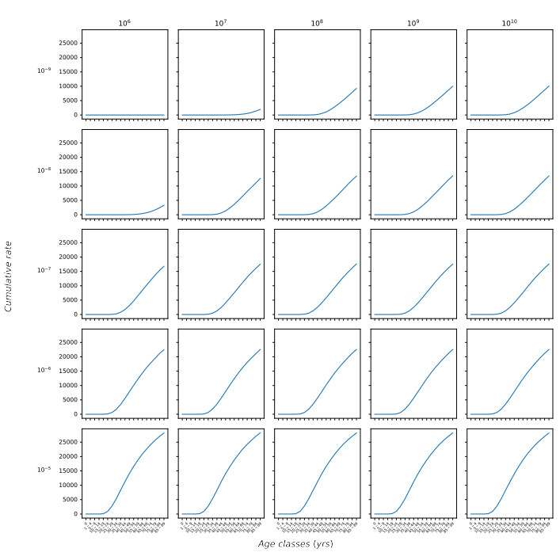
Linear-V2: n and p effects

Slide 9
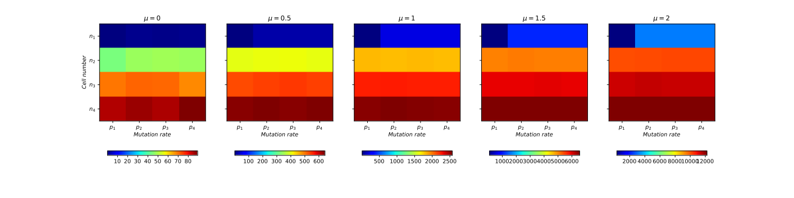
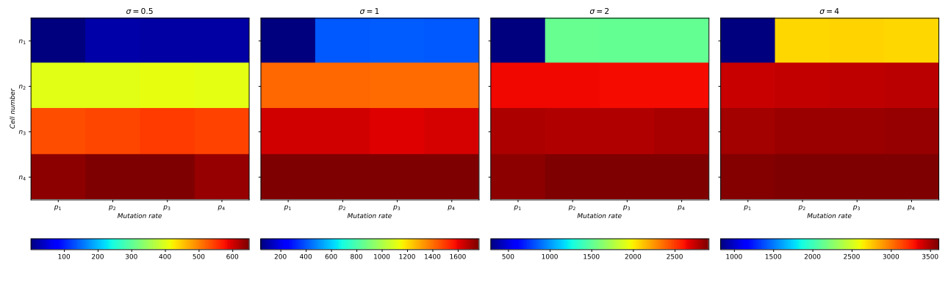
Linear-V2: g effects

Slide 10
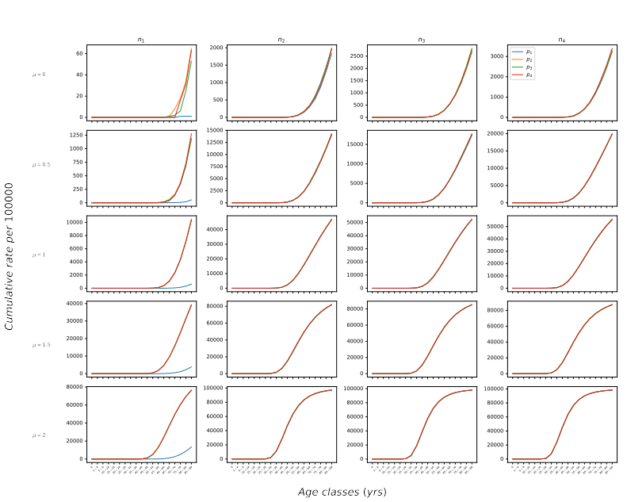
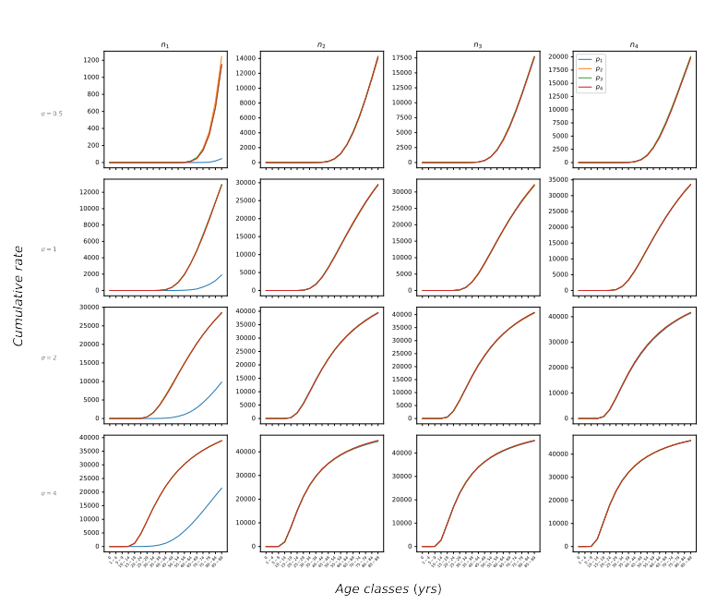
Linear V2: g effects

Slide 11
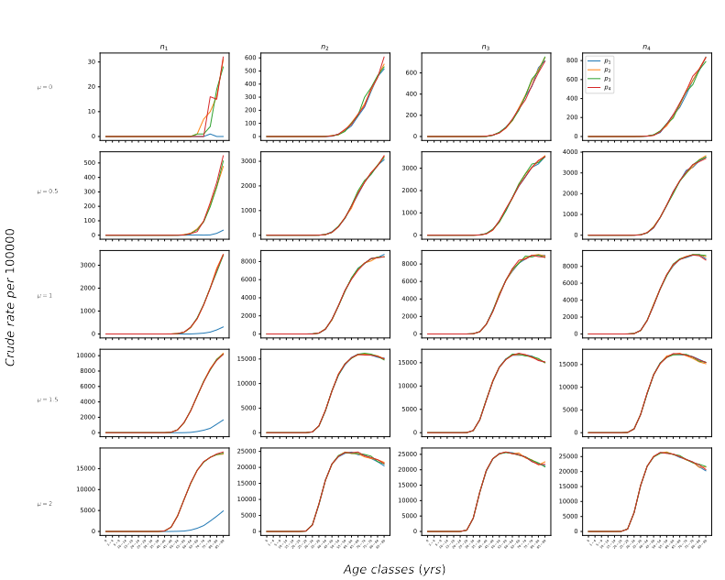
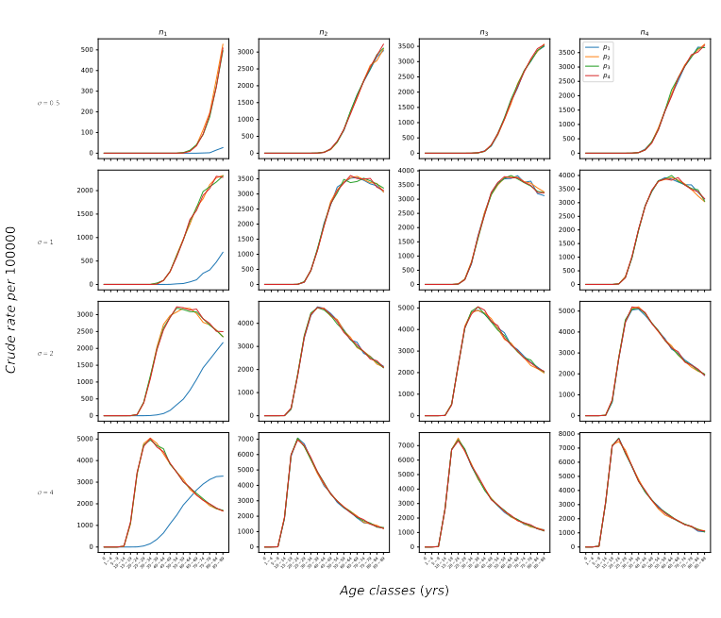
Linear V2: g effects

Slide 12
Linear-V3: Context + Age

Slide 13
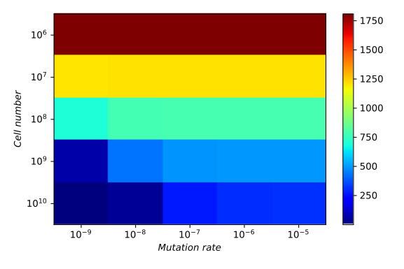
Linear-V3: n and p effects
Age-adjusted rate of incidence (per 100000)

Slide 14
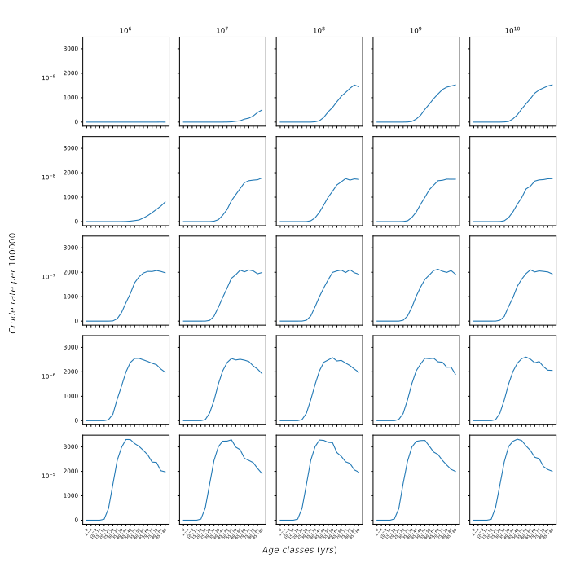
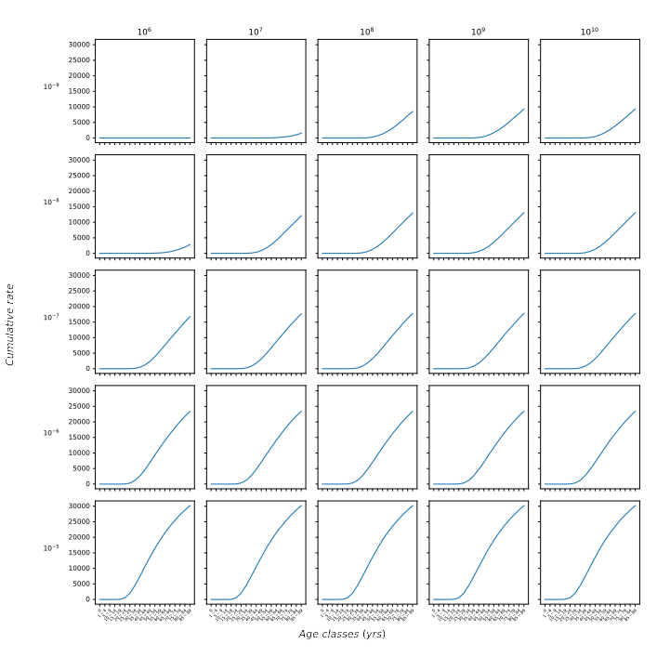
Linear-V3: n and p effects

Slide 15
Linear-V3: g effects

Slide 16
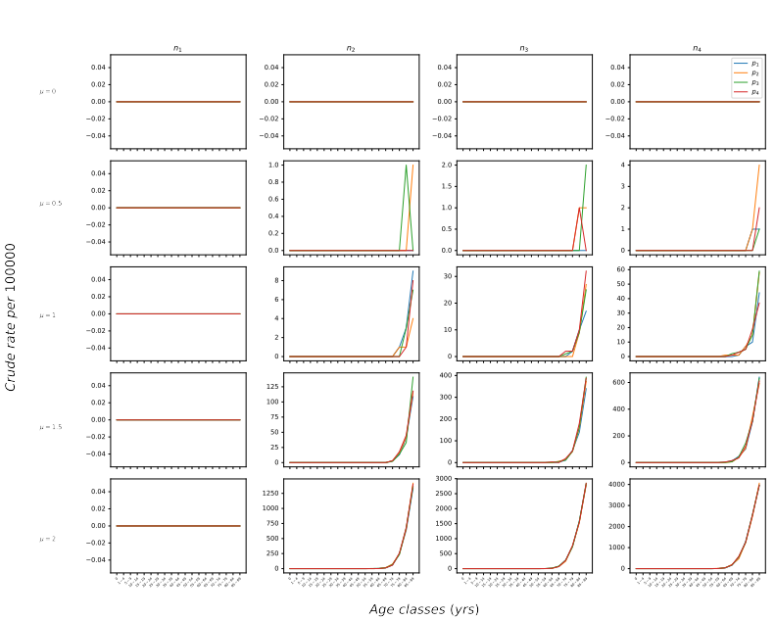
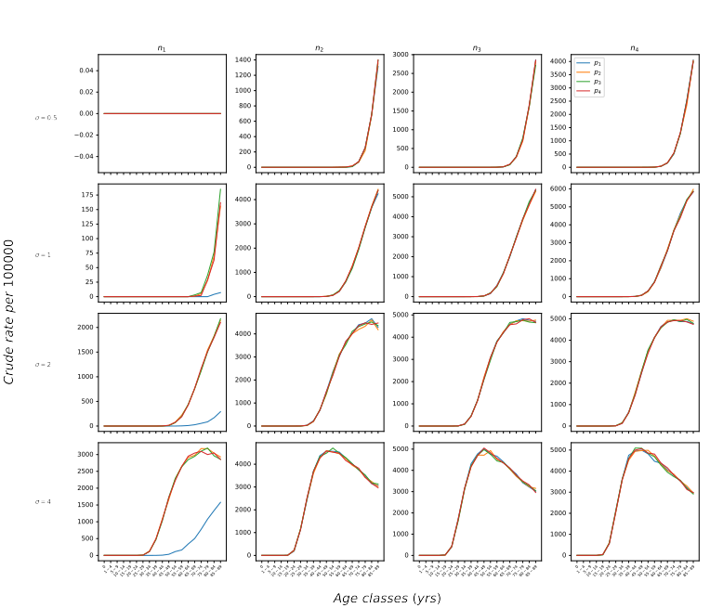
Linear-V3: g effects

Slide 17
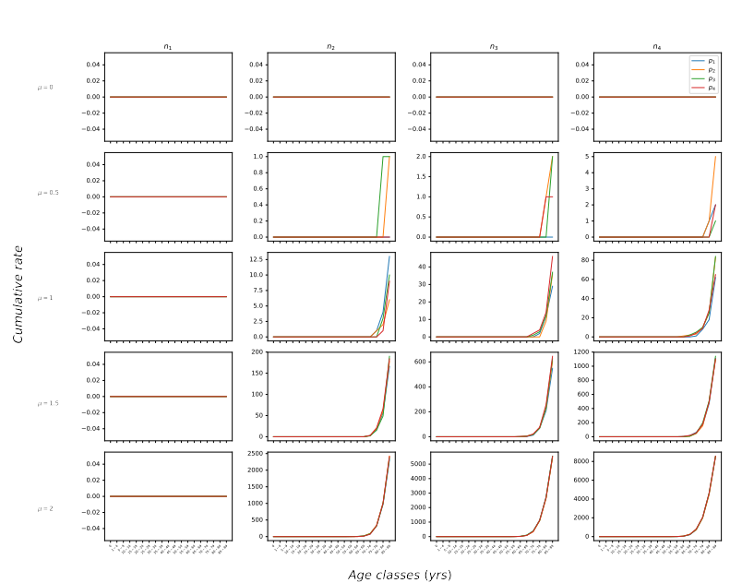
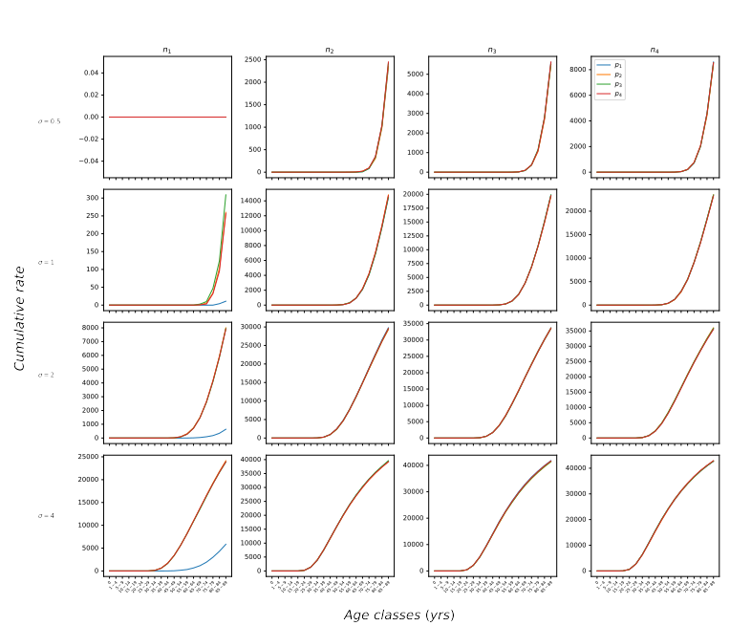
Linear-V3: g effects

