Slide 1
Additional figures from linear-model

Slide 2
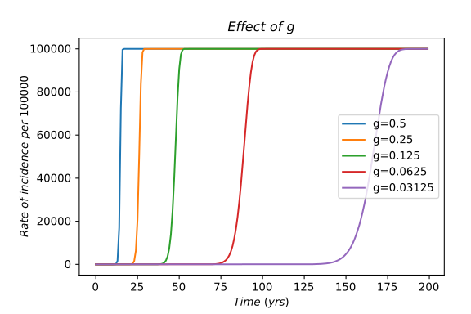
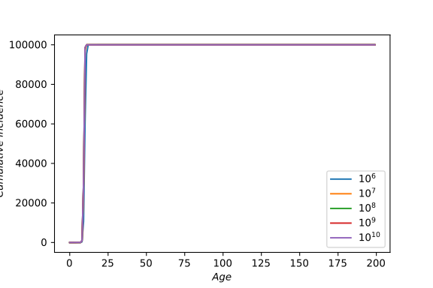
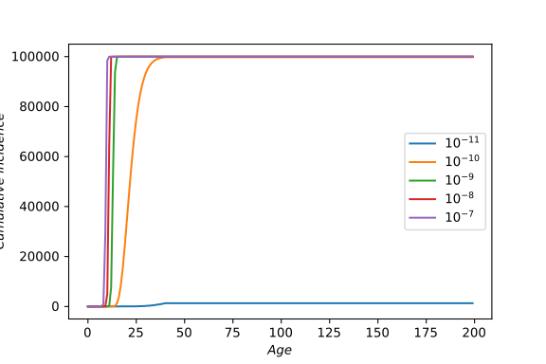
Context-independent

Slide 3
Context-independent
Cell number | Half age |  | Mutation rate | Half age |  | Growth rate | Half age
1000000 | 10 |  | 1E-11 | 36 |  | 0.5 | 16
10000000 | 10 |  | 1E-10 | 22 |  | 0.25 | 27
100000000 | 10 |  | 1E-09 | 13 |  | 0.125 | 49
1000000000 | 10 |  | 1E-08 | 11 |  | 0.0625 | 90
10000000000 | 10 |  | 1E-09 | 10 |  | 0.03125 | 168

Slide 4
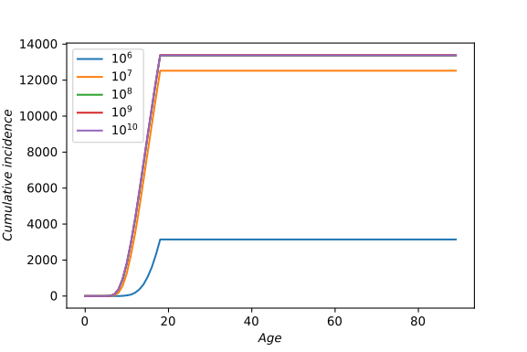
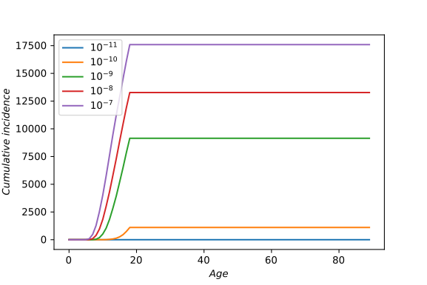
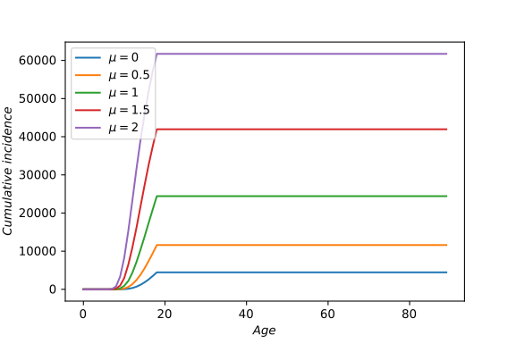
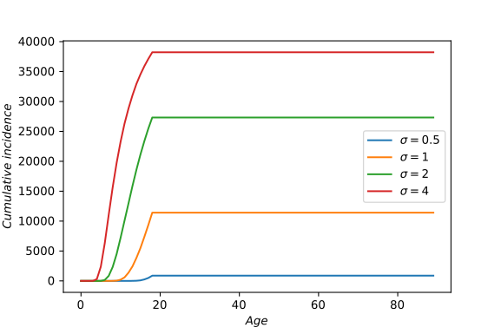
Context-dependent
Notes:
For top two, g = N(-0.1, 1.35)
For bottom two, n = 10^8, p = 10^-9

Slide 5
Context-dependent
Cell number | Half age |  | Mutation rate | Half age
1000000 | 17 |  | 1E-11 | NA
10000000 | 16 |  | 1E-10 | 18
100000000 | 15 |  | 1E-09 | 16
1000000000 | 15 |  | 1E-08 | 15
10000000000 | 15 |  | 1E-07 | 14
Gmean | Half age |  | Gvar | Half age
0 | 17 |  | 0.5 | 18
0.5 | 17 |  | 1 | 17
1 | 16 |  | 2 | 14
1.5 | 15 |  | 4 | 10
2 | 14

Slide 6
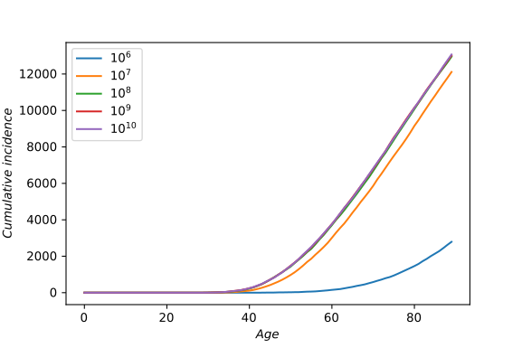
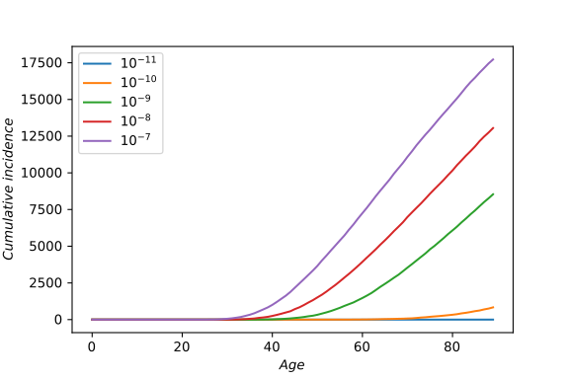
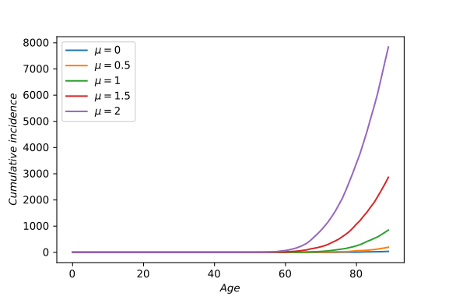
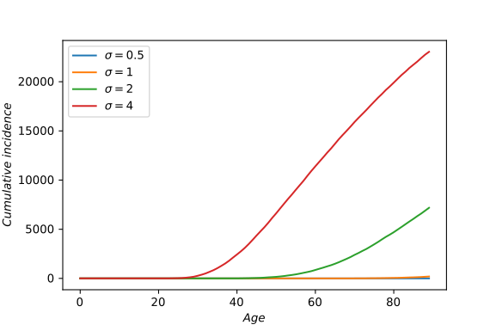
Context+age
Notes:
For top two, g = N(0.2, 3.5)
For bottom two, n = 10^8, p = 10^-9

Slide 7
Context+age
$Cell\ number$ | Half age |  | $Mutation\ rate$ | Half age
1000000 | 81 |  | 1E-11 | NA
10000000 | 72 |  | 1E-10 | 82
100000000 | 71 |  | 1E-09 | 74
1000000000 | 71 |  | 1E-08 | 70
10000000000 | 71 |  | 1E-07 | 66
Gmean | Half age |  | Var(g) | Half age
0 | 84 |  | 0.5 | NA
0.5 | 86 |  | 1 | 85
1 | 85 |  | 2 | 77
1.5 | 84 |  | 4 | 62
2 | 83

Slide 8
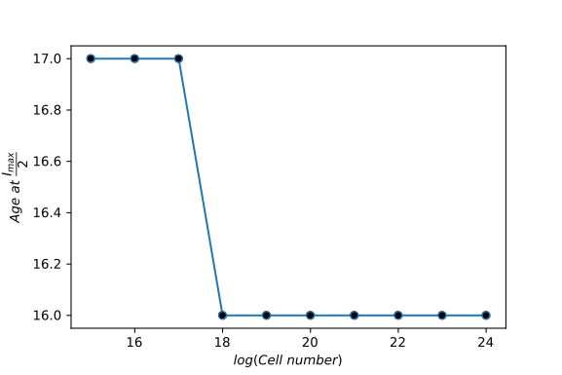
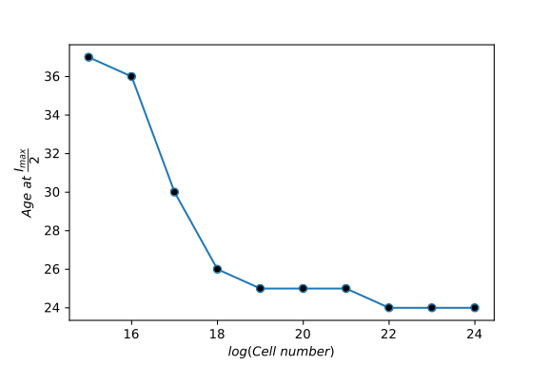
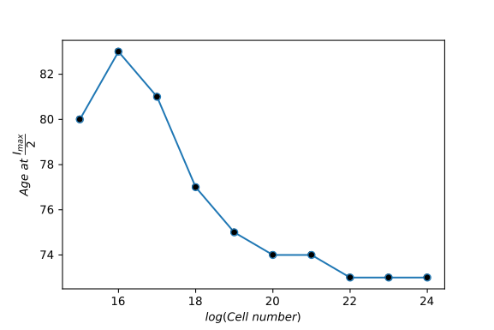
Age at Imax/2

Slide 9
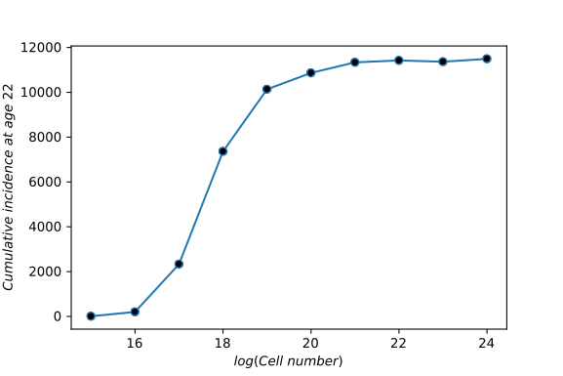
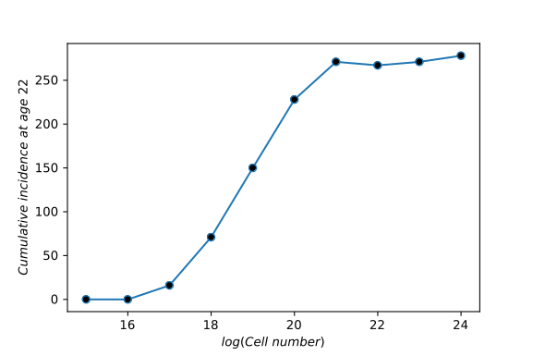
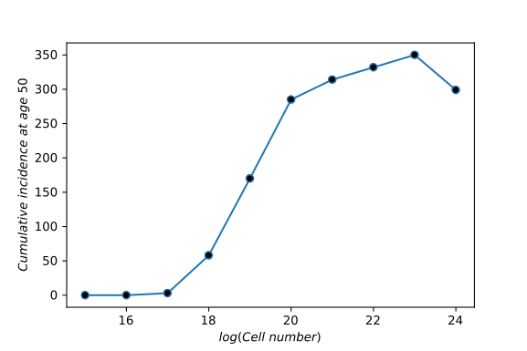
Incidence at an age vs log(n)

Slide 10
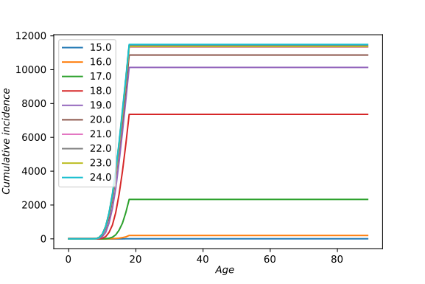
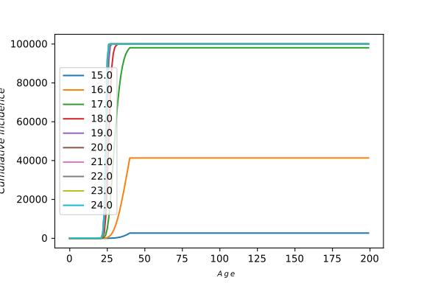
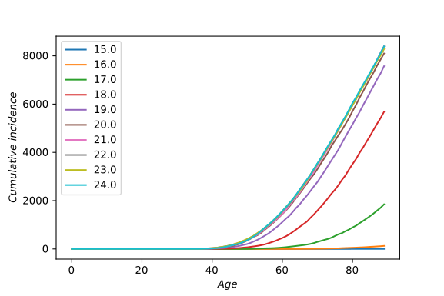
Cumulative incidence

Slide 11
Coding error
Figures in slides 4-10 all have the same coding error running through them-
  Cancer was counted in bins in the simulation, but crude and cumulative rates were calculated treating them as unbinned.
Error was corrected on 7th August, 2018, and following slides have replacement figures.

Slide 12
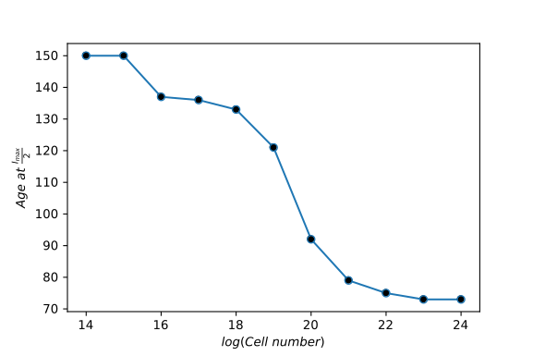
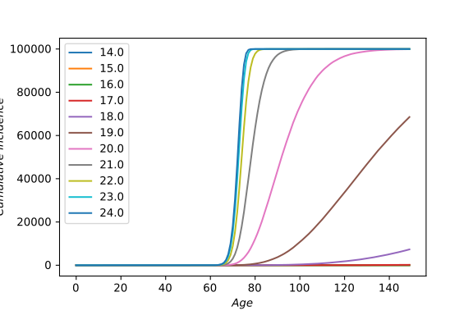
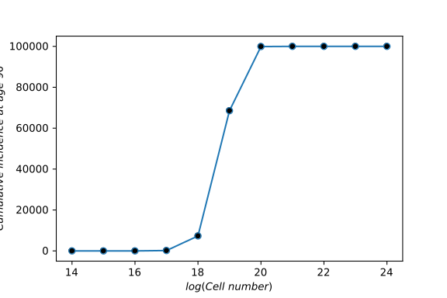
Context-independent-effect of n

Slide 13
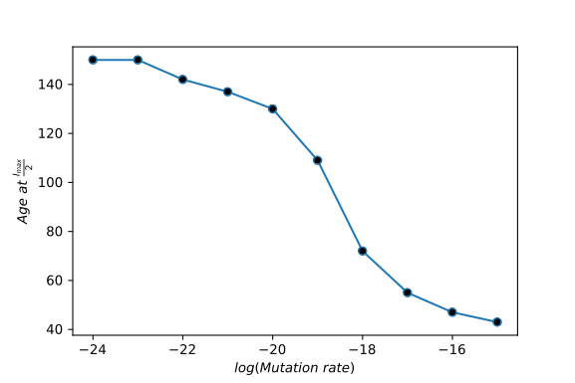
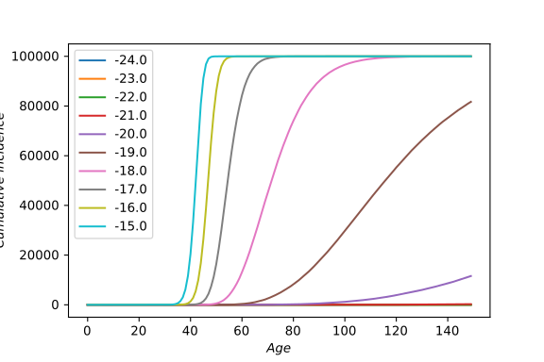
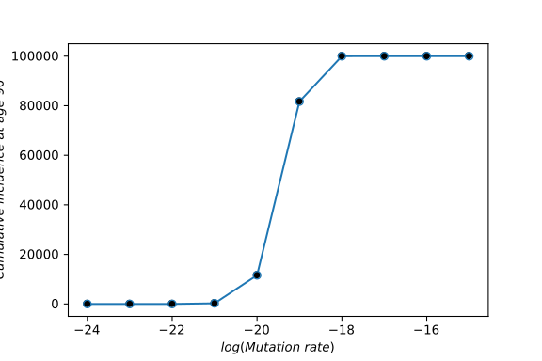
Context-independent-effect of p

Slide 14
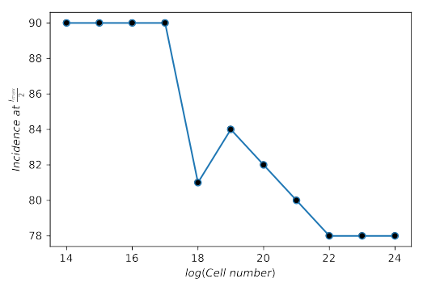
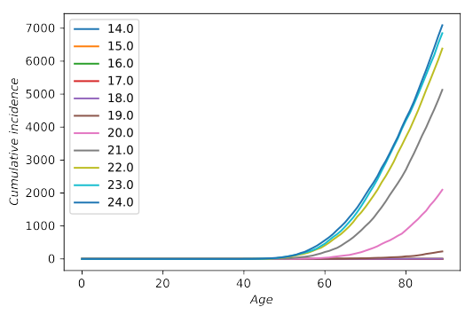
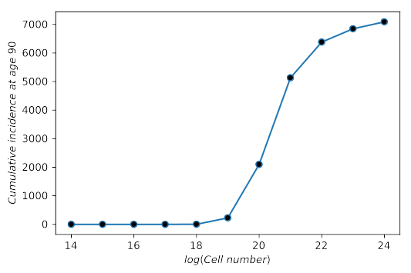
Context-dependent-effect of n

Slide 15
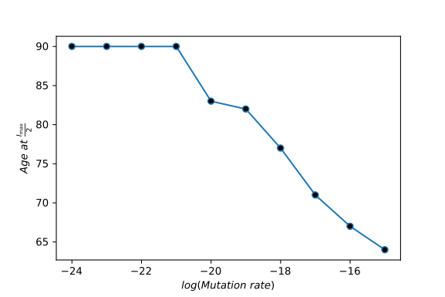
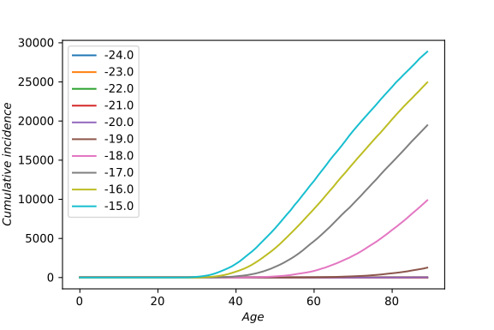
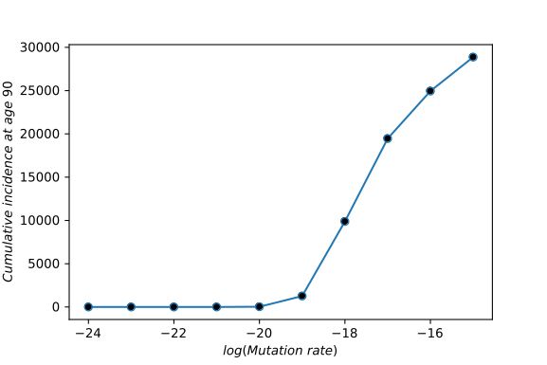
Context-dependent-effect of p

Slide 16
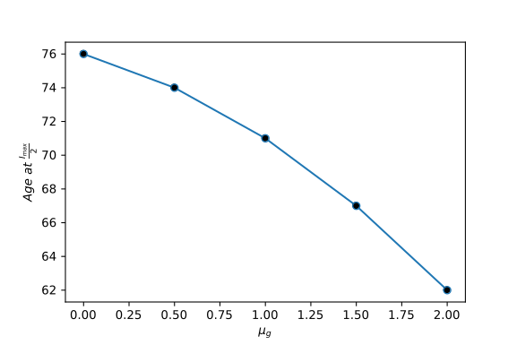
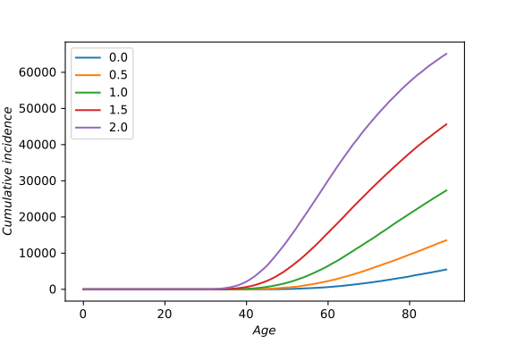
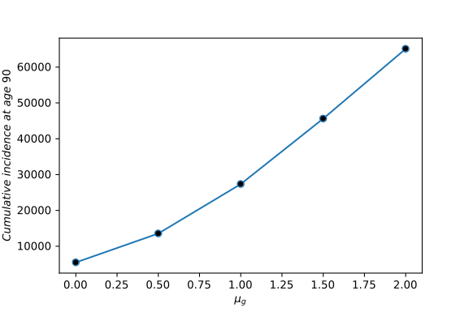
Context-dependent-mean(g)

Slide 17
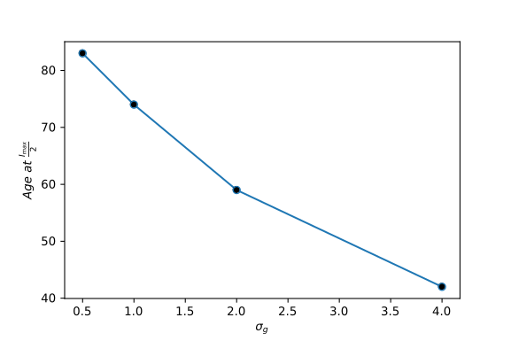
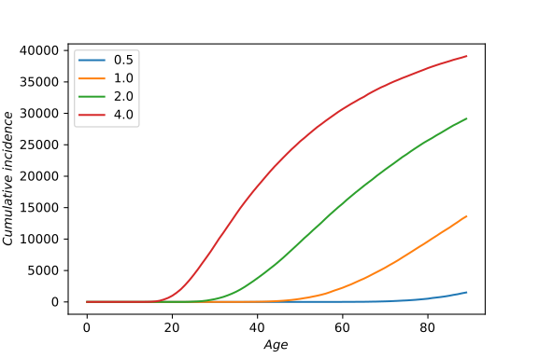
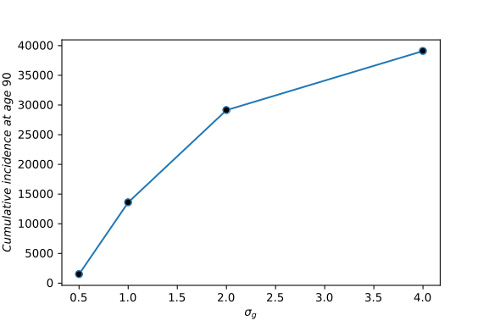
Context-dependent-Var(g)

Slide 18
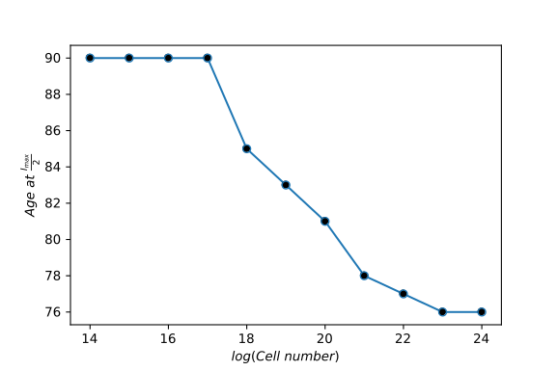
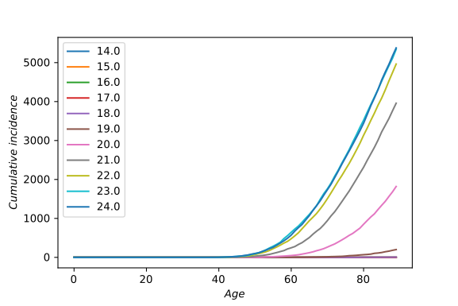
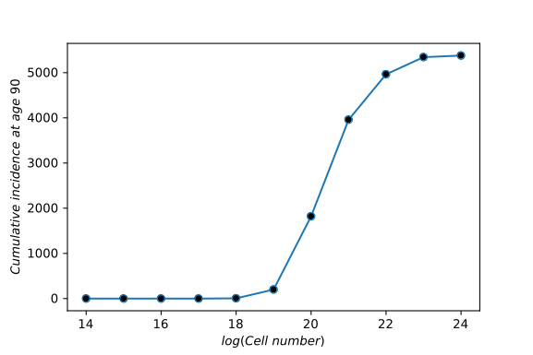
Context+Age-effect of n

Slide 19
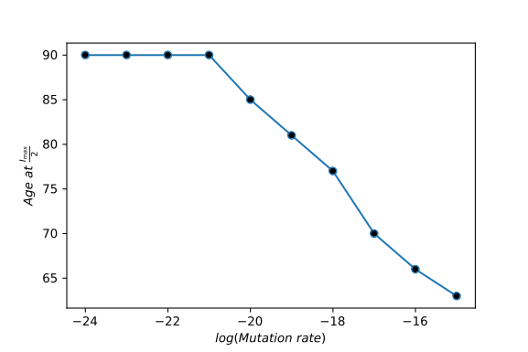
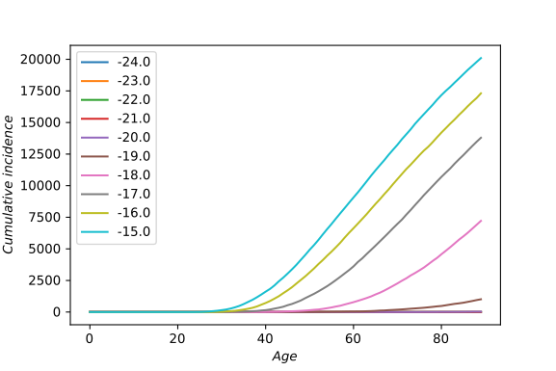
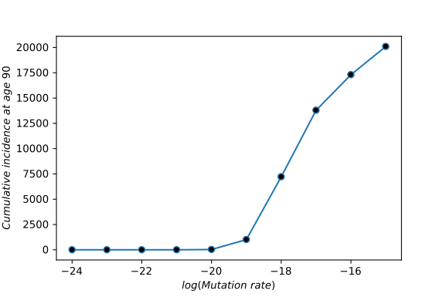
Context+Age-effect of p

Slide 20
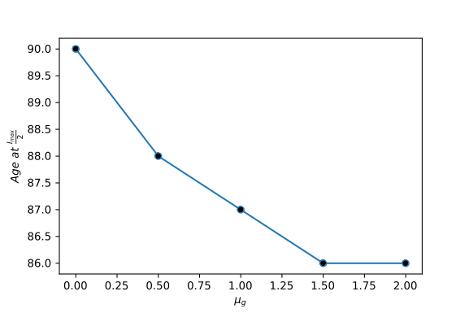
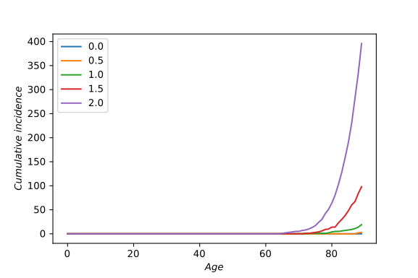
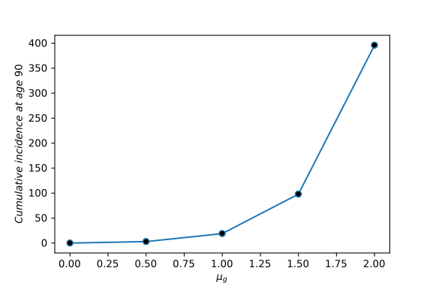
Context+Age-mean(g)

Slide 21
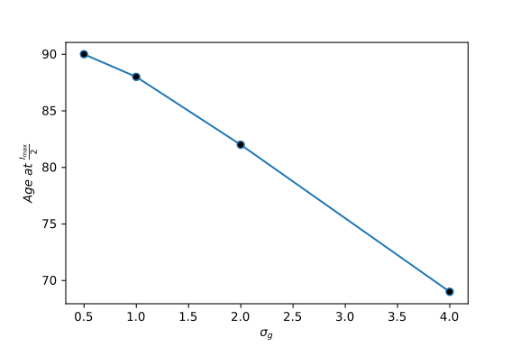
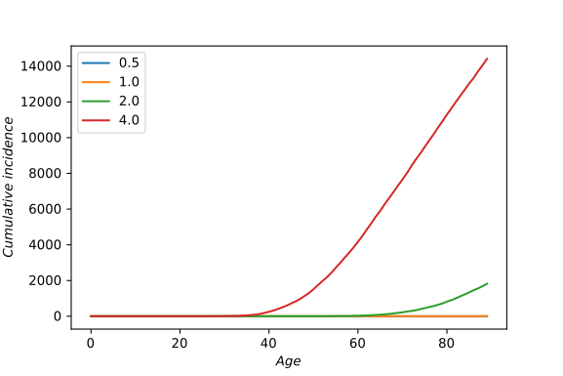
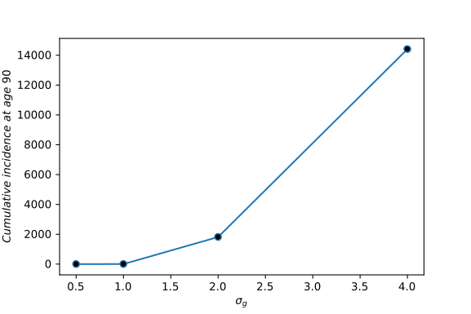
Context+Age-Var(g)

