Slide 1
Uptake-secretion network model
Power law consumption pattern of metabolites in cancer
Updates as of 20 Jun 2025
Vibishan B

Slide 2
Description of plots
Correlation b/w experimentally measured and model-predicted extracellular metabolome for all cell lines from Jain et al.
Heatmaps:
Pearson’s coefficient
Final cell number (for 1-celltype) and frequency of most abundant cell type (for 2- or more celltypes)
Slope of the measured vs predicted metabolome regression (ignore the figure title that says diet vs metabolome)
Intercept of the same
All of the above plots with and without the in-degree assumption

Slide 3
1-celltype, with in-degree

Slide 4
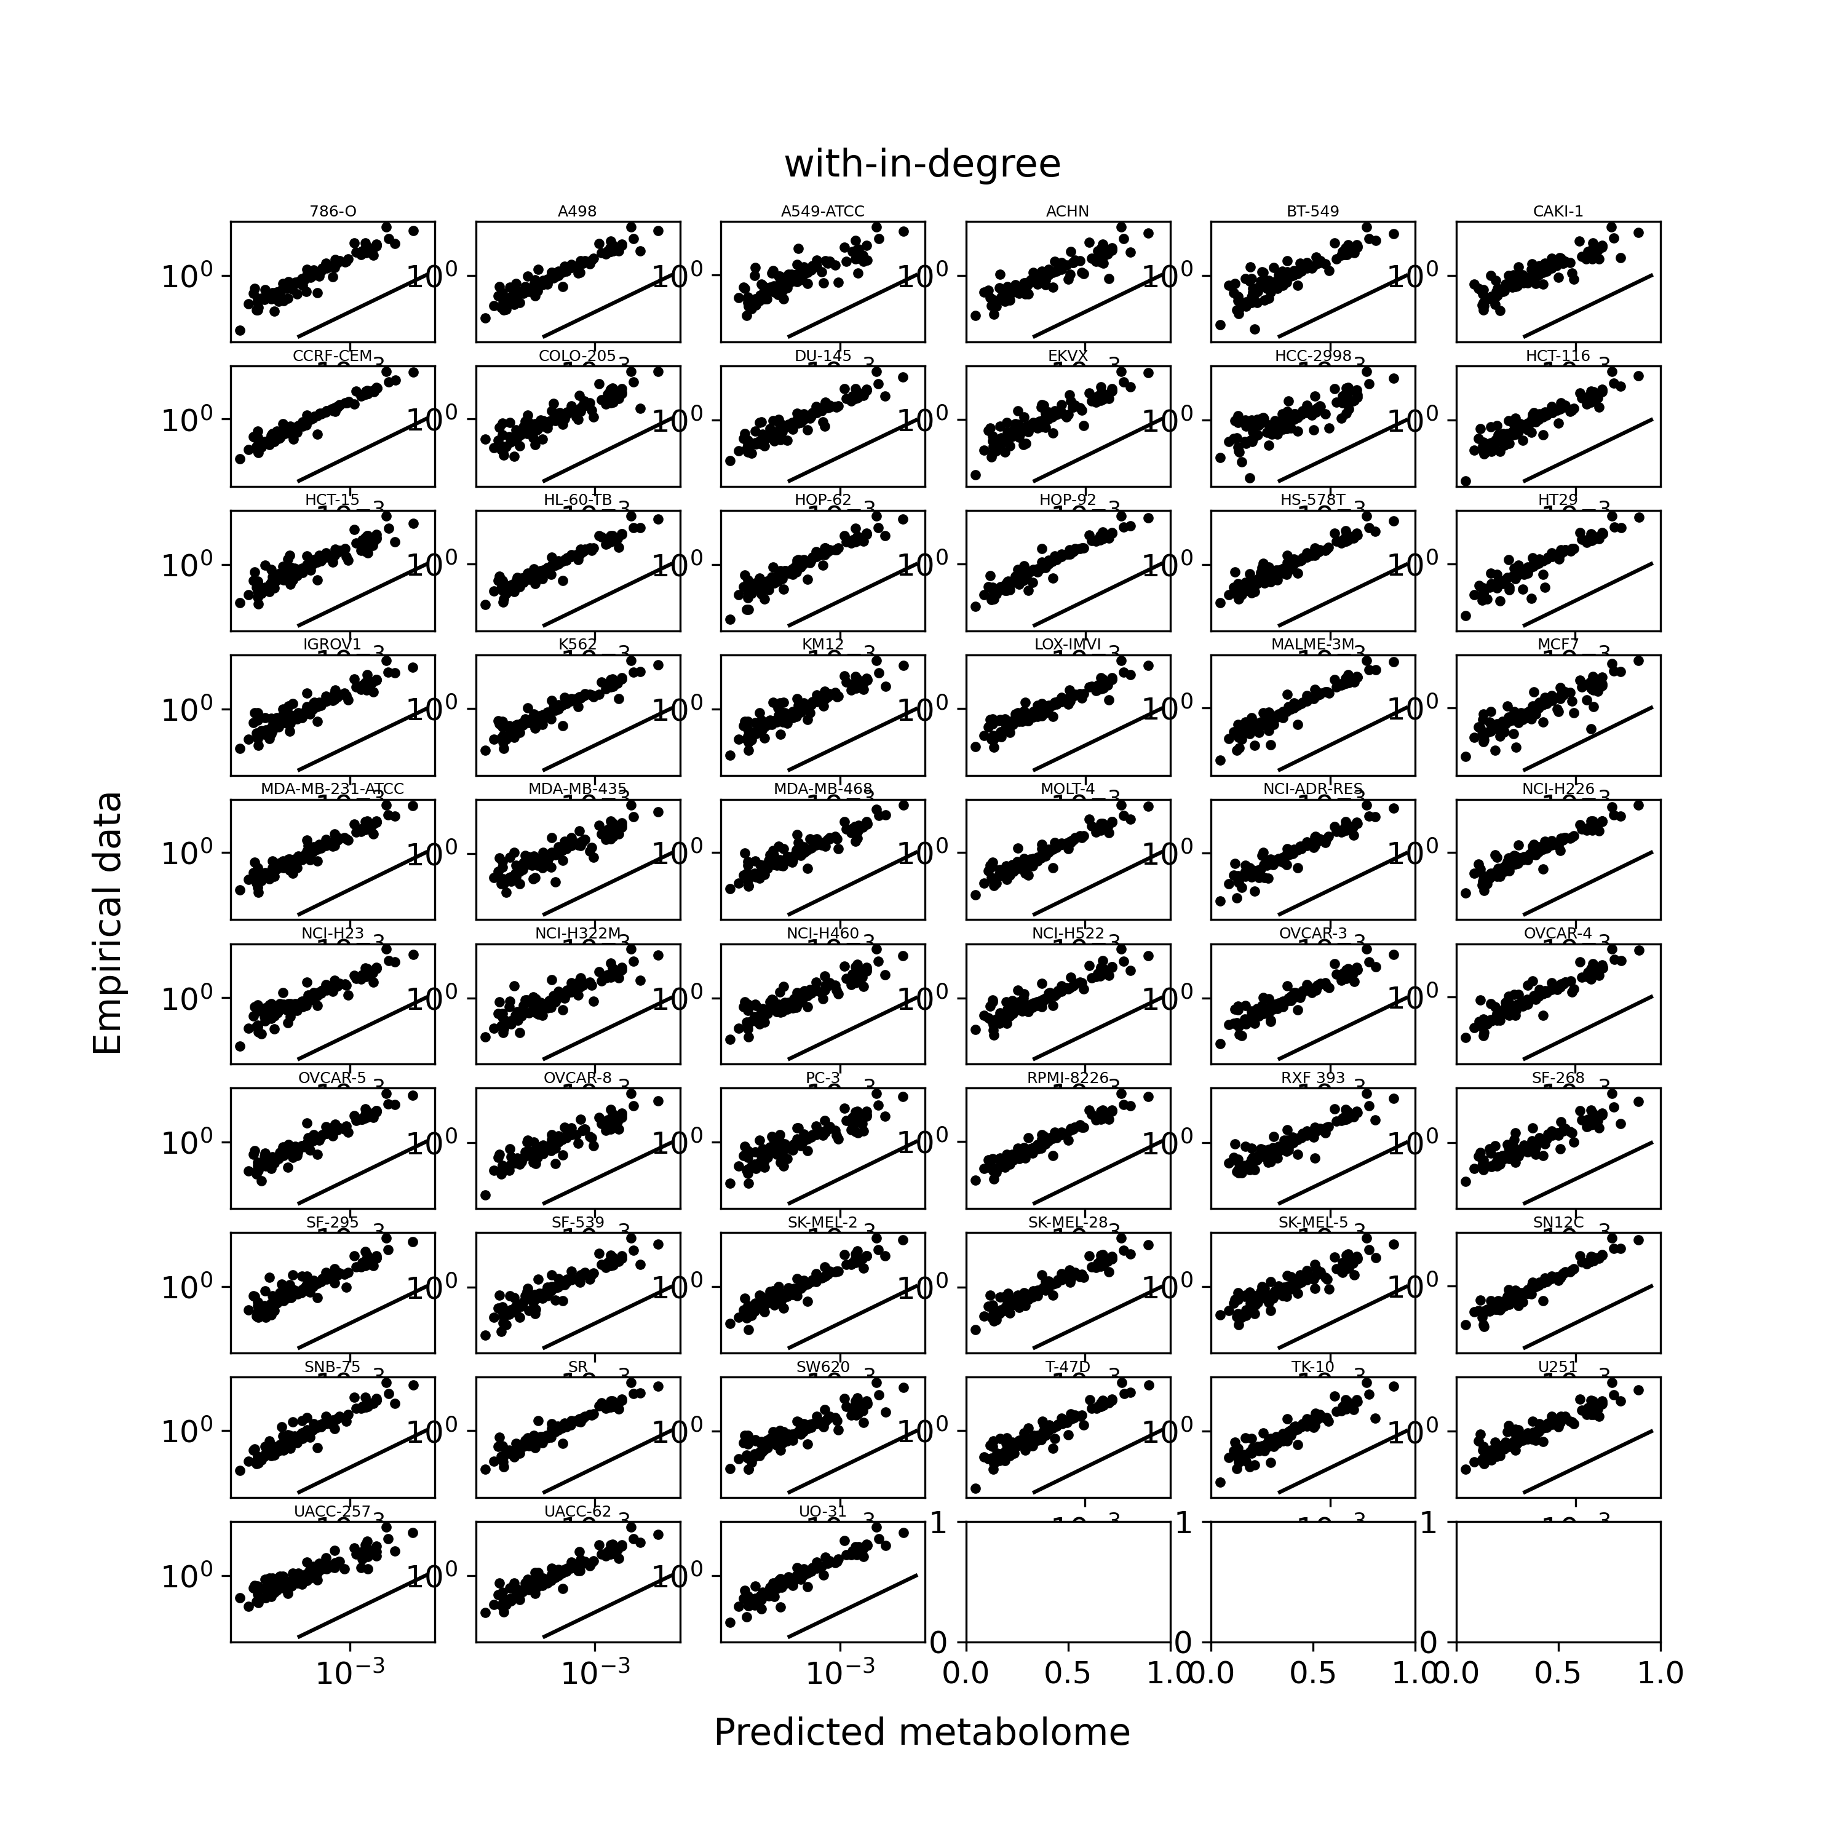
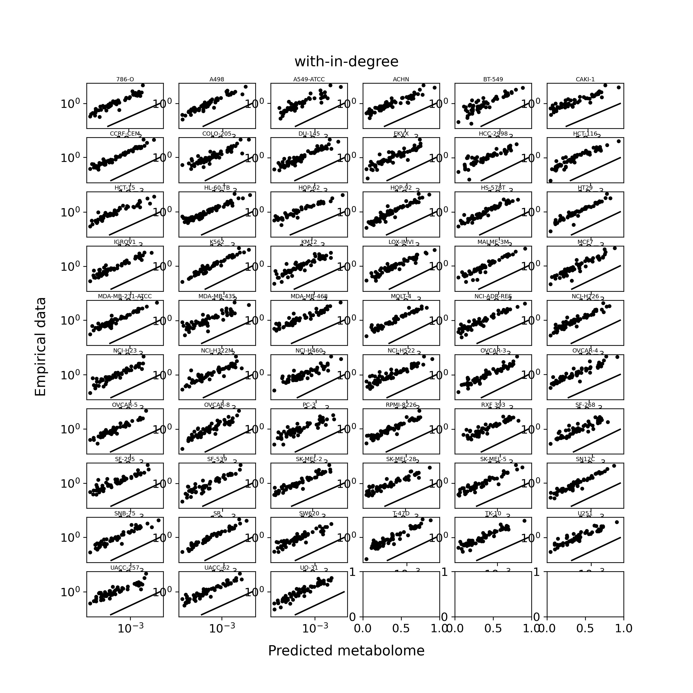
Static network
f = 0.775
Random network

Slide 5
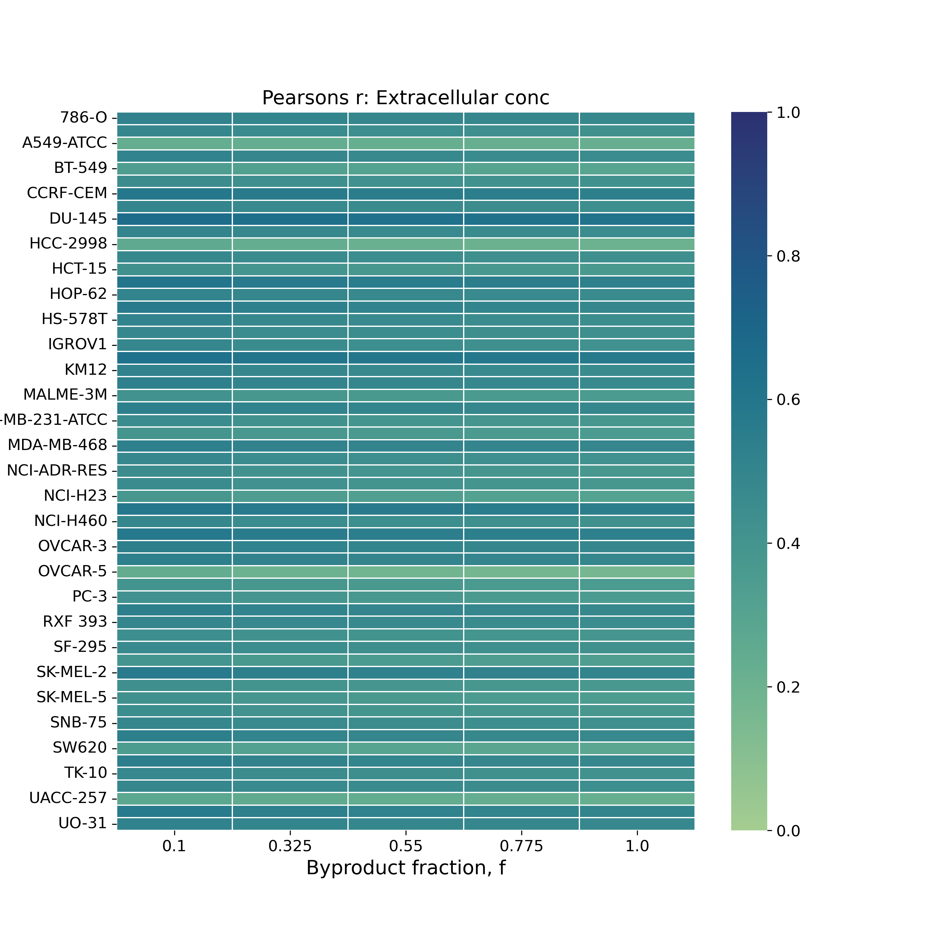
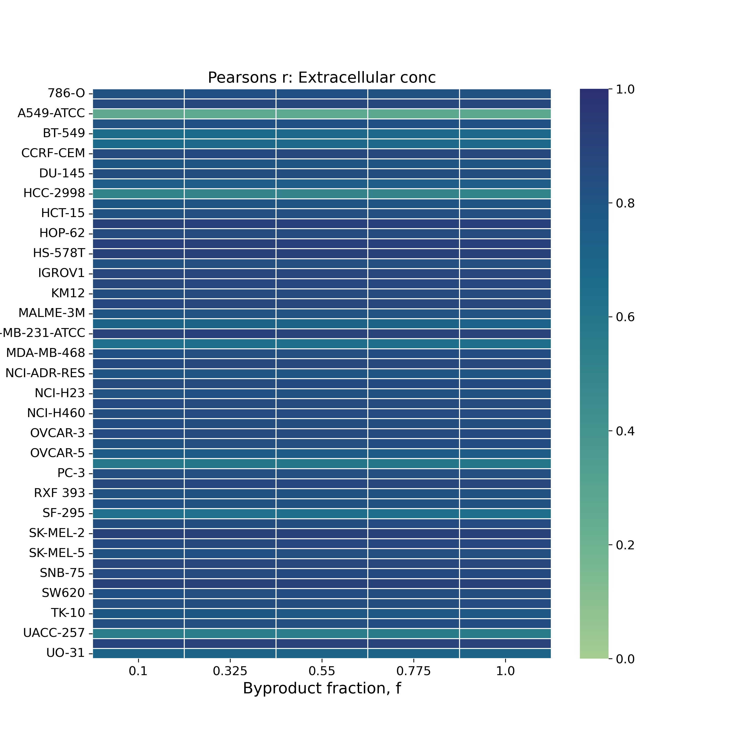
Static network
Random network

Slide 6
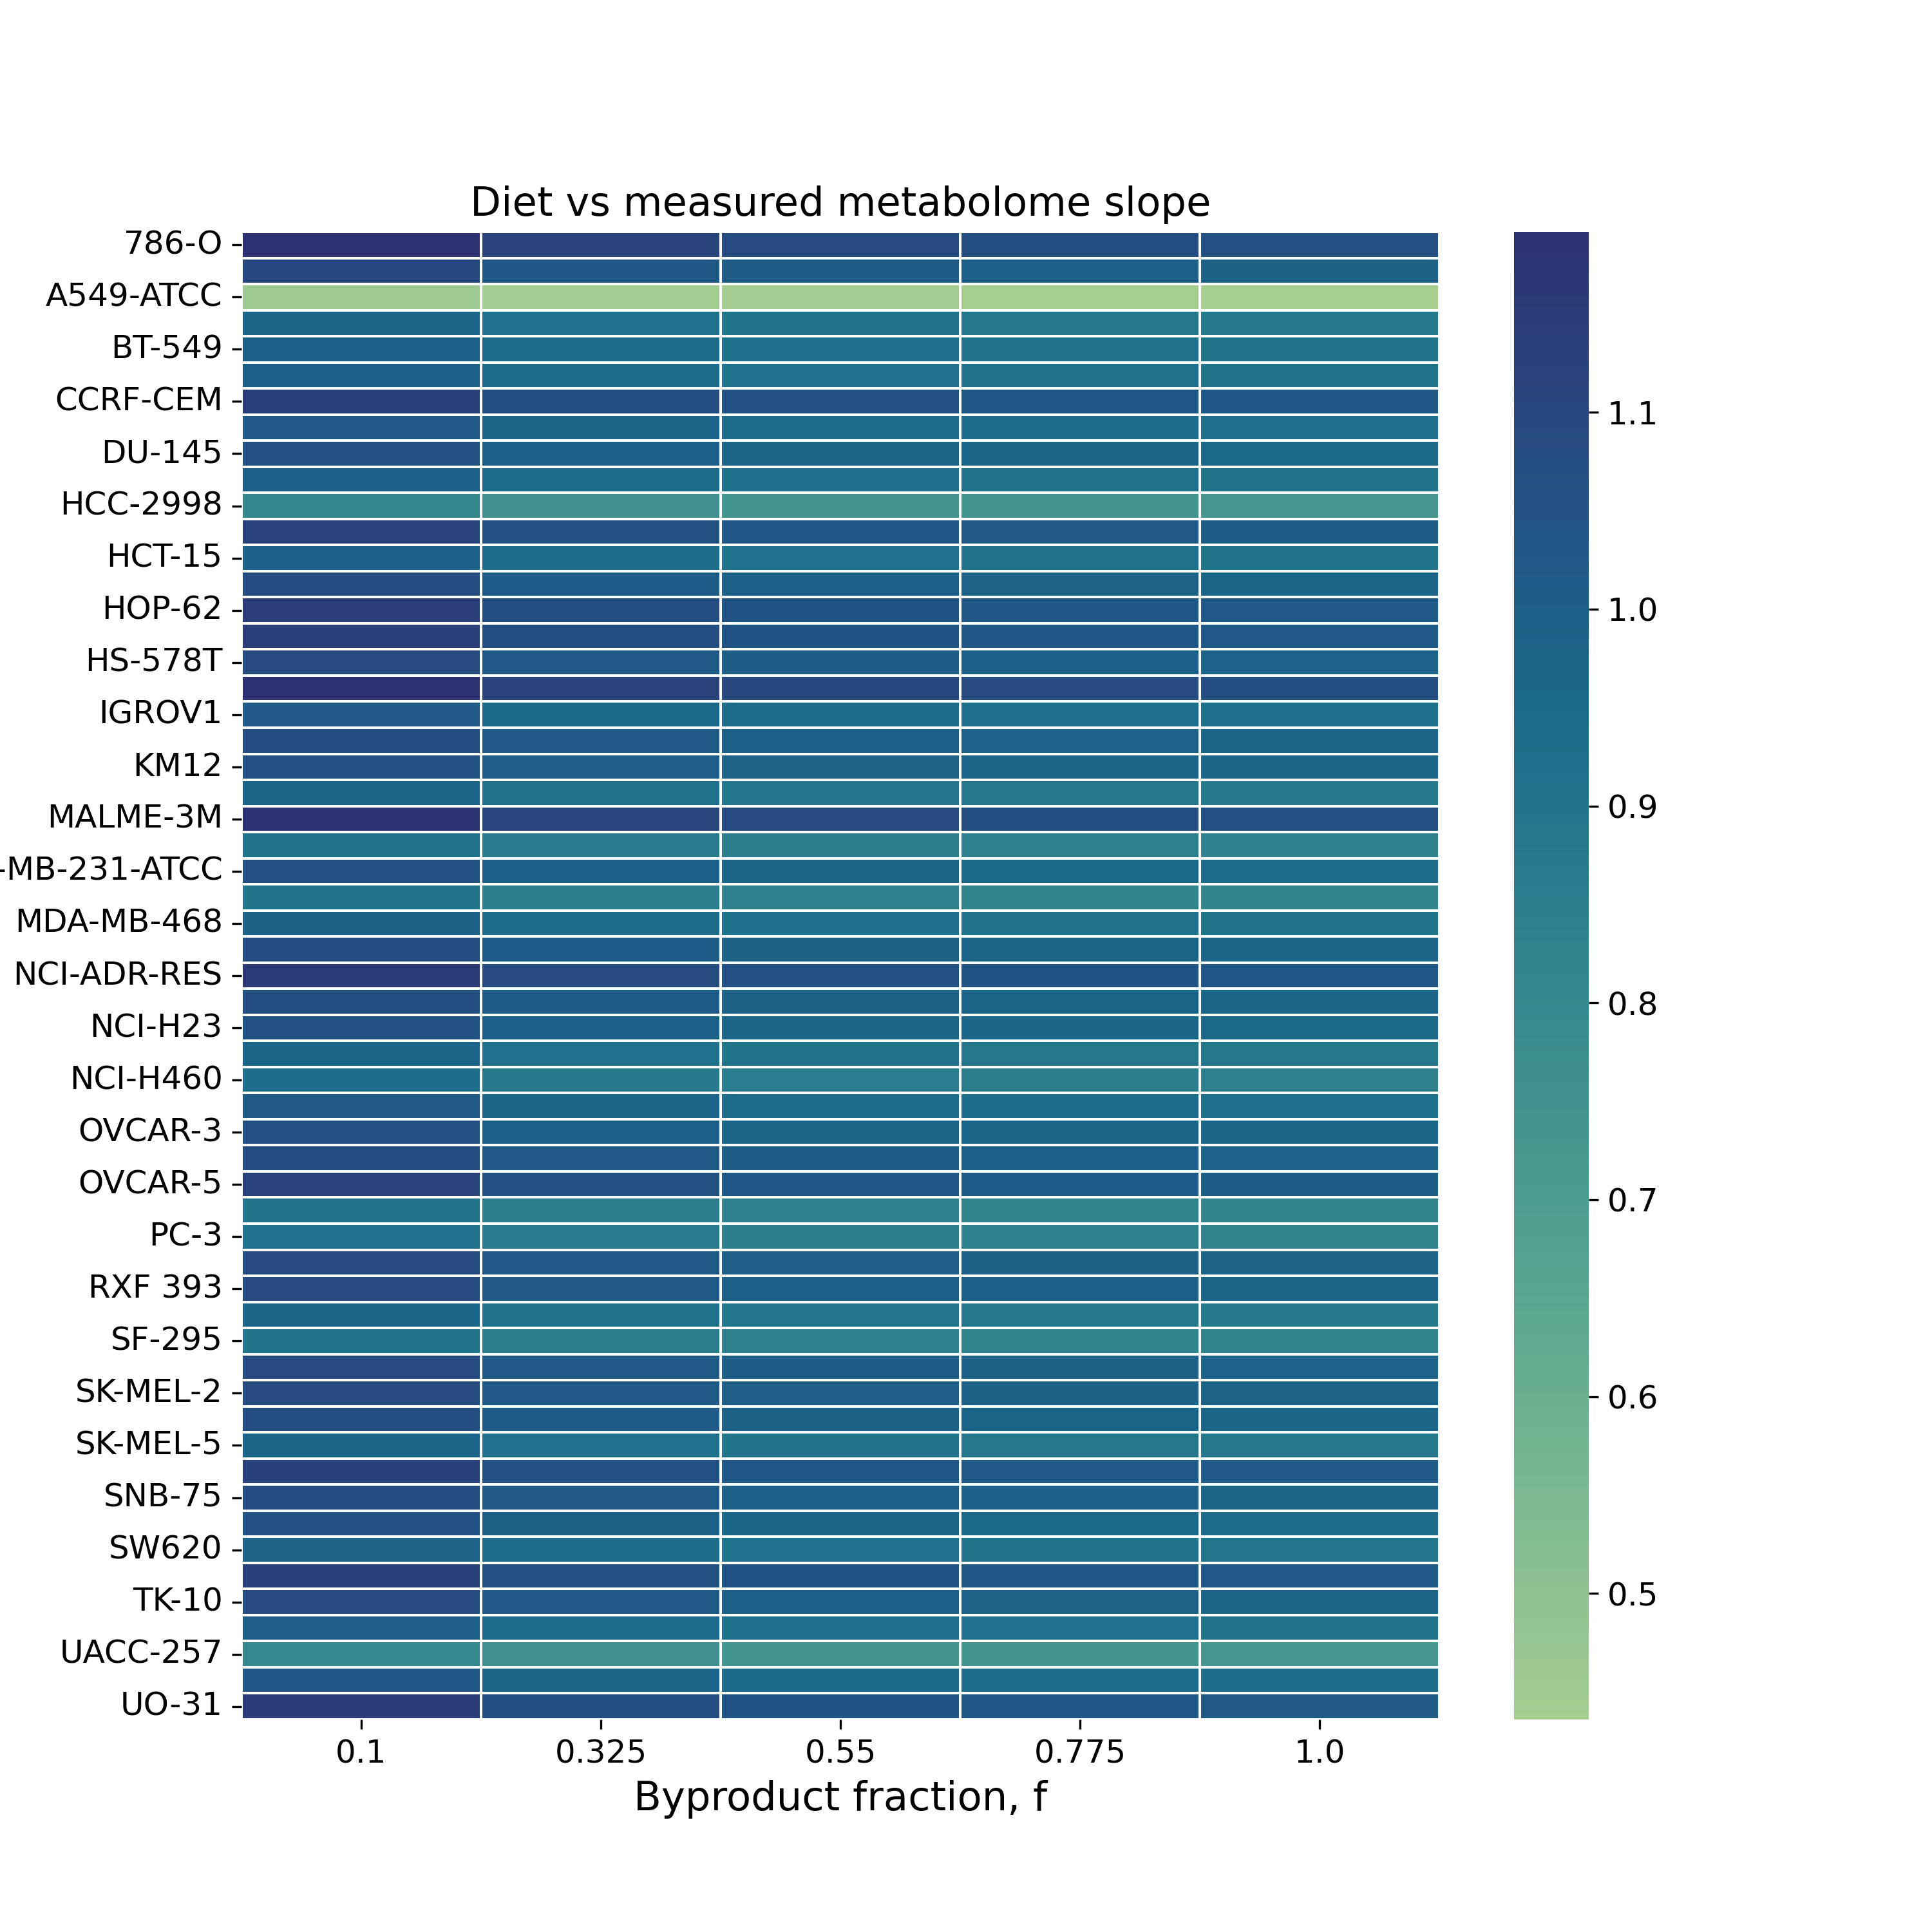
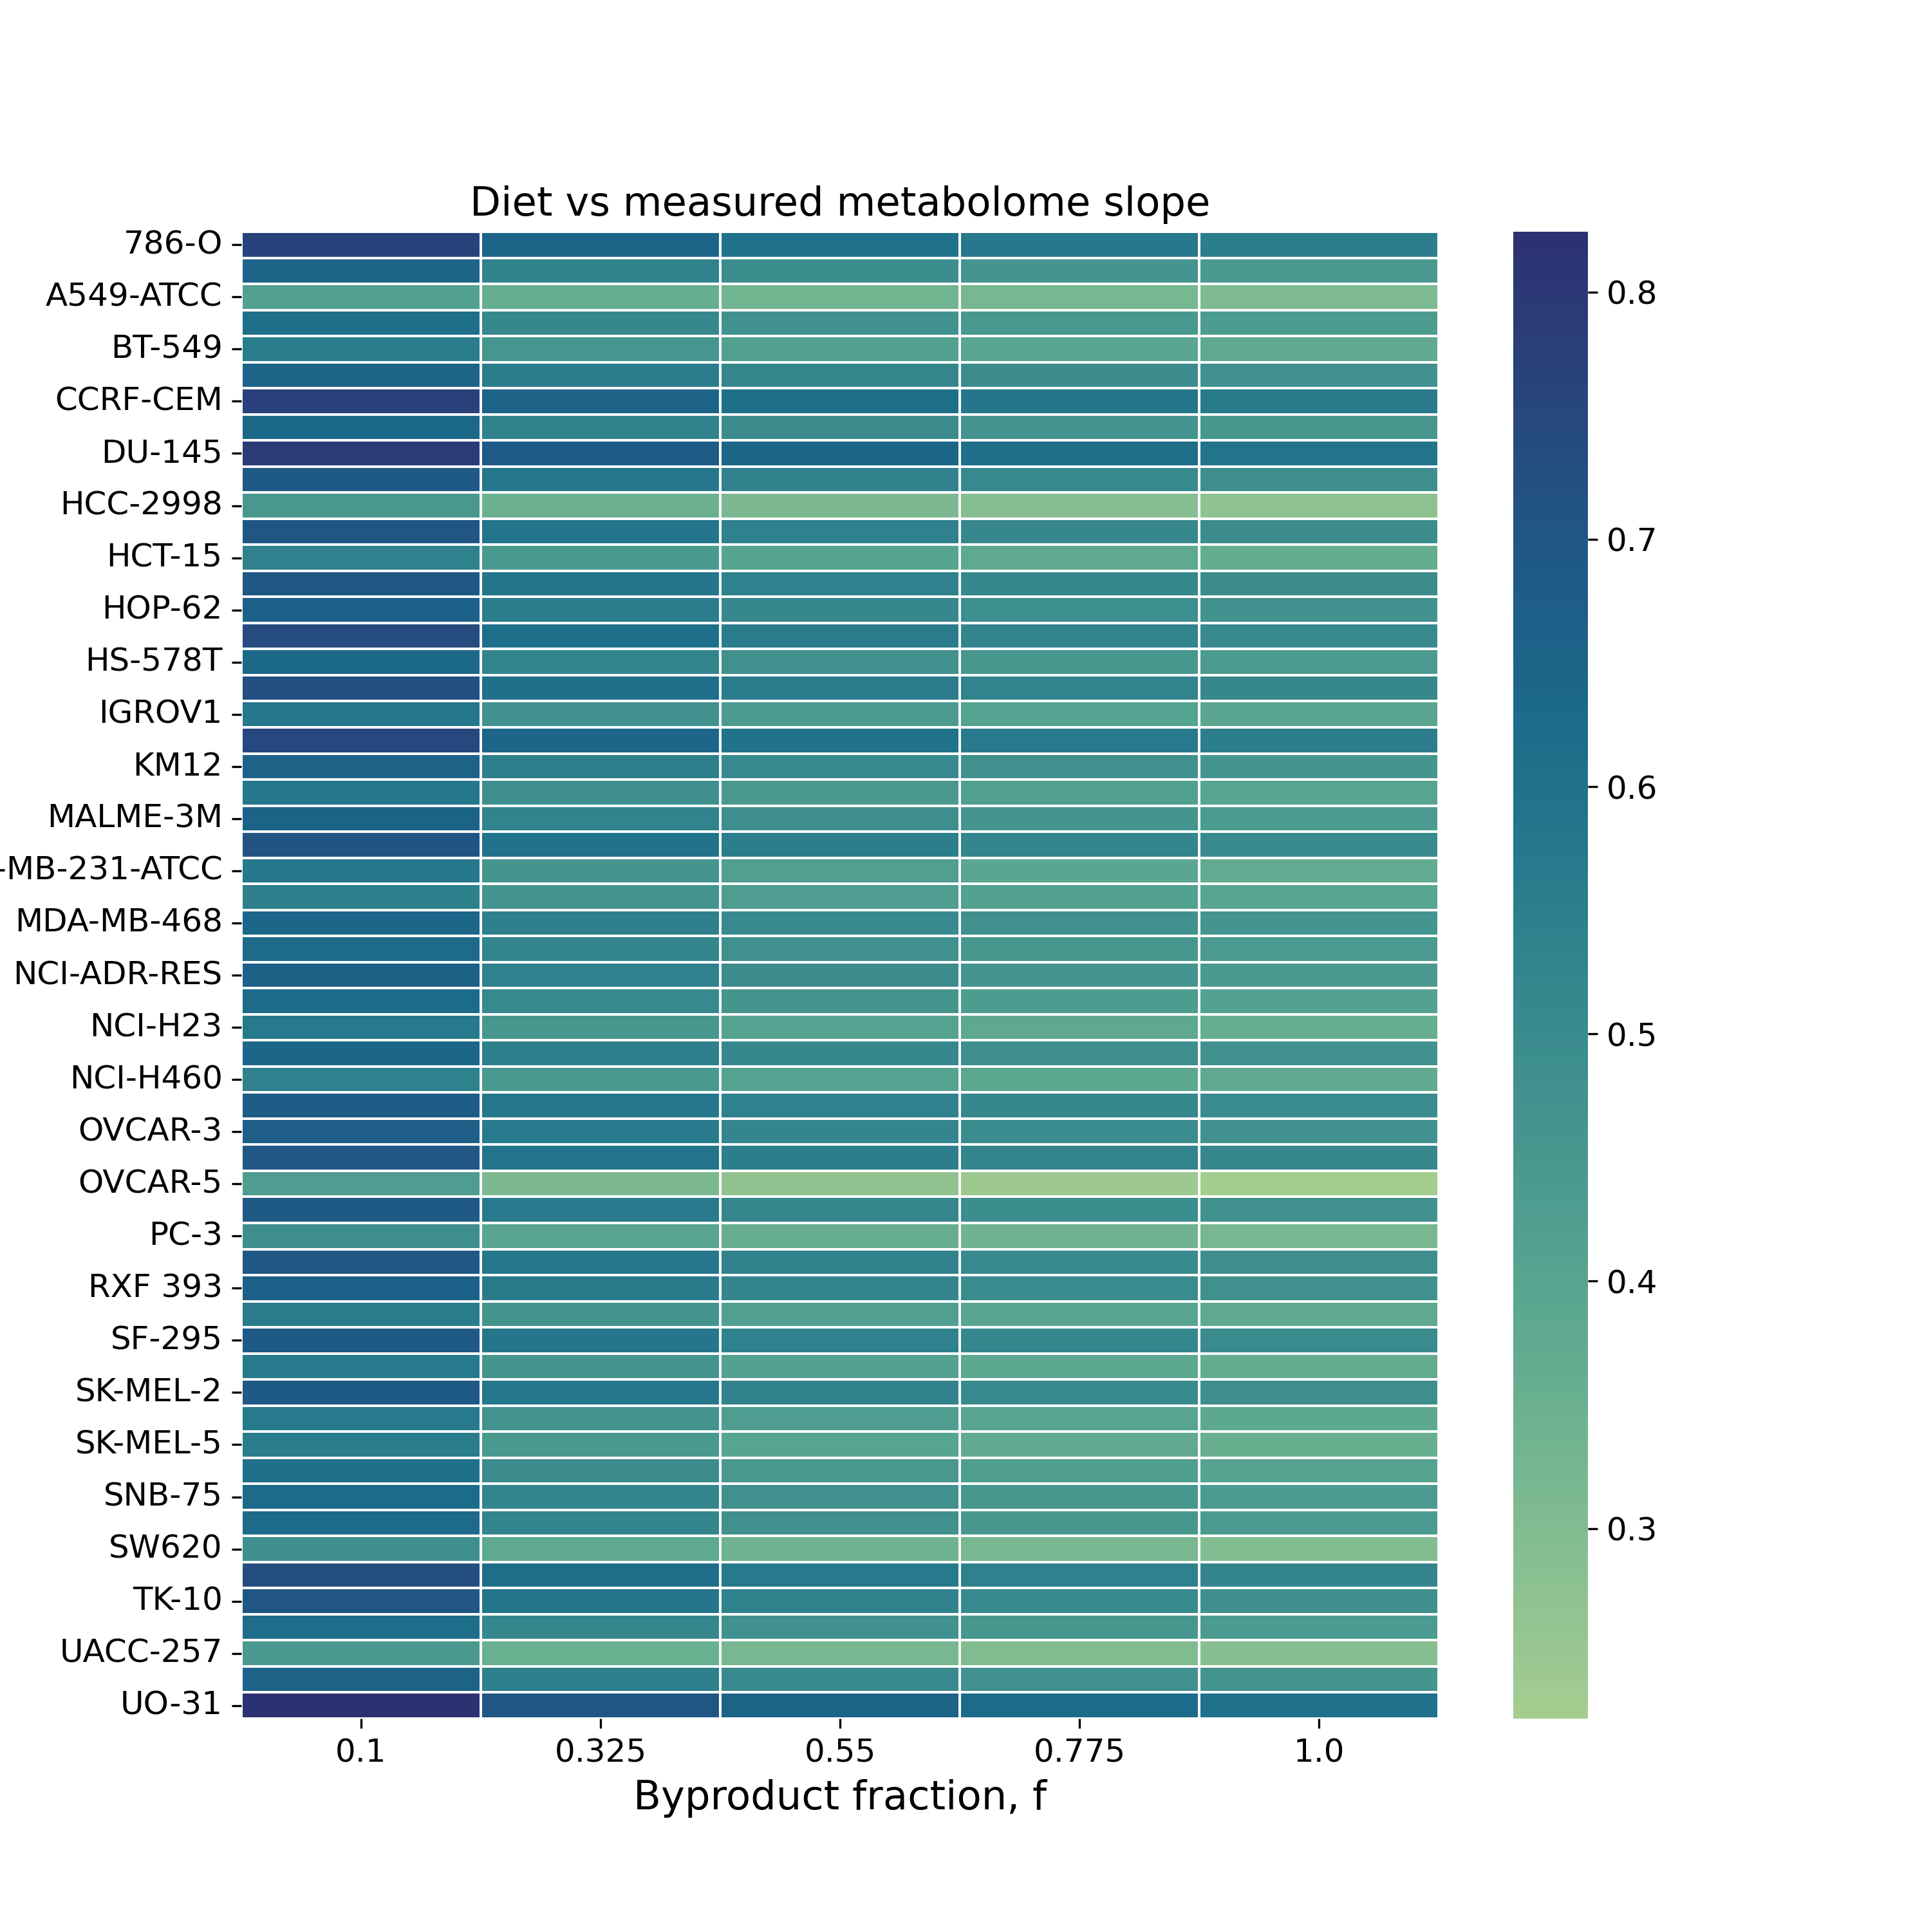
Static network
Random network

Slide 7
1-celltype, no in-degree

Slide 8

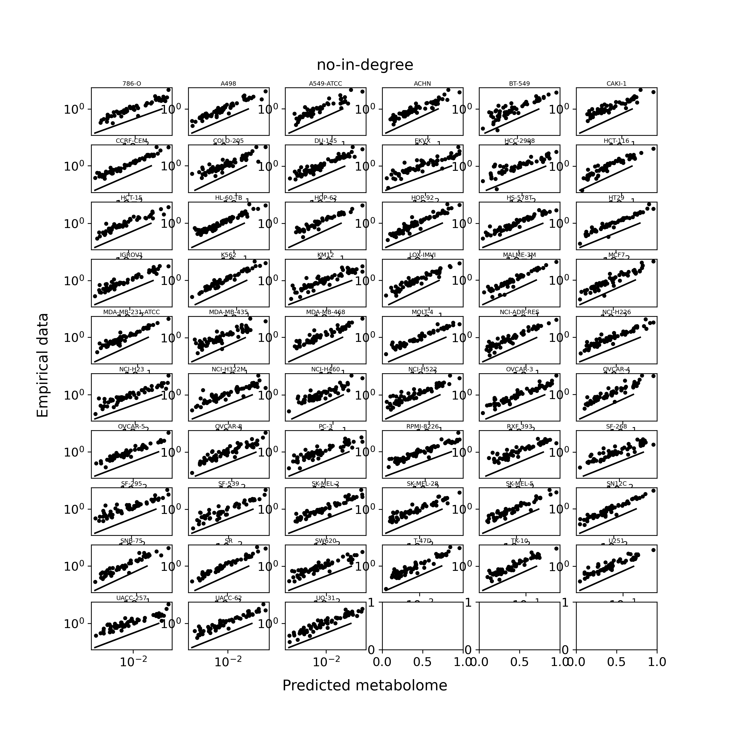
Static network
f = 0.775
Random network

Slide 9
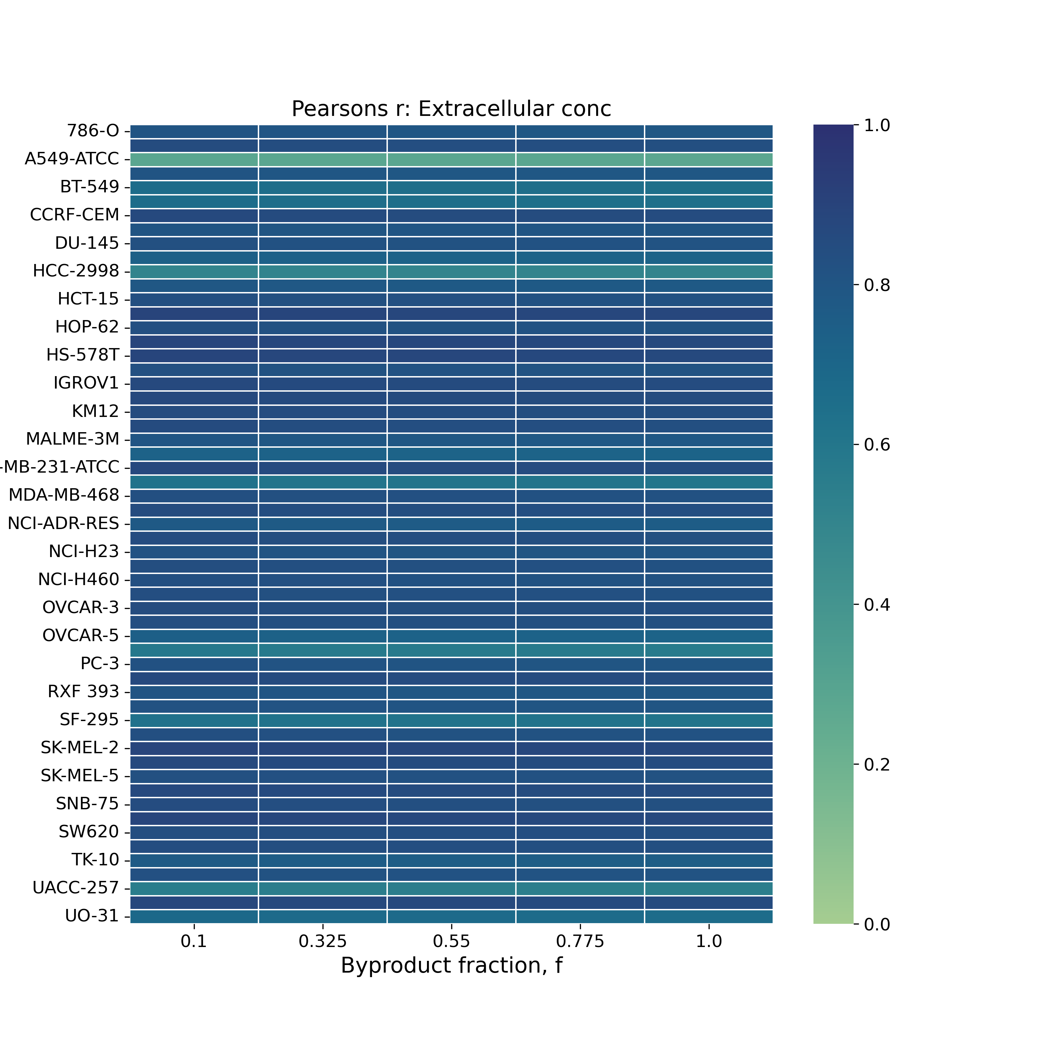

Static network
Random network

Slide 10
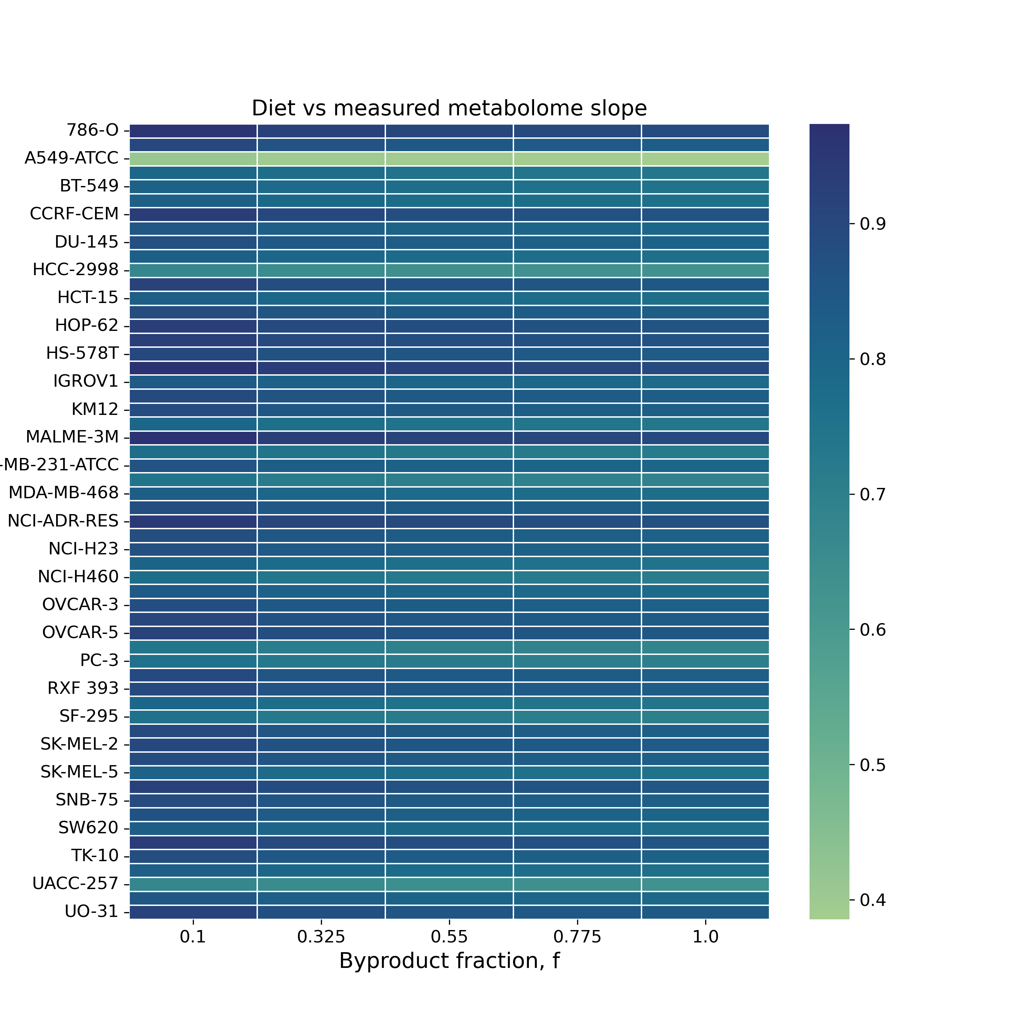
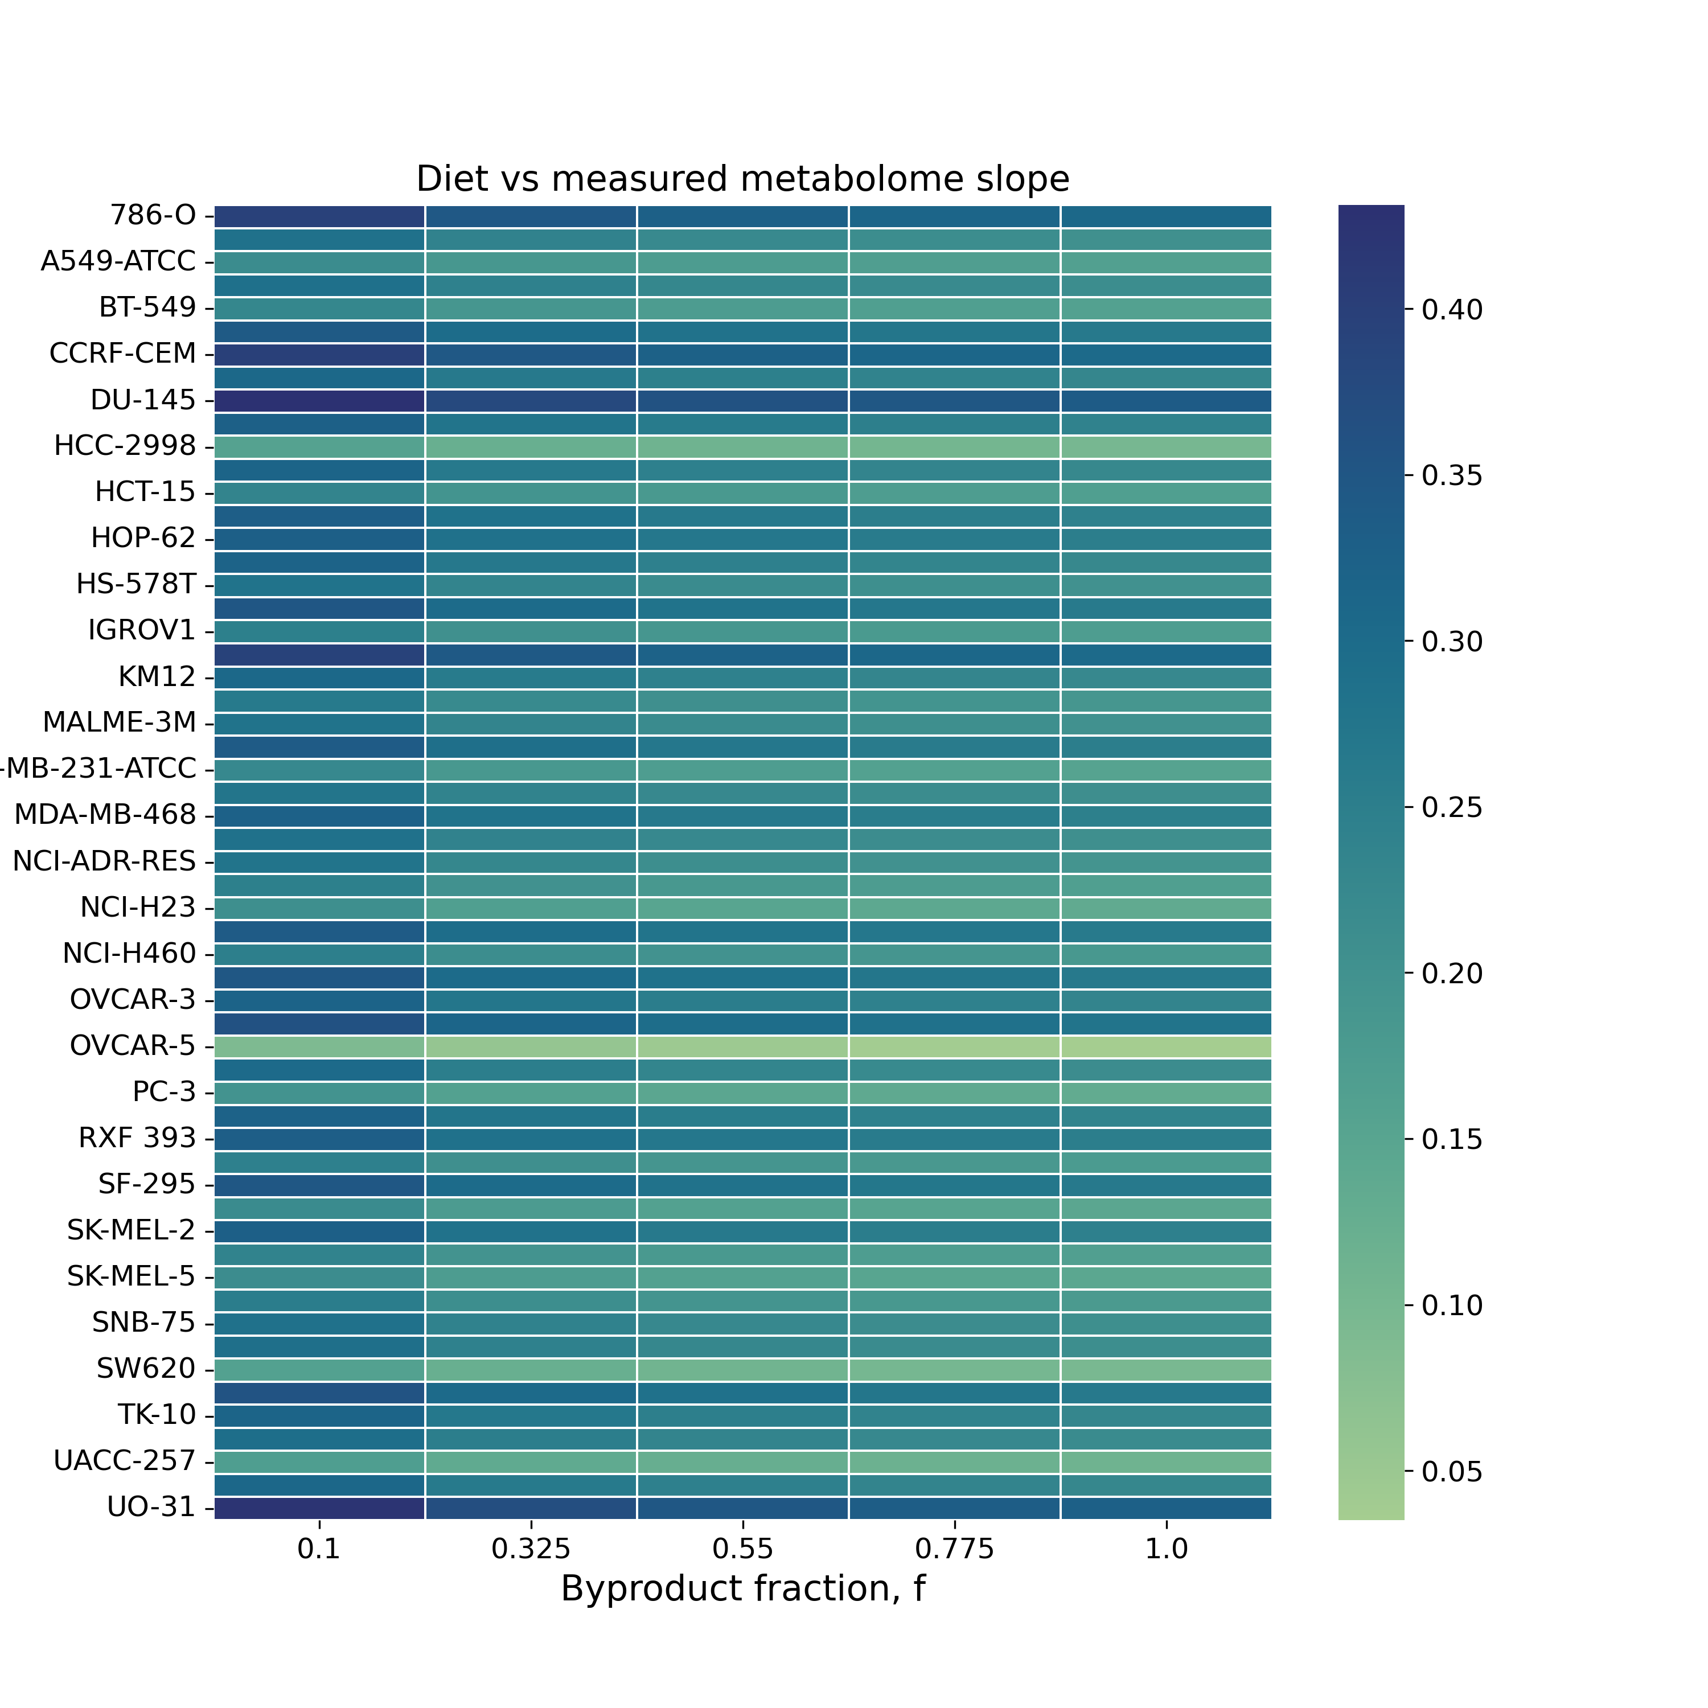
Static network
Random network

Slide 11
2-celltypes, with in-degree

Slide 12
Static network
f = 0.775
Random network

Slide 13
Static network
Random network

Slide 14
Static network
Random network

Slide 15
2-celltypes, no in-degree (some debugging remaining for random networks)

Slide 16
Static network
f = 0.775
Random network

Slide 17
Static network
Random network

Slide 18
Static network
Random network

