Slide 1
Figure plan
B Vibishan, Akshit Goyal & Mohit Kumar Jolly

Slide 2
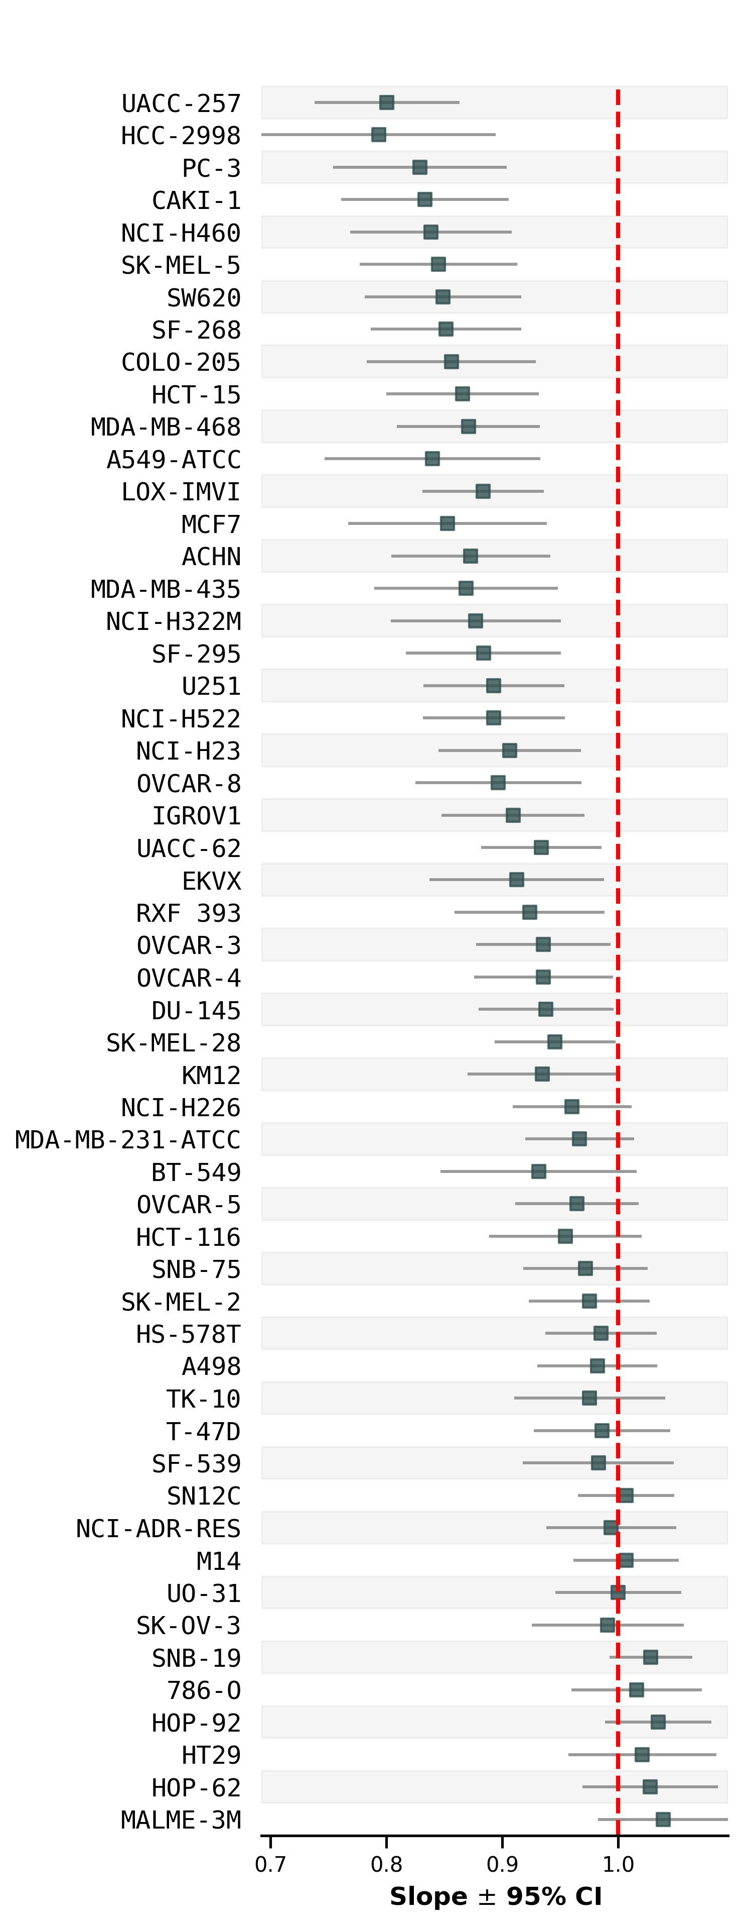
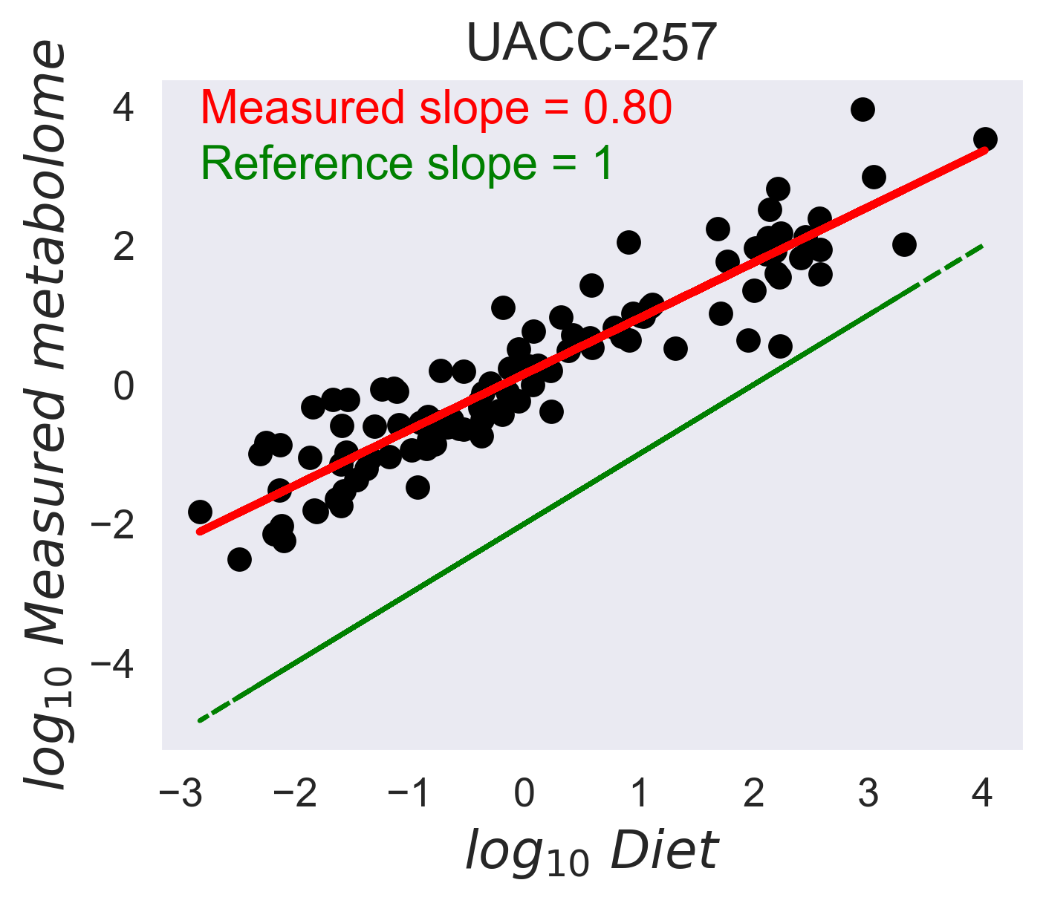
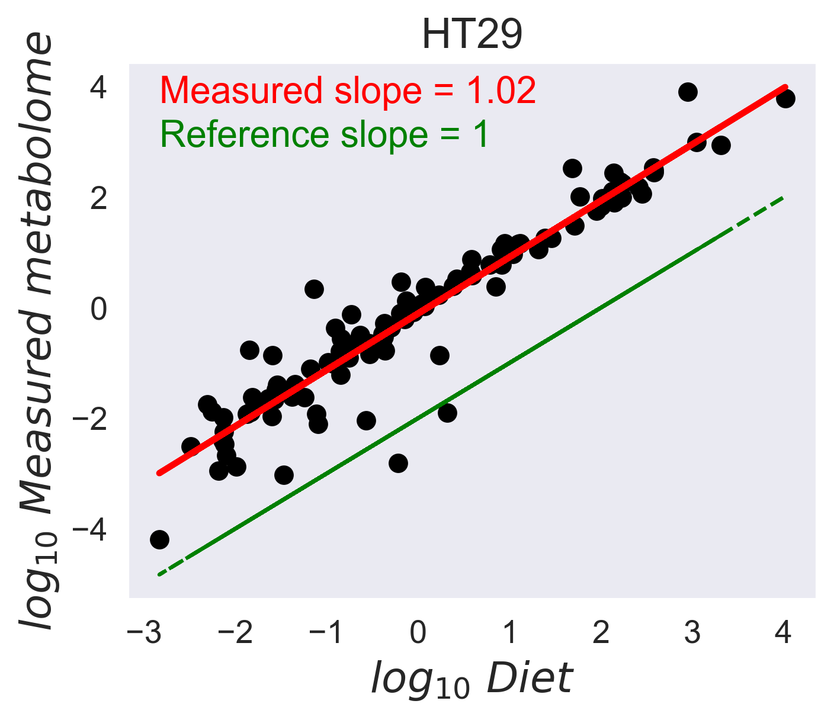
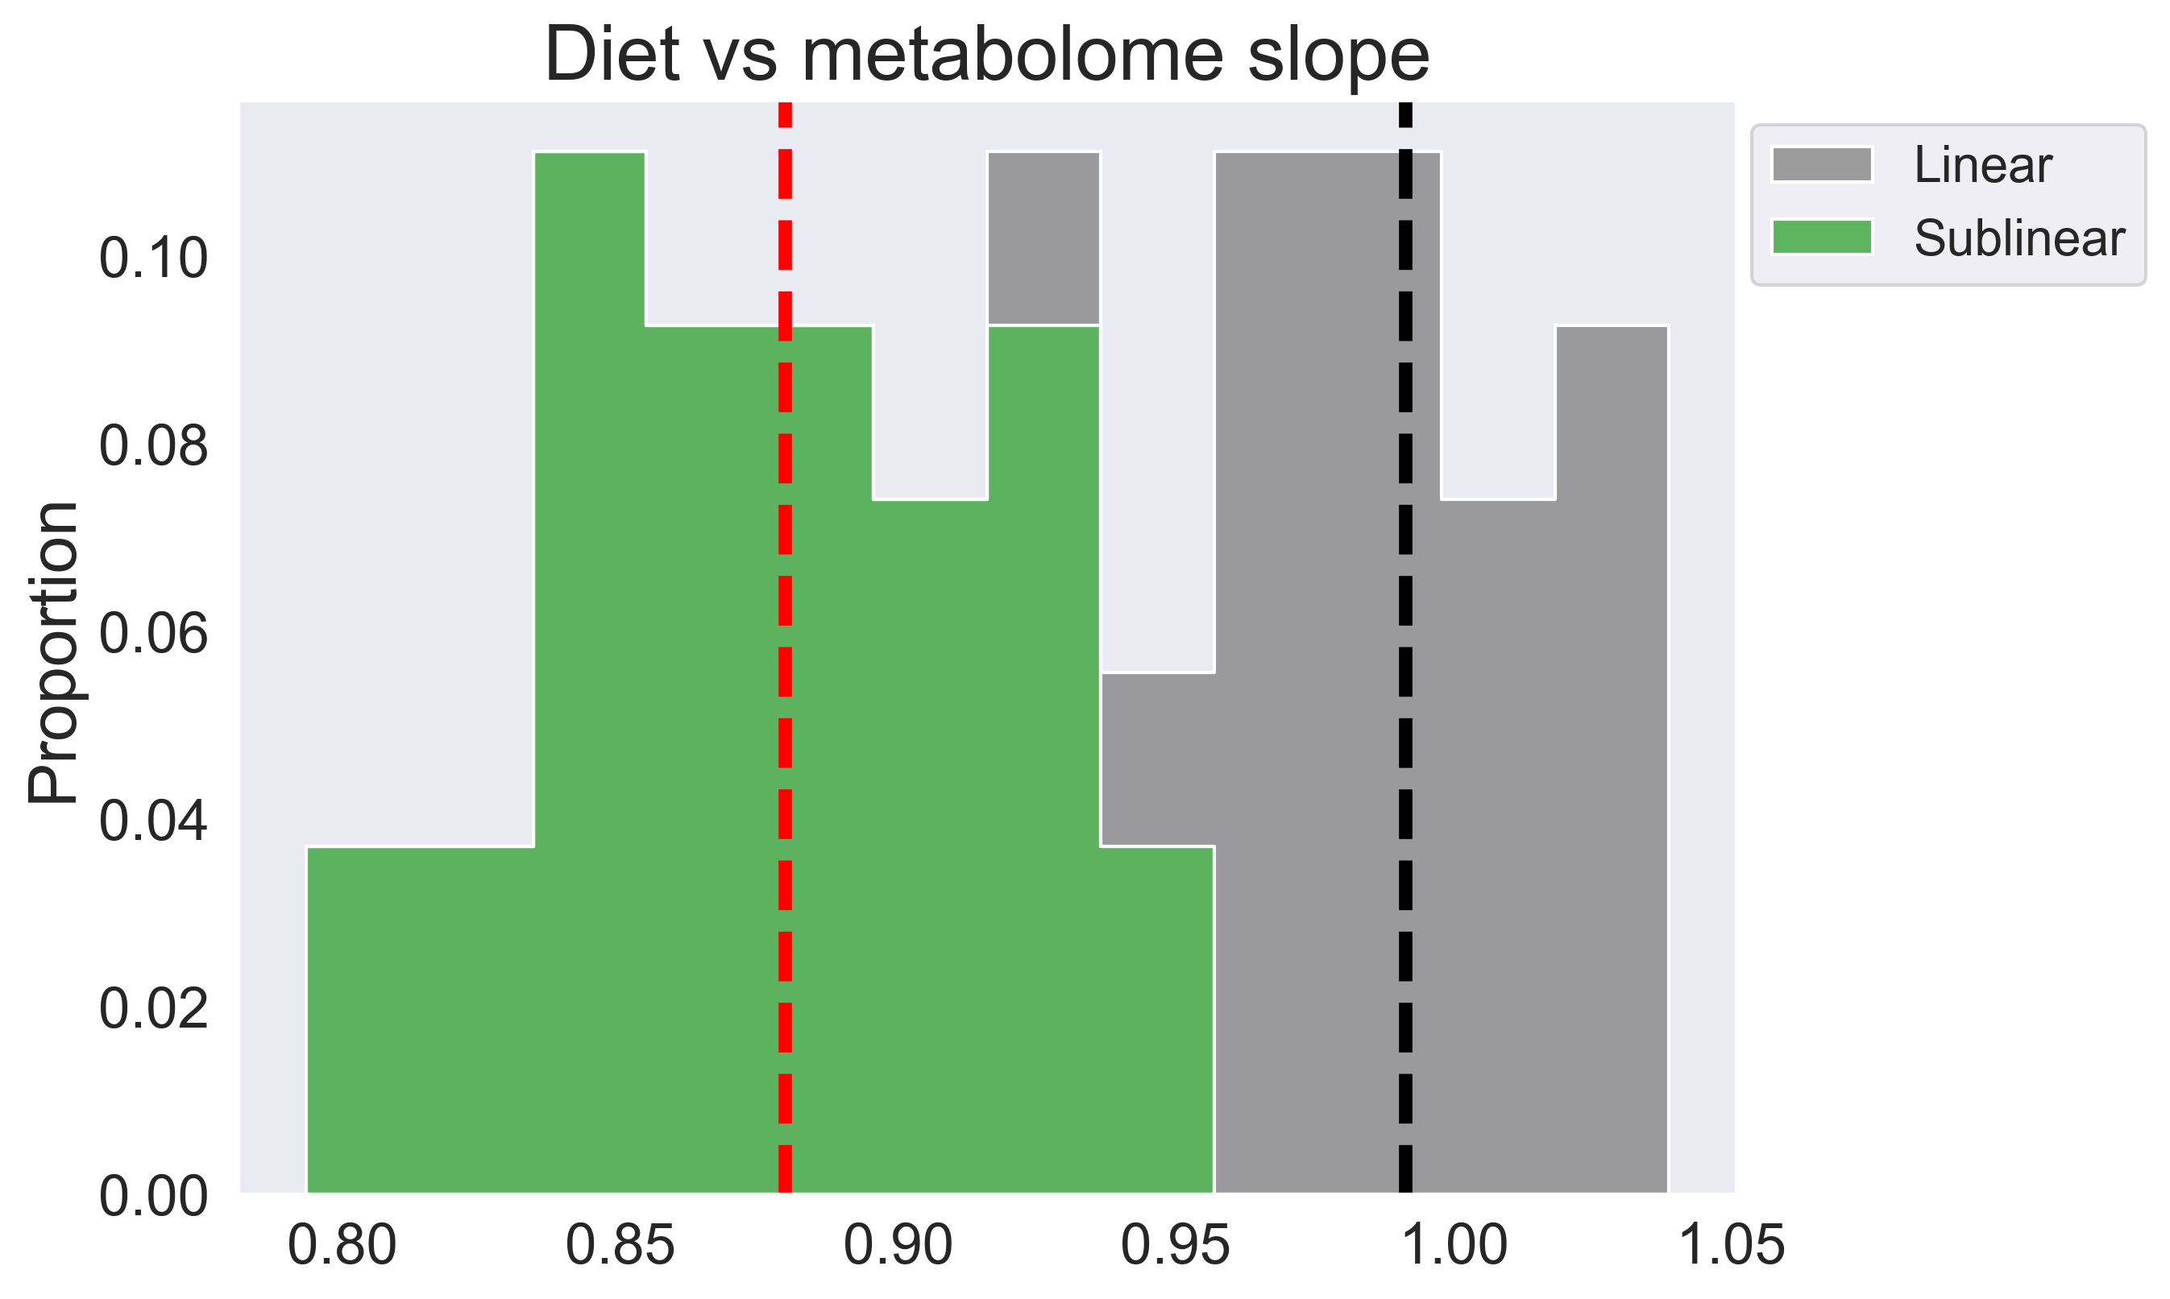
Figure 1: Power law statistics
A
B
C
Sublinear
Linear

Slide 3
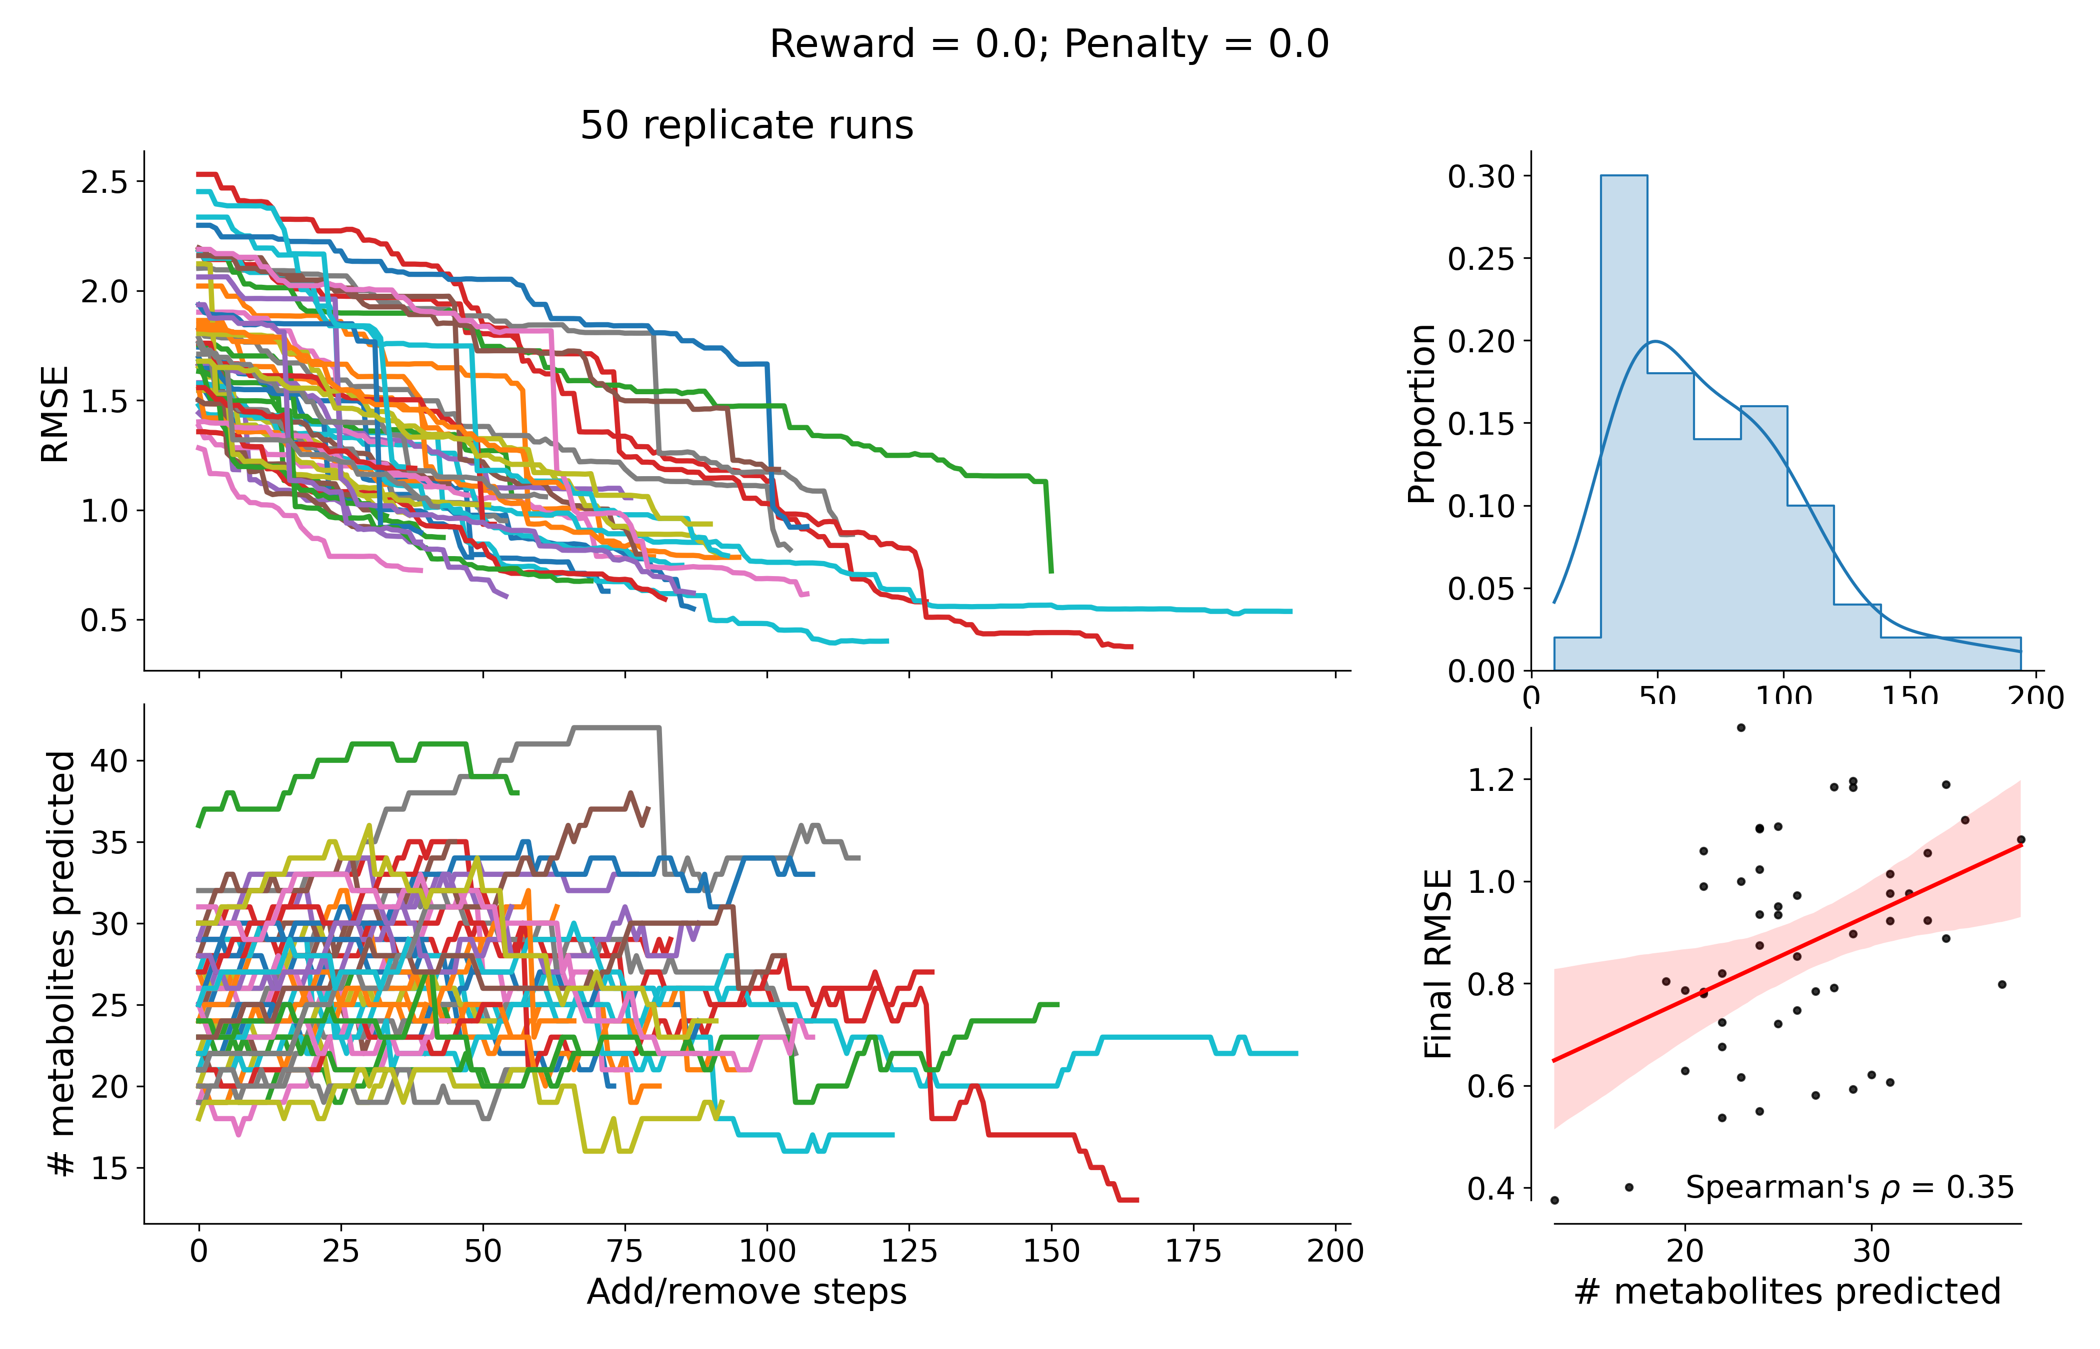
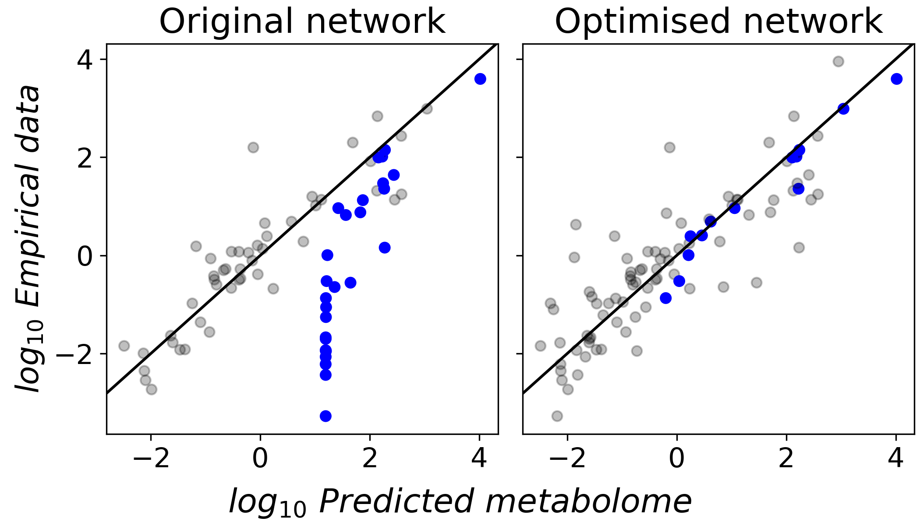
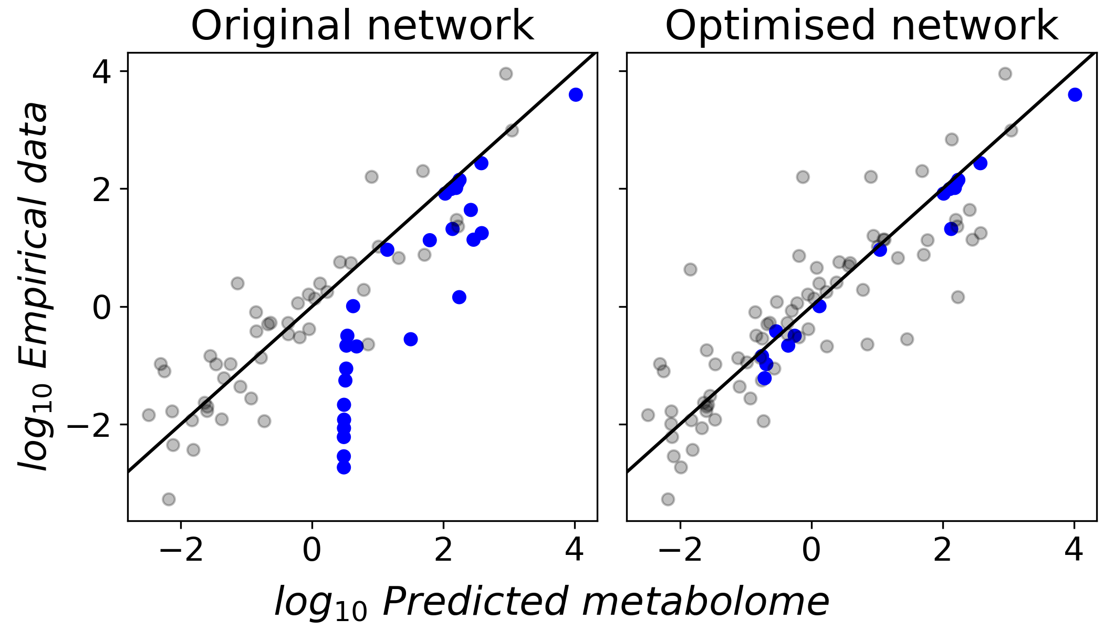
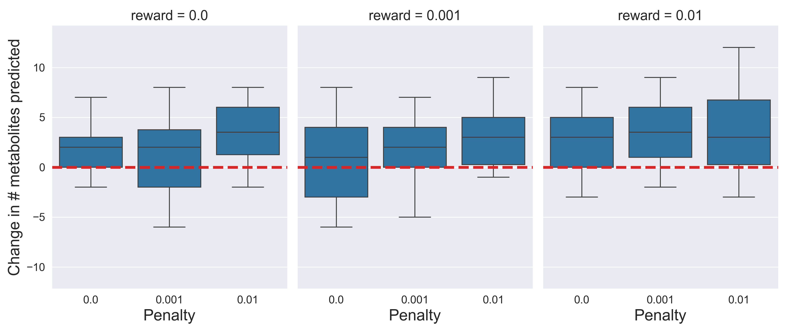
Figure 2: 1-celltype, A549-ATCC
A
C
i. Reward = 0; Penalty = 0
ii. Reward = 0.01; Penalty = 0.01
B

Slide 4
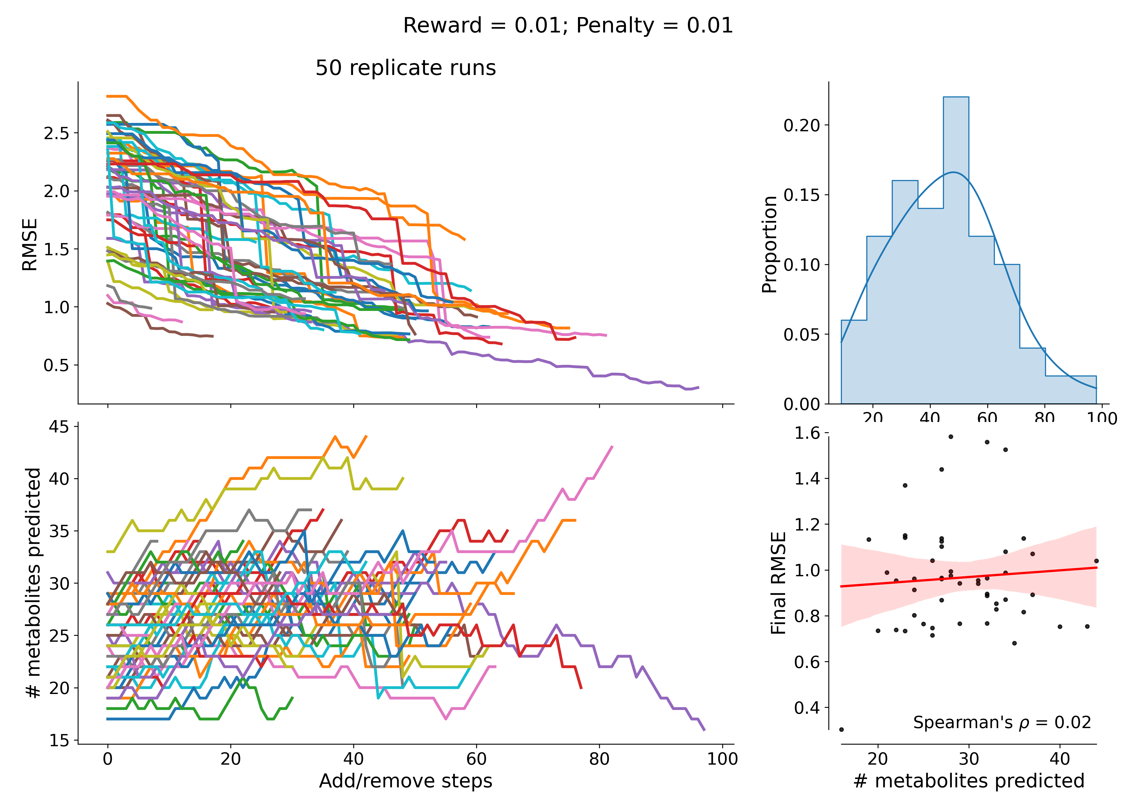
Extended Figure 2: 1-celltype model

Slide 5
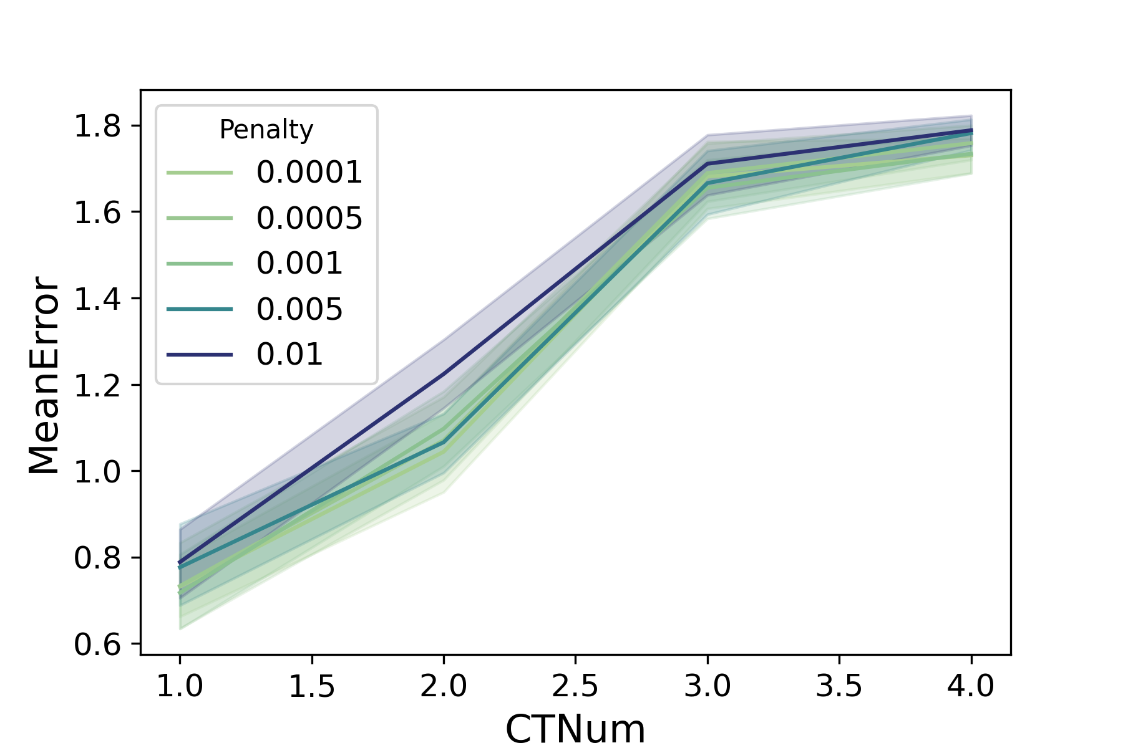
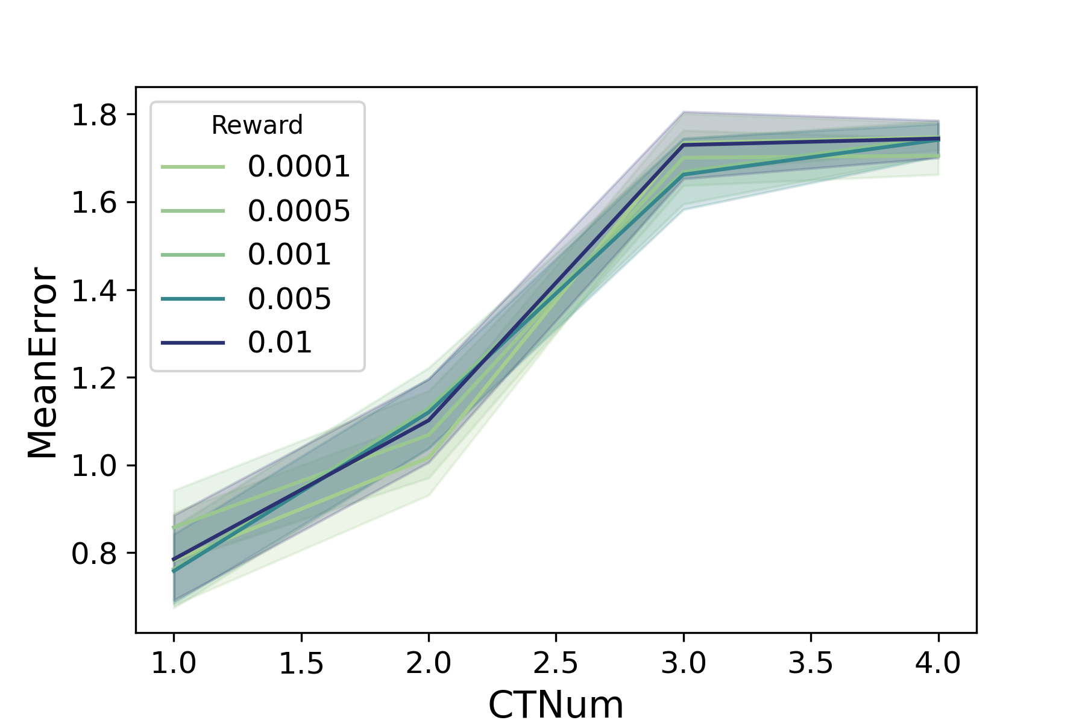
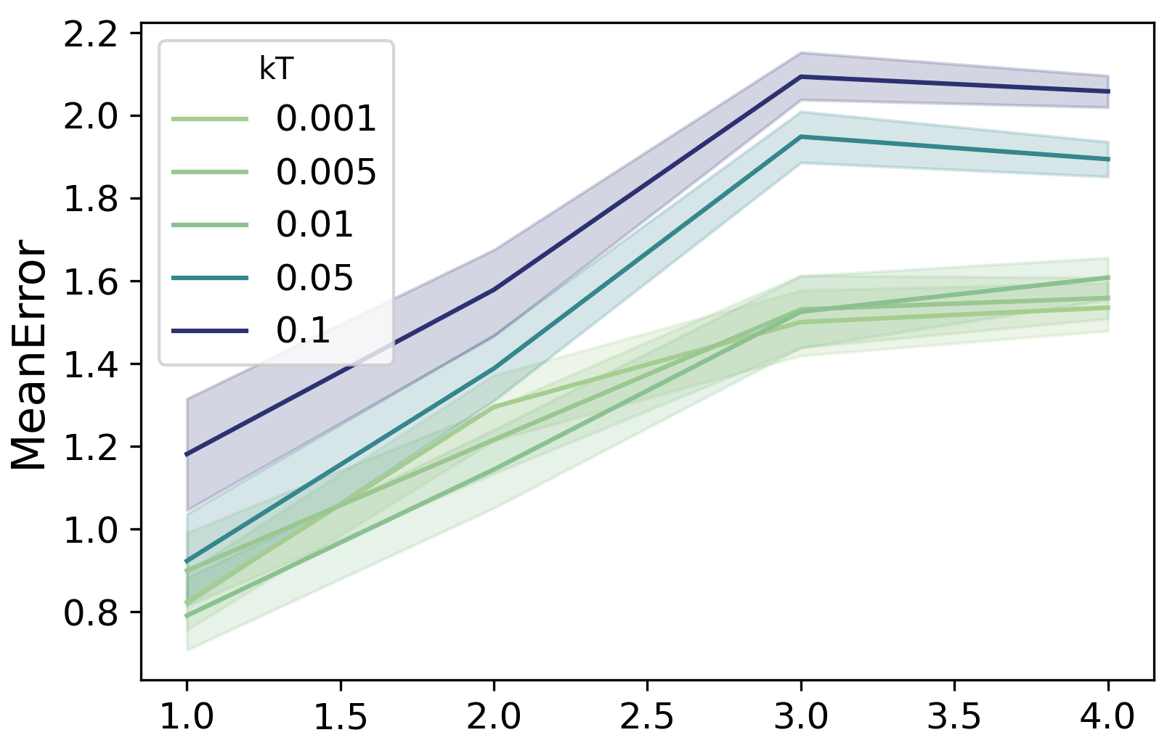
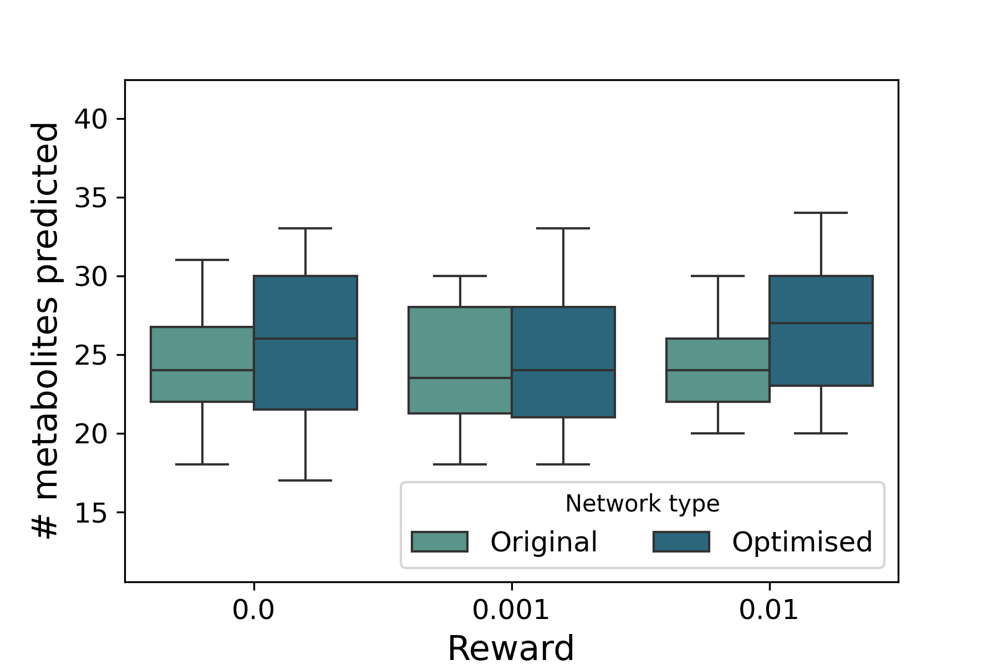
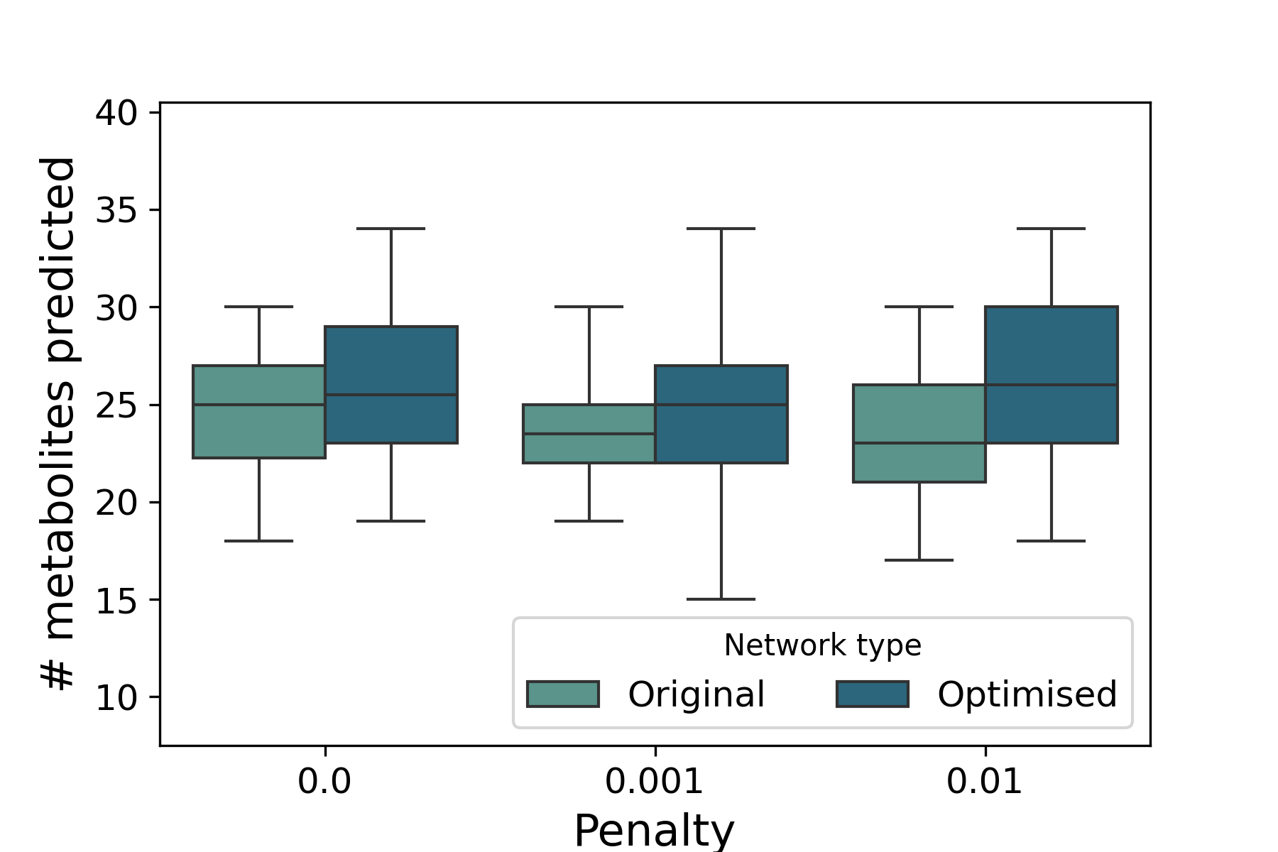
Sensitivity plots for the 1-celltype model
50 replicates for each point
Cell line: A549-ATCC
penalty = 0, reward = 0
kT = 0.02, reward = 0
kT = 0.02, penalty = 0
kT = 0.003
kT = 0.003

Slide 6
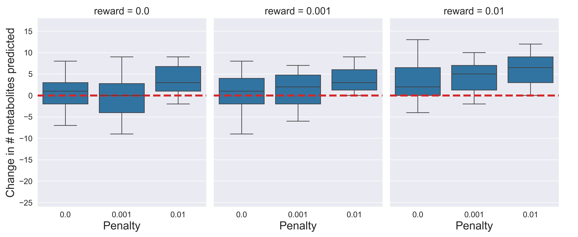
Sensitivity plots for A549-ATCC
50 replicates for each point
$$n_{CT}=1$$
$$n_{CT}=2$$

Slide 7
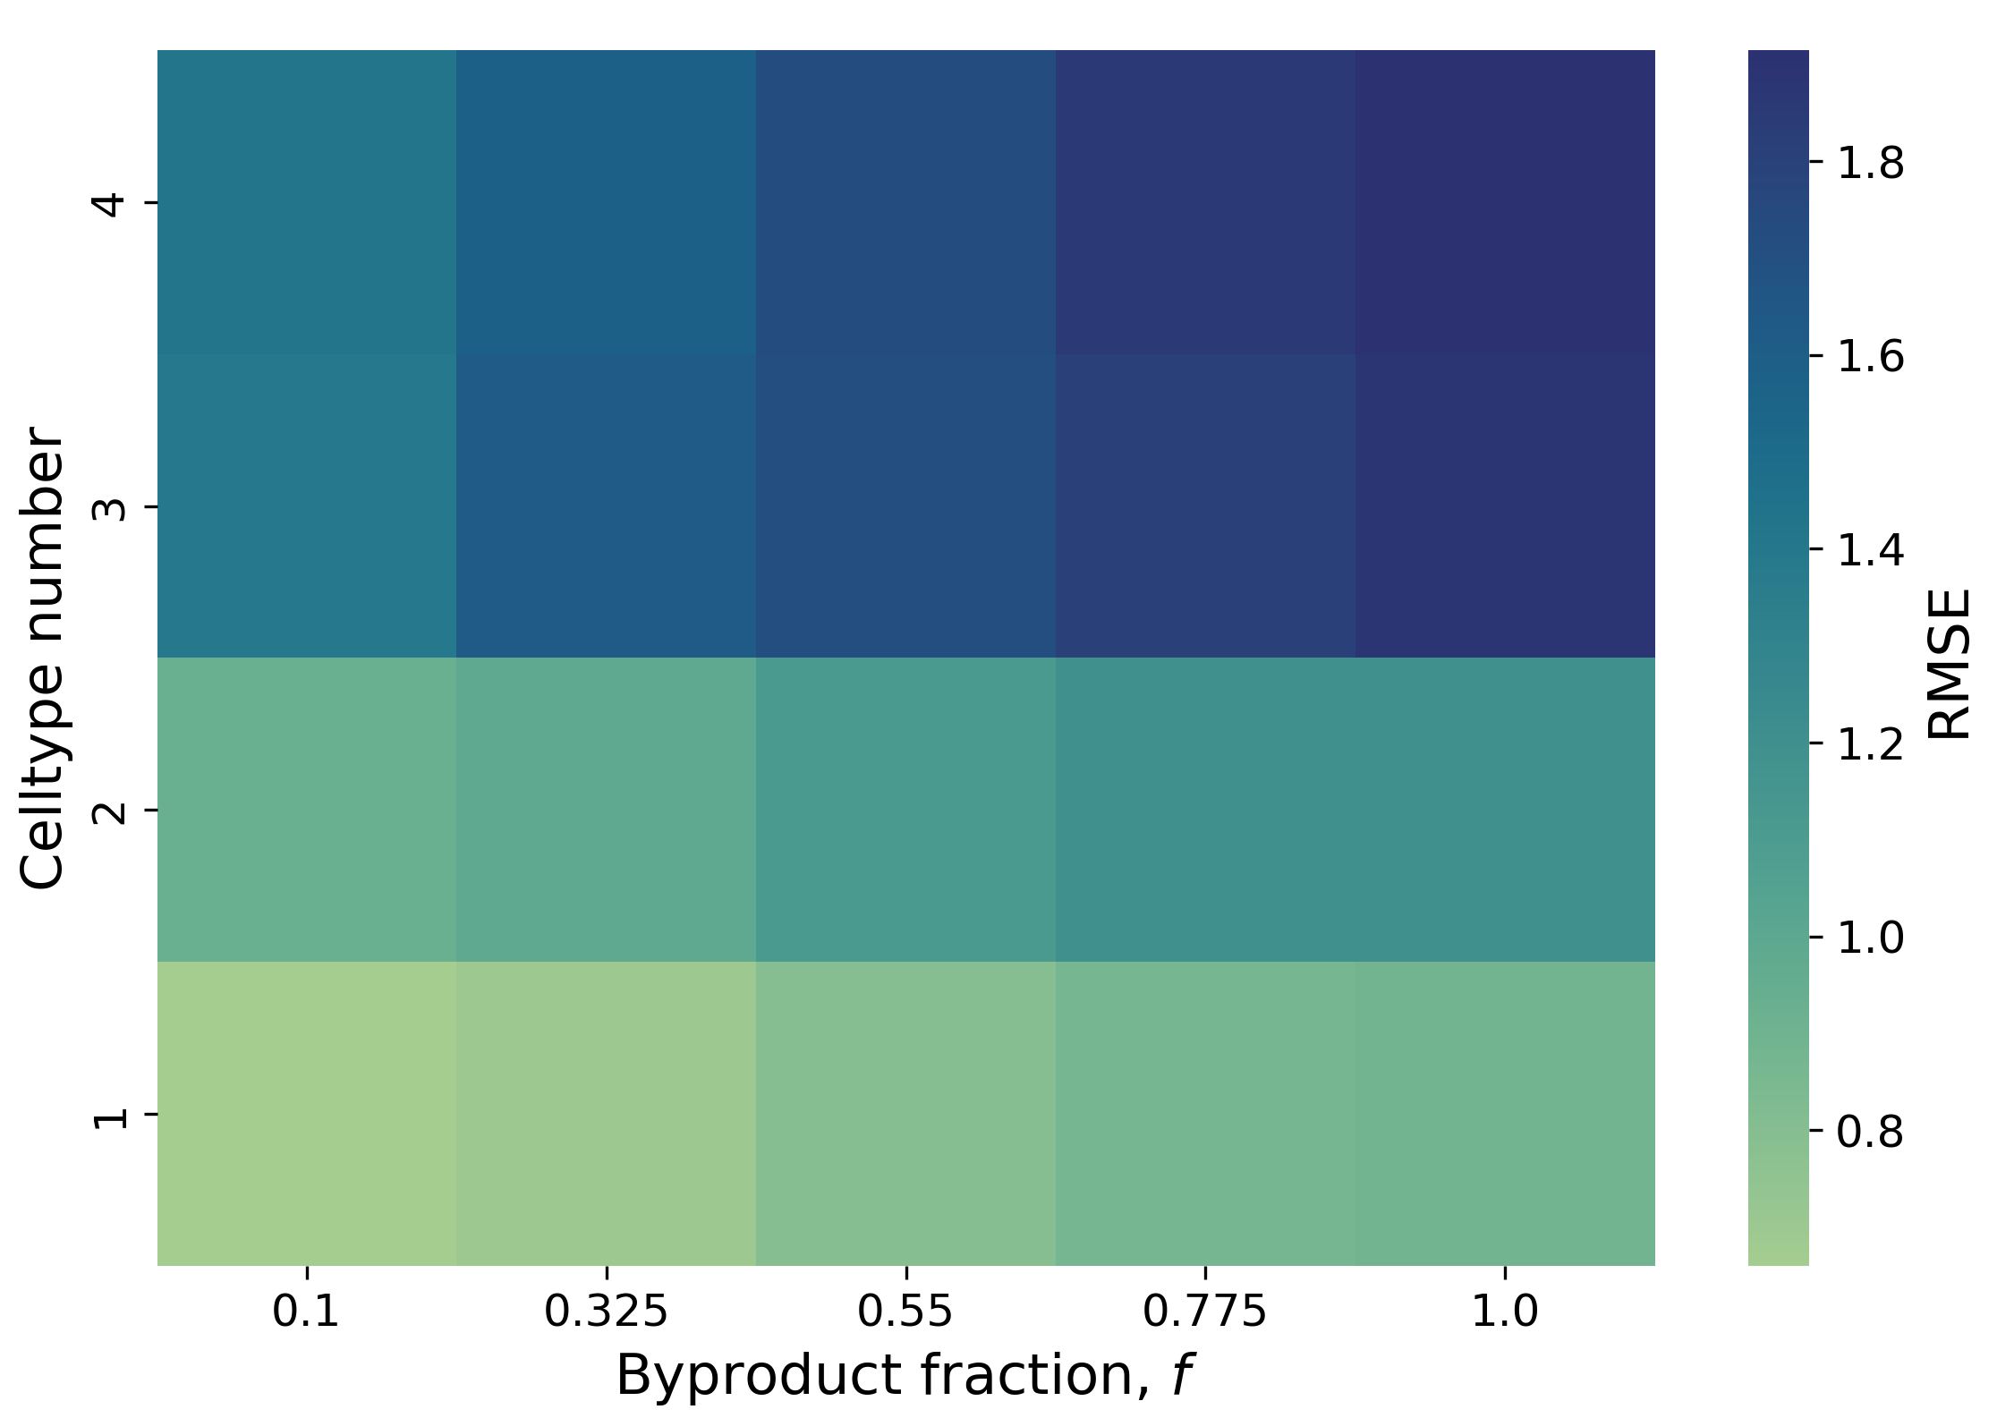
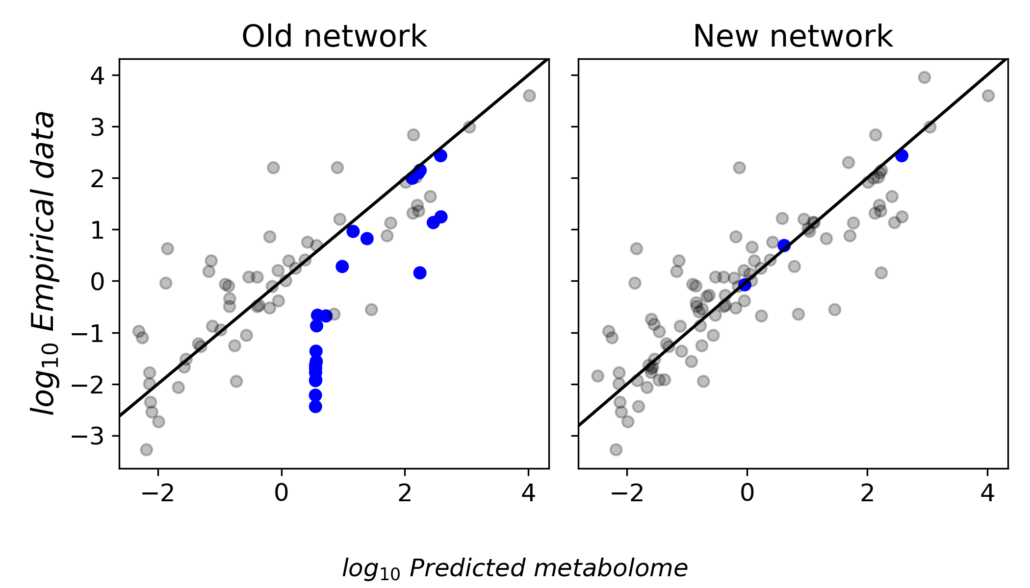
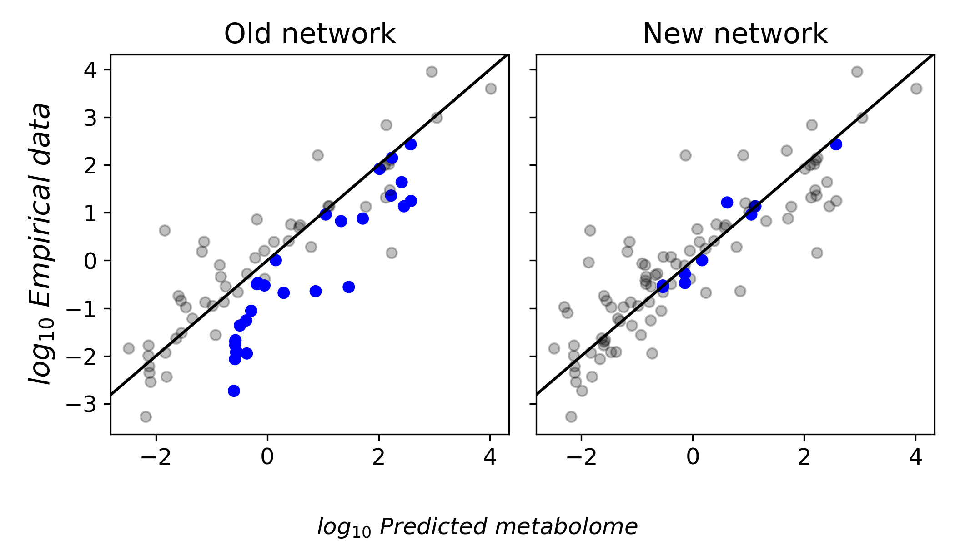
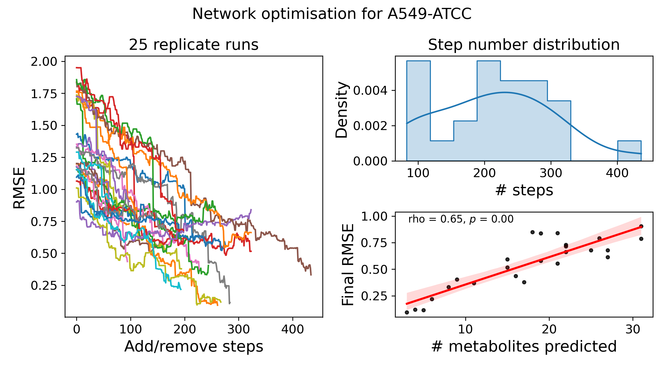
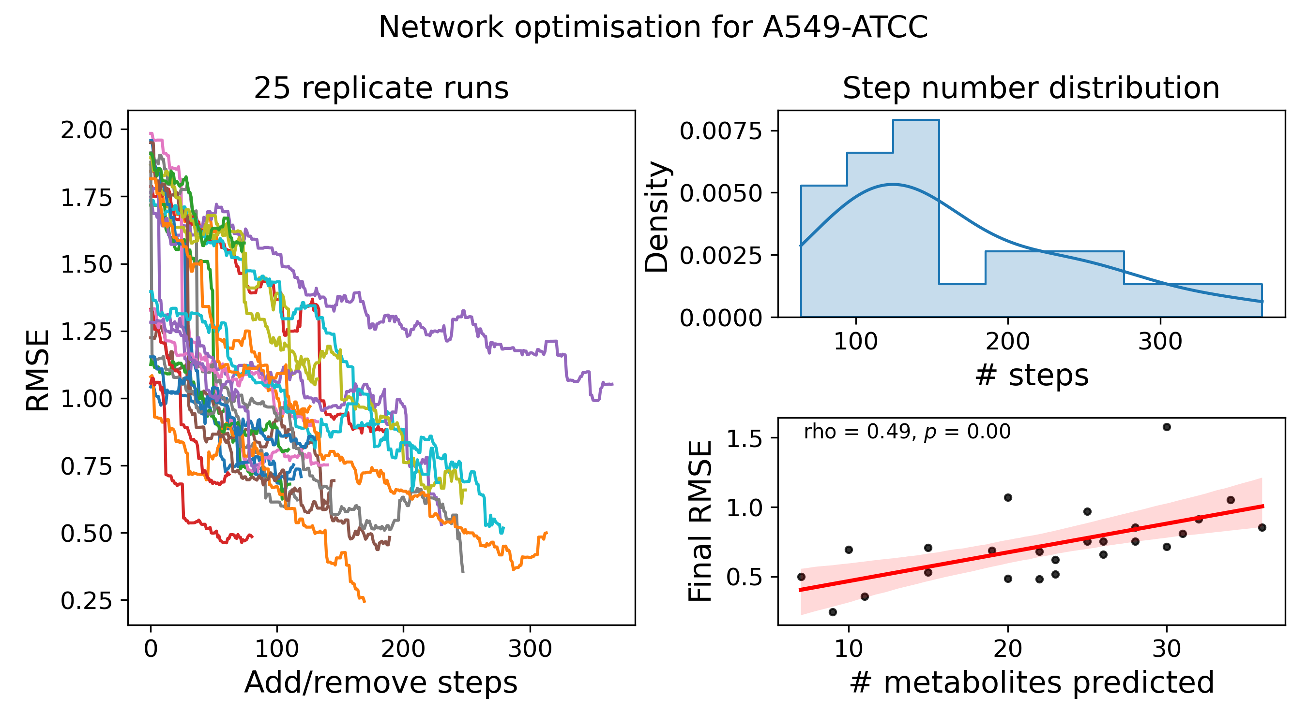
Figure 2: 1-celltype, A549-ATCC
A
kT = 0.003, reward and penalty = 0
B
i.
Reward = 0
ii.
Reward = 0.001
C
Reward = 0
D
Reward = 0.001
i.
ii.
i.
ii.
iii.
iii.

