Slide 1
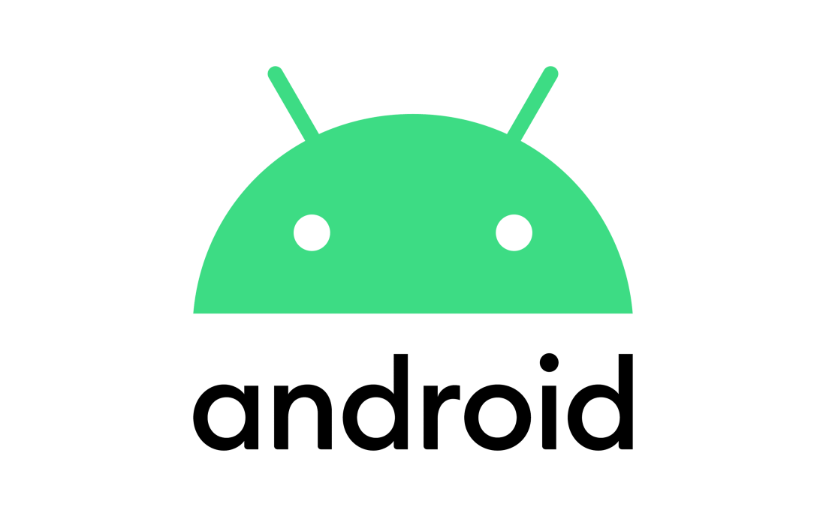
REVIEW-II
FITNESS APP
MADE BY
VIBHOR JAIN
MCA-III

Slide 2
INTRODUCTION
Since the emergence and popularization of smartphones, many mobile applications that track and record data about their users have been created. The classic example of this is the pedometer which utilizes the mobile device’s built-in accelerometer to track the number of steps the user takes each day. Applications in this category, that track and record health or activity data about their users, are typically called Wellness or Fitness Apps. These Wellness Apps are designed to assist the user in pursuing a healthy lifestyle by encouraging them to perform positive activities, and improve lifestyle choices. Factors that are typically targeted by such applications include exercise, sleep, and diet. Understanding the nature of this relationship is crucial when designing a Wellness App

Slide 3
FITNESS TRACKER
A fitness tracker is a device that uses sensors to track your orientation, movement, and rotation. The device collects data and converts it into steps, calories, sleep quality and general activity you perform through the day. ... A fitness tracker can easily figure whether you are running or spinning.

Slide 4
ABOUT PROJECT
MY PROJECT NAME IS FAST N FITNESS.It is free and open-source software; its source code is known as Android Open Source Project (AOSP), which However most Android devices ship with additional proprietary software pre-installed, most notably Google Mobile Services (GMS)[.which includes core apps such as Google Chrome, the digital distribution platform Google Play and associated Google Play Services development platform.

Slide 5
REFRENCE
https://developer.android.com/docs
https://github.com

