Slide 1

INCOME TAX PROCESSING RETURN MADE BY VIBHOR JAIN GUIDED BY DR VANDANNA SHARMA
REVIEW-IIII

Slide 2
Introduction
Income tax return processing is a java based application where all the automated processing is introduced. By this application we can reduce our time and get accurate information. We can also know the processing of tax return in step by step manner.
By this application we can also improve the performance of the system. This system makes the processing of income tax returns forms faster and easier.

Slide 3
BACKGROUND
Many ways and it reduces manpower in the Income tax Department.
This application can be used by any user of file their income tax . It will help department

Slide 4
purpose
The purpose of this describes the requirement of the external requirement for "INCOM TAX RETURN PROCESSING"
Income tax return processing is a java based application where all the automated processing is introduced. By this application we can reduce our time and get accurate information. We can also know the processing of tax return in step by step manner.
By this application we can also improve the performance of the system. This system makes the processing of income tax returns forms faster and easier.
Vision Statement
The aim of this product is to create a device that will remove barriers to global communication
To provide the information about tax return process in an easy way.
It will reduce the load work.
It will save paper work and save time.
To change and update record is simple.
It will also reduce Data redundancy.
Centralized database system.

Slide 5
Scope
Many ways and it reduces manpower in the Income tax Department.
This application can be used by any user of file their income tax . It will help department.

Slide 6
Document Conventions
This document follows MLA Format. Bold-faced text has been used to emphasize section and sub-section headings. Highlighting is to point out words in the glossary and italicized text is used to label and recognize diagrams.

Slide 7
Intended Audience and Reading Suggestions
This document is to be read by the development team, the project managers, marketing staff, testers and documentation writers. Our stakeholders, company manufacturing associated
hardware, company providing embedded operating system, shareholders of NAMMPSoft Inc. and distributors who markets the finished product, may review the document to learn about the project and to understand the requirements. The SRS has been organized approximately in order of increasing specificity. The developers and project managers need to become intimately familiar with the SRS. Others involved need to review the document as such: Overall Description – Marketing staff have to become accustomed to the various product features in order to effectively advertise the product. System features – Testers need an understanding of the system features to develop meaningful test cases and give useful feedback to the developers. External Interface Requirements – The hardware developers need to know the requirements of the device they need to build. The marketing staff also needs to understand the external interface requirements to sell the product by describing the user-friendly features of the INCOME TAX Nonfunctional and Functional Requirements – The hardware developers.

Slide 8
Product Scope
The INCOME TAX has features that enable any one person to communicate with anyone, whether they speak the same language or not. It also lets people be more familiar with their surroundings if they are in a foreign place. Refer to the project scope document for further information.
Many ways and it reduces manpower in the Income tax Department.
This application can be used by any user of file their income tax . It will help department.

Slide 9
References
Please consult the attached project scope document for further information regarding project scope. A use case diagram has been attached to accompany sections 2.1: Product Perspective and 2.2: Product Features. A user manual is included to accompany section 2.6: User Documentation. Product mock-ups and Requirements Validation Plan have also been included for general reference.
Please consult the attached project scope document for further information regarding project scope. A use case diagram has been attached to accompany sections Product Perspective and Product Features. A user manual is included to accompany section User Documentation. Product mock-ups and Requirements Validation Plan have also been included for general reference

Slide 10
2 Overall Description
2.1 Product Perspective
The software product being developed is for
Income tax return processing is an application which will make the processing of income tax returns forms faster and provides the users to see all the advantages.

Slide 11
2.2 Product Features
1. Register yourself:- In this module the user can registration enter his details. First they select user type like Individual ,HUF or other. Then there are 4 steps Enter basic details, Registration form , Registration verification and Registration successful.
2. Login here:-This Module will check the user name and password for authentication.
3. Form available for e-Filing:-This modules contain form related to income tax.
4. Tax Information and Services:-The user can views all the information about income tax and services.

Slide 12
2.3User Classes and Characteristics
The most important user class is the INCOME TAX RETURN PROCESSINGwho require these Sys.s to maintain their records and customer databases.
Another class of users is the ordinary users CAN REGISTER THEIR DETAILS.

Slide 13
2.4 Operating Environment
Hardware Requirement:
Processor: intel CORE i5
RAM: 2GB or more
HD: 500 GB
Software Requirement:
Operating System : Windows 7
Database : Mysql
Java (NetBeans IDE)

Slide 14
2.5 Assumptions and Dependencies
The project assumes that a MYSQL database is connected to it . Other Databases work with the project..It also needs a netbeans IDE,

Slide 15
3.1 User Interfaces
Front-end software: Netbeans IDE
Back-end software: Mysql command line client

Slide 16
3.2 Hardware Interfaces
Windows.
A browser which supports Mysql & Java

Slide 17
3.3 Software Interfaces
Hardware Requirement:
Processor: intel CORE i5
RAM: 2GB or more
HD: 500 GB
Software Requirement:
Operating System : Windows 7
Database : Mysql
Java (NetBeans IDE)

Slide 18
3.4 Communications Interfaces
It is a offline desktop based System

Slide 19
4. Sys. Features 4.1 Sys. feature 1
But now we want to do it automatically. Which will be so easier for Whole University and it has some advantages as follows?
1. Dynamic System
2. Error free
3. User Friendly

Slide 20
4.2 Sys. feature 2
We should need to analyze for the Income Tax the following things—
Users of the Income Tax Return Forms.
Forms and documents which are used for collecting the Income Tax.
Various reports used in Income Tax Function. In our system we collect report from income tax office and law chamber.
How is the current working procedure managed?
What are the current problems that you are facing?
Do you think any additional requirement can improve the current process?
By taking opinion from the user that, how the system can be easier to access for the user?

Slide 21
5. Other Nonfunctional Req.
Performance Req.
<If there are performance Req. for the product under various circumstances, state them here and explain their rationale, to help the developers understand the intent and make suitable design choices. Specify the timing relationships for real time Sys.s. Make such Req. as specific as possible. You may need to state performance Req. for individual functional Req. or features.>
5.2 Safety Req.
If there is extensive damage to a wide portion of the database due to catastrophic failure, such as a disk crash, the recovery method restores a past copy of the database that was backed up to archival storage (typically tape) and reconstructs a more current state by reapplying or redoing the operations of committed transactions from the backed up log, up to the time of failure.

Slide 22
Appendix A: Glossary
INCOME TAX RETURN PROCESSING

Slide 23
Requirements – Req.
System – Sys.

Slide 24
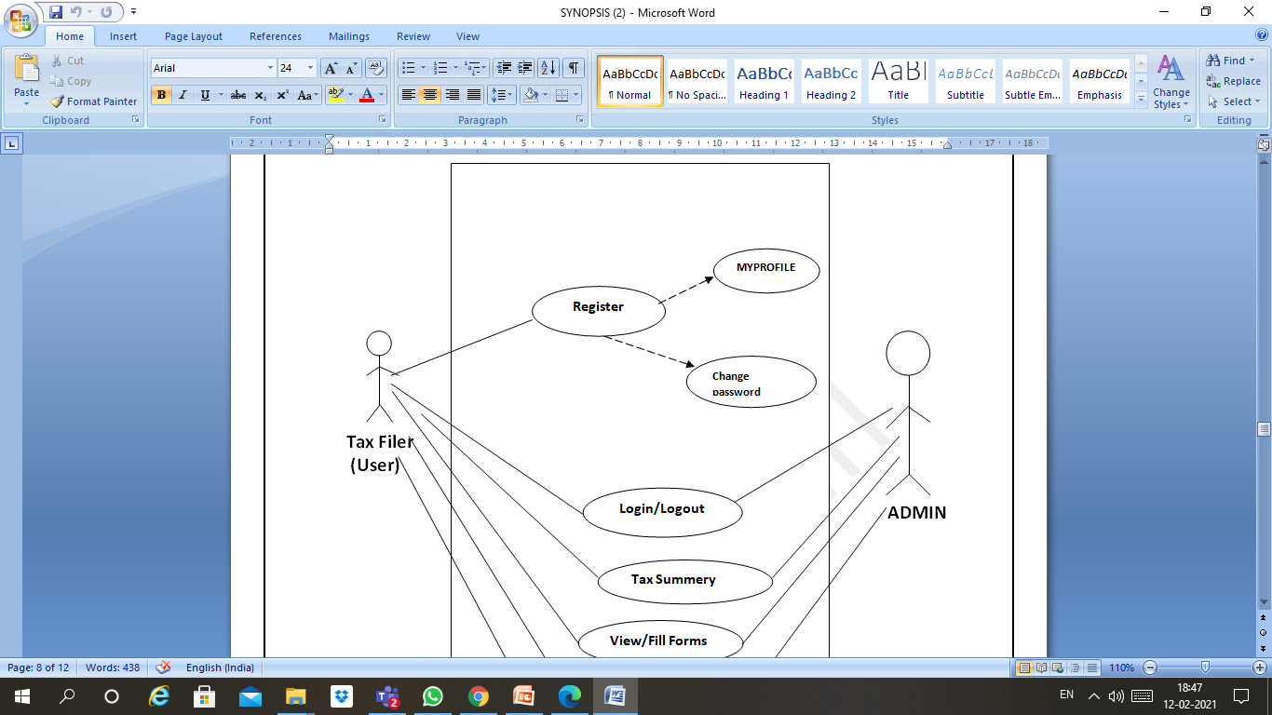
USE CASE DIAGRAM

Slide 25
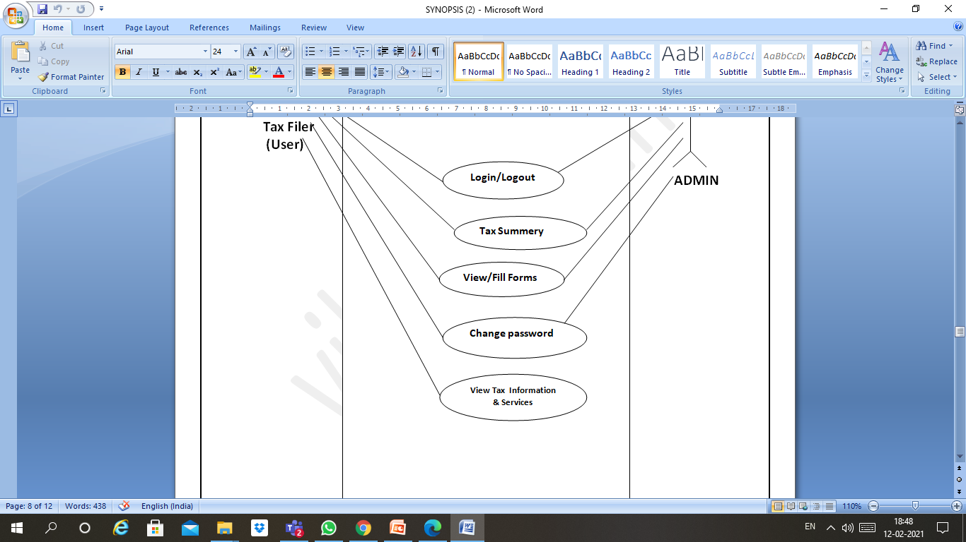

Slide 26
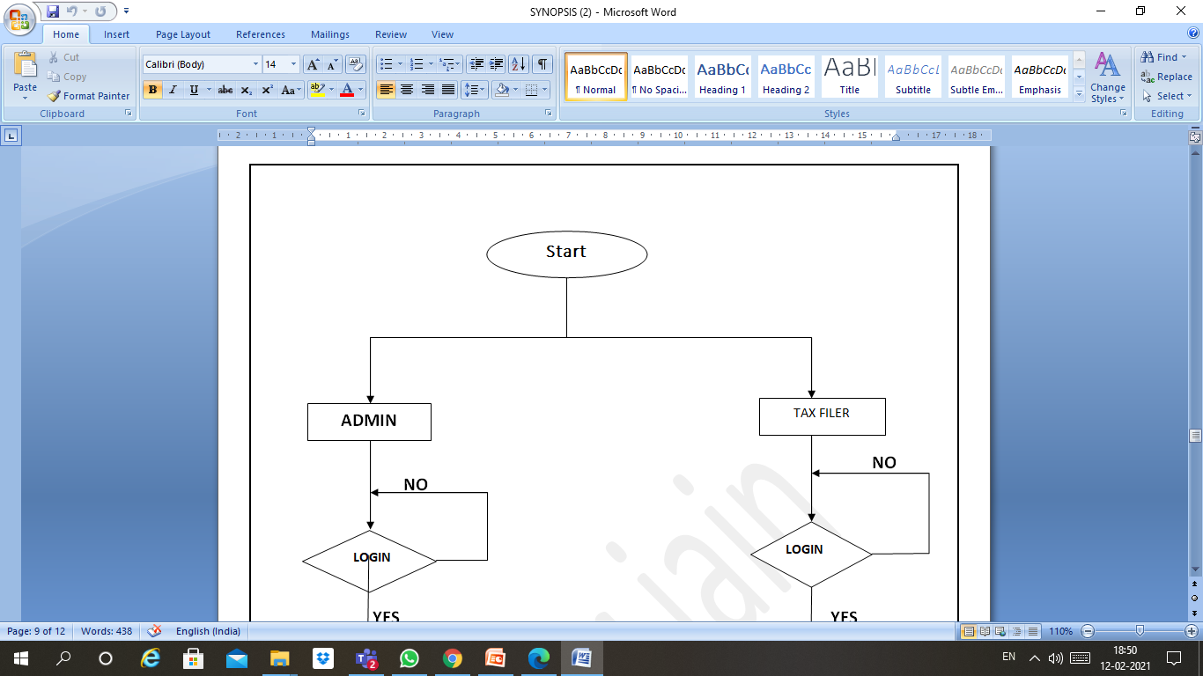
FLOWCHART

Slide 27
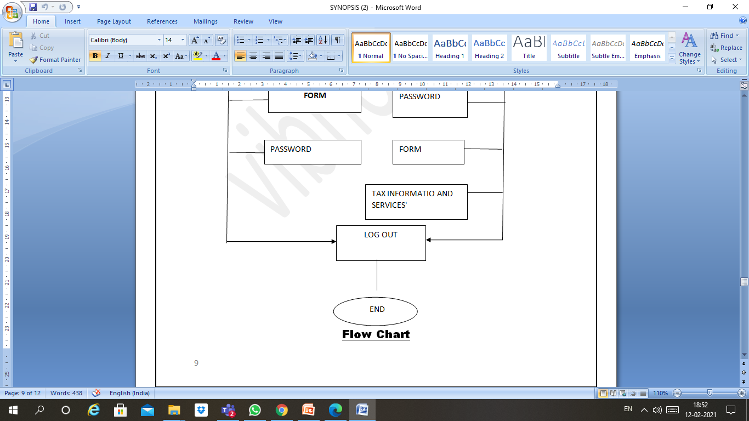

Slide 28
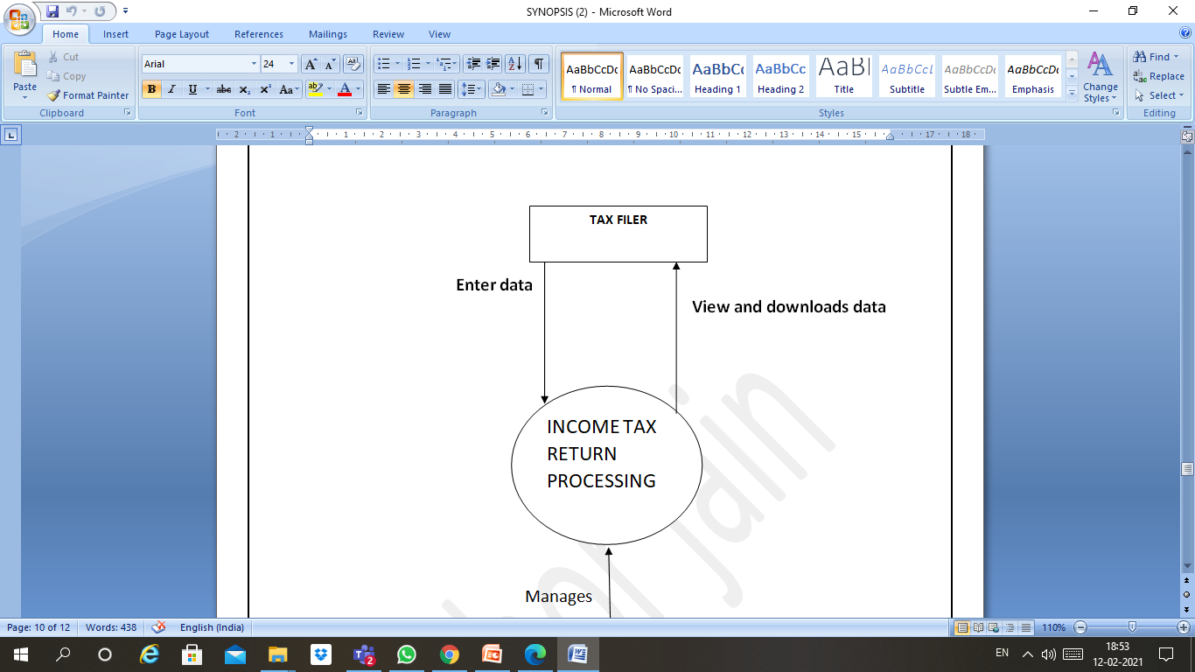
DFD 0 Level

Slide 29
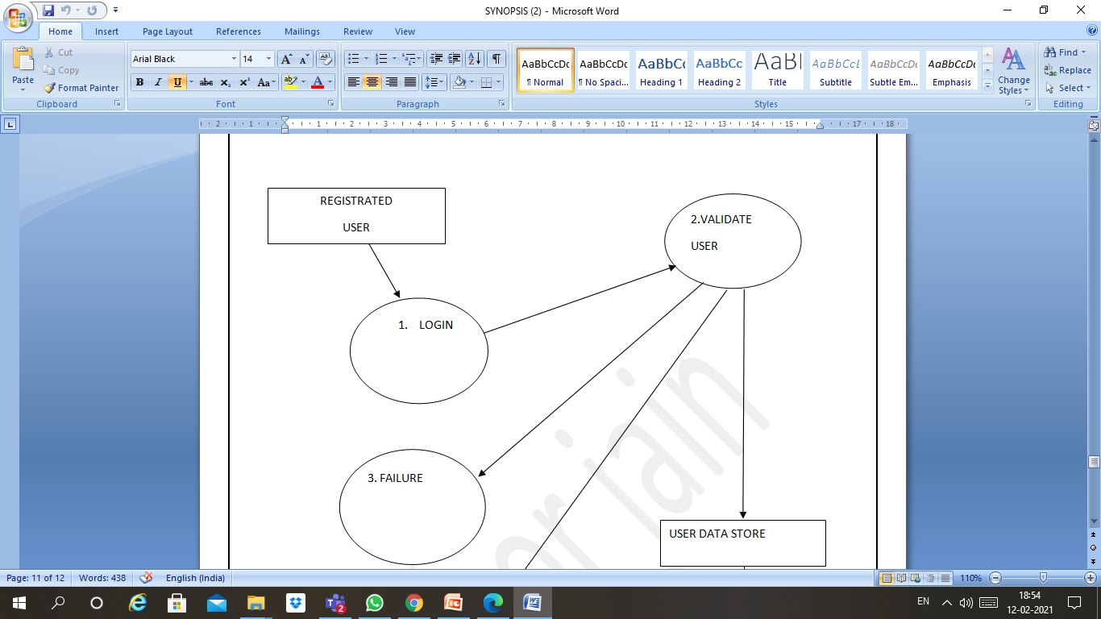
DFD 1 Level

Slide 30
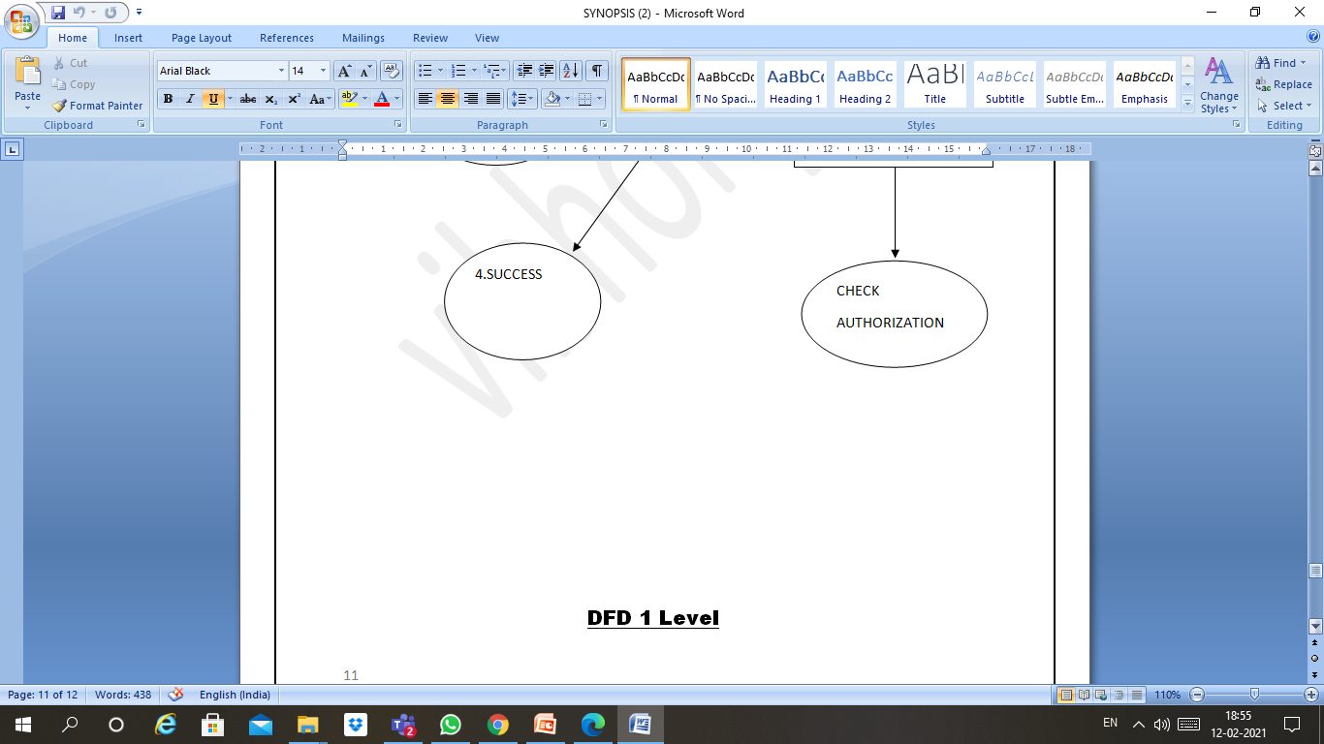

Slide 31
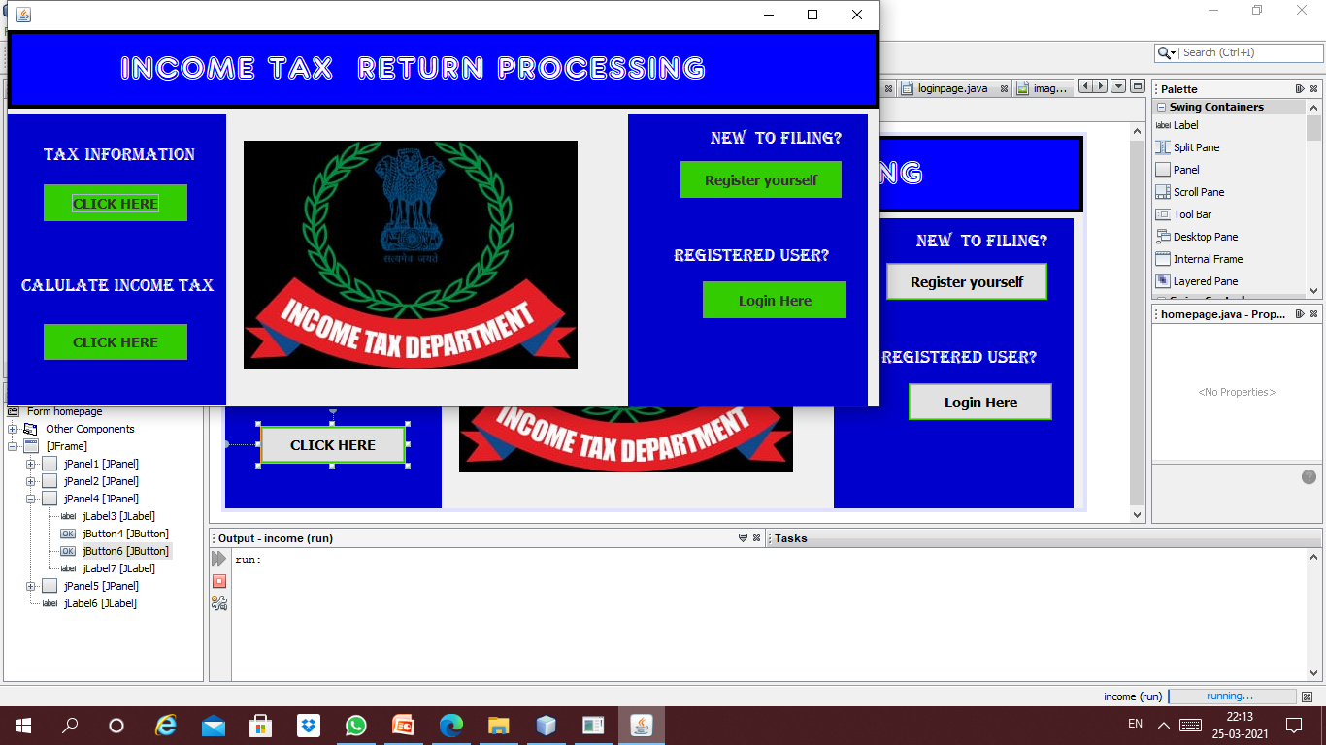
homepage

Slide 32
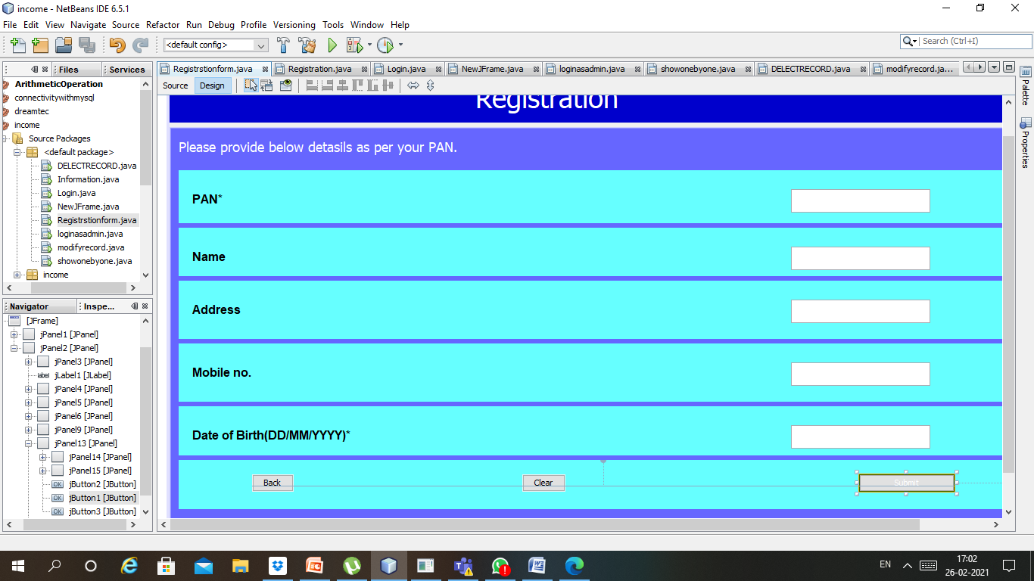
REGISTRATION(USER)

Slide 33
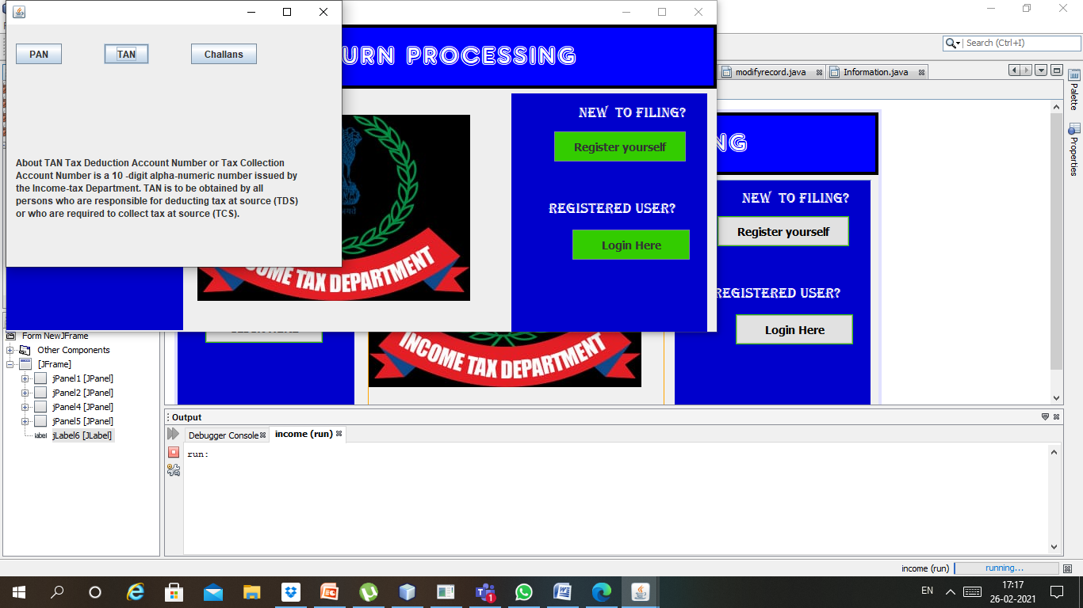

Slide 34
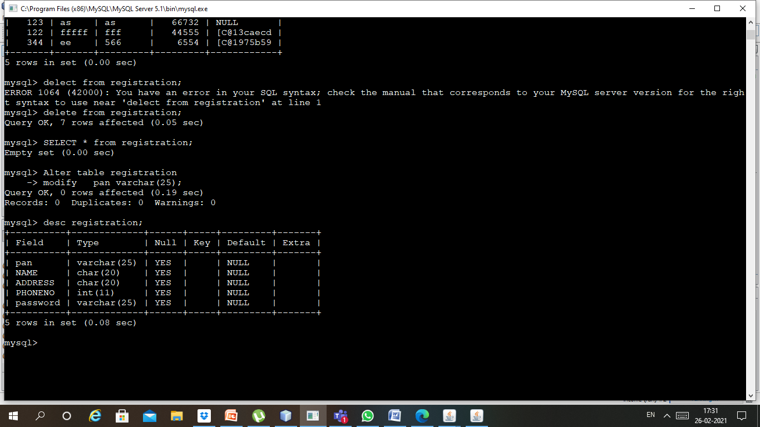
DATABASE CONNECTIVITY WITH MYSQL

Slide 35
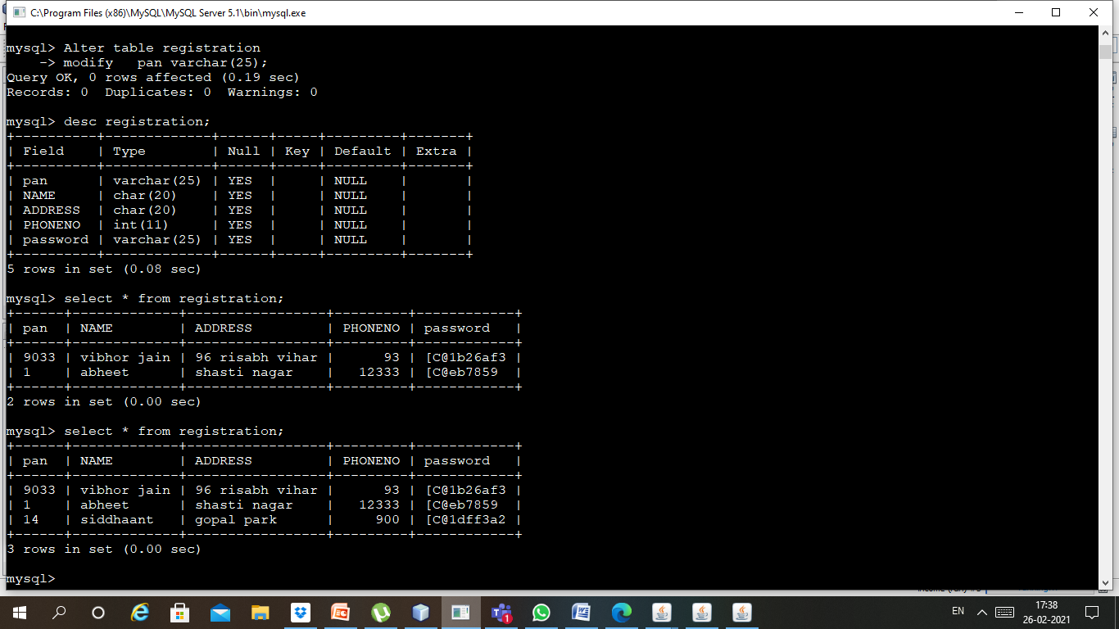

Slide 36
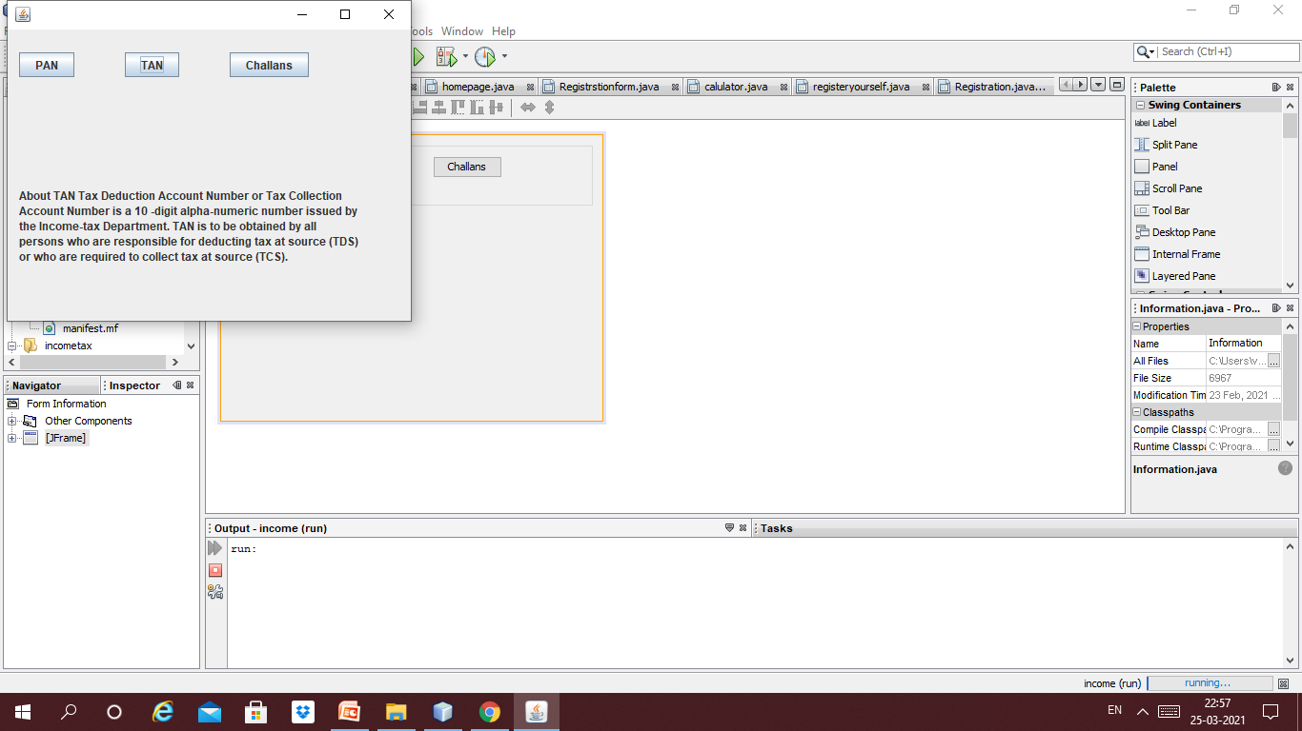

Slide 37
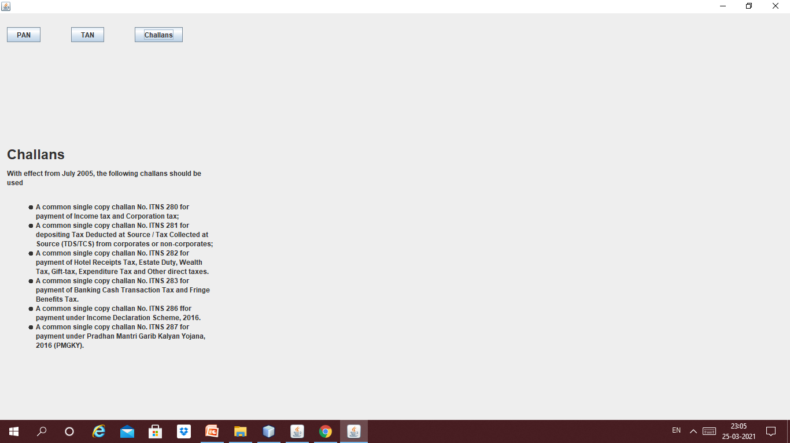

Slide 38
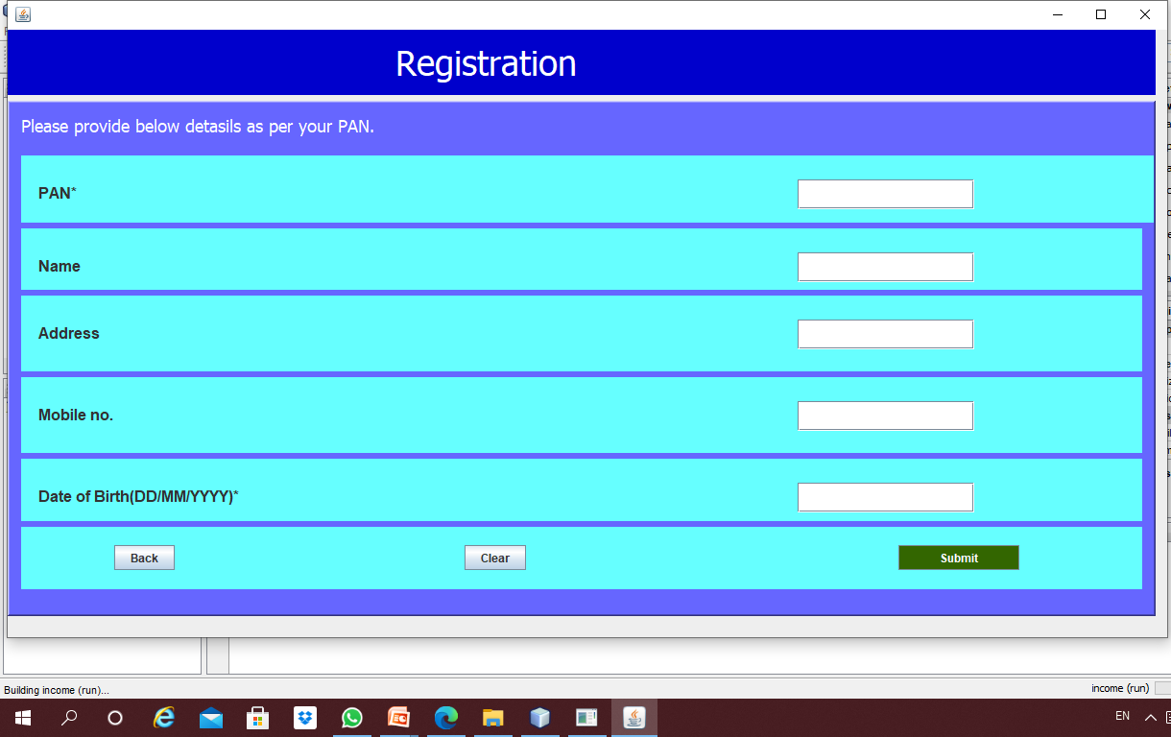
s Completion of Systems Development Phase

Slide 39
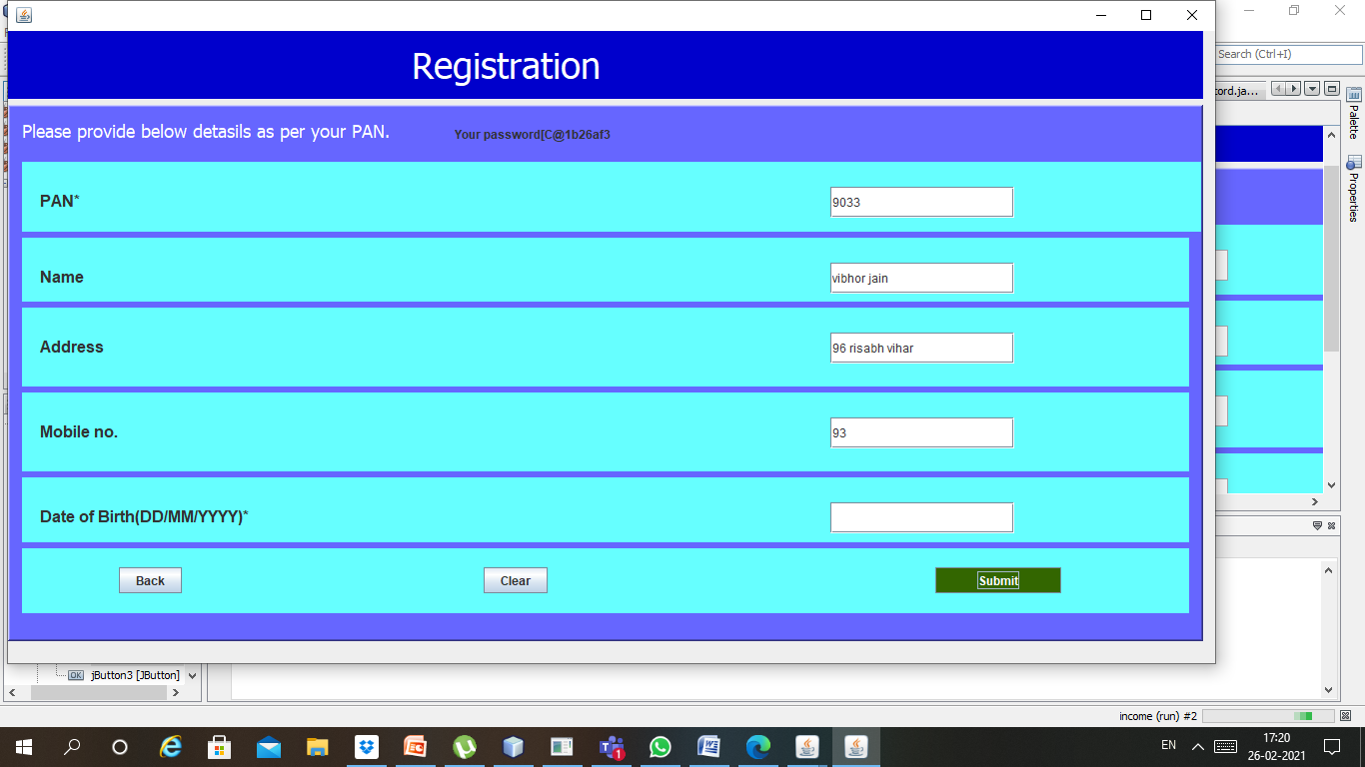
Working registration page

Slide 40
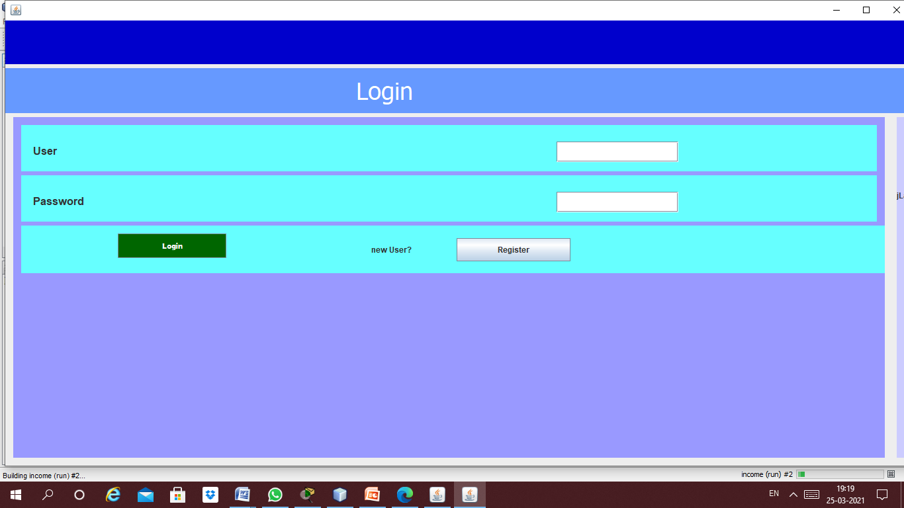
LOGIN PAGE

Slide 41
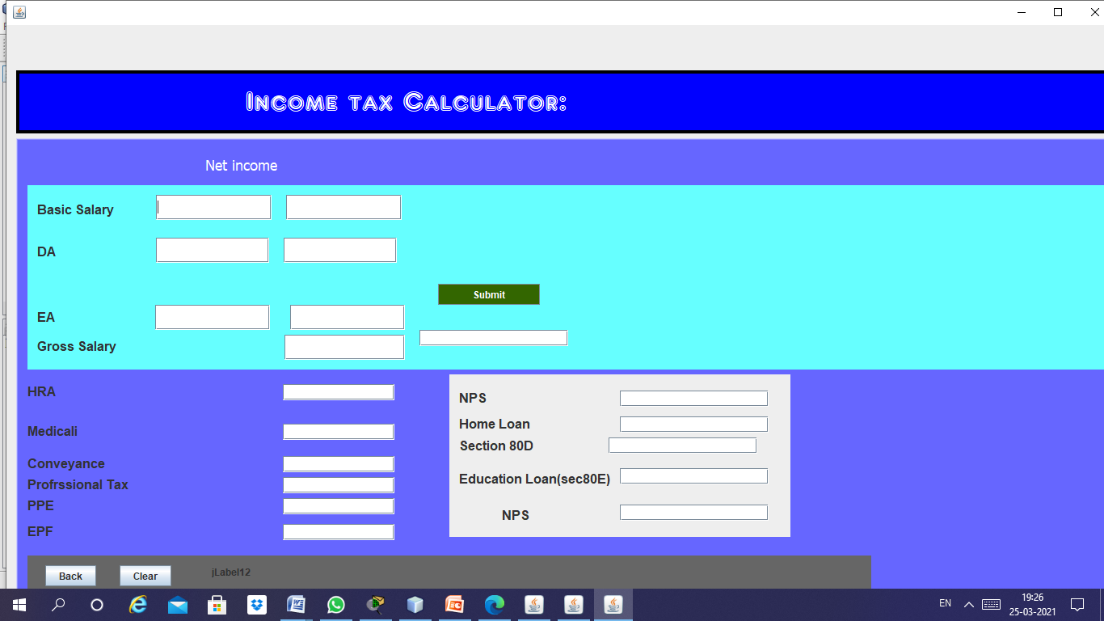
Income tax calculator

Slide 42
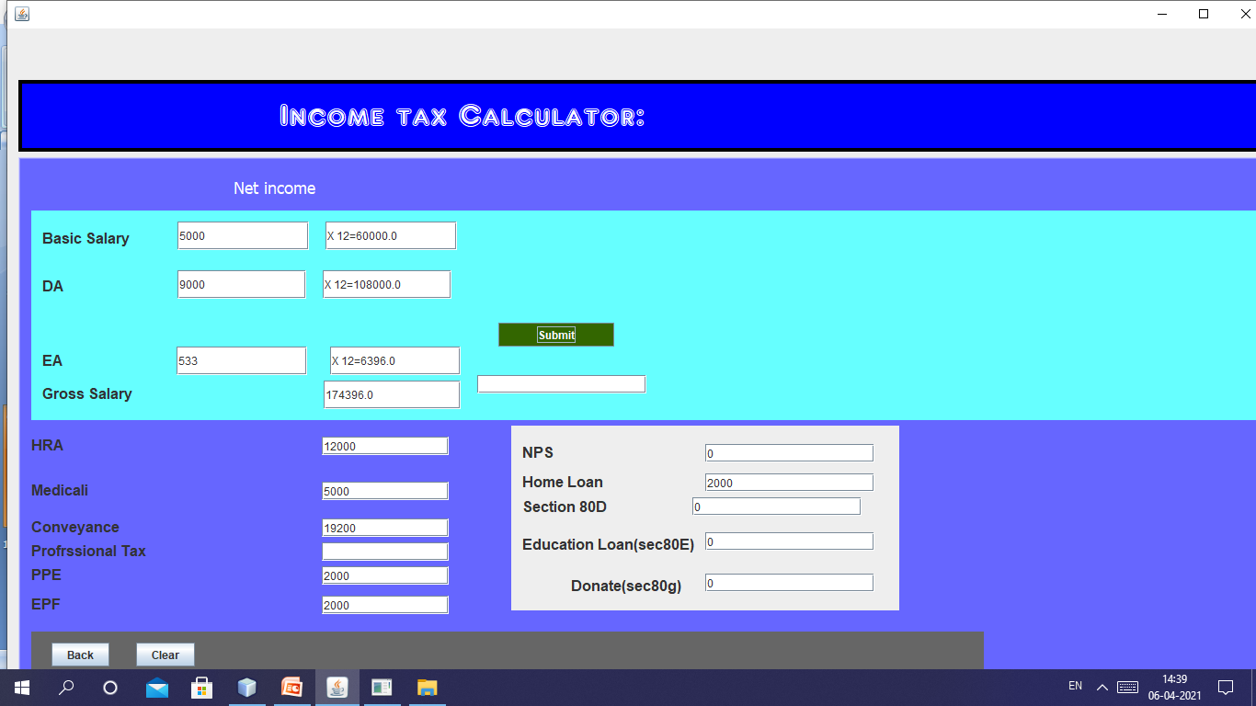
TAX CALCULATOR EXECUTES WITH TERMS

Slide 43
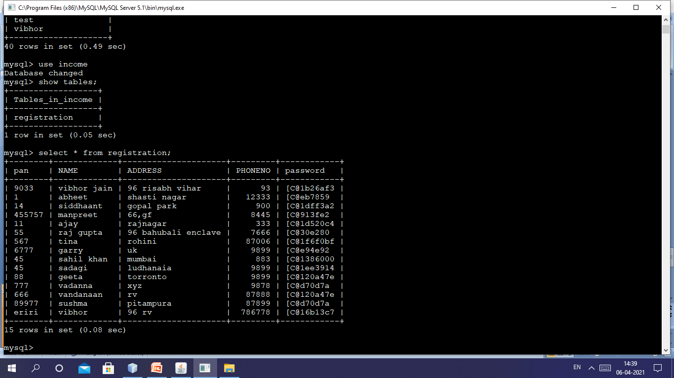
MYSQL TABLE WITH JAVA

Slide 44
Thank you

