Slide 1

INCOME TAX PROCESSING RETURN MADE BY VIBHOR JAIN GUIDDED BY DR VANDANNA SHARMA
REVIEW-IIII

Slide 2
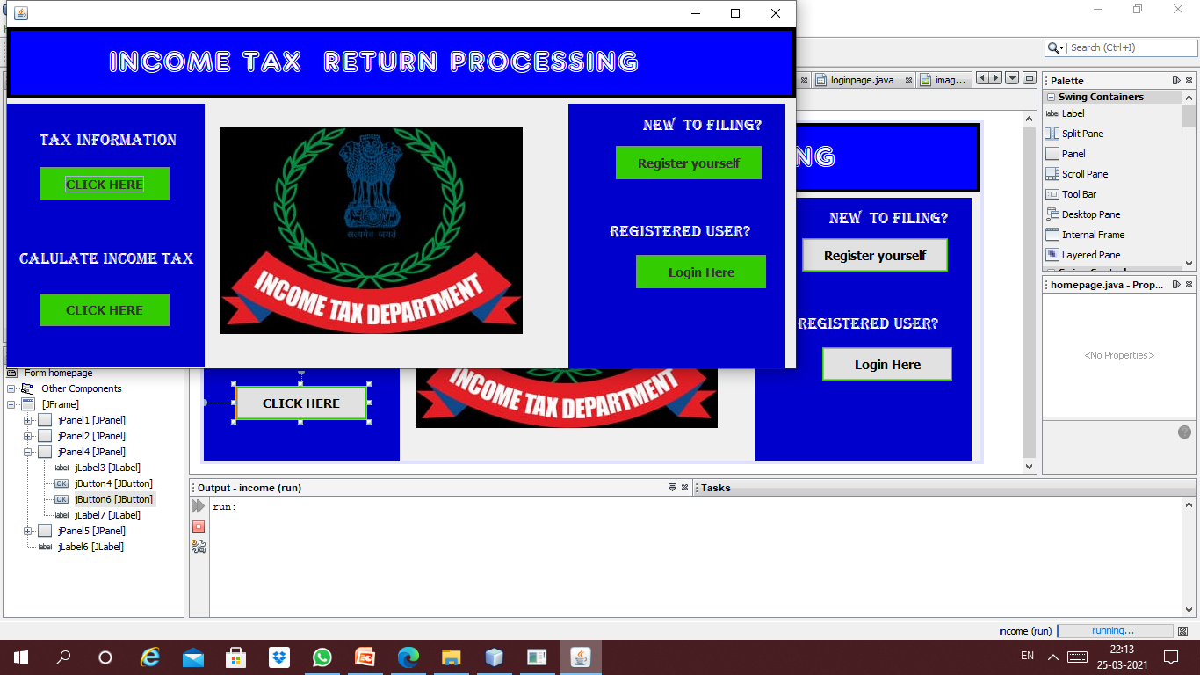
homepage

Slide 3
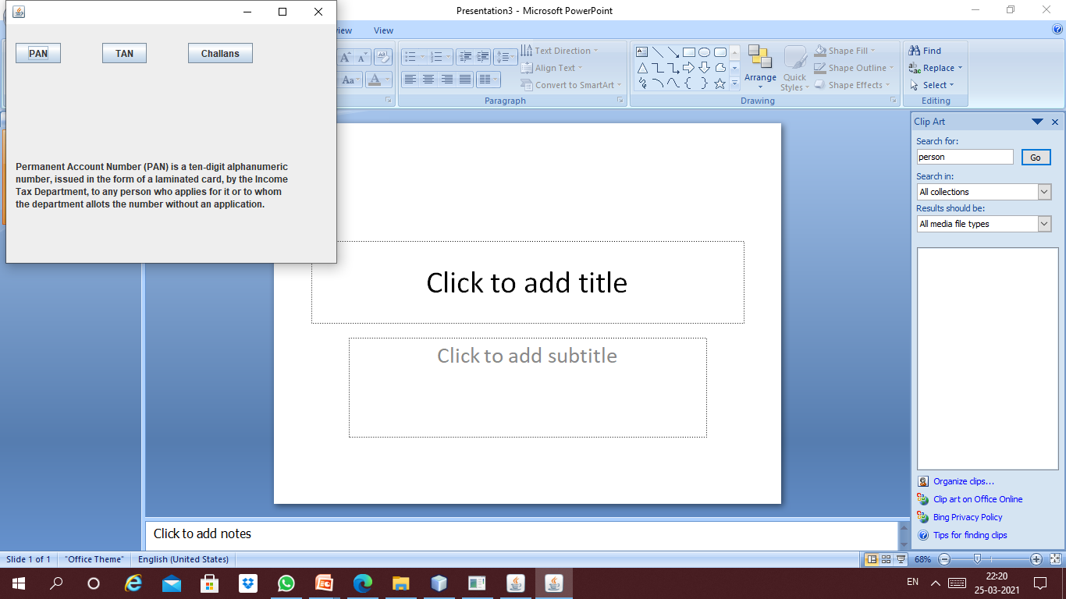

Slide 4
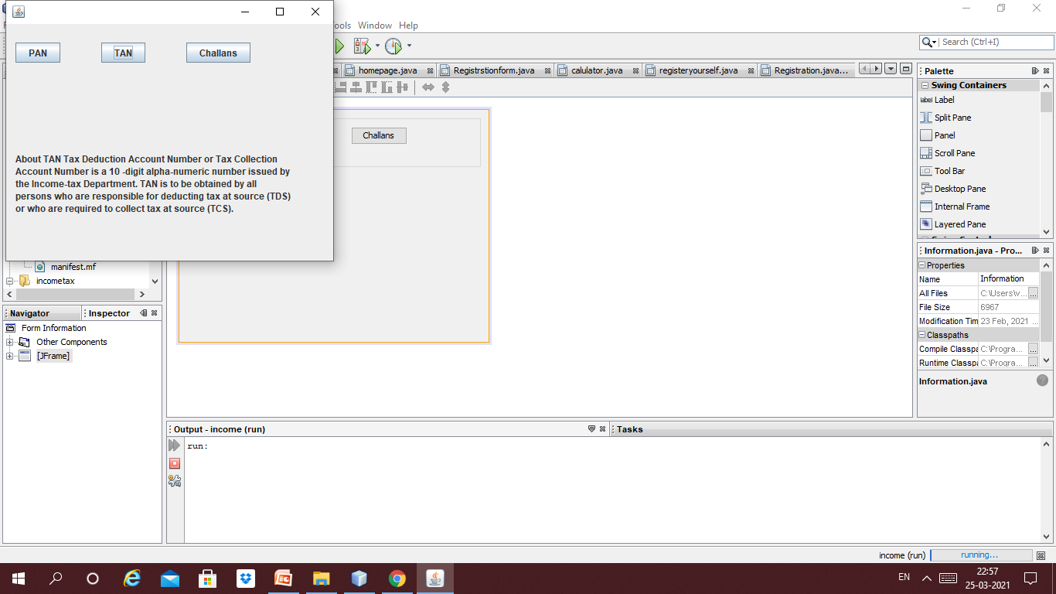

Slide 5
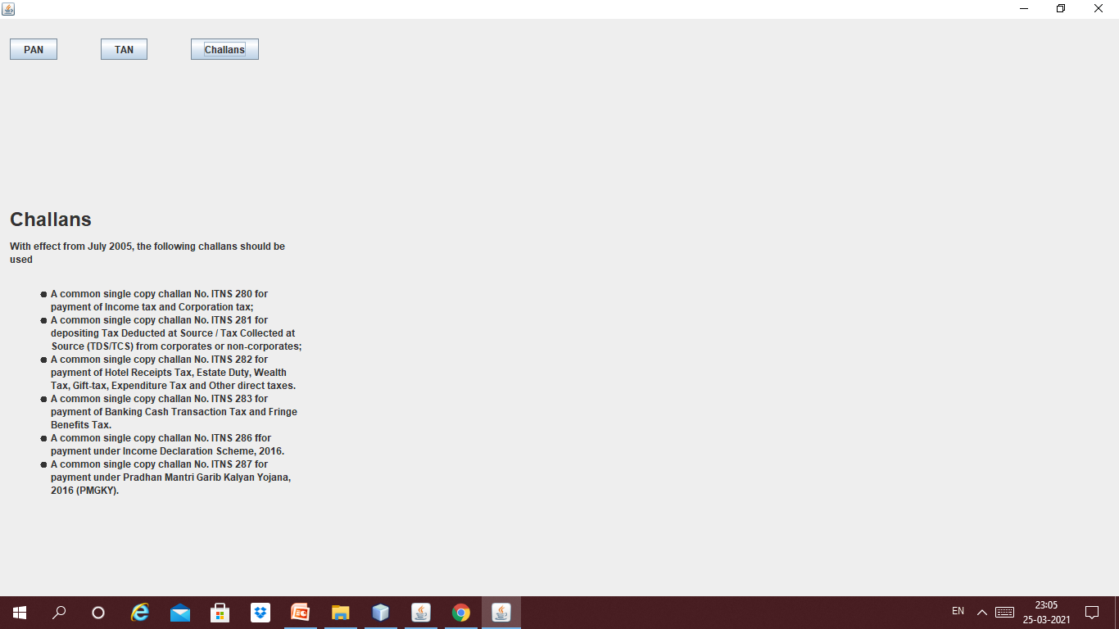

Slide 6
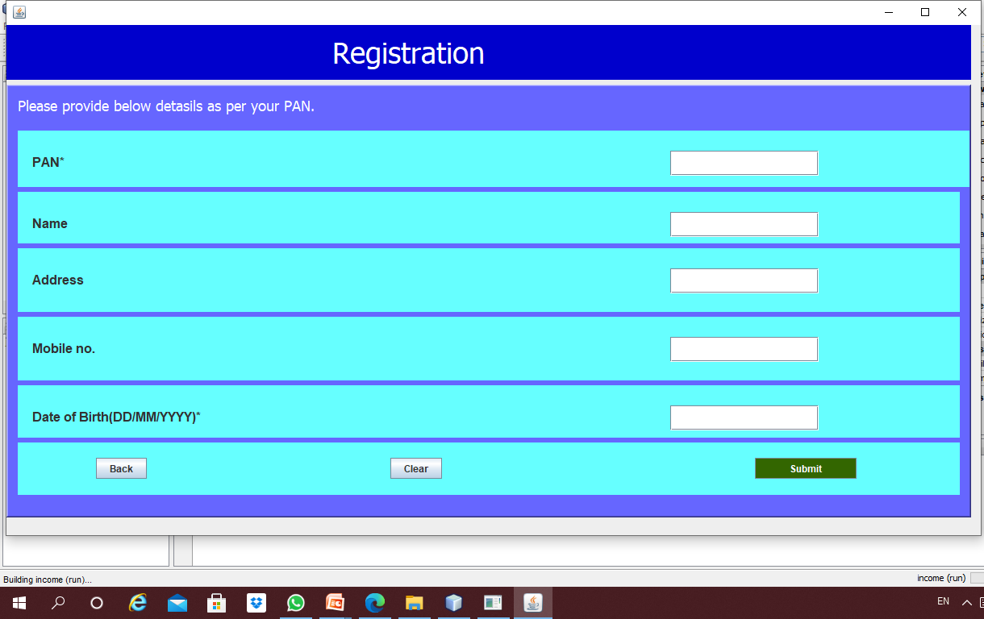
s Completion of Systems Development Phase

Slide 7
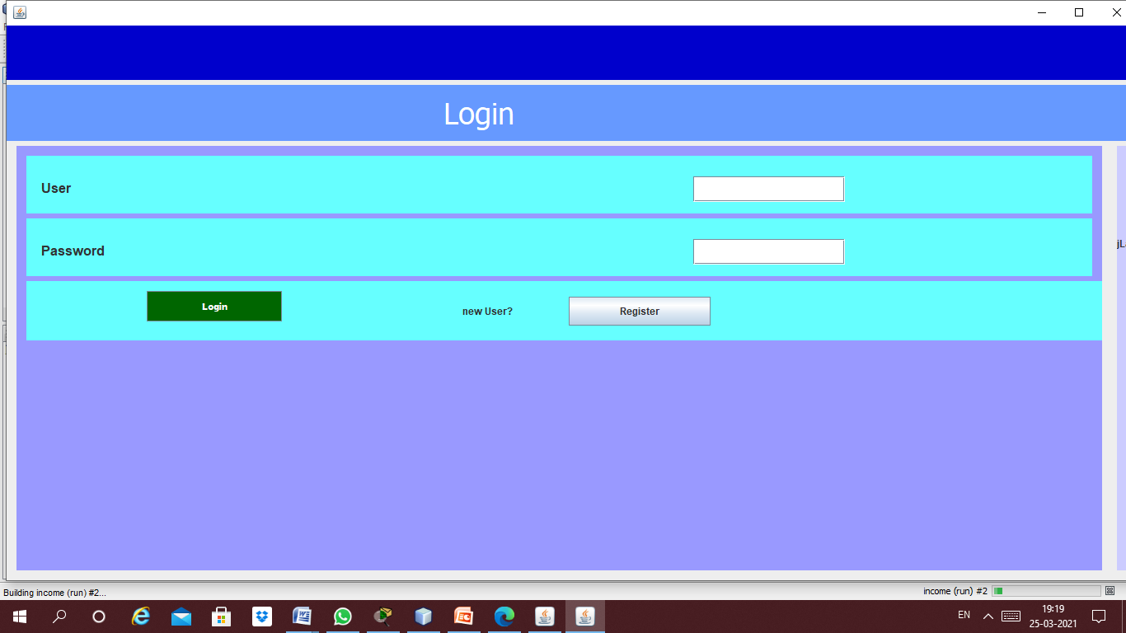
LOGIN PAGE

Slide 8
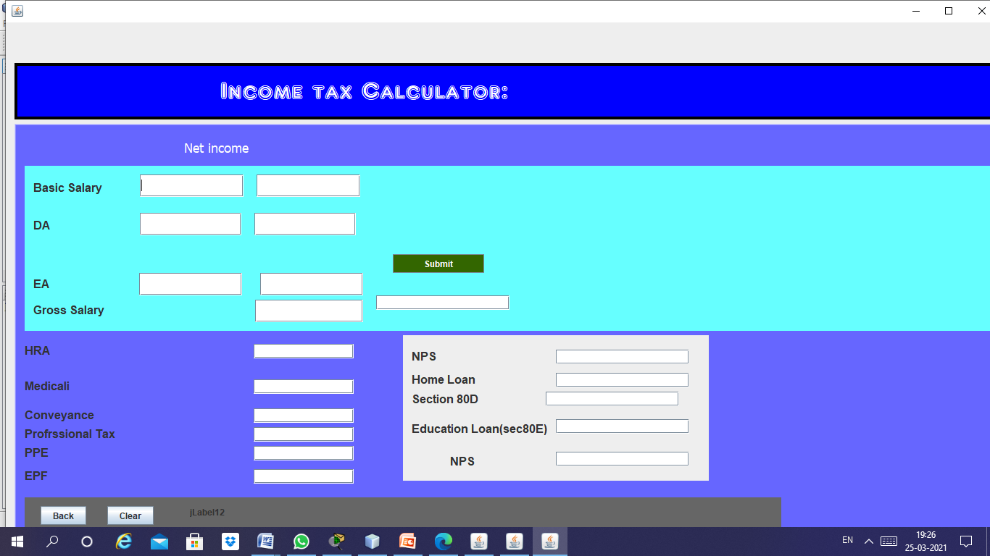
Income tax calculator

Slide 9
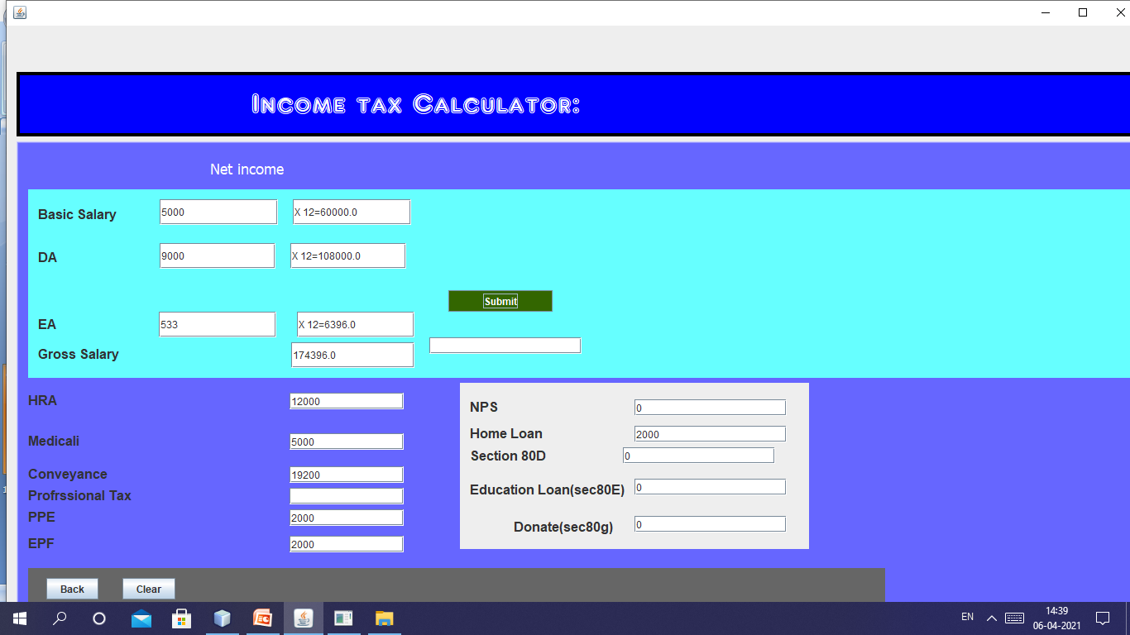
TAX CALCULATOR EXECUTES WITH TERMS

Slide 10
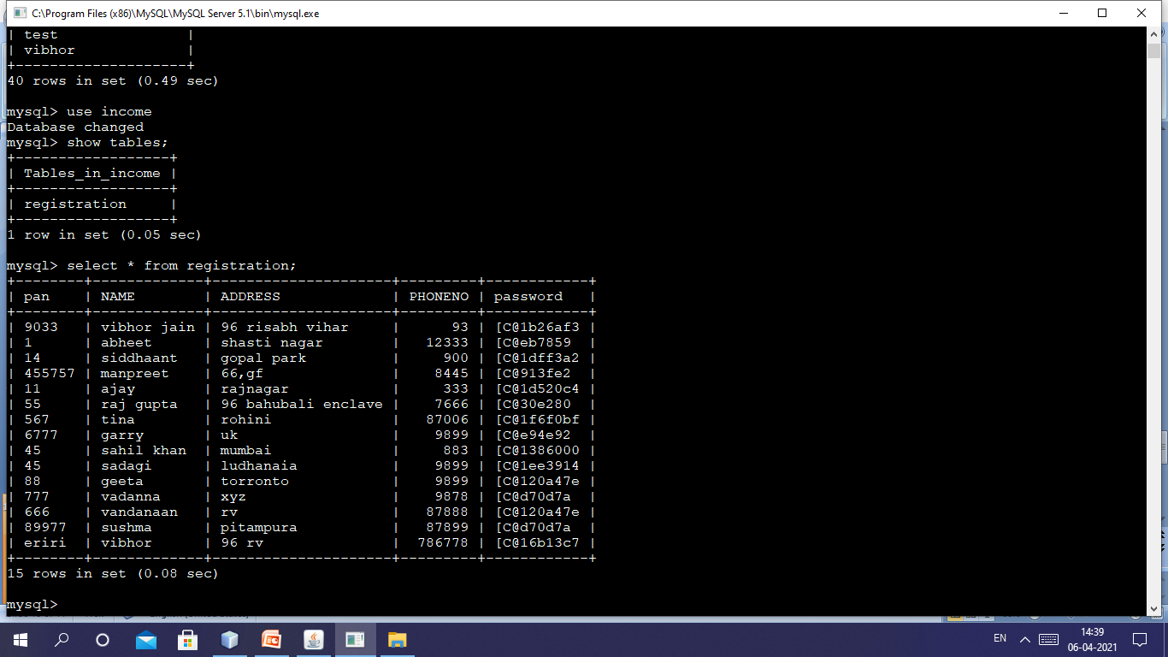
MYSQL TABLE WITH JAVA

Slide 11
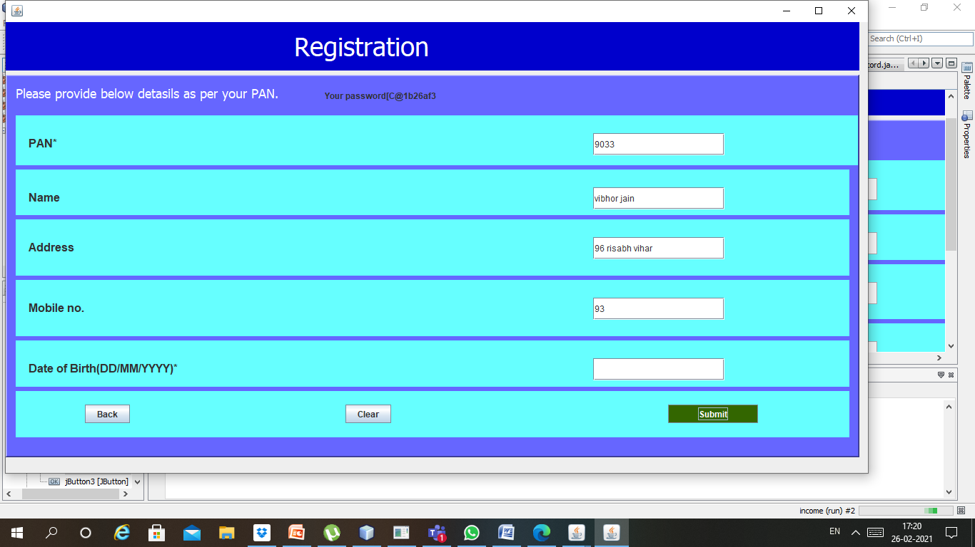
Working registration page

Slide 12
Thank you

