Slide 1
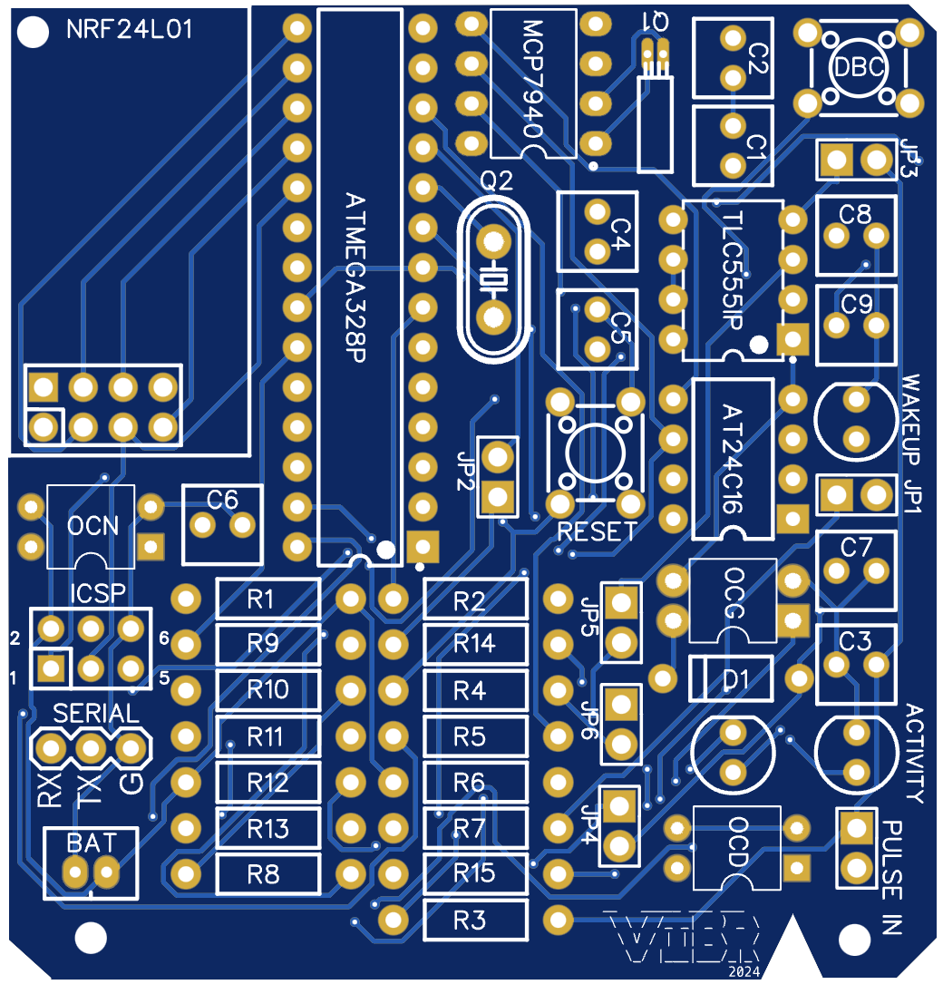
Jumper Settings
JP1: Wake up led
JP2: Activity led
JP3: Debouncer circuit power
JP4: Pullup Pulse input
JP5: Opto debouncer
JP6: Pulse Led
PULSE IN: Pulse input
Optional components:
TLC555IP
C8,C9
DBC
OCD

