Slide 1
Summer Internship Report at Cavisson
Made By: Vibhor Bijoy
Roll No: 384/COE/14

Slide 2
About My Internship
This summer vacation I did my internship with Cavisson which is situated in Noida.
In Cavisson software products are built to control the traffic on the internet.

Slide 3
About Netstorm
I was working with the Netstorm team in Cavisson.
Cavisson NetStorm is a cost-effective, performance enhancing and easy-to-use appliance for enterprise applications.
It is an extremely powerful load generator that provides an accurate estimation of Client Perceived Response Time (CPRT) enabling IT companies to guarantee the Service Level Agreements (SLA)
Advantages of Netstorm is followed in the next slide.

Slide 4
Advantages
Enterprise-scale, scalable, and stable technology
Massive load generator that provides an accurate estimation of Client Perceived Response Time
Advanced technology to handle load variables, user realism, application realism, and network realism
Extremely low CPU and memory overhead
Reusability of script, tight integration with Cavisson products

Slide 5
My Work Area
I worked on scripting.
Script is a collection of pages
Flow is the way in which a transaction occurs.
Types of scripts are of the following-
Perl
Javascript
TypeScript etc.

Slide 6
About My Project
The project that was given to me was to convert a JSON data in a file to an Excel sheet and download that excel sheet on Tomcat Apache server.

Slide 7
Technologies Used
Java
JSP
Servlet

Slide 8
Major Concept through this task
I got the golden opportunity to work in java using JSON .
JSON or Javascript Object Notation is a lightweight data interchange .
It is easy for humans to read and write.
It is easy for machines to parse and generate.
It is based on a subset of the JavaScript Programming Language, Standard ECMA-262 3rd Edition - December 1999.
JSON is a text format that is completely language independent but uses conventions that are familiar to programmers of the C-family of languages, including C, C++, C#, Java, JavaScript, Perl, Python, and many others.
It’s structure is easier as compared to XML.
It is widely used in REST(Representation Standard Transfer ) api’s.

Slide 9
Servers and Software Used
Java Eclipse Neon
MS Excel
Tomacat Apache 8 server

Slide 10
Java
Java is a programming language and a platform.
Java is a high level, robust, secured and object-oriented programming language.
Platform: Any hardware or software environment in which a program runs, is known as a platform. Since Java has its own runtime environment (JRE) and API, it is called platform.

Slide 11
Uses Of Java
Desktop Applications such as acrobat reader, media player, antivirus etc.
Web Applications
Enterprise Applications such as banking applications.
Mobile
Embedded System
Smart Card
Robotics
Games etc.

Slide 12
Types of Java Application
Standalone
Web
Enterprise
Mobile

Slide 13
Servlet
Servlet is a technology used to make J2EE or web applications.
It is robust and scalable because of Java
Servlet is an interface that must be implemented for creating any servlet.
Servlet is a class that extend the capabilities of the servers and respond to the incoming request. It can respond to any type of requests.

Slide 14
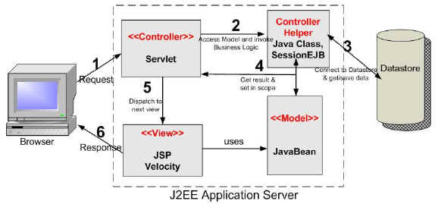
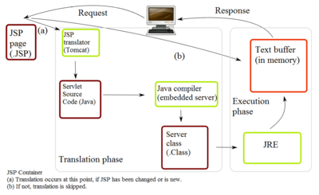
Working of Servlet

Slide 15
Working Of Servlet (continued)
Servlets give the response to the requests made by clients.
It basically implements an interface known as a servlet interface and the functionality of web server is extended with the help of servlets.
It runs on the server and is present in between the client and server. It is able to receive the requests from client side and response back being a server-sided program.The types of java servlets include HTTP servlets and generic or basic servlets.
The servlets are able to get the request from the client and after processing it can send the response to client from the server side back to the client.
The life cycle of a servlet consists of three steps which includes init, service and destroy and the methods are init(), service() and destroy().
This is the life cycle of servlet and the methods present in it works in the following way; the init method is called by the container when the instance of servlet has been created successfully, when the request from a client has been received at the server side, the service method of servlet is called respectively and this service method invokes the methods of HTTP protocol including doGet() and doPost() depending on the requirements.

Slide 16
JSP(Java Server Pages)
JSP technology is used to create web application just like Servlet technology. It can be thought of as an extension to servlet because it provides more functionality than servlet such as expression language, jstl etc.
A JSP page consists of HTML tags and JSP tags. The jsp pages are easier to maintain than servlet because we can separate designing and development. It provides some additional features such as Expression Language, Custom Tag etc.

Slide 17
JSP V/S Servlet
JSP is an extension to servlet .All features of servlet can be used in JSP. In addition we can use implicit objects, predefined tags etc.
JSP can be easily managed because we can easily separate our business logic with presentation logic. In servlet technology, we mix our business logic with the presentation logic.
In JSP there is fast development . There is no need to recompile and redeploy. Whereas servlet code needs to be updated regularly.
In JSP, we can use a lot of tags such as action tags, jstl, custom tags etc. that reduces the code. Moreover, we can use EL, implicit objects etc.

Slide 18
Tomcat Apache
Apache Tomcat, often referred to as Tomcat Server, is an open-source Java Servlet Container developed by the Apache Software Foundation (ASF).
Tomcat implements several Java EE specifications including Java Servlet, JavaServer Pages (JSP), Java EL, and WebSocket, and provides a "pure Java" HTTP web server environment in which Java code can run.

Slide 19
Tomcat Components
Catalina
Coyote
Jasper
Cluster

Slide 20
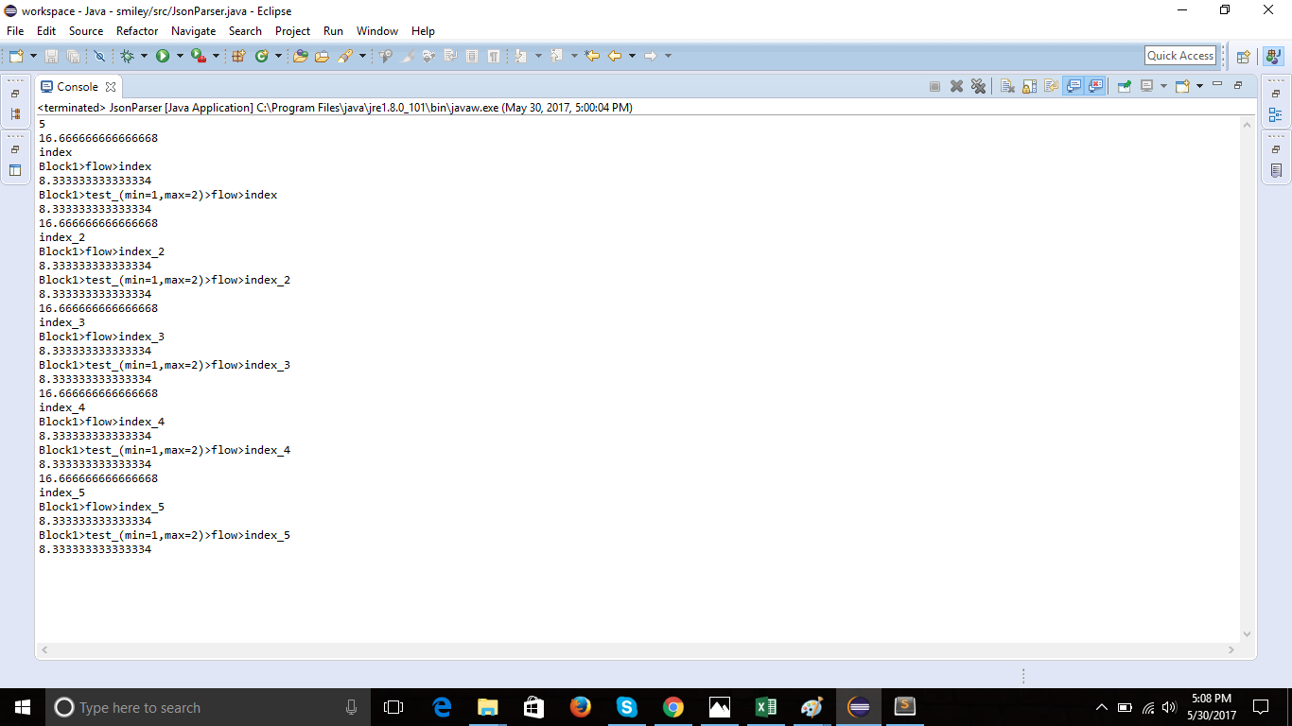
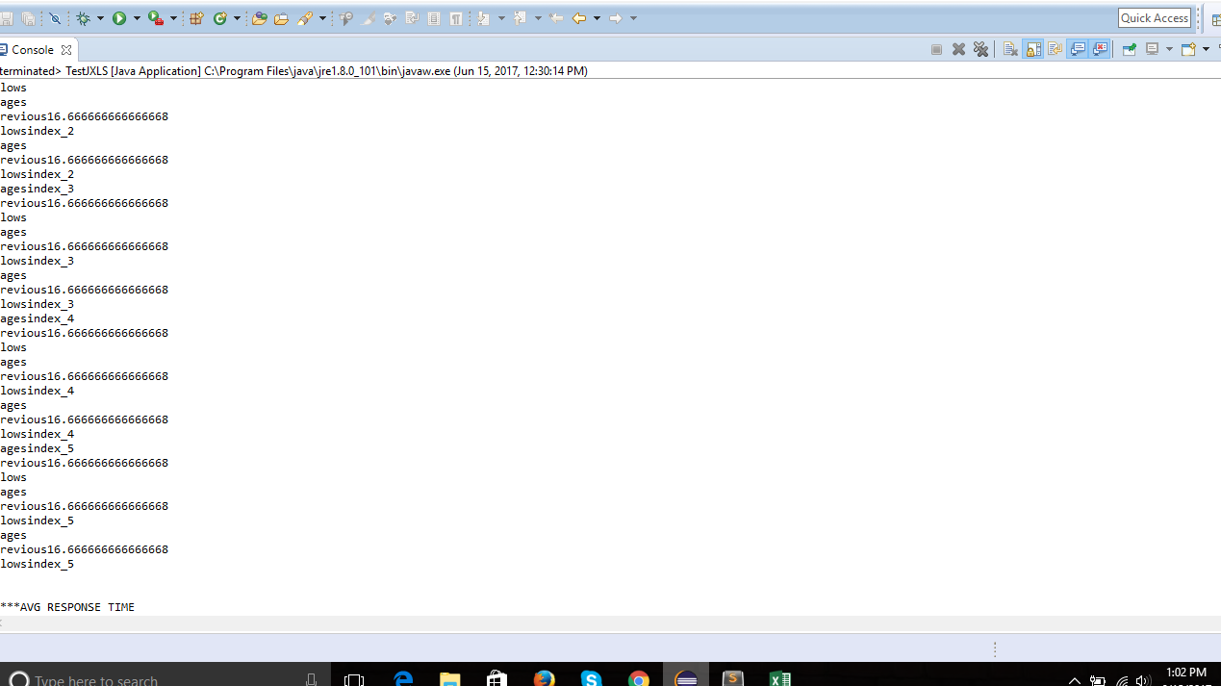
Java Outputs

Slide 21
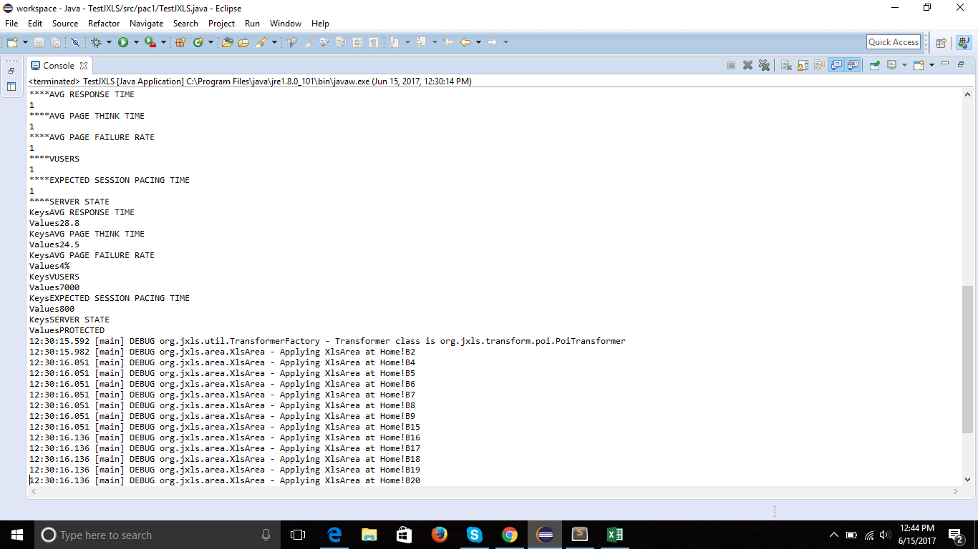
Outputs(continued)

Slide 22
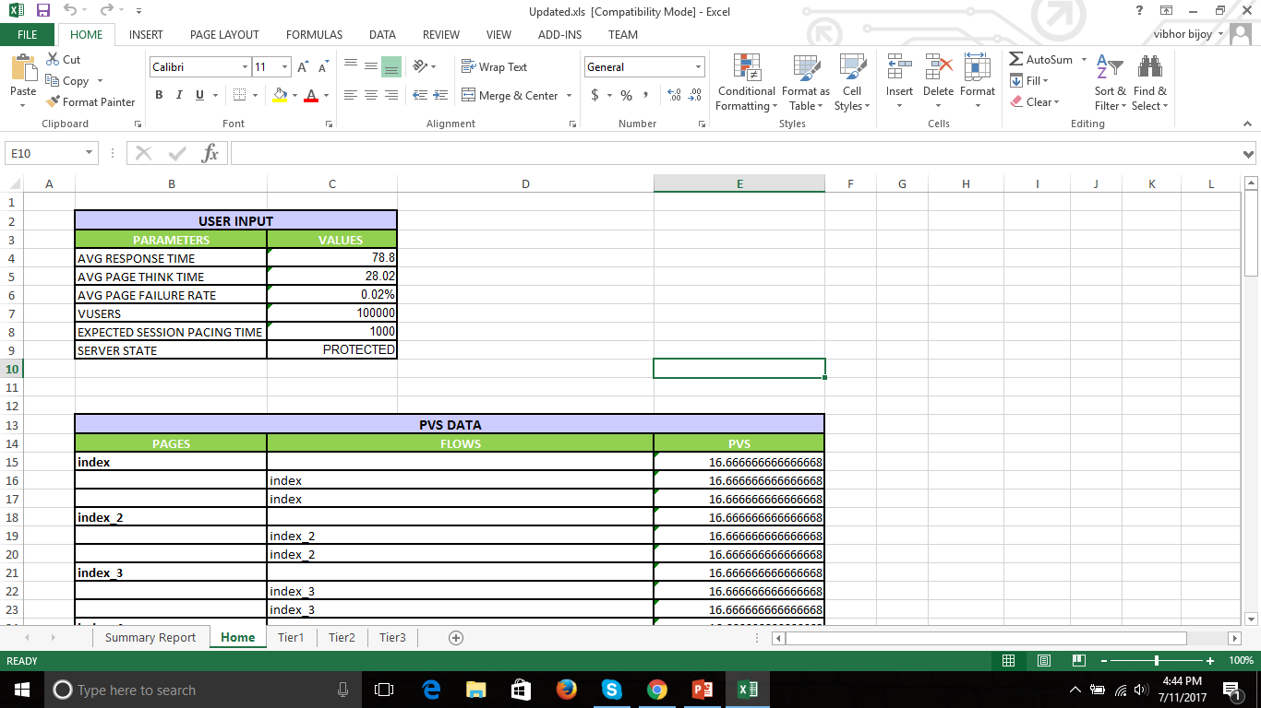
Excel Outputs

Slide 23
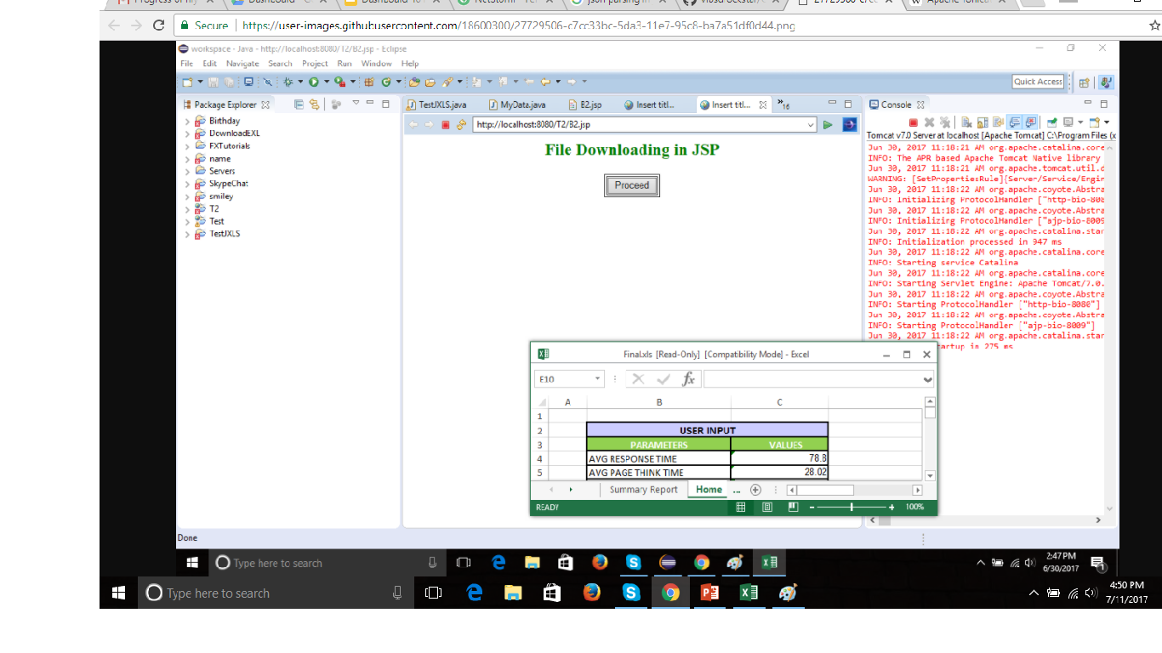
JSP Output

Slide 24
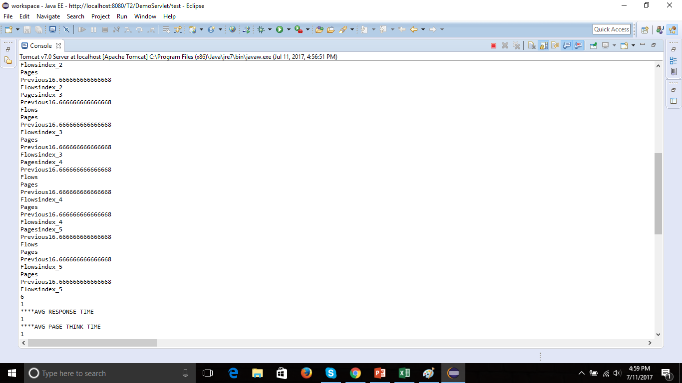
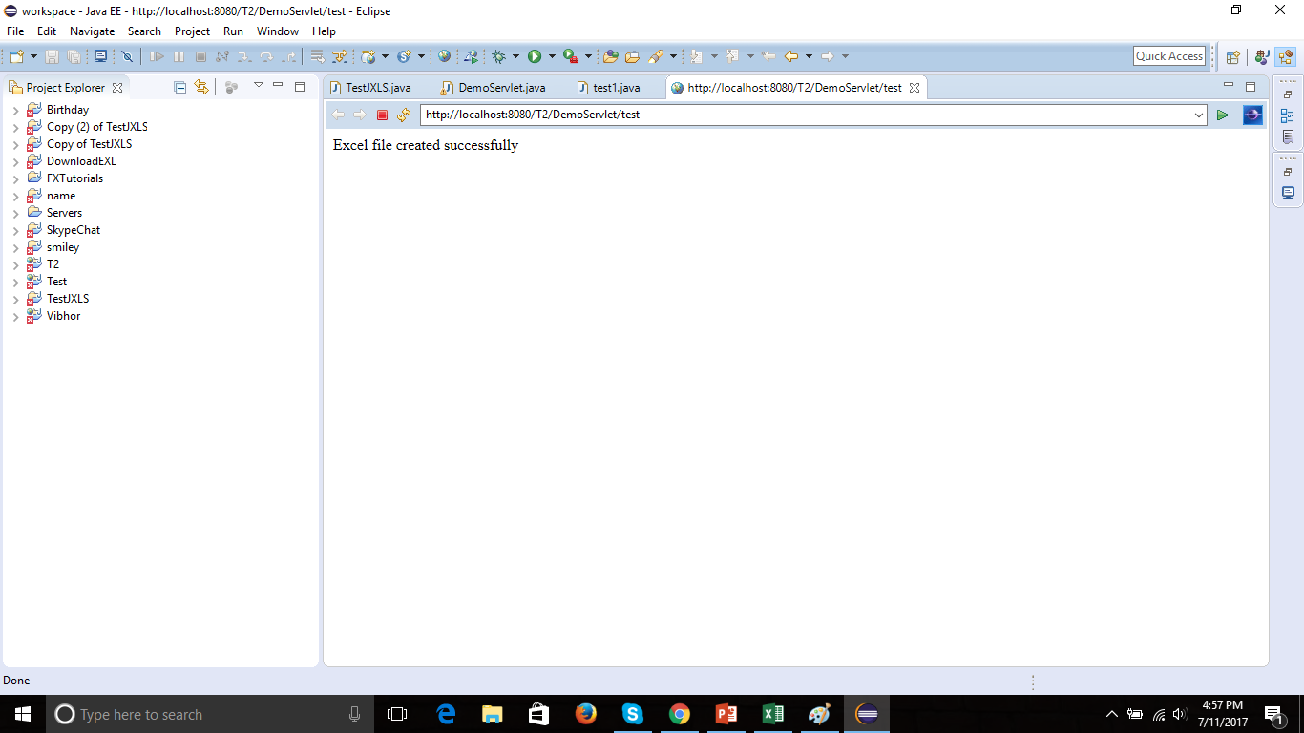
Servlet Output

Slide 25
THANK YOU

