Slide 1

Introduction
24 June 2024

Slide 2



GUI software
FIJI: https://fiji.sc/
BigWarp: https://imagej.net/plugins/bigwarp
Qupath: https://qupath.github.io/
Ilastik: https://www.ilastik.org/

Slide 3




packages
Bioconductor: https://www.bioconductor.org/
Seurat: https://satijalab.org/seurat/
Giotto Suite: https://drieslab.github.io/Giotto_website/
Voyager: https://pachterlab.github.io/voyager/index.html
…

Slide 4





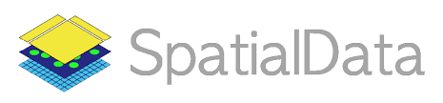

Python packages
Scverse: https://scverse.org/
AnnData: https://anndata.readthedocs.io/
Scanpy: https://scanpy.readthedocs.io/
Squidpy: https://squidpy.readthedocs.io/
SpatialData: https://spatialdata.scverse.org
SPArrOW: https://sparrow-pipeline.readthedocs.io/
Harpy: https://harpy.readthedocs.io/en/latest/
…

Slide 5
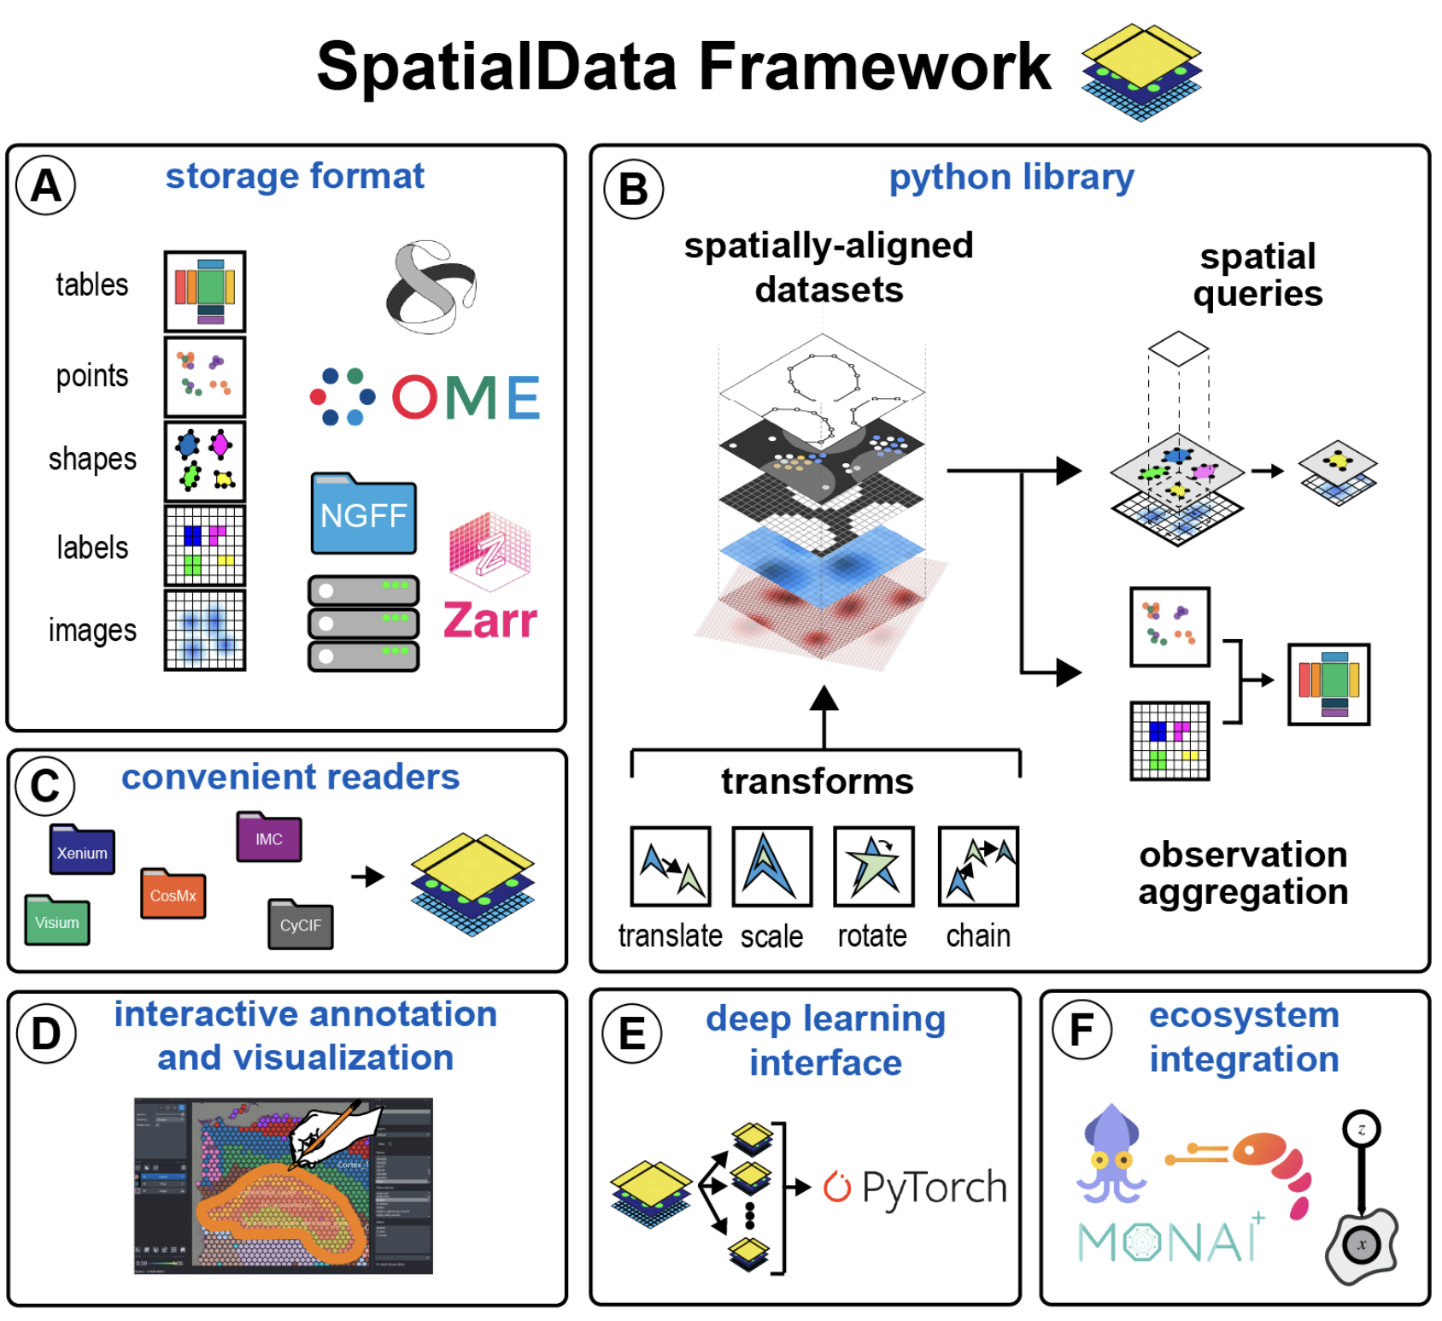
SpatialData
Data framework that handles data storage format, access, alignment in different coordinate spaces, processing operations…
Napari plugin for interactive annotation and visualization

Slide 6
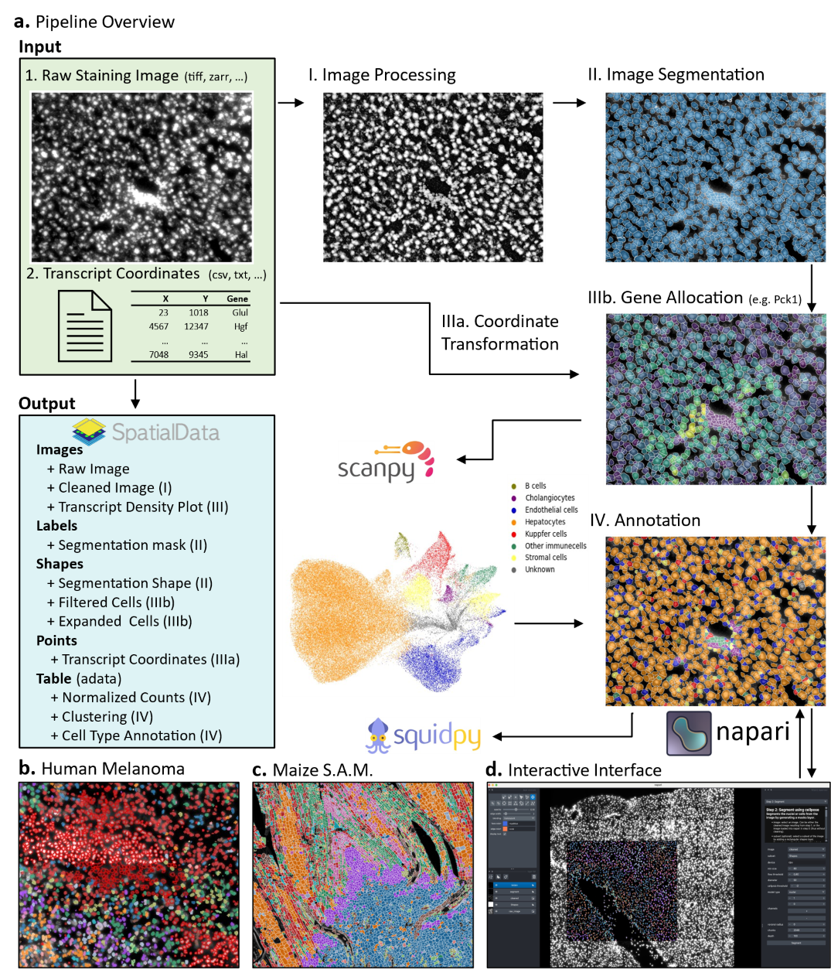

Developed by Lotte Pollaris (Yvan Saeys lab) in collaboration with the VIB Spatial Catalyst
A flexible, interactive and scalable pipeline for targeted spatial transcriptomics analysis
Lotte Pollaris

Slide 7
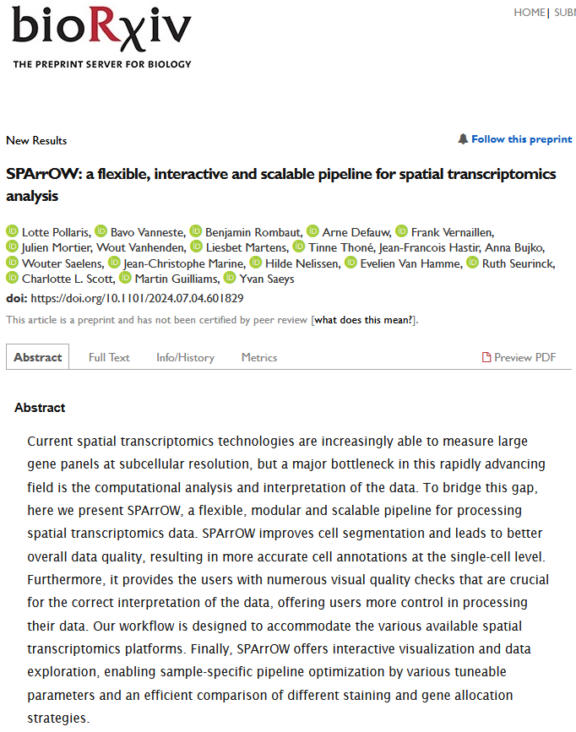
Pollaris et al., SPArrOW: a flexible, interactive and scalable pipeline for spatial transcriptomics analysis
bioRxiv 2024.07.04.601829; https://doi.org/10.1101/2024.07.04.601829
Lotte Pollaris

Slide 8

Developed by Benjamin Rombaut (Yvan Saeys lab) in collaboration with the VIB Spatial Catalyst
Broadens the capabilities of SPArrOW for proteomics, multi-omics, …
https://harpy.readthedocs.io/en/latest/
Benjamin Rombaut

Slide 9
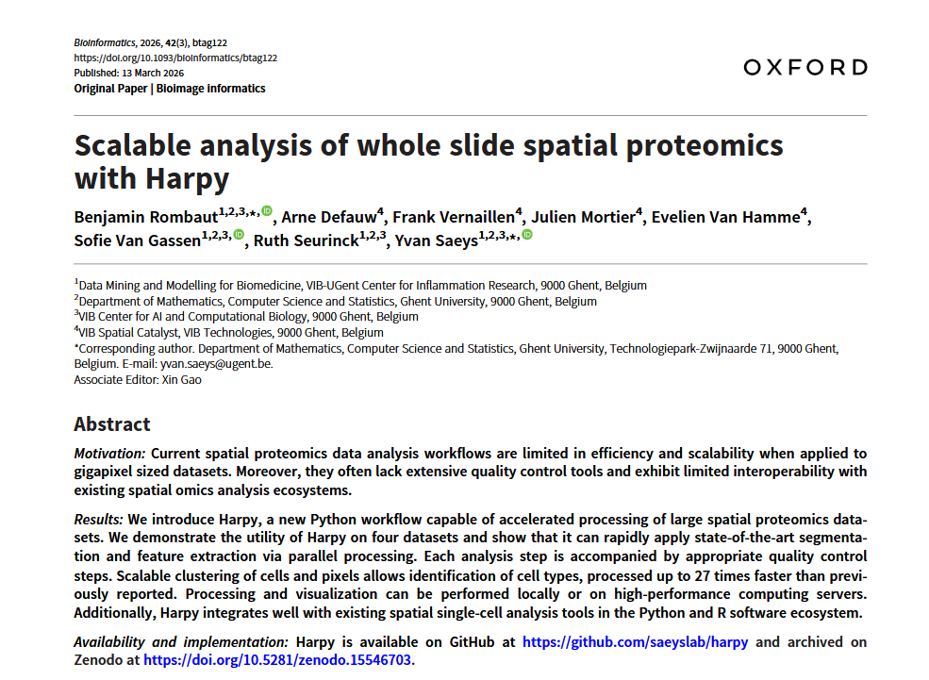
Benjamin Rombaut
Rombaut et al., Scalable analysis of whole slide spatial proteomics with Harpy, Bioinformatics, Volume 42, Issue 3, March 2026, https://doi.org/10.1093/bioinformatics/btag122

Slide 10
Why ?
Features: Image preprocessing, segmentation, shallow and deep feature extraction, data aggregation, QC, plotting, downstream, segmentation-free approaches, …
Integration with state-of-the-art tools
Scalable
Multi-platform support
Active maintenance and development by the VIB Spatial Catalyst

Slide 11
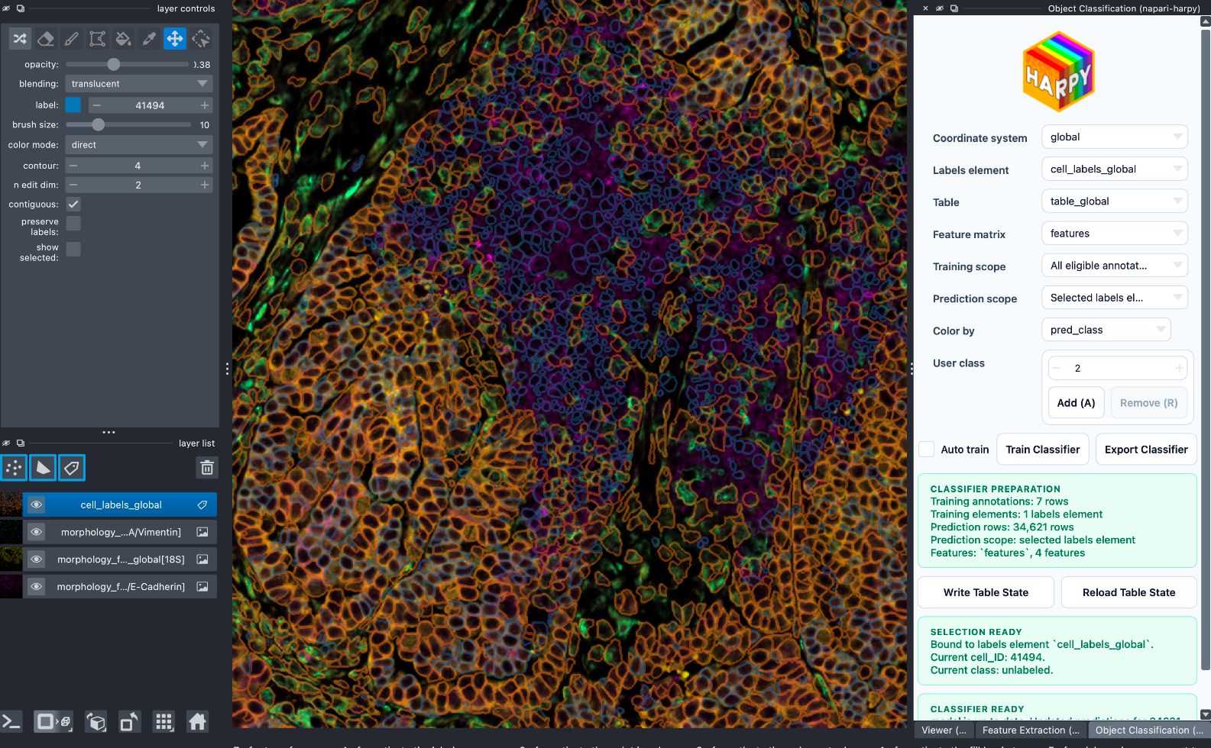
Why napari- ?
Napari-harpy offers interactive exploration, feature extraction and object classification

