Slide 1

Sequencing-based spatial transcriptomics

Slide 2
Visium reader
sdata = hp.io.visium(
path = path_outs,
counts_file = counts_file,
dataset_id = dataset_id,
fullres_image_file = path_img,
output = output_path
)
https://harpy.readthedocs.io/en/latest/generated/harpy.io.visium.html#harpy.io.visium

Slide 3
VisiumHD reader
sdata = hp.io.visium_hd(
path = path_outs,
dataset_id = dataset_id,
filtered_counts_file = False,
bin_size = [2, 8, 16, 32],
bins_as_squares = True,
fullres_image_file = path_img,
load_all_images = True,
output = output_path
)
https://harpy.readthedocs.io/en/latest/generated/harpy.io.visium_hd.html

Slide 4
Other readers
We have experience with the following assays:
Curio Seeker
BMKMANU S1000
BMKMANU S3000
Nova-ST
Stereo-Seq
Contact VIB Spatial Catalyst !

Slide 5
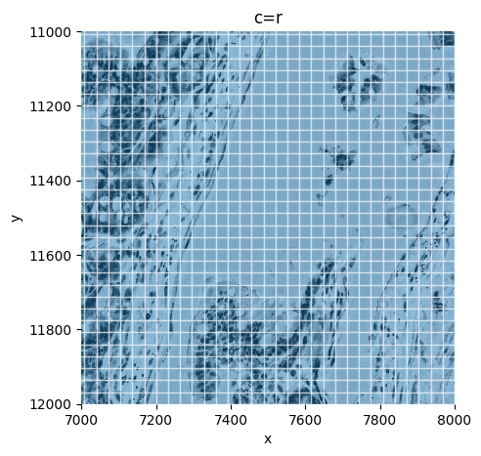
Tesselation
sdata = hp.im.add_grid_labels(
sdata,
shape=shape,
size=size,
output_shapes_name="output_shapes",
output_labels_name="output_labels",
grid_type="square",
transformations=transformations,
overwrite=True
)
https://harpy.readthedocs.io/en/latest/generated/harpy.im.add_grid_labels.html#harpy.im.add_grid_labels

Slide 6
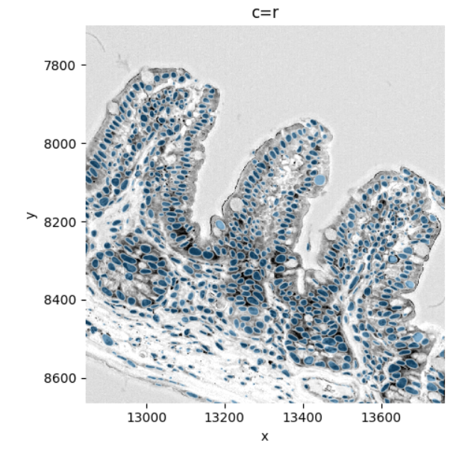
Segmentation
sdata = hp.im.segment(
sdata,
image_name = "image",
output_labels_name = "labels_nuclei",
output_shapes_name = "shapes_nuclei",
model = hp.im.instanseg_callable,
output = "all_outputs",
instanseg_model = instanseg_model,
pixel_size = 0.5,
overwrite = True,
)
https://harpy.readthedocs.io/en/latest/generated/harpy.im.segment.html

Slide 7
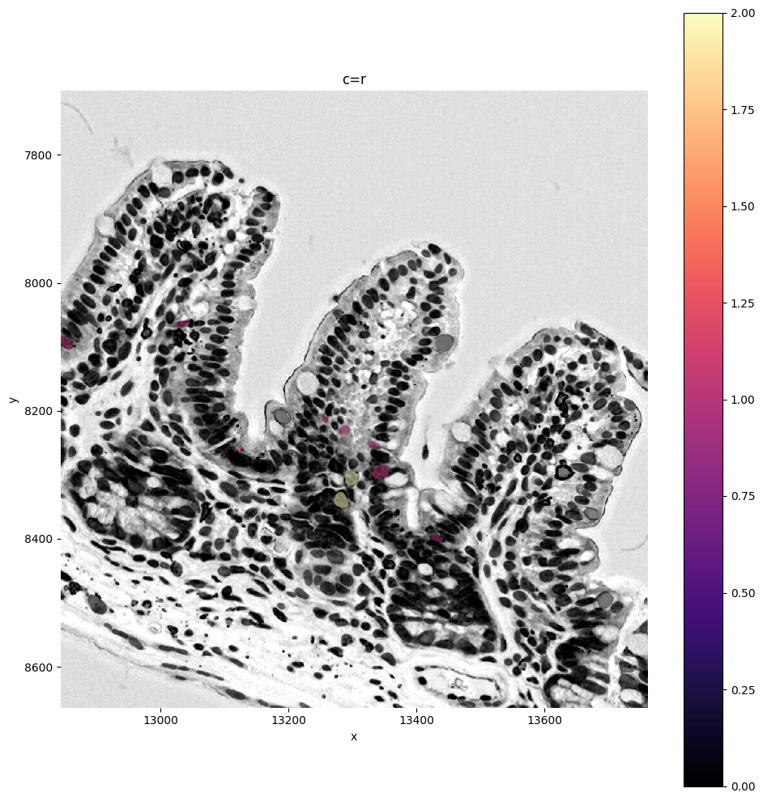
Rebinning
sdata = hp.tb.bin_counts(
sdata,
table_name="table",
labels_name="labels_layer",
output_name="new_table",
append = False,
overwrite=True,
)
https://harpy.readthedocs.io/en/latest/generated/harpy.tb.bin_counts.html

