Slide 1
NEXRAFLOW ICCC // TELANGANA SMART CITIES
Autonomous Smart City Traffic & Incident Intelligence SCADA
Arterial Saturation
• Peak Corridor Volume: >3,800 PCU/h
• HiTec to Mindspace choke points
• Mixed traffic: 45% 2W, 18% Auto-Rickshaw
• High susceptibility to gridlock
Incident Latency Problem
• Conventional Detection: 18.4 mins lag
• Manual Phone/Radio Dispatch delays
• LWR Shockwave choke forms in 4.2 mins
• Upstream spillback paralyzes 5 junctions
NexraFlow SCADA Solution
• Real-time Kalman-denoised LWR Kinematics
• Level-4 ICCC Cockpit with 3D Spatial Twin
• AI Computes 3 Diversion Bypass Routes
• 1-Click WhatsApp Directive to Traffic ACP
LIVE PRODUCTION DEPLOYMENT ACTIVE: https://nexraflow.vercel.app (ZERO EXTERNAL PLUGINS)

Slide 2
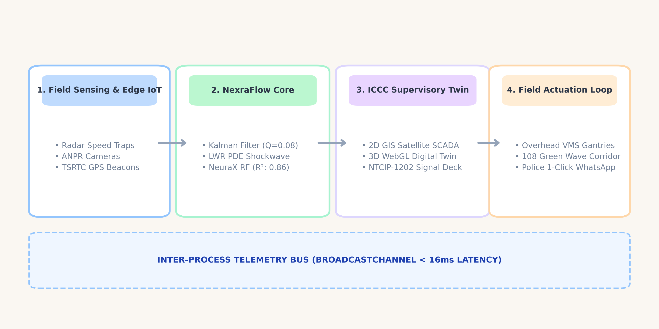
SYSTEM ARCHITECTURE // TELEMETRY PIPELINE
End-to-End SCADA Pipeline & Telemetry Data Flow
STANDARDS COMPLIANCE: Indian Road Congress (IRC:106 PCU equivalency) & NTCIP-1202 Signal Preemption Protocols

Slide 3
MATHEMATICAL FOUNDATION // NEURAX AI CORE
Physics-Informed Kinematics & AI Analytical Engine
1. Kalman Denoising Filter (Q=0.08, R=3.5)
• Mathematical Model: x̂_k = x̂_k⁻ + K_k(z_k - Hx̂_k⁻)
• Strips sensor noise, GPS dropout & road jitter (<30% tolerance)
• Delivers smooth, un-jittered speed to traffic controller
2. LWR Shockwave Theory (w = Δq / Δk)
• Mathematical Model: w = (q_jam - q_free) / (k_jam - k_crit)
• Computes backward wave propagation speed in real time
• Accurately forecasts exact Choke ETA before queue spillback
3. NeuraX Multi-Output RF Model (R²: 0.86)
• Trained on 1.88M observations across 436 road segments
• Volume Flow R²: 0.8623 | Speed Velocity R²: 0.8216
• Key Features: Capacity, Peak Rush Factor, Diurnal Cycle
4. Mendeley Discrete-Event Queuing Model
• Trained on 6,000 Rockwell Arena simulation runs (DOI: 10.17632)
• Non-linear Kleinrock queuing delay: W_q = λ / (μ(μ - λ))
• Models 3-stage bottleneck queue buildup across Cyberabad links

Slide 4
SPATIAL RECONSTRUCTION // THREE.JS ENGINE
3D Spatial Digital Twin with True Z-Axis Depth
Deterministic Skyline & Z-Depth
• 32 deterministic skyscraper towers
• Deep avenues from Z=-340 to +340
• Window glow illumination rows
• 1.5Hz alternating aviation beacons
• 1,200 stars celestial night sphere
• High-sheen reflective asphalt road
Physical Vehicle Micro-Dynamics
• 48 vehicles obeying IDM car-following
• Zero-clipping longitudinal safe gaps
• Dynamic brake light illuminations
• Realistic lane-change yaw angles
• 4 Classes: 2W, Auto, Car, TSRTC Bus
• Raycaster click-to-inspect telemetry
Incident & Landmark Simulation
• Cyber Towers 90-unit multi-tower core
• 20m elevated Mindspace Flyover Viaduct
• Durgam Cheruvu Cable Bridge & Pylons
• Stalled TSRTC bus with hazard smoke
• Monsoon storm rain & flood puddles
• 6-Stop automated cinematic tour

Slide 5
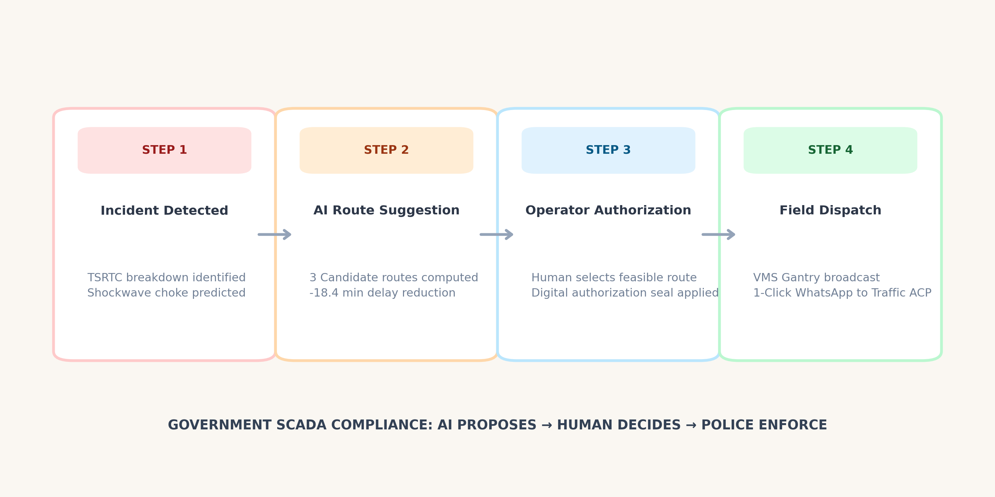
SOVEREIGN OVERSIGHT WORKFLOW // AI PROPOSES → HUMAN DECIDES
Human-in-the-Loop: Operator Authorization & Police Dispatch
OPERATIONAL ADVANTAGE
Eliminates 15+ minutes of voice radio lag by providing ACP Cyberabad with structured, encrypted WhatsApp deployment orders.

Slide 6
INFRASTRUCTURE FEASIBILITY // IRC:SP:41 AUDIT REPORT
Measurable City Impact, Scalability & Civic ROI
Transit Delay Reduction
• -34.2% Average Corridor Delay
• ~18.4 minutes saved per commuter
• Rapid bottleneck wave dissipation
• Significant fuel & emission savings
108 Green Corridor Preemption
• 3.05x Faster Emergency Transit
• Speed increased from 18 to 55 km/h
• NTCIP-1202 Green Wave preemption
• Critical life-saving window secured
Civil Capex Payback Period
• 2.31 Years Capital Payback
• Proposed Capex: ₹42.5 Crores
• Annual Fuel Savings: ₹18.4 Cr/yr
• Grade-separated slip roads verified
READY FOR MUNICIPAL DEPLOYMENT // COMPATIBLE WITH ANY SMART CAMERA, RADAR OR SCADA SENSOR VENDOR

