Slide 1
DATA ANALYST PORTFOLIO / PUBLIC CASE STUDY
Driver onboarding
pilot evaluation
2 × 2
Pilot vs comparison
Before vs after
Performance, short-term retention and the trade-offs behind a good operational decision.
100%
fictional data
Python · KPI analysis · Difference-in-differences
SYNTHETIC CASE STUDY • NO EMPLOYER OR OPERATIONAL DATA • RESULTS ARE ILLUSTRATIVE
01

Slide 2
02 / THE QUESTION
What decision are we trying to inform?
A process change should be assessed against both primary outcomes and possible unintended consequences.
01
Reliability
BUSINESS QUESTION
Routes within plan
Can onboarding be made more predictable without losing route reliability, people or quality?
02
Retention
Active on day 14
03
Guardrails
Delivery quality & safety
SYNTHETIC CASE STUDY • NO EMPLOYER OR OPERATIONAL DATA • RESULTS ARE ILLUSTRATIVE
02

Slide 3
03 / THE DATASET
A reproducible fictional scenario
No names, figures, files or findings from a real workplace are included.
24
4,800
1,200
invented sites
synthetic route records
synthetic driver starts
Two groups × two periods • 100 routes and 25 starts per site per period
Every input is generated from a fixed random seed; outputs can be rerun independently.
SYNTHETIC CASE STUDY • NO EMPLOYER OR OPERATIONAL DATA • RESULTS ARE ILLUSTRATIVE
03

Slide 4
04 / DESIGN & METHOD
How the comparison works
A simple 2×2 design distinguishes the pilot’s change from the contemporaneous comparison-group change.
BEFORE
AFTER
DIFFERENCE-IN-DIFFERENCES
Pilot
Pilot
Pilot change
− Comparison change
Comparison
Comparison
Result is a relative change, not proof of causality.
SYNTHETIC CASE STUDY • NO EMPLOYER OR OPERATIONAL DATA • RESULTS ARE ILLUSTRATIVE
04

Slide 5
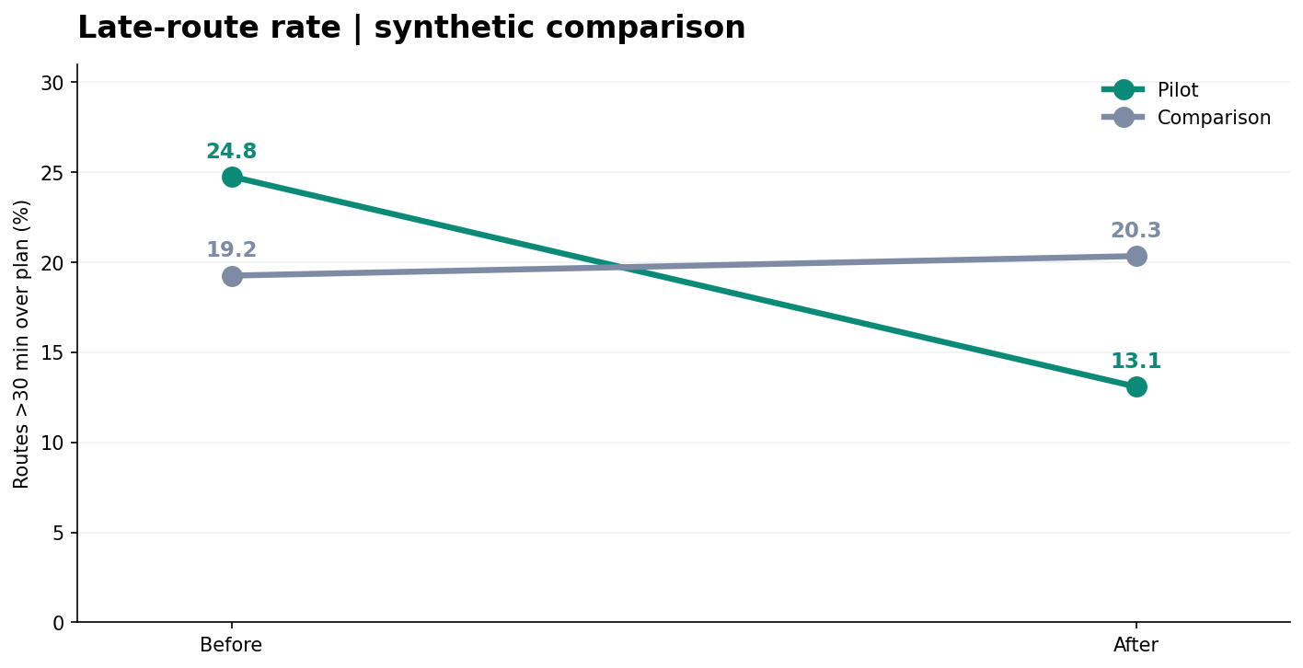
05 / RESULT 1 / RELIABILITY
Late-route rates improved in the fictional pilot
Primary KPI: share of routes more than 30 minutes beyond plan.
SYNTHETIC DID
-12.75
percentage points
A favourable relative change is an analytical signal — not a verified intervention effect.
SYNTHETIC CASE STUDY • NO EMPLOYER OR OPERATIONAL DATA • RESULTS ARE ILLUSTRATIVE
05

Slide 6
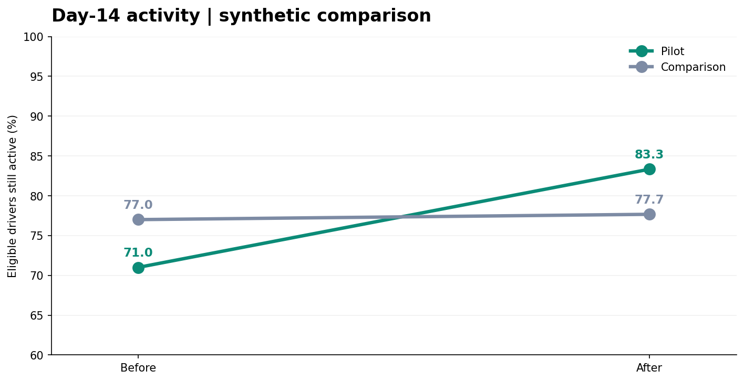
06 / RESULT 2 / DRIVER ACTIVITY
More fictional starters were active on day 14
The denominator includes eligible, matured new-driver cohorts only.
SYNTHETIC DID
+11.67
percentage points
Day-14 activity is a short-term indicator, not proof of skill or long-run retention.
SYNTHETIC CASE STUDY • NO EMPLOYER OR OPERATIONAL DATA • RESULTS ARE ILLUSTRATIVE
06

Slide 7
07 / RESULT 3 / GUARDRAILS
Not every metric moved in the right direction
Primary gains should not obscure service-quality or safety concerns.
On-time dispatch
Delivery completion
Safety proxy
+2.75 pp
-0.68 pp
-14.07 pts
Favourable
Unfavourable
Unfavourable
Interpretation: monitor service and safety before recommending rollout.
SYNTHETIC CASE STUDY • NO EMPLOYER OR OPERATIONAL DATA • RESULTS ARE ILLUSTRATIVE
07

Slide 8
08 / INSIGHT VS INFERENCE
Signals are not proof
Communicate analytical evidence without making unsupported claims.
WHAT THE FICTIONAL DATASET SHOWS
WHAT IT CANNOT ESTABLISH
• Better relative route reliability
• Higher day-14 activity
• Improved dispatch
• Unfavourable quality/safety signals
• Causation from just two periods
• Long-term retention or competence
• Actual safety incidents
• Realised monetary savings
SYNTHETIC CASE STUDY • NO EMPLOYER OR OPERATIONAL DATA • RESULTS ARE ILLUSTRATIVE
08

Slide 9
09 / DECISION SUPPORT
What a responsible analyst would recommend
Better evidence matters more than a positive headline KPI.
01
Validate the comparison
02
Investigate adverse guardrails
Check route mix, site selection and whether group trends were similar before launch.
Break down completion and safety-proxy changes by site and driver tenure.
03
Strengthen retention analysis
04
Model costs only with approval
Use consistently matured cohorts and later checkpoints, not only day 14.
Use verified, authorised cost inputs and include downside scenarios.
SYNTHETIC CASE STUDY • NO EMPLOYER OR OPERATIONAL DATA • RESULTS ARE ILLUSTRATIVE
09

Slide 10
PORTFOLIO TAKEAWAY / SYNTHETIC ANALYSIS
Good analysis asks
what changed — and why.
Reproducible Python scripts, transparent DiD calculations, short-term activity analysis and clear communication of operational trade-offs.
README / NOTEBOOK / CODE / SYNTHETIC DATA / SLIDES
SYNTHETIC CASE STUDY • NO EMPLOYER OR OPERATIONAL DATA • RESULTS ARE ILLUSTRATIVE
10

