Slide 1
Crypto-Storage
By Victor Veliz and Phuc Pham

Slide 2
Contents
Introduction
Architecture
Tools are used for the project
Demo
Conclusion

Slide 3
Introduction
Cloud is the future.
Dropbox, Google Drive will not protect user’s privacy from inside attack.
The web application to allow user upload his/her files and protect them.
Everything belonged to user such as password, files will be encrypted.

Slide 4
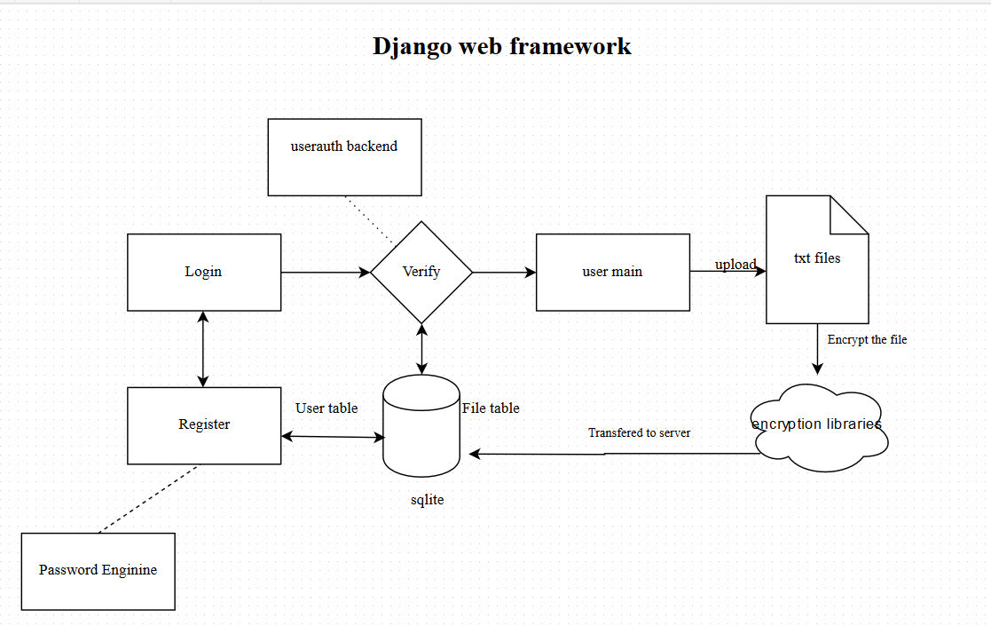
Architecture

Slide 5
Tools
Django web framework.
Microsoft Azure.
Visual Studio.
SJCL crypto library.
Asmcrypto library.

Slide 6
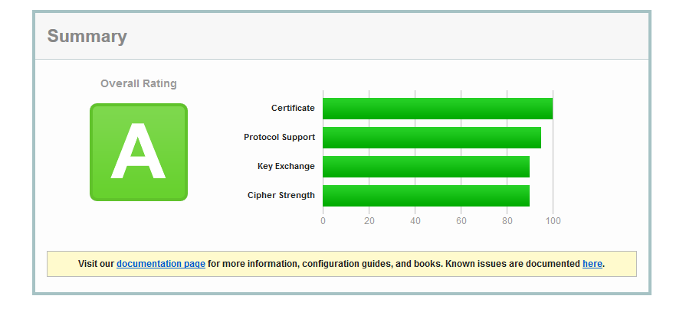
Server protection

Slide 7
Cryto Library
SJCL and asmcryto are JavaScript crypto libraries.
Pbkdf2 in asmcrypto library is used to provide authentication.
SJCL with AES, CCM authenticated-encryption modes.

Slide 8
DEMO

Slide 9
Conclusion
Teamwork, we know each other more.
The web application fulfill all important security expects.
We will enhance the app so I will support all different file formats.
Building a dedicate server to host the web app.

