Slide 1
Internet of Things – Security Vulnerabilities in Communication
Victor Veliz
Survey CECS 579

Slide 2
What is IoT and why should we care?
Internet of Things (IoT) are exactly that, things-- that are made “smart,” including home appliances and wearable gadgets.
However, because of the interaction with the Internet, objects are vulnerable to attacks.

Slide 3
How are “smart” things made?
THINGS (anything and everything can be a “thing”)+ UNIQUE ID TAGS (no practical limit)+ SENSOR (RFID)= “SMART” THINGS!!!
Notes:
MAKE THIS SLIDE #3…

Slide 4
IoT: Main vulnerabilities of attacks
Security: data breach such as hacking, 3rd parties and organizations that want to collect your personal information.
Privacy – “ Live Logging”

Slide 5
Other Problems with IoT…
Power consumption
Attacks
Jamming in common radio spectrum 2.4GHz band.
Cost effective inexpensive security mechanisms.
Unlike for RFID cryptography in IoT devices which requires space and a vast computation of resources to keep a system secure.

Slide 6
Research Articles
IoT In Home Ecosystem
RFID Security
RERUM Framework

Slide 7
IoT in Home Ecosystem
Research states that the IoT ecosystem’s data and applications that interact between various domains is “poorly defined.”
Cloud Framework
1) Cloud Service and Storage Domain, 2) the Cloud Device and Context Domain, and 3) the Cloud Trusted Domain.
Security provided in Private zones and Home Hubs

Slide 8
RFID: Problem(s) & Possible Solution(s):
Main problems in IoT RFID devices
Query tag unique ID
Possible Solutions
Physical Methods ( shielding with electrostatic material)
Tag anti-collision algorithms
1) deterministic methods where all tags read are based on the splitting of groups to subgroups and
2) probabilistic methods where algorithms such as the B tree are used to allow tags respond in time intervals efficiently.
In Reader anti-collision, scheduling is implemented where a central node takes care of the communication based on the distance to the RFID reader.
Encryption & Authentication
A proposed solution for RFID tag encryption in which it disallows copying tag data and disallows transmission forgery is using a “low-cost GPS digital signature architecture, which combined an optimized GPS algorithm design and an optimized SHA-1 design

Slide 9
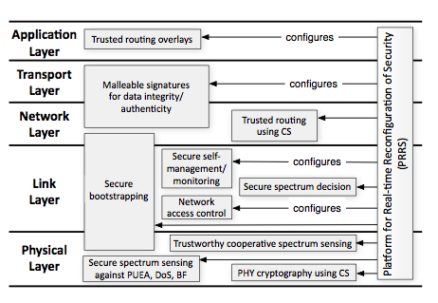
RERUM Framework
REliable, Resilent and secUre IoT for sMart objects.
Idea of incorporating privacy & security on early design stage.
Mainly in the Smart City sector, but it is broad.
Security Implementation
Hop to hop authentication. End to end authentication. Public Key cryptography in wireless sensors.
Cognitive radio capabilities
Check for best band to avoid jamming/congestion
Better power usage.
Network Bootstrapping protocols
EAP, PANA, etc.
Compressive Sensing
Ensures packets encoded are reconstructed at receive nodes
No decryption even with high probability by deavsdropper
Figure2RERUM coverage of OSI stack [1, fig. 1]

Slide 10
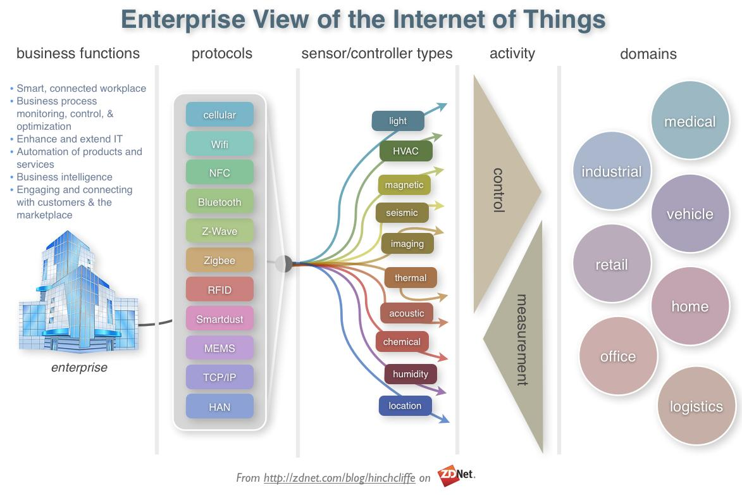
IoT: Quick Overview

Slide 11
The End
Questions?

Slide 12
References
[1] Pohls, H.C.; Angelakis, V.; Suppan, S.; Fischer, K.; Oikonomou, G.; Tragos, E.Z.; Diaz Rodriguez, R.; Mouroutis, T., "RERUM: Building a reliable IoT upon privacy- and security- enabled smart objects," in Wireless Communications and Networking Conference Workshops (WCNCW), 2014 IEEE , vol., no., pp.122-127, 6-9 April 2014
[2] Hailong Feng; Wenxiu Fu, "Study of Recent Development about Privacy and Security of the Internet of Things," in Web Information Systems and Mining (WISM), 2010 International Conference on , vol.2, no., pp.91-95, 23-24 Oct. 2010
[3] Arabo, A., "Privacy-aware IoT cloud survivability for future connected home ecosystem," in Computer Systems and Applications (AICCSA), 2014 IEEE/ACS 11th International Conference on , vol., no., pp.803-809, 10-13 Nov. 2014

