Slide 1
Plan First,
Code Second
How AI Agent Planning Transforms Development
on Large Codebases
Vic | March 2026

Slide 2
THE CHALLENGE
Why "Just Let the Agent Do It" Fails
Autonomous Agent on Legacy Code
With Planning First
"Implement feature X for the payments module"
Wrong assumptions about architecture
Misses existing patterns and conventions
Breaks integration with related modules
Multiple painful review iterations
Hours of back-and-forth corrections
"Let's plan this together first"
Agent understands full context first
Plan reviewed before any code is written
Edge cases caught during planning
Near-perfect implementation on first pass
Minimal review iterations needed
For large / legacy codebases. Starting from scratch? Autonomous mode can work fine.

Slide 3
THE WORKFLOW
Four Steps to Near-Perfect Implementation
01
02
03
04
LOAD CONTEXT
ITERATE PLAN
GATE CHECK
EXECUTE
▶
▶
▶
Feed everything:
Jira ticket, code pointers,
past plans, debug logs
Review, refine, repeat.
Batch edits as bullet
points in single messages
"Any open questions
or decisions that
block implementation?"
Implement per plan.
Include unit + integration
tests in scope
↻ Repeat until plan is solid

Slide 4
STEP 1
Loading Context: The First Prompt
Be Specific
Create a plan in plan.md for implementing
[Jira ticket PROJ-1234 description].
Relevant code:
@src/payments/processor.ts
@src/billing/invoice-service.ts
Reference previous plan:
@plans/proj-1200-refund-flow.md
Debug context from staging:
[paste relevant logs / stack traces]
Include unit and integration tests in plan.
Reference exact files, not
"the payments module"
Give Full Context
Paste the entire Jira
ticket, not a summary
Show Patterns
Point to past plans and
similar implementations
Include Logs
Real debug output helps
the agent understand state

Slide 5
STEP 2
Iterative Plan Review
Batch Everything
Update the plan with these changes:
- Step 3: use RetryableProcessor instead
of raw HTTP calls — see @src/lib/retry.ts
- Add error handling for timeout scenarios
in the webhook callback step
- Q: Should we add a circuit breaker here
or rely on the existing retry logic?
- Integration test should cover the full
billing cycle, not just the new endpoint
Put all edits, questions,
and concerns into a single
message as bullet points.
The agent processes them
all in one pass — saves
context window and time.
Ask Questions Too
Mix corrections with
questions. Let the agent
think through trade-offs
with you during review.

Slide 6
STEPS 3 & 4
Gate Check → Execute
Gate Check Prompt
Execution Prompt
Before we implement — are there any
open questions, ambiguities, or
decision points that would prevent
you from implementing this plan as-is?
If anything is unclear, ask now.
Implement everything according to
@plans/proj-1234-plan.md
Follow the plan step by step.
Run tests after each major change.
If a test fails, fix it before moving
to the next step.
Include integration tests that cover
the full subsystem, not just units.
This prevents the agent from making
assumptions during implementation.
Forces explicit resolution of unknowns.

Slide 7
LEVEL UP
Pro Tips for Power Users
Set Up Project Memory
Guard Your Context Window
CLAUDE.md / .cursorrules
Persistent instructions the agent reads
every session: coding conventions, test
commands, architecture patterns.
Write once, never repeat yourself.
The #1 technical constraint
/clear between unrelated tasks.
Keep plans in external .md files,
not inline in the conversation.
Full context = degraded output.
Two-Model Pattern
Version-Control Your Plans
Architect + Builder
Use a powerful model (Opus) for
planning. Hand the plan to a faster
model (Sonnet) for execution.
Faster, cheaper, often cleaner.
Plans are team assets
Commit plans/ alongside code.
Future tasks can reference past
plans as context for the agent.
Compounds in value over time.

Slide 8
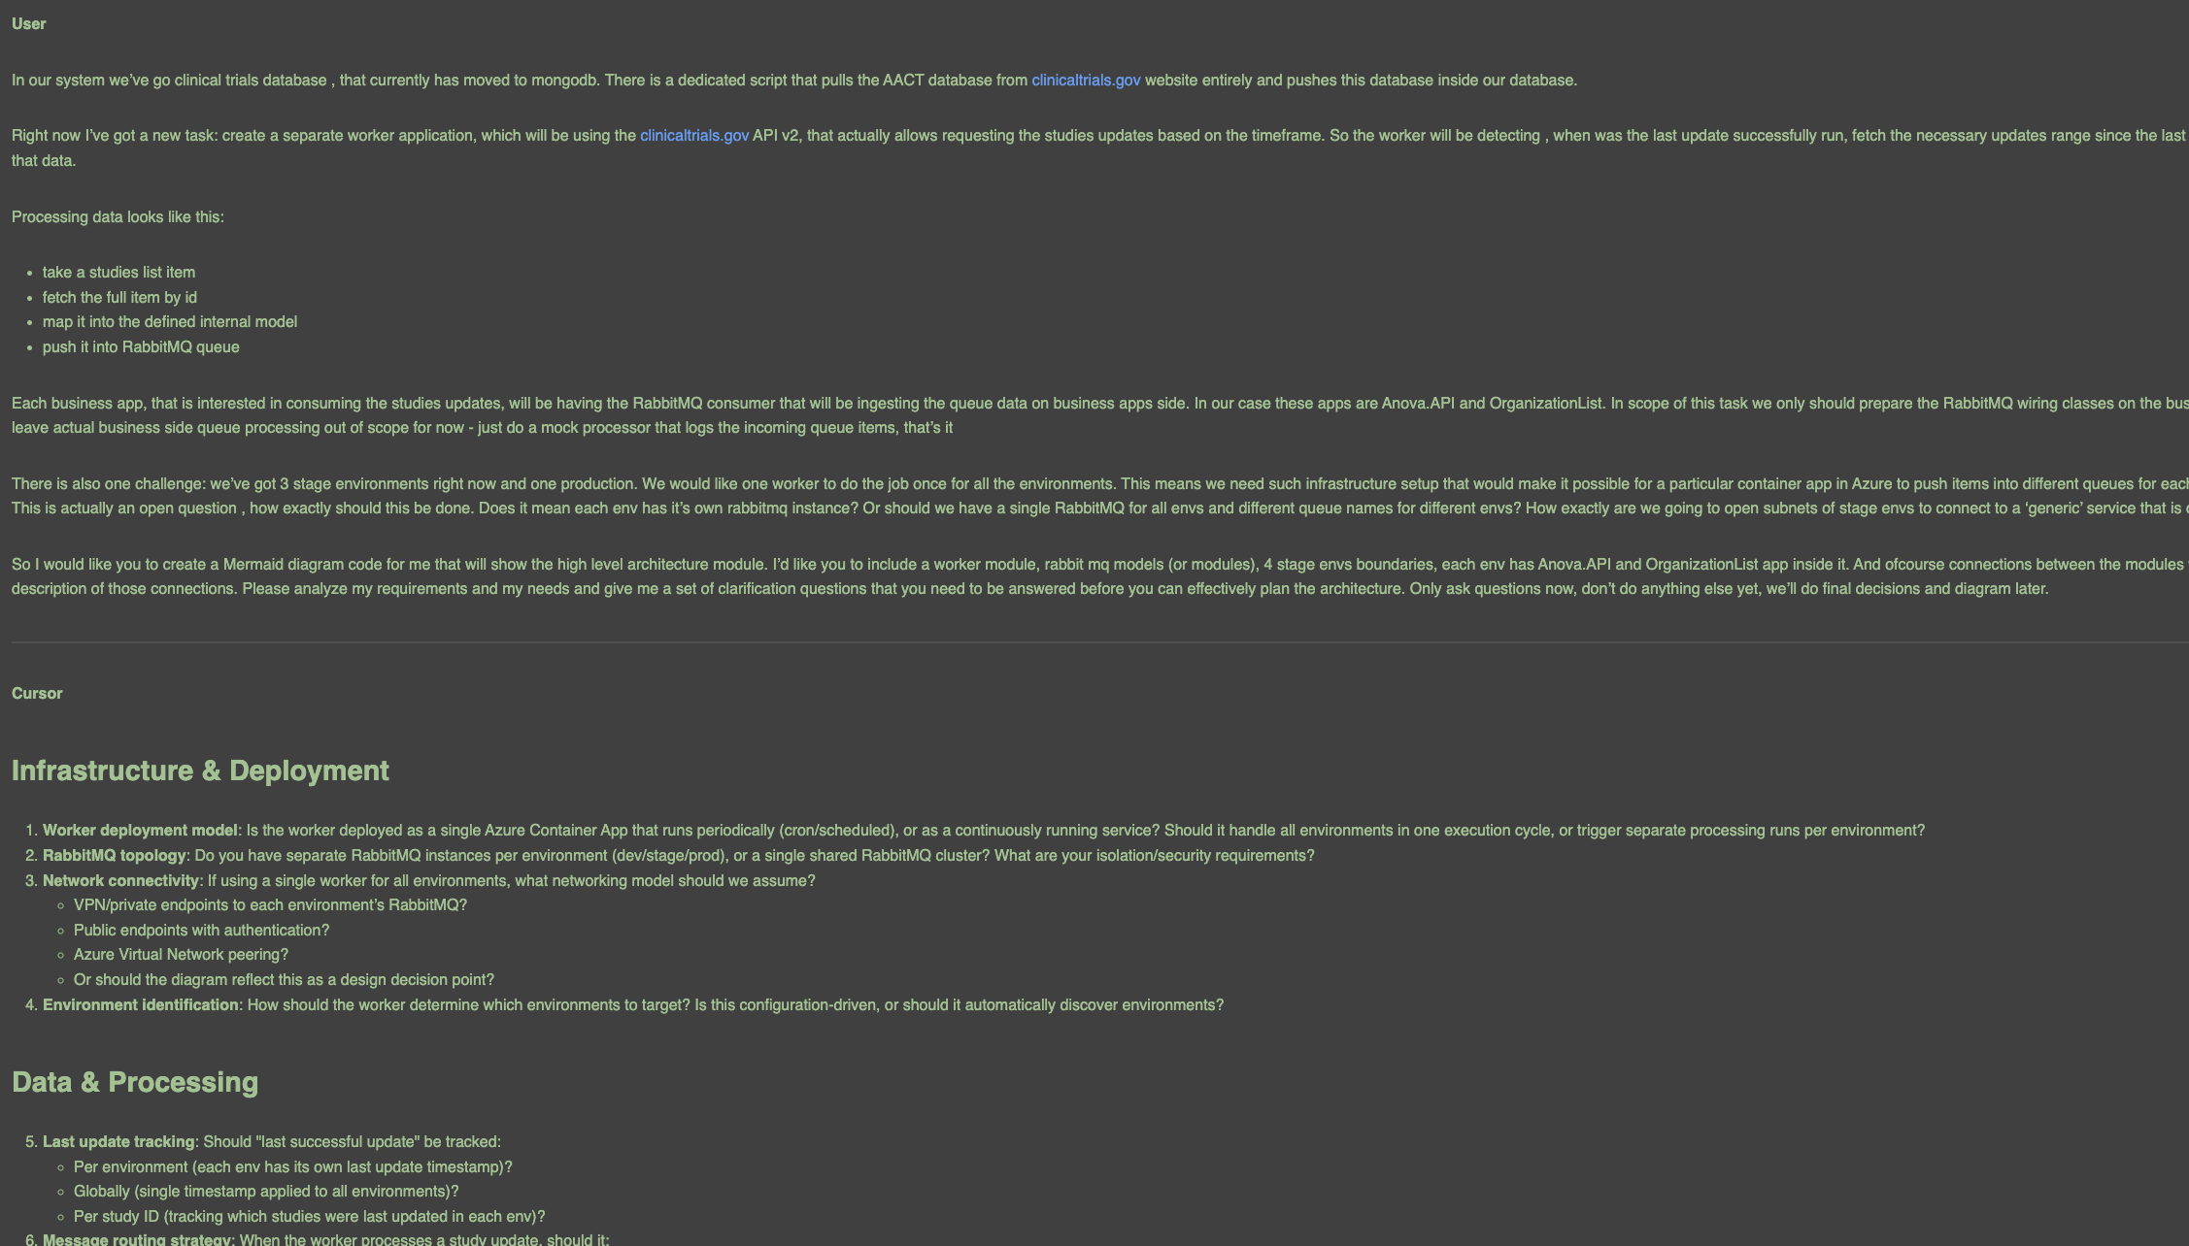
REAL EXAMPLE
Feature: Clinical Trials Data Worker
Planning conversation in Cursor: context loading with architecture questions and clarification phase

Slide 9
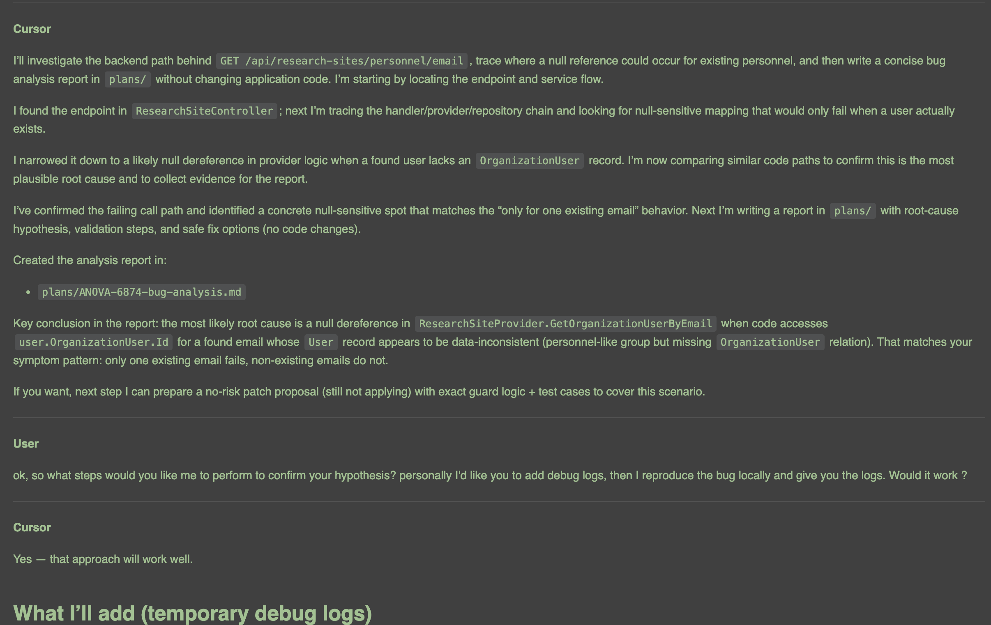
REAL EXAMPLE
Bug Fix: ANOVA-6874 Null Reference
Bug analysis: agent traces null reference through code, proposes root cause, suggests debug logs

Slide 10
KNOW YOUR CONTEXT
When to Plan vs. When to Ship
PLAN FIRST
GO AUTONOMOUS
Large or legacy codebases
Multi-file or multi-module changes
Complex business logic
Changes with integration risks
Unfamiliar areas of the code
Greenfield / new projects
Single-file, small scope changes
Well-defined tasks (rename, typo fix)
Prototyping and exploration
You could describe the diff in one line
Common Anti-Patterns
Vague prompts: "fix the payments bug" — no context, no file pointers, no logs
Piecemeal feedback: one tiny correction per message wastes context window
Skipping tests in the plan: integration tests catch what unit tests miss

Slide 11
KEY TAKEAWAYS
What to Remember
1
Planning is a force multiplier
10 min of planning saves hours of review iterations
2
Context is everything
Jira tickets, code pointers, past plans, debug logs — the more you give, the better the output
3
Batch your feedback
All edits + questions in one message. The agent handles them in a single pass
4
Always include testing in the plan
Integration tests on subsystems catch what unit tests miss
5
This is a methodology, not a tool
Works with Cursor, Claude Code, or any AI agent that plans

Slide 12
Thank You
Questions?
Resources:
claude.com/blog/best-practices-for-prompt-engineering
cursor.com/docs/agent/planning
code.claude.com/docs/en/best-practices

