Slide 1

Extra OKIC Info Moment 3
Wednesday 20-5-2020

Slide 2
This meeting
Please mute yourself
Please turn off your camera
If you have questions: you can ask them in the chat!
First: state your name and OKIC in the chat

Slide 3
Today
Programme of the Kick-In
Online
Physical
Do-group market
Do-groups
Online and physical kiddo’s
Size of the groups
Extra Kick-Info
Deadline kiddo’s
Bracelets
Alcohol
OKI
Physical vs online
Reservation of rooms
Programme activities
Information to participants
IntroCloud
Important deadlines

Slide 4
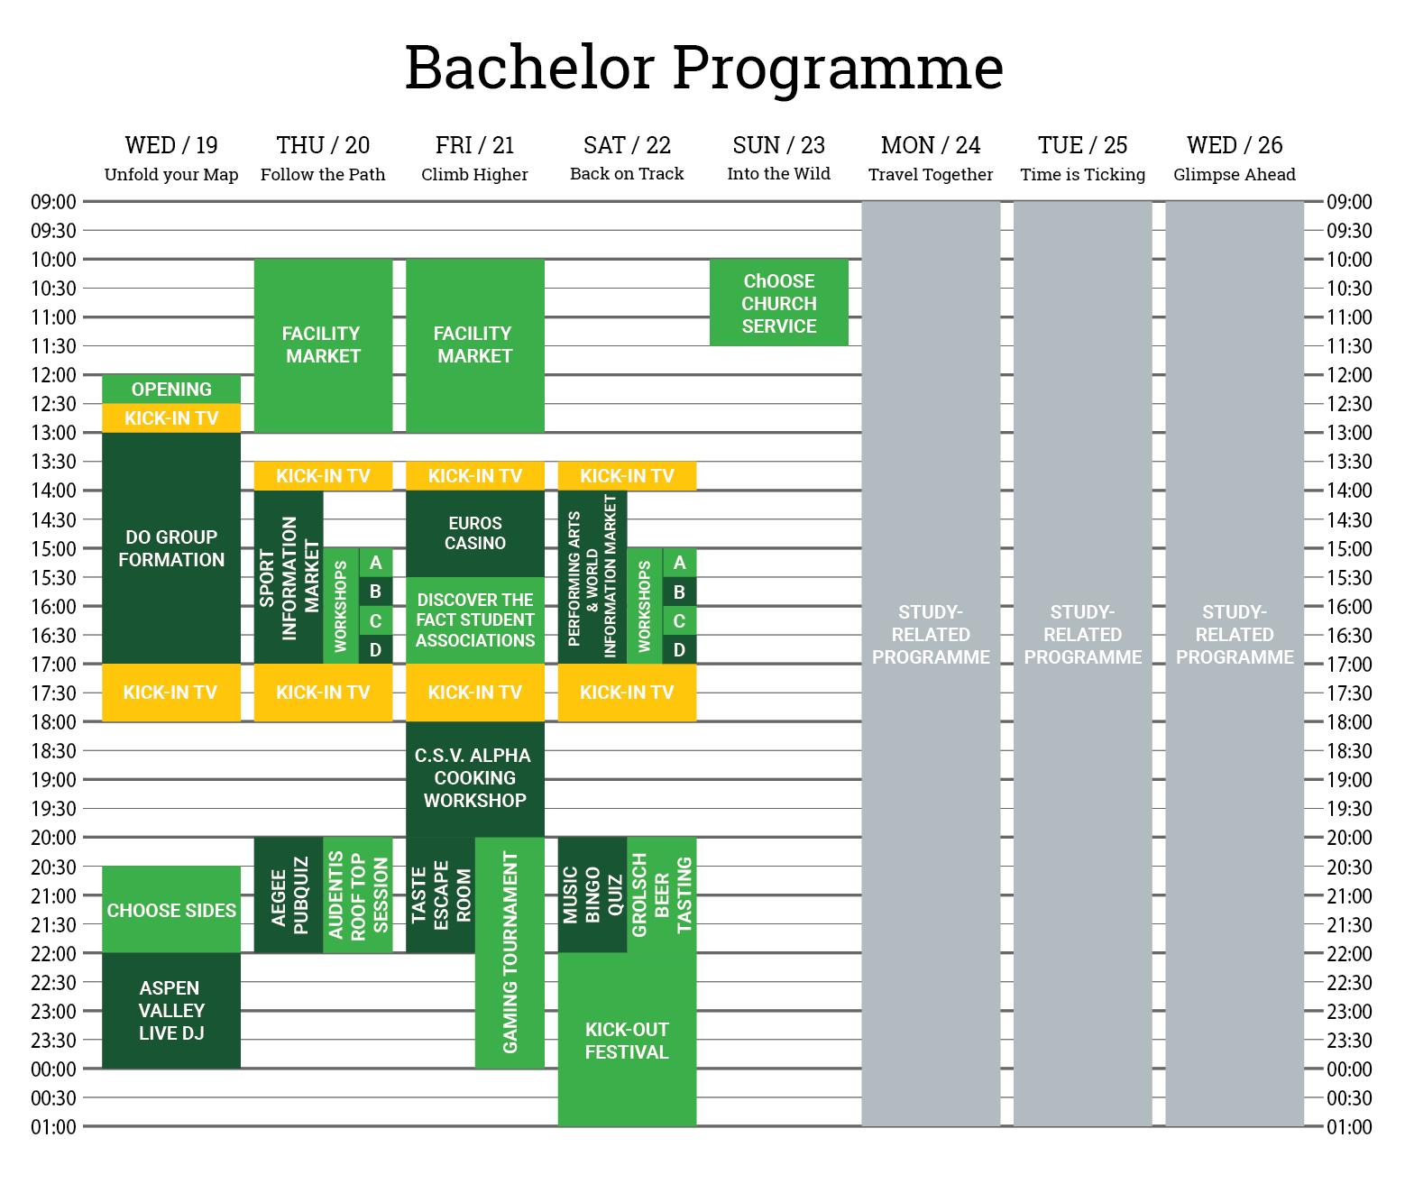
Online programme
Registration
Do-group formation
Kick-In TV
Infomarkets
Sport & Culture workshops
Evening activities
Facility Market
Hope do-groups can meet up at home/outside and follow programme together.

Slide 5
Physical programme
Signing up / timeslots
Thursday/Friday/Saturday 09:30-13:30
Sunday
Workshops: sports and culture
Tours: campus and city
Dinners
Foodhallen drive through
BBQ/Pizza on campus
Still very unsure, protocols must be completed and approved.
Can be cancelled at any time due to measures.

Slide 6
Do-group market
Minimal required: OKI booklet
deadline 19th of July
Our text before the 1st of July: general explanation
Requirements see extra manual
Optional: livestream organized by OKI
Link is put in booklet
We are looking at other possibilities for promoting
Interested let us know before 1st of July!

Slide 7
Do-group market
Kiddo receives booklet / watches livestream
Kiddo fills in top 3/5 on dashboard on www.kick-in.nl before certain deadline (differs per study)
Algorithm divides kiddo’s over the do-groups
Do-groups get contact information of the kiddo’s
Do-groups meet up (if possible)!
Kiddo’s receives login for the app (IntoCloud)

Slide 8
Do-groups
No separate online and physical do-groups, because
Advise from CvB/stuurgroep/M&C and SU.
Practical
Do-groups of 2/3 people at small studies
Kiddo’s fail with giving right information on time
Who guides the do-groups?
Everyone the same intro: no secondary groups
People can switch easily between online and physical participation
If they feel unsafe/uncomfortable
Decide to come to Enschede
Size of the groups
Normally 8-12
We try to make them smaller, depends on registration

Slide 9
Extra Kick-Info
Deadline kiddo’s
18th of August is the deadline for signing up for the Kick-In
Bracelets
This year no bracelets, because of limiting physical contact
Participant bags will be distributed, but not sure how and when
Alcohol
No alcohol before 16:00
No alcohol for minors
At physical activities: try to minimize the alcohol because of the 1,5-meter.
Do-group parent trainings
Please make sure everyone has followed a training
Otherwise they can follow 29/6 15:45, please mail secretaris@kick-in.nl

Slide 10
OKI
Physical vs online
Online activities, so everyone can access the information
Limited capacity for physical location
Reservation of rooms
UT will take a look at the room requests
Please fill in your requests in link, will be sent with mail after this meeting
Deadline is Monday 22nd at 12:00
Information to participants
We can send information for you (nice clear format)
You can also mail yourself
We can update the confirmation mails, email secretaris@kick-in.nl

Slide 11
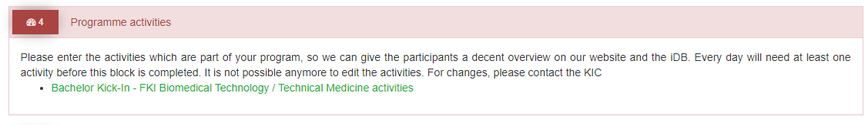
OKIC Programme Activities
Organisation dashboard section 4
Deadline: 1st of July
As soon as possible

Slide 12
Introcloud
Platform for during Kick-In
All associations get a page
6,- EXL VAT
3 accounts
Study-associations should register
Dashboard at kick-in.nl
Personal page: you can modify it yourself
Chats with new students for questions
Deadline for this is 26th of June

Slide 13
Important deadlines
Date | Action
22nd of June | Request rooms for OKI using link
26th of June | Register for IntroCloud page (your study association)
1st of July | Adding programme activities to dashboard
1st of July | Let us know if you want livestream for do-group market
19th of July | Do-group booklet

Slide 14
Next meeting
Extra meeting:
2nd of July 17:00
If you have any questions/issues, please email secretaris@kick-in.nl we can
discuss them during the meeting

Slide 15
Thank you for your presence!

Slide 16
Any Questions?
Ask them in the chat!
If you have any feedback on this meeting, please let us know!

