Slide 1
The Underperformance Phenomenon
All Students
Performance
Criterion
(e.g., Freshman
or Cumulative
GPA)
Ability
Stereotyped
Students (e.g.,
Women in math,
African
Americans)
Ability (Preparation) Predictor Scores (e.g., SAT scores)
Underperformance: At every level of preparation, performance on the criterion measure is lower
for members of the ability-stereotyped group.

Slide 2
Social Identity: The part of personal identity
--our sense of who we are-- that comes from
our group memberships and the social categories
to which we belong: our age, sex, race,
religion, profession, ethnicity, nationality, sexual
orientation, region, social class, ideological
persuasion, political affiliation, mental health
status, etc.

Slide 3
Contingencies of Social Identity: The particular
way that society and settings are set to judge and
treat people based on a social identity they
have.

Slide 4
By affecting the comfort level and performance
pressure that we feel in specific situations and
in entire walks of life, identity contingencies
can affect both specific performances and
life defining choices of careers, relationships,
regions of the country to live in, etc.
Notes:
--The experience of women in math careers
--The experience of whites in interracial interaction--the Steven Wright example

Slide 5
“People often see themselves in terms of
whichever one of their allegiances (identities)
is under attack…whether he accepts or
conceals it, proclaims it discreetly or flaunts it,
it is with that allegiance that the person
concerned identifies” (p. 26) Amin Maalouf
from In the Name of Identity; Violence and the
Need to Belong.

Slide 6
Social identities originate from, and are sustained by contingencies that go with them in particular situations.

Slide 7
The most psychologically impactful identity contingencies are those that in some way threaten the individual.

Slide 8
Stereotype Threat & Standardized Math Test Performance Among Women (Percent Correct Corrected for Guessing)

Slide 9
Cues that signal threatening contingencies foster vigilance and hamper a sense of belonging in the setting. This, in turn, impairs learning and performance.

Slide 10
Cues that signal non-threatening contingences foster belonging in the setting and thus, learning and performance.

Slide 11
Contingencies deriving from features of a setting that would exist even without ongoing prejudice
Identity-segregated networks, personal & professional
The form of “color-blindness” in which group differences in identity contingencies are not recognized
Low priority on identity integration in the setting

Slide 12
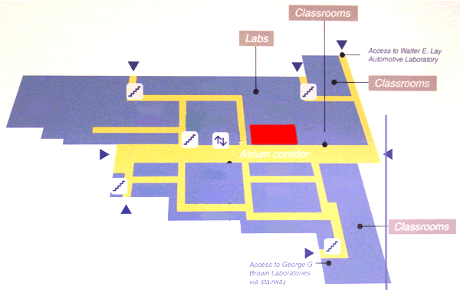


Neutral Structural Cue
Office
Notes:
Here is your office in red. Now, every time you use the restroom, and walk through the door marked for your gender, you are reminded of the fact that you are a male or female. It’s the way the environment has been structured.
I would argue that this is a neutral structural cue, because it reminds you of your social identity in the setting, but it doesn’t have any specific contingencies attached to that identity in this setting.
However, imagine that your office building looks like the math building at Stanford, which is configured like this…

Slide 13
Threatening Structural Cue
Office
Notes:
If this is my office, and I am a woman. Because of the structure of THIS environment, every time I use the restroom, I am not only reminded of the fact that I am a woman, but now, I have to go downstairs two floors to use the only female facilities in the building!
And I start to wonder, going through the possible contingencies that this cue is bring to the fore:
why is there only one bathroom for women?
Why is it located in the basement?
How much weight should I give this cue?
Does this mean that women are not valued here?
Thus, when the cues and possible contingencies they imply are threatening, we argue that my identity as a woman will come to the fore and be psychologically central and strongly felt.
A second example of contingency cues is that of numbers…
Imagine that there are two classrooms…

Slide 14
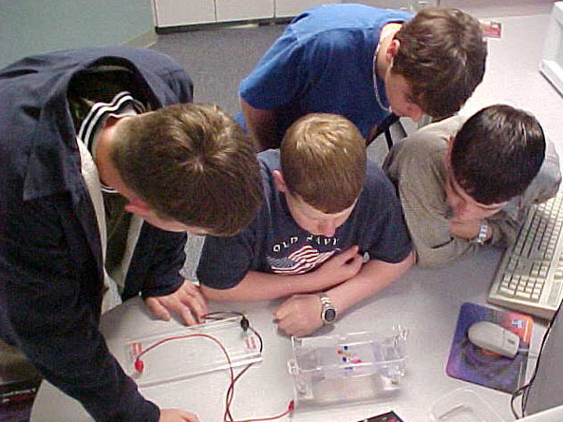
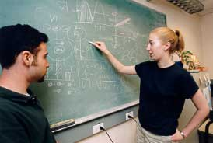

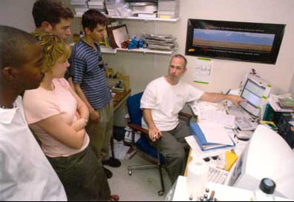
Summer Conference Video Murphy & Steele
Balanced Video (1:1)
Unbalanced Video (3:1)
2 (participants gender) X 2 (video) factorial design
Unbalanced Video = cue of identity threat for women
Notes:
The pictorial representation of gender in these “conferences” were manipulated.
In the Balanced Video condition, there was an overall 1: 1 ratio of men to women depicted in the video
While in the Unbalanced Video condition, there was a 3:1 ratio of men to women depicted- mirroring the average ratio found in these majors nationally.
Thus, our design was a….
And the Unbalanced Video served as our identity threat cue for women.
And what did we expect?

Slide 15
Interaction, F(3, 42) = 4.35, p < .01
Notes:
In line with our hypothesis, you an see that women became vigilant in when watching the unbalanced video, remembering significantly more details about unbalanced video than the women watching the balanced video.
Also, we see

Slide 16
Interaction, F(3, 46) = 2.80, p < .05
Notes:
that women recalled more of the identity cues planted in the experimental room when asked to do so…after watching the unbalanced video than women watching the balanced video…
So, we’ve shown that the cue of numbers matters for women’s physiology and for their level of vigilance and attention…
What about for their sense of belonging?

Slide 17
Unbalanced Video Balanced Video
Interaction: F(3, 42) = 4.35, p < .01
* Finger pulse amplitude, Ear pulse amplitude, Finger pulse transit time, Temperature
Notes:
We found a significant interaction for our heart rate index. In line with our hypothesis, women should increased cardiac responding when watching the unbalanced video than the women watching the balanced video, and the men watching either video.
What about vigilance? Are they more vigilant in that condition?

Slide 18
Interaction: F(3, 46) = 2.17, p < .04
Notes:
As predicted, women watching the balanced video that depicted an even number of men women in the video reported more sense of belonging in the domain of math, science and engineering than the women watching the unbalanced video.
Finally, let’s take a look at what happened with our stereotype activation measure.

Slide 19
Toward Remedy

Slide 20
Bad news: Identity threat is intrinsic to most diverse settings, the default state of affairs unless something is done to reduce it.

Slide 21
Good news: Some level and salience of identity safety cues in a setting can foster trust even when other cues in the setting might suggest otherwise.

Slide 22
Identity safety = When enough cues, implicit or explicit, signal that identity-based threats are not normative in the setting, or that genuine acceptance in the setting is possible, a sense of identity safety results. Performance and trust are then less tied to group identity.

Slide 23
Achieving the inter-subjective sense of “identity safety”: Strategies for Settings
Relationships
Leadership/Normative Influence
Critical Mass
Attributional Strategies
De-racializing perception of setting
Resist permanent tracking & fixed ability representations of jobs, careers, tests & performances
Self-Affirmation
Challenge & support (e.g., feedback)
Integrated friendship networks

Slide 24
What happens when we focus on similarity rather than difference?
Remind students that ALL students have problems
Remind students that diversity is valued
Remind students that approaching faculty is the norm and not the exception
Reminding students that ALL are part of the institution
Results from a program at Michigan that ”intervened” prior to the start of school:
Arrived 6 weeks early
Randomly selected to represent the student body
Oversampled by race, SES
Engaged in group activities and courses that emphasized the above traits

Slide 25
Post Intervention Achievement Composite (Review session, study group & office hour attendance, hours spent studying, emails to professors, in standardized score units) Walton & Cohen, Journal of Personality and Social Psychology, 2007

Slide 26
GPA Change Pre and Post Intervention (In Unstandardized residuals) Walton & Cohen, Journal of Personality and Social Psychology, 2007

