Slide 1
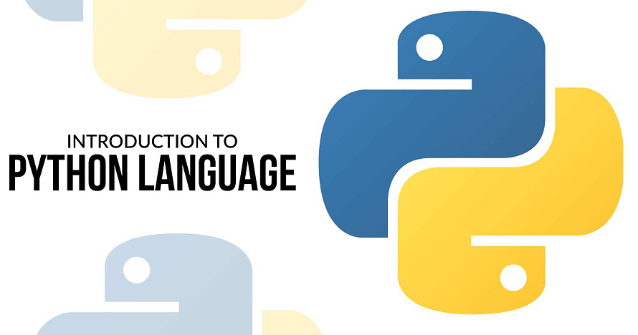

take a quick journey into the python’s world
Hi there. Welcome to my world.
Vic P. (vic4key@gmail.com)

Slide 2
What is Python ?
Created in 1991 - 32 years ago (by Guido van Rossum)
High-level Programming Language
Script/Interpreter Programming Language
Object-Oriented Programming (OOP)
Focus on Implementation & Quick Create Production
Designed to be Highly Readable
Cross-platform (Desktop, Mobile, Web, Etc)

Slide 3
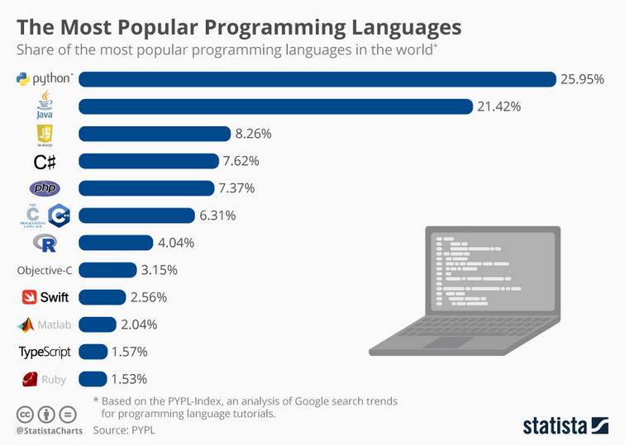
Python’s Growing
PYPL-Index - Popularity Programming Language Index
https://pypl.github.io/
Statista – Popular and Famous Statistics in the World
https://www.statista.com/chart/16567/popular-programming-languages/

Slide 4
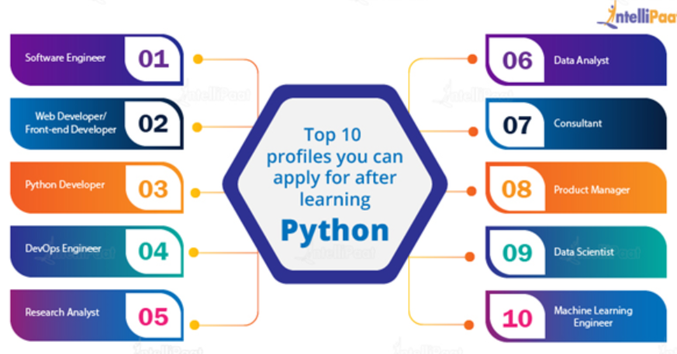
Python’s Jobs

Slide 5
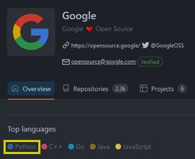
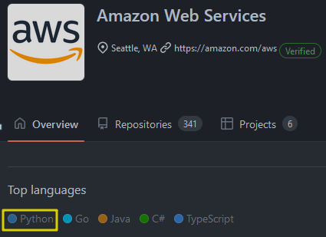
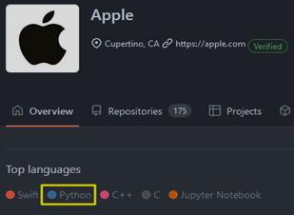
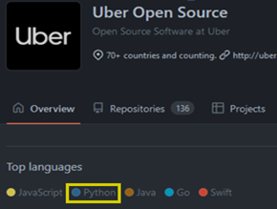
GitHub Links
Big Tech with Python
…
https://github.com/google
https://github.com/aws
https://github.com/apple
https://github.com/uber
https://github.com/dropbox
https://github.com/microsoft
https://github.com/Kitware
https://github.com/Netflix
https://github.com/VinAIResearch
…

Slide 6
Python’s Applications
Companies create new drugs, simulate the universe, disrupt markets, and much more
Examples
MIT University - Using Python to discover new antibiotics
https://news.mit.edu/2020/artificial-intelligence-identifies-new-antibiotic-0220
https://dspace.mit.edu/bitstream/handle/1721.1/128575/1220877663-MIT.pdf
AstraZeneca – Using Python to reverse and simulate antibiotics for COVID-19
https://www.python.org/success-stories/python-for-collaborative-drug-discovery/
https://github.com/covid19-model/simulator.git
https://github.com/geohot/corona.git
Uber - Disrupting the taxi market with Python
https://eng.uber.com/hypothesis-gu-funcs-unit-testing/
https://eng.uber.com/michelangelo-pyml/
Stanford University – Leverage Python language to assist Healthcare professionals in the practice of medicine, encompassing Clinical Research, Patient Care, and Hospital Management
https://uit.stanford.edu/service/techtraining/class/python-healthcare
https://www.datacamp.com/blog/python-in-healthcare-ai-applications-in-hospitals
Etc

Slide 7
Python’s Advantages
Easy to Install & Learn
Write Less Do More
Write Once Run Everywhere
Many Packages/Libraries (Built-in & Community Sharing)
Easy to Install Packages/Libraries
Free and Open Source
Large Community

Slide 8
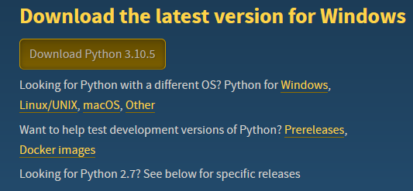

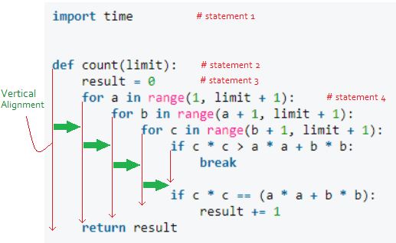
Advantages
Install https://www.python.org/downloads
Simple Syntax like Human’s Read/Write English
Python Code Clear and Reduce Syntax Error
Keywordify Instead of Special Characters (and, or, xor, etc)
No More Semi-Colon “;” Or Braces { }
Code Indentation Required
Etc
VN & Worldwide Considering Python is the first language of choice in universities and even kids in school
https://baomoi.com/bo-pascal-hoc-sinh-lop-11-se-duoc-day-python/c/36351892.epi
https://khoahocphattrien.vn/thoi-su-trong-nuoc/hoc-sinh-se-hoc-python-c-c-thay-the-cho-ngon-ngu-lap-trinh-pascal/20200917084121401p882c918.htm
Easy to Install & Learn

Slide 9


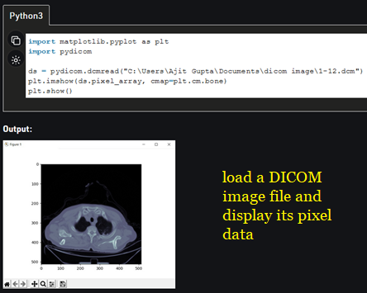
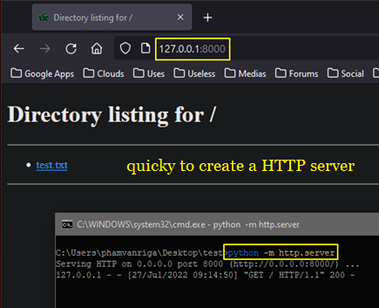
Advantages
Shorten Syntax
One-Liner Syntax
Many built-in functions, classes, data-structures, helpers, etc
Write Less Do More

Slide 10
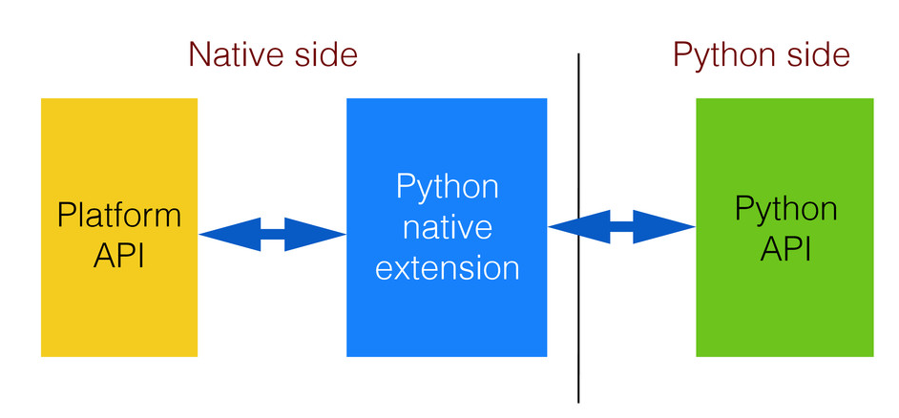
Advantages
All OS platform’s APIs are wrapped into Python’s built-in packages
Desktop (Windows, Linux, Mac OS, etc)
Mobile (Android, iOS, etc)
Web (App, Frontend, Backend, etc)
Others (IoT, Raspberry Pi, Arduino, GPU, etc)
Write Once Run Everywhere

Slide 11
Advantages
You have them – Yep. Me too!
Python Binding for almost popular libraries from other languages (Qt, OpenGL, OpenCV, CUDA, ITK, VTK, GDCM, TensorFlow, etc)
Similar Libraries
C++ STL (math, string, list, map, etc) ~ Python’s built-in
C++ Array, Matrix (Armadillo, GLM, etc) ~ Python (NumPy)
Built-in Libraries
Popular Data Format (SQLite, JSON, CVS, XML, Zip, Gzip, etc)
Network (HTTP, FTP, Socket, SSL, etc)
GUI (Tkinter)
Community Sharing
https://pypi.org/
https://pythonhosted.org/
https://github.com/
Etc
Many Packages/Libraries (Built-in & Community Sharing)

Slide 12
Advantages
To Install
pip install package-name
Example:
pip install pydicom
pip install git+https://github.com/python/hashlib
To Uninstall
pip uninstall package-name
Example:
pip uninstall pydicom
To Upgrade
pip install --upgrade package-name
Example:
pip install --upgrade pydicom
Easy to Install Packages/Libraries

Slide 13
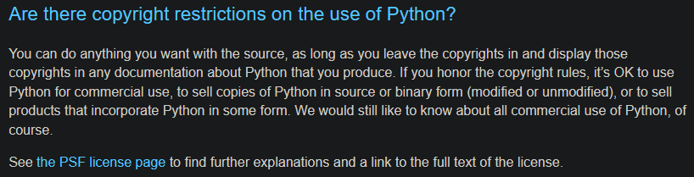
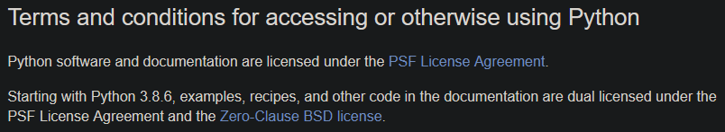
Advantages
Python is Free & Open Source
Released under the license
PSF aka Python Software Foundation (BSD-style)
BSD Zero Clause
These license are free with the following permissions
Commercial use
Distribution
Modification
Private use
Free and Open Source

Slide 14
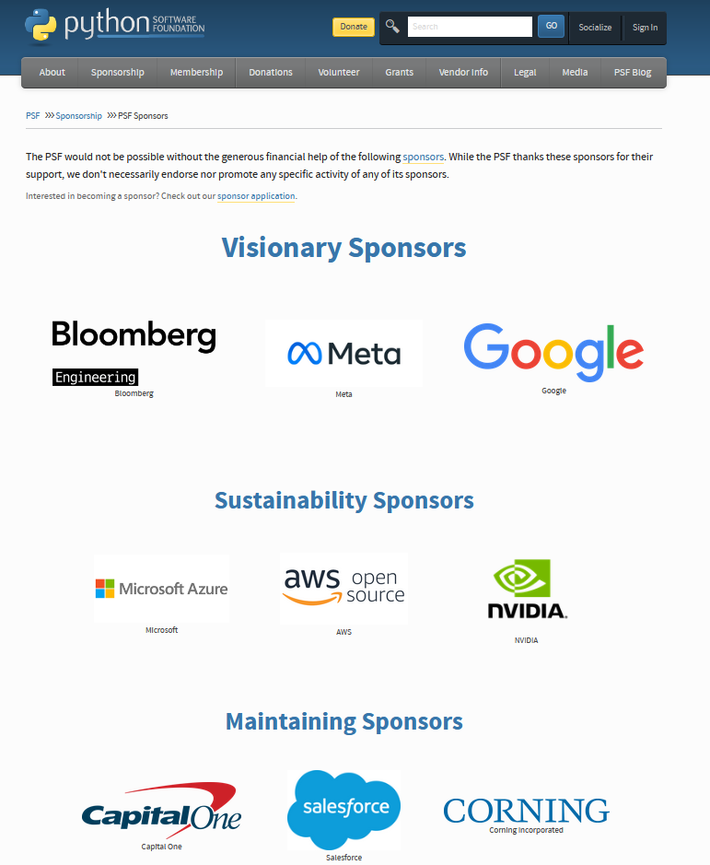
Advantages
Sponsoring & Supporting by many big techs like Google, Microsoft, Facebook, Amazon, Nvidia, etc
https://www.python.org/psf/sponsorship/sponsors/
Community
StackOverflow @ https://stackoverflow.com/
RealPython @ https://realpython.com/
PySlackers @ https://pyslackers.com/
PyDiscord @ https://www.pythondiscord.com/
Large Community

Slide 15
Python’s Disadvantages
Slow Speed & High Memory Usage
Multi-Threading Useless
Weak Support in Mobile Computing
Runtime Errors

Slide 16
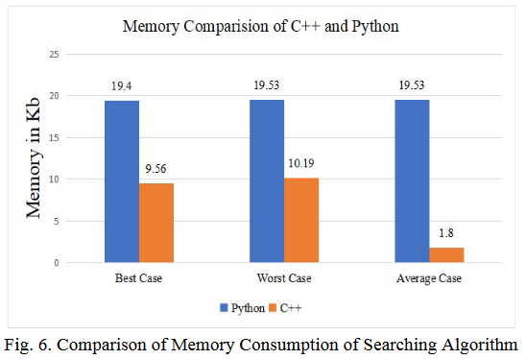
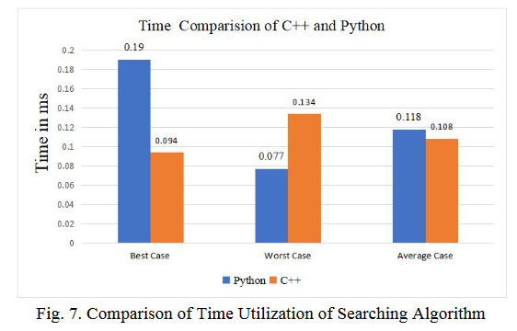
Disadvantages
Memory Comparison
Time Comparison
Slow Speed
High Memory Usage
Reference to “Comparative Analysis of C++ and Python in Terms of Memory and Time” at https://www.preprints.org/manuscript/202012.0516/v1

Slide 17
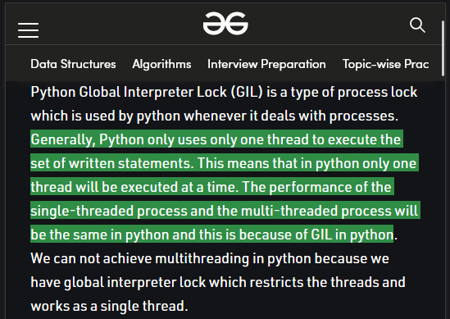
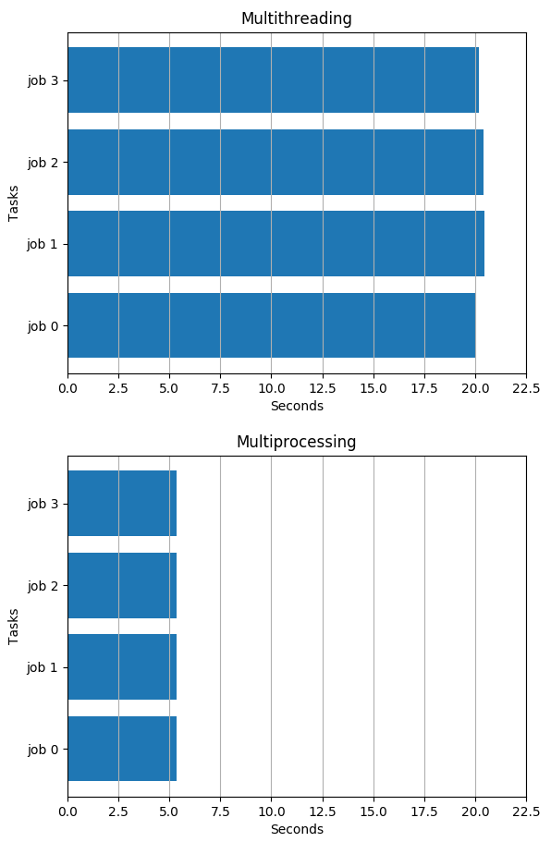
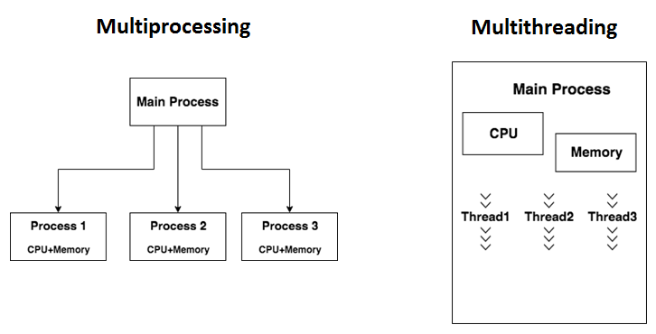
Disadvantages
In Python, Multi-threading is useless.
Why ?
It’s GIL (Global Interpreter Lock).
What it is? What it for?
Multi-processing
Multi-Threading Useless

Slide 18
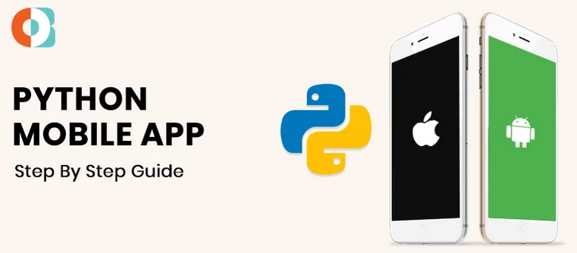
Disadvantages
Currently, Python is workable in Mobile OS but “poor support” and “not fully utilized the power of SoC”
But should not use Python for mobile app production that need “performance” and focus on “mobile computing”
Weak Support in Mobile Computing

Slide 19
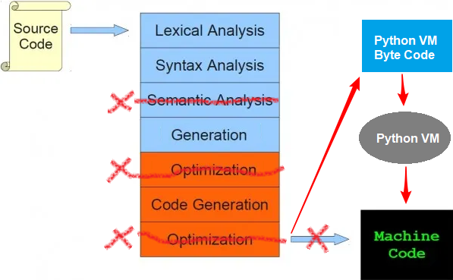
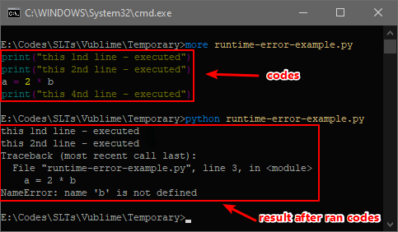
Disadvantages
Runtime Error - Errors that show up at runtime
Dynamically typed
No semantic code analyzing & code optimization
So have to spend a lot of effort for testing
Runtime Errors

Slide 20
IDE(es)
Visual Studio (official fully support VS2017 and later) [paid]
VS2015 and earlier support via extension
https://visualstudio.microsoft.com/vs/features/python/
https://docs.microsoft.com/en-us/visualstudio/python/overview-of-python-tools-for-visual-studio
PyCharm (by JetBrains) [paid]
https://www.jetbrains.com/pycharm/
Visual Studio Code [free]
https://code.visualstudio.com/docs/languages/python
PyDev (Eclipse IDE) [free]
https://www.pydev.org/
IDLE (built-in) – but almost no one used it [free]

Slide 21
For Our Production
We can take advantages of Python for production as other companies are doing
Several cases we don’t need to modify C++ codes (Eg. Do a testing, run a task, make a new in-sensitive feature, etc)
Use directly Python’s libraries to avoid write many C++ codes
Easy to extends or make a new features
Saving time
Etc
To do this I have 3 ways as the following
Embedding Python into Application (C/C++ Application)
Integrate as a Service
Use PIPE I/O Technique

Slide 22
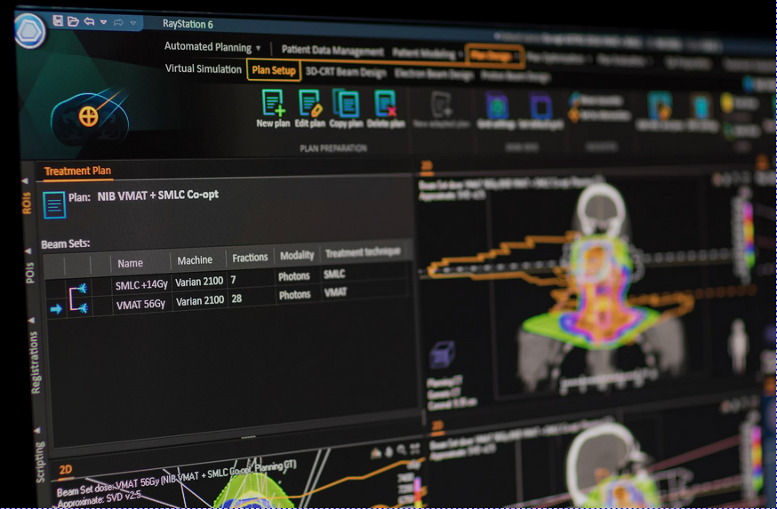
Popular Software with Python
RayStation
https://www.raysearchlabs.com/raystation/
“Scripting in RayStation Demo” - https://youtu.be/vGRg9jQ4IuI

Slide 23
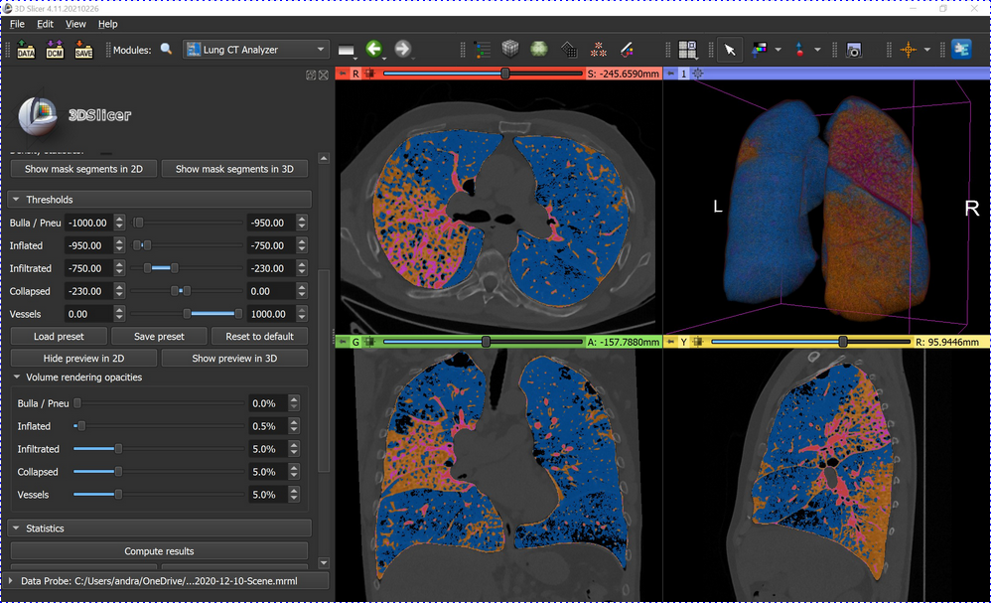
Popular Software with Python
Kitware 3D Slicer
https://www.slicer.org/
“3D Slicer - Crop Volume with Python module” - https://youtu.be/0GPqqlwru3o

Slide 24
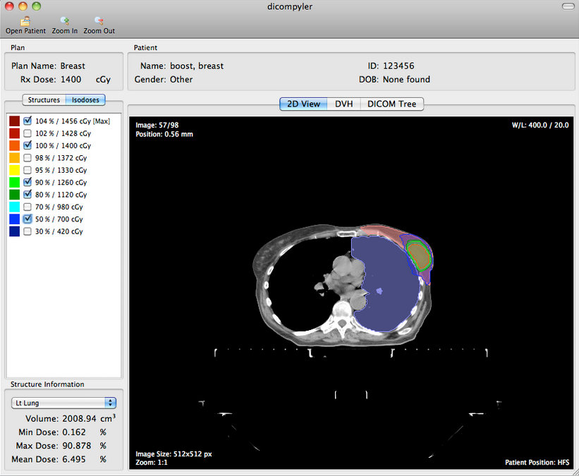
Popular Software with Python
DicomPyler
https://www.dicompyler.com/
“Real-time Isodose Display” - https://youtu.be/vvI_84i2NNs

Slide 25
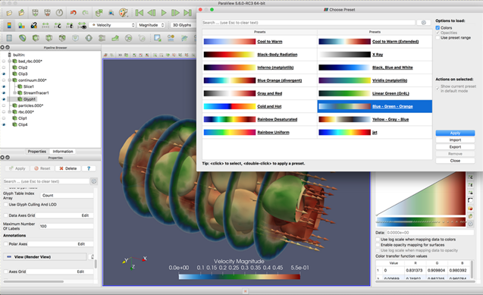
Popular Software with Python
Kitware ParaView
https://www.paraview.org/
“ParaView Post Processing: Vectors, Streamlines, Contours, Iso-surfaces and Iso-Volumes” - https://youtu.be/fnawxr0WLJU

Slide 26
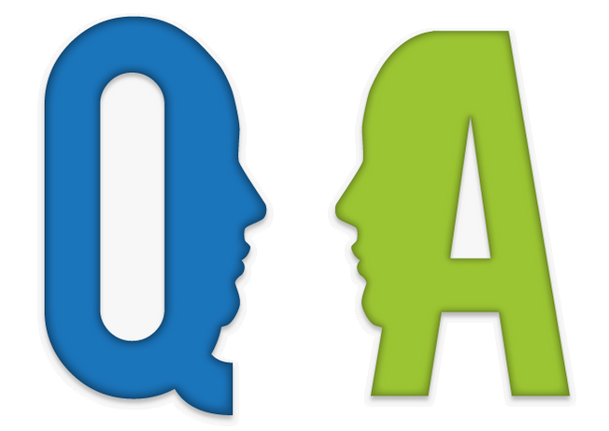
Thanks for Your Attention
Hey
I’m back

