Slide 1
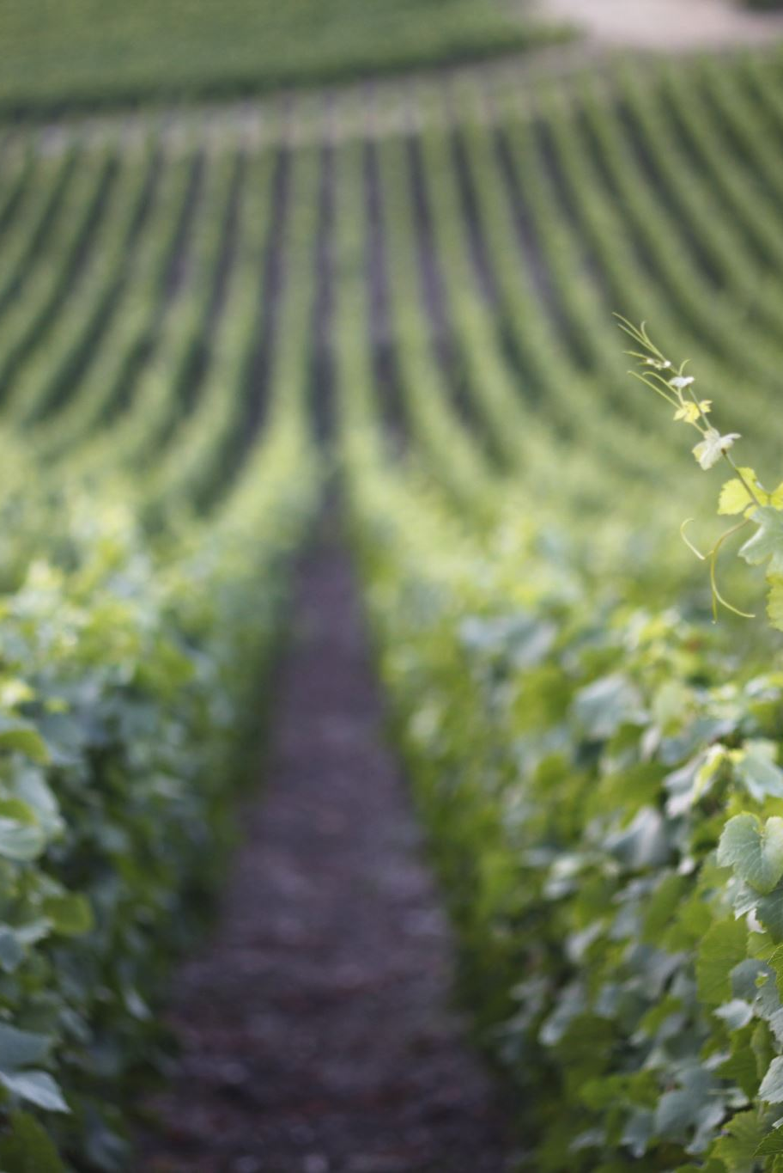
Project Overview – Wine Quality Prediction
European winery aims to improve product consistency with data science.
Manual tasting is costly, slow, and subjective.
Goal: Use machine learning to predict wine quality from lab-measured features.
Accurate predictions help optimize fermentation and reduce quality variability.
Data source: Wine Quality Dataset (UCI); red & white Vinho Verde wines.
It is available at http://www3.dsi.uminho.pt/pcortez/wineMerged red and white CSV files

Slide 2
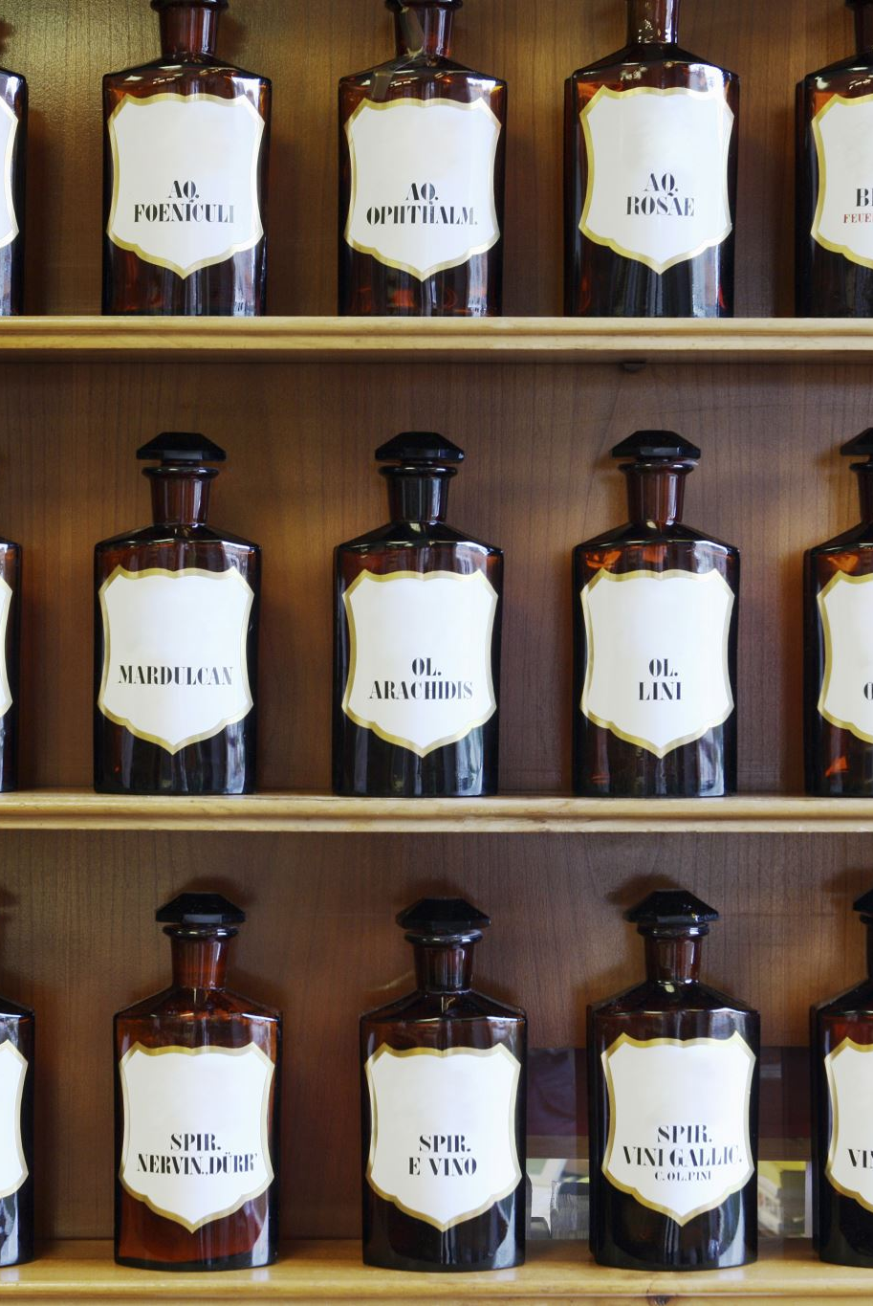
Project Objective
For this task, I have chosen to approach the wine quality prediction problem as a binary classification task.
Instead of predicting the exact numerical wine quality score (regression or multi-class task), the goal is to classify wines into two categories:
Good quality (quality ≥ 7)
Not good (quality < 7)
To achieve this, a new binary target variable will be created from the original quality column.
This classification approach allows to train a model that distinguishes high-quality wines from lower-quality ones based on their physicochemical pro

Slide 3
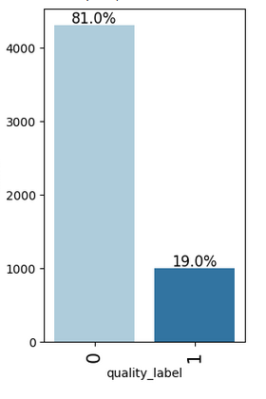
Target Imbalance & Evaluation Metric
Only 19 % of wines are labelled “good” (quality ≥ 7) ⇒ strong class imbalance.
Accuracy would be misleading (majority‑class baseline ≈ 81 %).
Selected F1 score to balance:
•Precision – of wines predicted good, how many truly are.
• Recall – of truly good wines, how many we capture.
Both false positives (bad wine recommended) and false negatives (good wine missed) matter.

Slide 4
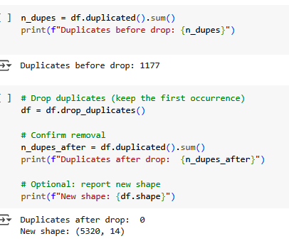
Duplicates Removed
Identified 1 177 duplicate rows (18 % of raw data).
Removed to avoid bias & over‑representation.
New shape: 5 320 rows (clean, unique records).

Slide 5
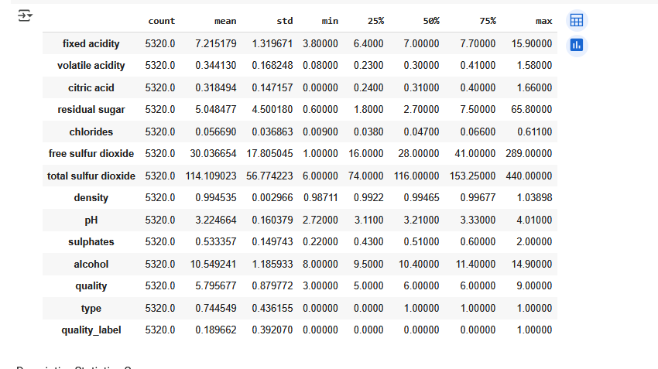
Dataset Snapshot (post‑cleaning)
5 320 unique samples × 14 columns.
11 numeric physicochemical features.
3 label/categorical columns: type, quality (0‑10), quality_label (binary).
No missing values – ready for EDA and modeling.

Slide 6
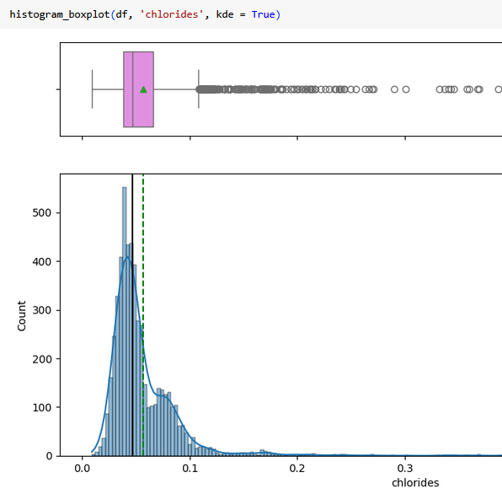
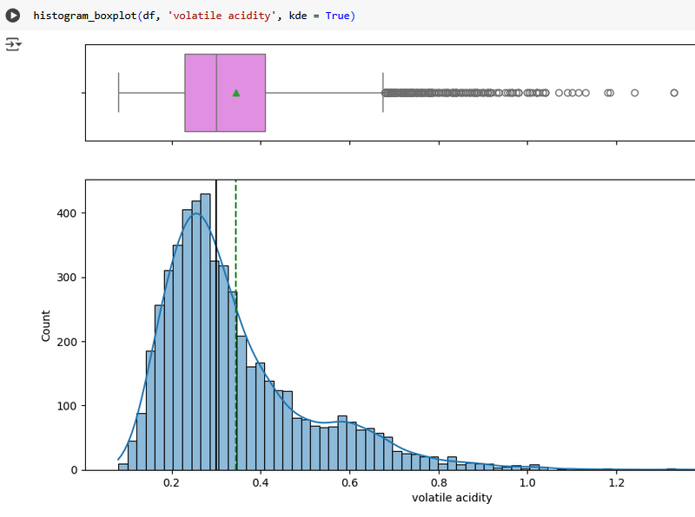
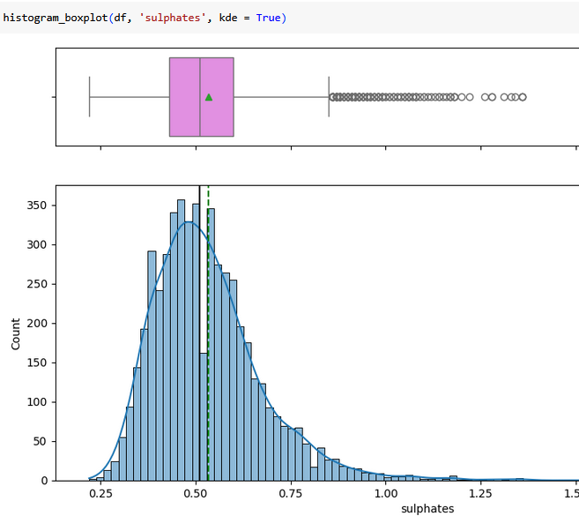
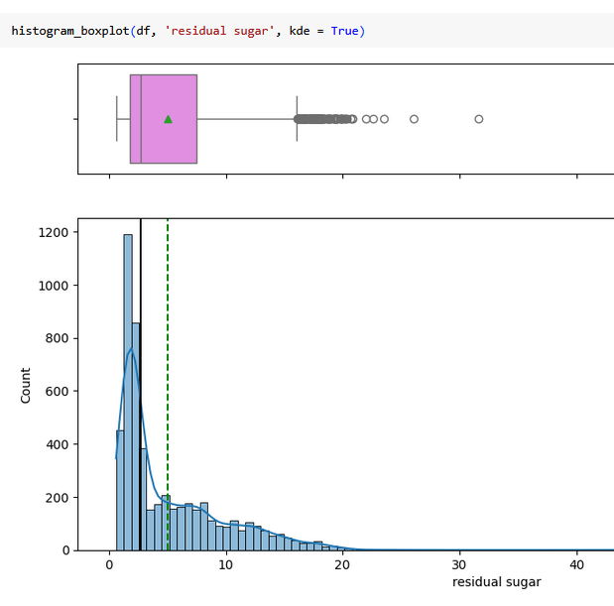
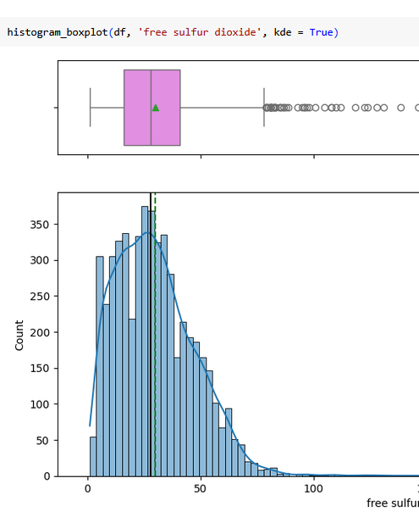
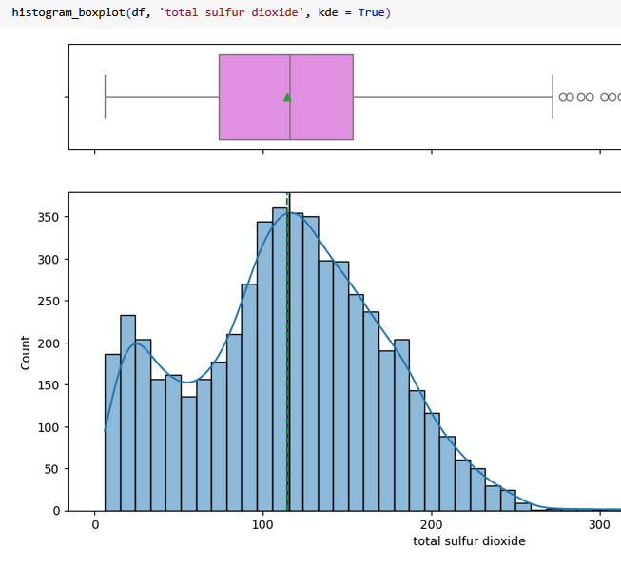
Descriptive Statistics Highlights
Several features (chlorides, residual sugar, volatile acidity) are right-skewed.
Outliers clipped at the 99.5ᵗʰ percentile to stabilize model gradients.
Applied log transforms on skewed variables to compare against raw scale.
Models trained on both raw and log-transformed datasets to quantify impact.

Slide 7
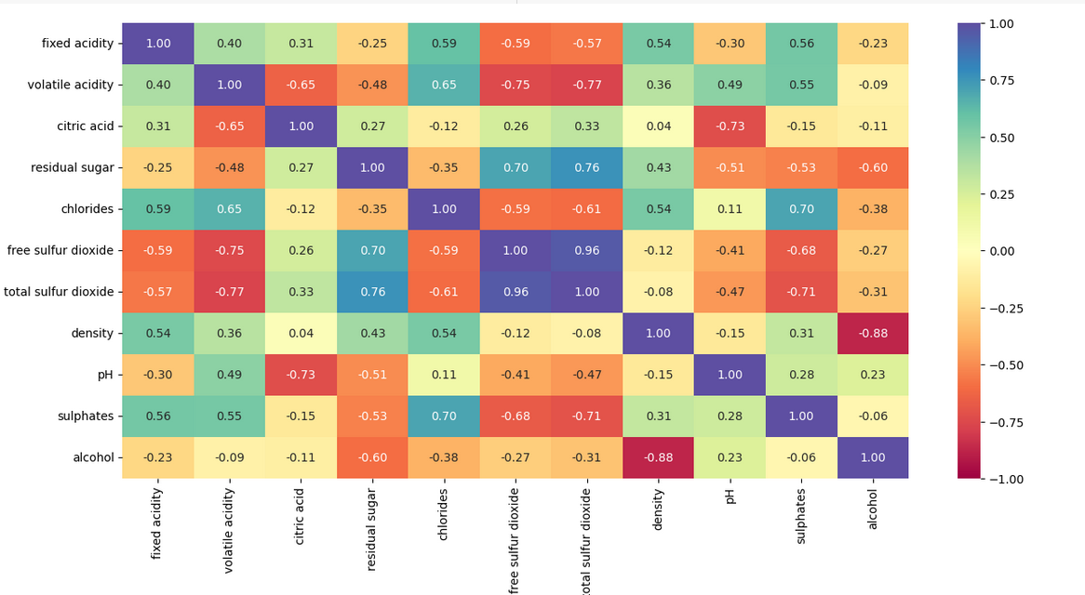
Key Correlation Hot‑Spots
Free SO₂ ↔ Total SO₂: 0.95 (redundant).
Density ↔ Alcohol: −0.88 (inverse).
Volatile Acidity ↔ Total SO₂: −0.77.
Residual Sugar ↔ Total SO₂: 0.76.
Citric Acid ↔ pH: −0.72.
Drop/combine highly correlated pairs to reduce multicollinearity.

Slide 8
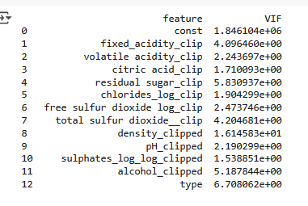
Multicollinearity (VIF) Insights
Fixed acidity overlaps with citric acid & pH → high VIF.
Residual sugar collinear with density & Total SO₂.
Free vs Total SO₂ measure similar preservative effects.
Density largely determined by alcohol & residual sugar.
pH influenced by multiple acids ⇒ inflated VIF.
Remove or combine high‑VIF features for stable models.

Slide 9
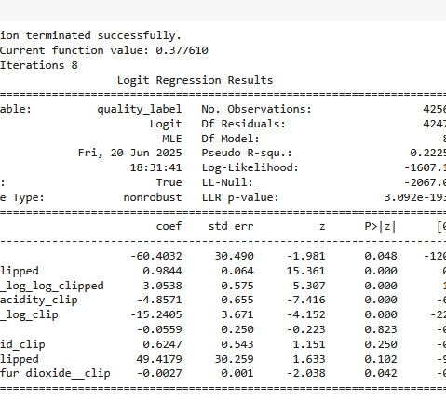
Logistic Regression – Core-8 Features
•Alcohol & sulphates are strong positive predictors of wine quality.
Volatile acidity and chlorides significantly reduce quality.
Type (red/white) is not significant after accounting for chemical features.
Density shows a large coefficient but wide confidence interval

Slide 10
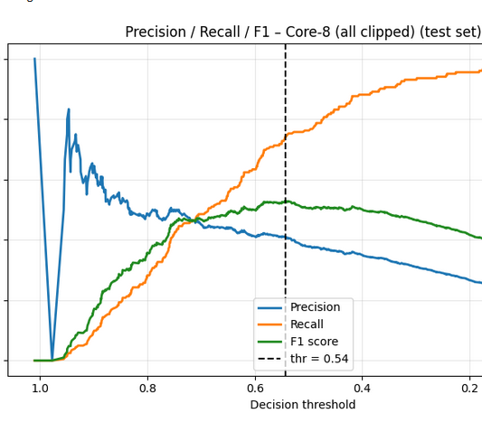
Threshold Tuning – Precision / Recall / F1
Why Adjust the Threshold?
The dataset is imbalanced (~19% high-quality wines), so the default 0.50 threshold may not yield optimal performance.
Tuning Approach:
Evaluated model performance across a range of decision thresholds.
Calculated Precision, Recall, and F1 Score at each threshold.
Selected the threshold that maximized the F1 score (can adapt based on business priorities).
Optimal Threshold Identified:
Model trained on 8 selected features
Threshold = 0.54
Precision increased to 0.58
Recall improved to 0.49
F1 Score rose from 0.47 → 0.53
Key Insight:
Slightly lowering the threshold leads to a more balanced model—improving the ability to detect good wines while controlling false positives.

Slide 11
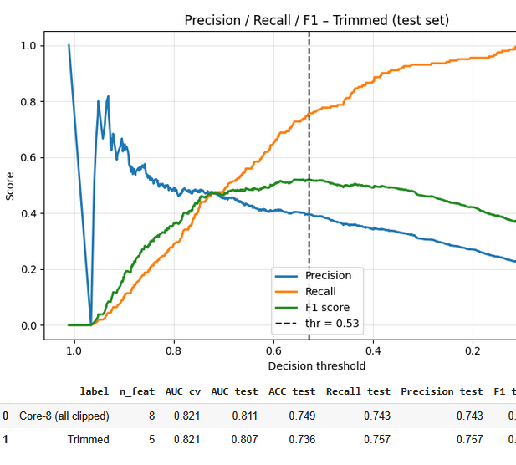
Comparing Logistic Models: Accuracy vs Simplicity
Key Observations
Performance parity: Both models deliver virtually identical AUC (≈ 0.81).
Precision-recall trade-off:
Trimmed-5 gains a modest +0.014 in precision/recall, useful if missing good wines is costlier.
Core-8 retains a slightly higher F1 (+0.008) and overall accuracy.
Model simplicity: Trimmed-5 uses 37 % fewer predictors, reducing multicollinearity and easing deployment.
Threshold shift: Optimal cutoff drops from 0.54 → 0.53 as feature set shrinks.
Take-away
If interpretability and minimal feature footprint are priorities, the Trimmed-5 model is attractive with virtually no loss in AUC.
When maximising balanced F1 is critical, keep the Core-8 variant.

Slide 12
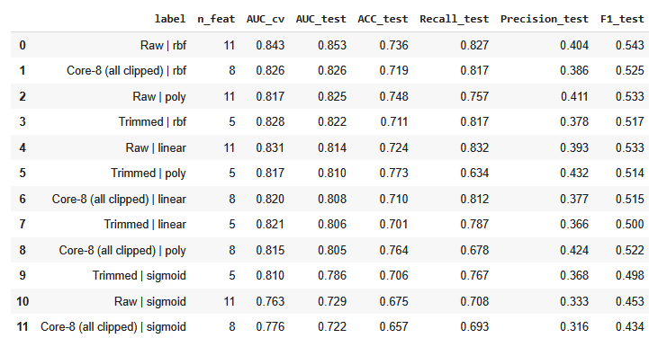
Support Vector Classifier (SVC) – Model Comparison
Performance across feature sets and kernel types (Raw vs. Log-Transformed) Best performing model: Raw features with RBF kernel (AUC = 0.853, F1 = 0.543) Key Observations: • Non-linear kernels (RBF, Poly) consistently outperform linear and sigmoid kernels • Trimmed features maintain strong results with fewer inputs • Linear models benefit from transformed features but slightly underperform non-linear ones Why SVM Performs Better on Raw Features: • Raw data retains complex structure that RBF and Poly kernels can utilize • Log transformations can compress variability and mask nuanced relationships • SVM kernels need diverse input spread to form optimal margins

Slide 13
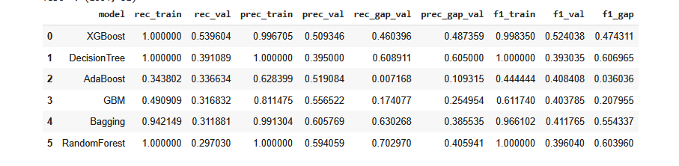
Model Performance Comparison
• SVM (RBF) with raw features achieved best F1 score (0.543) and AUC (0.853).
• Logistic Regression (Core-8, clipped) was close: F1 = 0.529, AUC = 0.821.
• Tree models (RandomForest, Bagging) showed overfitting with large train/test gaps.
• Log-transformed models slightly underperformed vs. raw features in non-linear models.
• Final Recommendation: Deploy Logistic model for simplicity; retain SVM as benchmark.

Slide 14
Key Modeling Takeaways
Key Takeaways
SVM (RBF) delivered the best performance (F1 = 0.543, AUC = 0.853), effectively capturing non-linear relationships in the data.
Logistic Regression with low-VIF features offered competitive F1 (0.529) with added simplicity and interpretability.
Ensemble models like Random Forest and Bagging suffered from overfitting — achieving high train recall but poor generalization on test data.
Log-transformations did not improve results for non-linear models and in some cases reduced performance.
Conclusion
This project successfully framed wine quality prediction as a binary classification task. Using robust preprocessing, feature engineering, and model tuning, the analysis showed that raw features with SVM (RBF) yielded the strongest results. Alcohol and volatile acidity emerged as key predictors. These findings offer practical value in wine quality screening and production optimization.

Slide 15
Lessons Learned
Feature selection with VIF improved model performance and reduced multicollinearity.
8 core features were selected, including key predictors like alcohol, volatile acidity, and sulphates.
Threshold tuning (0.54) helped balance precision and recall under class imbalance.
Kernel models (e.g., SVM RBF) performed best on raw data, capturing non-linear relationships effectively.
Linear models like Logistic Regression still performed competitively with clean, selected features.
Visual metrics (Precision-Recall & ROC curves) gave better insight than accuracy alone.
Future improvements: add more data and balance the target classes to enhance model generalization.

Slide 16

Real-World Application
Logistic Regression offers a simple and fast tool for quality prediction after lab testing—ideal for deployment in production environments.
SVM (RBF) provides robust performance and can be used to cross-validate lab-based quality assessments.
The model can be embedded in the wine production process to flag potentially high- or low-quality batches for manual inspection.
Enhances decision speed and consistency, reducing subjectivity in quality control.
Models can be integrated into the production pipeline to automatically flag wines that may need manual review.
Enables faster, more consistent decisions in quality control, reducing reliance on subjective tasting alone.

