Slide 1

Mar
Apr
May
Jun
Jul
Aug
Customer A
Calendar month
Customer B
Customer C
1
2
3
4
5
6
Customer A
Customer month
Customer B
Customer C

Slide 2
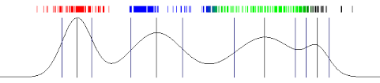
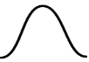















Behaviours
$$B_{1}$$
$$B_{2}$$
$$B_{3}$$
$$B_{4}$$
Emission
States
$$S_{1}$$
$$S_{2}$$
$$S_{3}$$
Transition
Behaviours
Clusters
$$C_{1}$$
$$C_{2}$$
$$C_{3}$$
$$C_{4}$$
Emission
States
$$S_{1}$$
$$S_{2}$$
$$S_{3}$$
Transition

Slide 3



Step I:
Train
Train Database
Model
Model Pipeline
Step II:
Predict
Customised retention strategies:
Discount offers
Reminder of engagement
Model
2%
11%
CRM Team
19%
38%
67%

Slide 4
Feature Extraction
Feature Distributional Modelling
Fitting Mixture Model
Analytics and Prediction
Pipeline
Whizz Database

