Slide 1

User Cancellation Modelling: on Clustering of Customer Behaviours
Victor Wang
Supervisors: Andrew Mellor, Junaid Mubeen

Slide 2
Agenda
Motivation and Goal
Background – Business Settings at Whizz
Model
Customer Journey
Methodology
Result
Clusters
Feature Analysis
Conclusion

Slide 3



Motivation and Goal
Retained customers create higher revenues
Making a sell to a new customer costs up to 5 times more.
Customer retention strategies targeting on high risk customers
Motivation

Slide 4
Motivation and Goal
Retained customers create higher revenues
Making a sell to a new customer costs up to 5 times more.
Customer retention strategies targeting on high risk customers
Motivation
Goal – Churn (Cancellation) modelling
Who?
Identify customers most prone to cancel subscription
Assess likelihood
Why?
Analyse critical reason triggering cancellation
Make bespoke retention policy

Slide 5


Business Settings at Whizz
Cancellation Mechanism
Contractual
Pupils subscribe to access Whizz products on a 1-month or 1-year contract
Voluntary
Subscribers make the choice to leave the service at the end of the subscription; otherwise auto-rolled

Slide 6
Business Settings at Whizz
Cancellation Mechanism
Contractual
Pupils subscribe to access Whizz products on a 1-month or 1-year contract
Voluntary
Subscribers make the choice to leave the service at the end of the subscription; otherwise auto-rolled
Data Records
Time period: 2014-Jan-01 – 2018-Apr-20
Pupil
Subscription
Lesson History
Pupil ID
Date of birth
Pupil ID
Start date
End date
Lesson ID
Pupil ID
Time
Mark
…
5685 pupils
28025 subscriptions
~1.6 million lesson activities

Slide 7




Business Settings at Whizz
Cancellation Mechanism
Contractual
Pupils subscribe to access Whizz products on a 1-month or 1-year contract
Voluntary
Subscribers make the choice to leave the service at the end of the subscription; otherwise auto-rolled
Data Records
Time period: 2014-Jan-01 – 2018-Apr-20
Features
Churn outcome
(renew / cancel)
Pupil
Subscription
Lesson History
$$X=$$
Pupil ID
Date of birth
Pupil ID
Start date
End date
Lesson ID
Pupil ID
Time
Mark
…
Renew
$$\left[\begin{matrix}\begin{matrix}\begin{matrix}1.2 \\ 52.2\end{matrix} & \begin{matrix}20 \\ 34\end{matrix}\end{matrix} & ⋯ & \begin{matrix}80\% \\ 31\%\end{matrix} \\ ⋮ & ⋱ & ⋮ \\ \begin{matrix}25.1 & 99\end{matrix} & ⋯ & 43\%\end{matrix}\right]$$
$$\left[\begin{matrix}0 \\ \begin{matrix}1 \\ \begin{matrix}⋮ \\ 0\end{matrix}\end{matrix}\end{matrix}\right]$$
5685 pupils
28025 subscriptions
Cancel
~1.6 million lesson activities
Pass rate
Usage time
(hours)
Number of visits

Slide 8
Customer Journey
Pupils’ activities are split into monthly time periods with each customer-month represented by features.
Mar
Apr
May
Jun
Jul
Aug
Customer A
Calendar month
Customer B
Customer C

Slide 9
Customer Journey
Pupils’ activities are split into monthly time periods with each customer-month represented by features.
Mar
Apr
May
Jun
Jul
Aug
Customer A
Calendar month
Customer B
Customer C
1
2
3
4
5
6
Customer A
Customer month
Customer B
Customer C

Slide 10
Customer Journey
Pupils’ activities are split into monthly time periods with each customer-month represented by features.
Mar
Apr
May
Jun
Jul
Aug
Customer A
Calendar month
Customer B
Customer C
1
2
3
4
5
6
Customer A
Customer month
Customer B
Customer C
We assume the cancellation to be ONLY dependent on the current month.
The assumption holds since we observe statistically constant churn rate over customer month.
The assumption enables us to treat activities in different customer months indifferently.

Slide 11



Methodology
Key Assumptions
Churners and non-churners exhibit different behaviours generated by some states
States
$$S_{1}$$
$$S_{2}$$
$$S_{3}$$

Slide 12
Methodology
Key Assumptions
Churners and non-churners exhibit different behaviours generated by some states
States
$$S_{1}$$
$$S_{2}$$
$$S_{3}$$
Transition

Slide 13
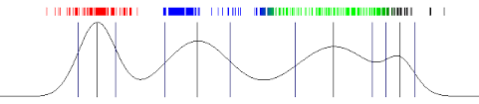
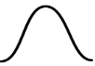
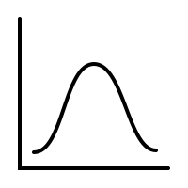




Methodology
Key Assumptions
Churners and non-churners exhibit different behaviours generated by some states
Generative process: State → Cluster
Clusters
$$C_{1}$$
$$C_{2}$$
$$C_{3}$$
$$C_{4}$$
Emission
States
$$S_{1}$$
$$S_{2}$$
$$S_{3}$$
Transition

Slide 14
Methodology
Key Assumptions
Churners and non-churners exhibit different behaviours generated by some states
Generative process: State → Cluster → Behaviour observations
Behaviours
Clusters
$$C_{1}$$
$$C_{2}$$
$$C_{3}$$
$$C_{4}$$
Emission
States
$$S_{1}$$
$$S_{2}$$
$$S_{3}$$
Transition

Slide 15
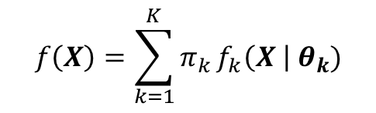


Methodology
Key Assumptions
Churners and non-churners exhibit different behaviours generated by some states
Generative process: State → Cluster → Behaviour observations
Behaviours
Mixture Model
$$f\left(X\right)=\sum_{k=1}^{K}{π_{k}}f_{k}\left(X \right| θ_{k})$$
Clusters
$$C_{1}$$
$$C_{2}$$
$$C_{3}$$
$$C_{4}$$
Emission
Markov State Transition probability
States
$$S_{1}$$
$$S_{2}$$
$$S_{3}$$
$$A=\left(a_{ij}\right)$$
Transition
$$a_{ij}=P\left({s_{t+1}=S}_{i} | s_{t}=S_{j}\right)$$

Slide 16
Methodology
Key Assumptions
Churners and non-churners exhibit different behaviours generated by some states
Generative process: State → Cluster → Behaviour observations
Customers’ behaviours are independent from others’
Behaviours
Mixture Model
$$f\left(X\right)=\sum_{k=1}^{K}{π_{k}}f_{k}\left(X \right| θ_{k})$$
Clusters
$$C_{1}$$
$$C_{2}$$
$$C_{3}$$
$$C_{4}$$
Emission
Markov State Transition probability
States
$$S_{1}$$
$$S_{2}$$
$$S_{3}$$
$$A=\left(a_{ij}\right)$$
Transition
$$a_{ij}=P\left({s_{t+1}=S}_{i} | s_{t}=S_{j}\right)$$

Slide 17
Methodology
Key Assumptions
Churners and non-churners exhibit different behaviours generated by some states
Generative process: State → Cluster → Behaviour observations
Customers’ behaviours are independent from others’
Make inference!
Behaviours
Mixture Model
$$f\left(X\right)=\sum_{k=1}^{K}{π_{k}}f_{k}\left(X \right| θ_{k})$$
Clusters
$$C_{1}$$
$$C_{2}$$
$$C_{3}$$
$$C_{4}$$
Emission
Markov State Transition probability
States
$$S_{1}$$
$$S_{2}$$
$$S_{3}$$
$$A=\left(a_{ij}\right)$$
Transition
$$a_{ij}=P\left({s_{t+1}=S}_{i} | s_{t}=S_{j}\right)$$

Slide 18
Methodology
Key Assumptions
Churners and non-churners exhibit different behaviours generated by some states
Generative process: State → Cluster → Behaviour observations
Customers’ behaviours are independent from others’
Pipeline

Slide 19
Methodology
Key Assumptions
Churners and non-churners exhibit different behaviours generated by some states
Generative process: State → Cluster → Behaviour observations
Customers’ behaviours are independent from others’
Pipeline
Feature Extraction
Extract features to represent customers within a specific customer month.
Feature Distributional Modelling
Assess distributions, correlations, etc.
Clustering
Fit mixture model;
Define states
Analytics and Prediction
Interpret clusters

Slide 20
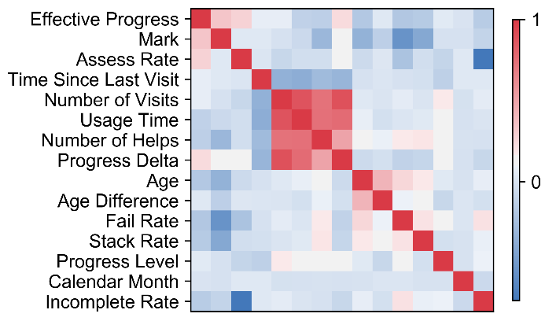
Methodology
Key Assumptions
Churners and non-churners exhibit different behaviours generated by some states
Generative process: State → Cluster → Behaviour observations
Customers’ behaviours are independent from others’
Pipeline
Feature Extraction
Extract features to represent customers within a specific customer month.
Feature Distributional Modelling
Assess distributions, correlations, etc.
Clustering
Fit mixture model;
Define states
Analytics and Prediction
Interpret clusters

Slide 21
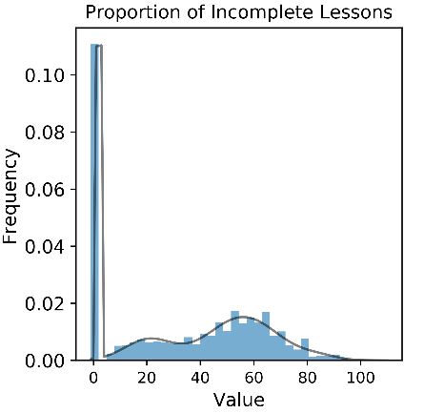
Methodology
Key Assumptions
Churners and non-churners exhibit different behaviours generated by some states
Generative process: State → Cluster → Behaviour observations
Customers’ behaviours are independent from others’
Pipeline
Feature Extraction
Extract features to represent customers within a specific customer month.
Feature Distributional Modelling
Assess distributions, correlations, etc.
Clustering
Fit mixture model;
Define states
Analytics and Prediction
Interpret clusters

Slide 22
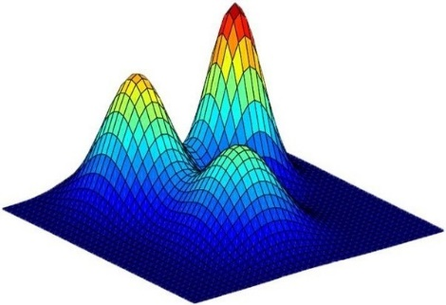
Methodology
Key Assumptions
Churners and non-churners exhibit different behaviours generated by some states
Generative process: State → Cluster → Behaviour observations
Customers’ behaviours are independent from others’
Pipeline
Feature Extraction
Extract features to represent customers within a specific customer month.
Feature Distributional Modelling
Assess distributions, correlations, etc.
Clustering
Fit mixture model;
Define states
Analytics and Prediction
Interpret clusters

Slide 23
Methodology
Key Assumptions
Churners and non-churners exhibit different behaviours generated by some states
Generative process: State → Cluster → Behaviour observations
Customers’ behaviours are independent from others’
Pipeline
Feature Extraction
Extract features to represent customers within a specific customer month.
Feature Distributional Modelling
Assess distributions, correlations, etc.
Clustering
Fit mixture model;
Define states
Analytics and Prediction
Interpret clusters

Slide 24
A Closer Look at Clustering…
Different users have different data available. For example, inactive users will have no records in features like marks, pass rates, etc.
Rather than interpolating missing information, we divide customers by activity level.

Slide 25
A Closer Look at Clustering…
Different users have different data available. For example, inactive users will have no records in features like marks, pass rates, etc.
Rather than interpolating missing information, we divide customers by activity level.
G1
Inactive
Inactive
No activity
G2
No-assess
There’s activity but no assessment
G3
Complete Info
Most Active
There’s activity and assessment taken

Slide 26
A Closer Look at Clustering…
Different users have different data available. For example, inactive users will have no records in features like marks, pass rates, etc.
Rather than interpolating missing information, we divide customers by activity level.
Churn Rate
G1
Inactive
22.99%
(6417)
Inactive
No activity
G2
No-assess
16.94%
(425)
There’s activity but no assessment
G3
Complete Info
10.21%
(11019)
Most Active
There’s activity and assessment taken

Slide 27
A Closer Look at Clustering…
Different users have different data available. For example, inactive users will have no records in features like marks, pass rates, etc.
Rather than interpolating missing information, we divide customers by activity level.
Churn Rate
G1
Inactive
22.99%
(6417)
G1
Clusters
Inactive
No activity
G2
No-assess
16.94%
(425)
Fit
Mixture Model
G2
Clusters
There’s activity but no assessment
G3
Complete Info
10.21%
(11019)
Most Active
There’s activity and assessment taken
G3
Clusters

Slide 28
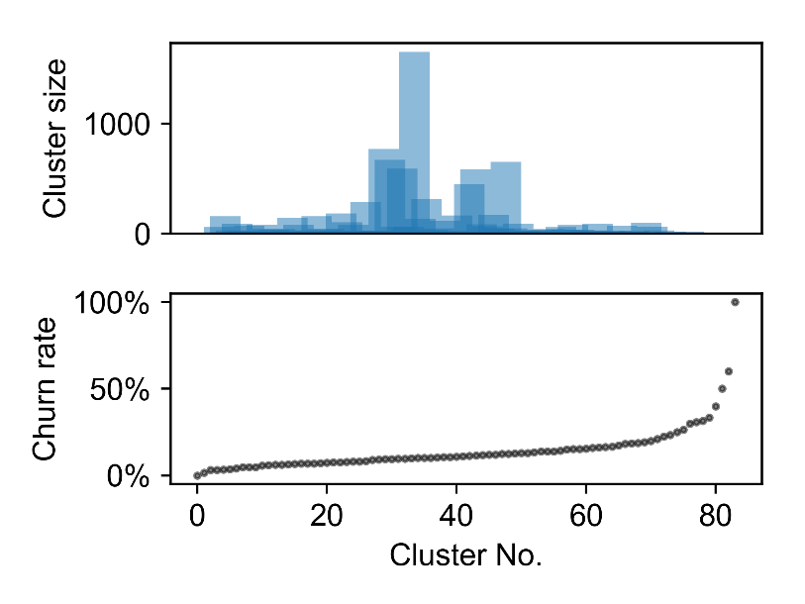
Cluster Churn Rates (Who)
Identified Clusters: Size

Slide 29

Cluster Churn Rates (Who)
Identified Clusters: Size
Features ($X$)
Churn outcome

Slide 30
Cluster Churn Rates (Who)
Identified Clusters: Size and Churn Rate
Features ($X$)
Churn outcome

Slide 31
Cluster Churn Rates (Who)
Identified Clusters: Size and Churn Rate
Observations:
The purely behaviour based model infer many clusters:
the corresponding churn rate ranges from 0% to 100%.
It is more challenging to identify users of extreme high/low churn probability:
the cluster size tends to be much smaller for those extreme high/low churn rate.

Slide 32
Cluster Churn Rates (Who)
Identified Clusters: Size and Churn Rate
Observations:
The purely behaviour based model infer many clusters:
the corresponding churn rate ranges from 0% to 100%.
It is more challenging to identify users of extreme high/low churn probability:
the cluster size tends to be much smaller for those extreme high/low churn rate.
652
12.5%
From Cluster Churn Rate to Churn Probability of Individual Pupil

Slide 33
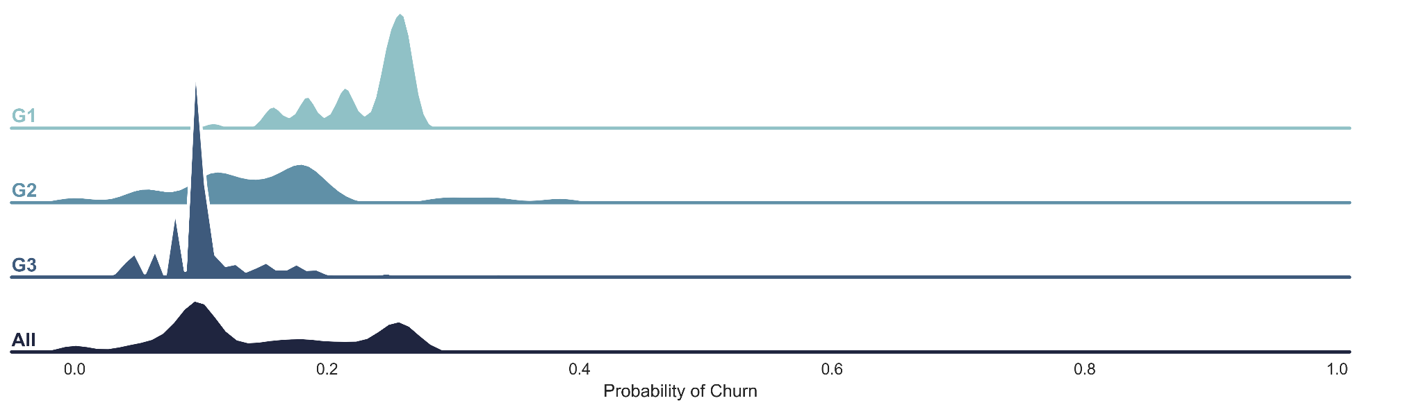
Cluster Churn Rates (Who)
Identified Clusters: Size and Churn Rate
Observations:
The purely behaviour based model infer many clusters:
the corresponding churn rate ranges from 0% to 100%.
It is more challenging to identify users of extreme high/low churn probability:
the cluster size tends to be much smaller for those extreme high/low churn rate.
From Cluster Churn Rate to Churn Probability of Individual Pupil

Slide 34
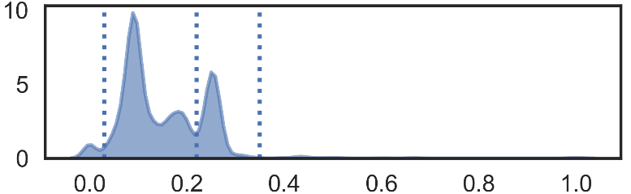
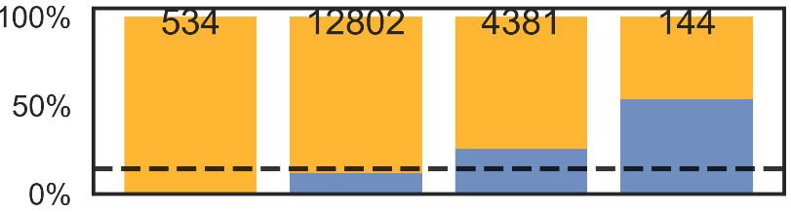
Cluster Churn Rates (Who)
Identified Clusters: Size and Churn Rate
Observations:
The purely behaviour based model infer many clusters:
the corresponding churn rate ranges from 0% to 100%.
It is more challenging to identify users of extreme high/low churn probability:
the cluster size tends to be much smaller for those extreme high/low churn rate.
From Cluster Churn Rate to Churn Probability of Individual Pupil

Slide 35
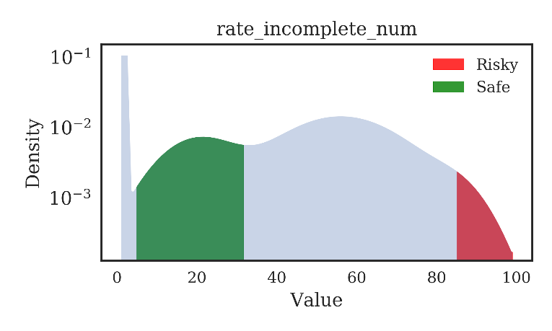
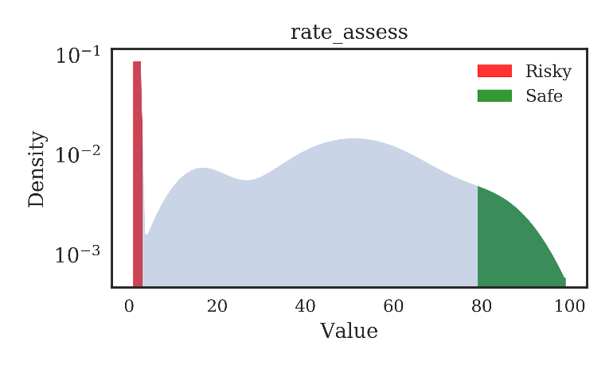
Feature Analysis (Why)
The mixture model methodology, by its nature, is designed for identifying clusters, but not explicitly for analysing feature importance.
However, by counting frequencies of components of risky and safe clusters, we can see how feature impacts churn outcome.
Risky cluster: churn rate > 50%
Safe cluster: churn rate < 5%
We can look at the component each cluster falls in for features.
Observations:
Subscribers having many incomplete lesson records are most likely to churn.
Subscribers taking few assessment are most likely to churn

Slide 36


Prediction Workflow
How does Whizz use this model to predict the risk of churn for a set of subscribers?
Step I:
Train
Train Database
Model
Model Pipeline

Slide 37

Prediction Workflow
How does Whizz use this model to predict the risk of churn for a set of subscribers?
Step I:
Train
Train Database
Model
Model Pipeline
Step II:
Predict
Model
2%
11%
19%
38%
67%

Slide 38
Prediction Workflow
How does Whizz use this model to predict the risk of churn for a set of subscribers?
Step I:
Train
Train Database
Model
Model Pipeline
Step II:
Predict
Model
2%
11%
19%
38%
Customised retention strategies:
Discount offers
Reminder of engagement
Etc.
67%
CRM Team

Slide 39







Conclusion
Behaviours
Clusters
$$C_{1}$$
$$C_{2}$$
$$C_{3}$$
$$C_{4}$$
Emission
States
$$S_{1}$$
$$S_{2}$$
$$S_{3}$$
Transition

Slide 40
Conclusion
Feature Extraction
Feature Distributional Modelling
Fitting Mixture Model
Analytics and Prediction
Pipeline
Whizz Database
Behaviours
Clusters
$$C_{1}$$
$$C_{2}$$
$$C_{3}$$
$$C_{4}$$
Emission
States
$$S_{1}$$
$$S_{2}$$
$$S_{3}$$
Transition

Slide 41

Conclusion
Feature Extraction
Feature Distributional Modelling
Fitting Mixture Model
Analytics and Prediction
Pipeline
Feature selection:
Select features by industrial expertise
Add nonlinear transformation / interaction of existing features
Whizz Database
Feature importance :
Measure importance of dimension in a multivariate setting
Behaviours
Clusters
$$C_{1}$$
$$C_{2}$$
$$C_{3}$$
$$C_{4}$$
Emission
States
$$S_{1}$$
$$S_{2}$$
$$S_{3}$$
Transition

Slide 42
Appendix

Slide 43
Customer Month Independence
We assume the cancellation to be ONLY dependent on the current month.
The assumption holds since we observe statistically constant churn rate over customer month.
The assumption enables us to treat activities in different customer months indifferently.

Slide 44
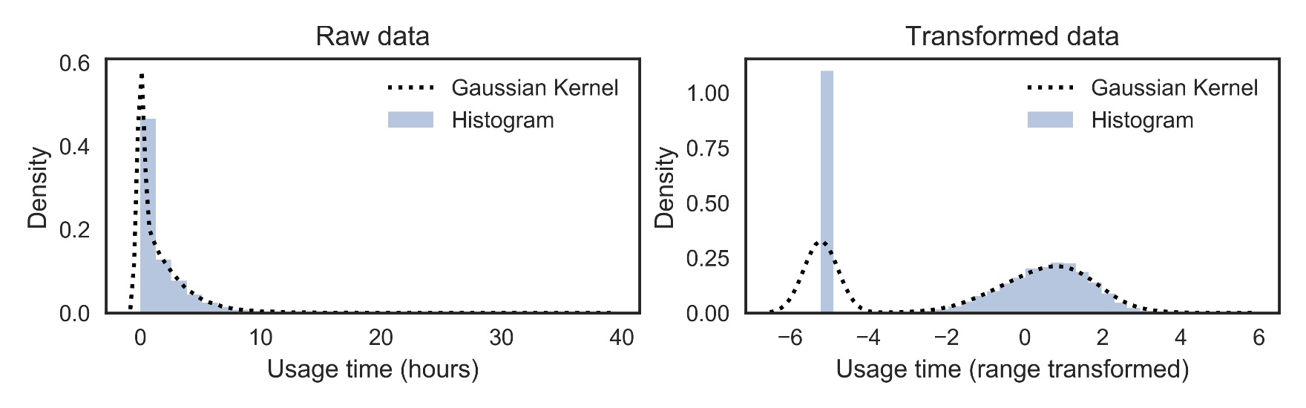
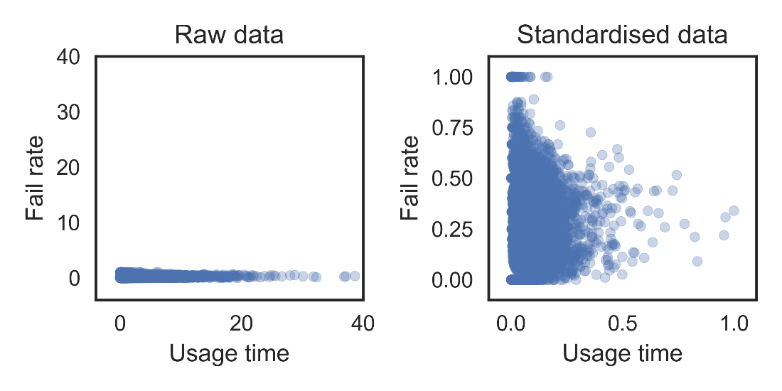
Data Transformation

Slide 45
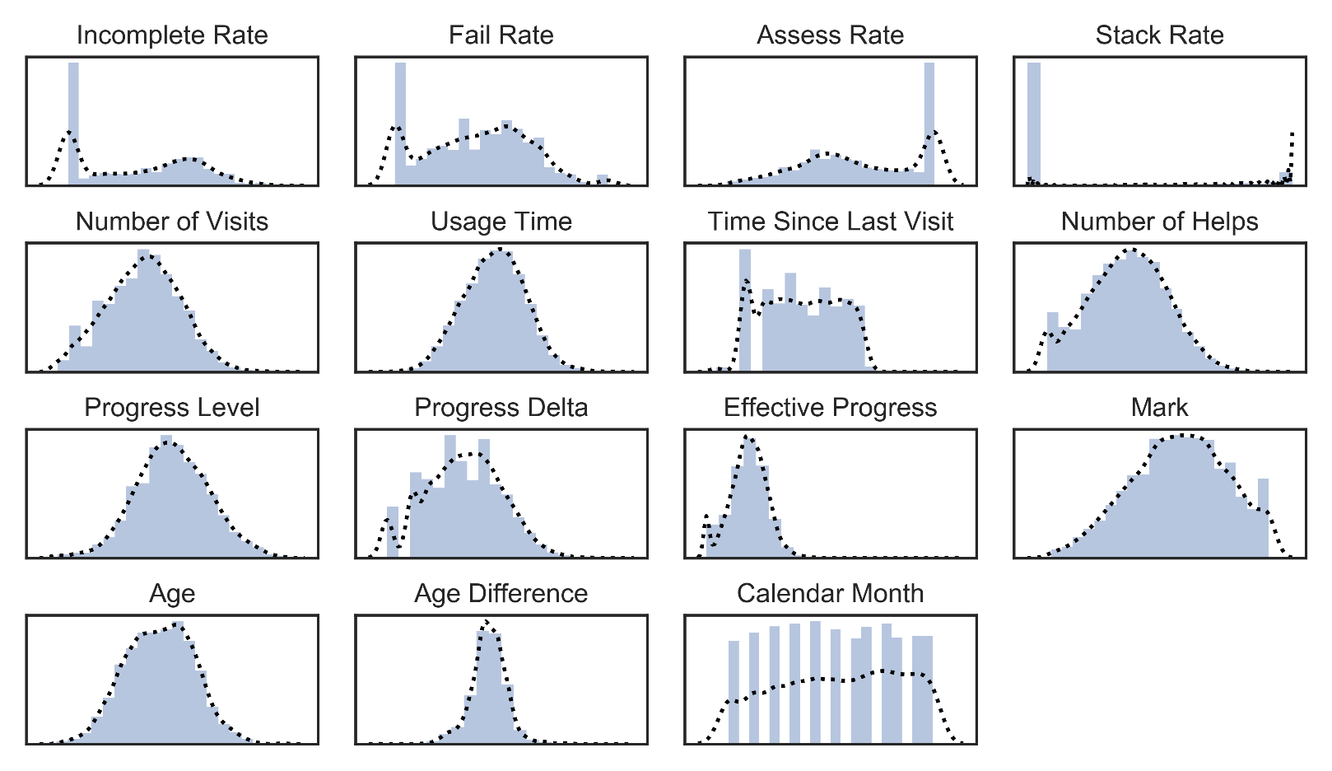
Distributional Modelling – I

Slide 46
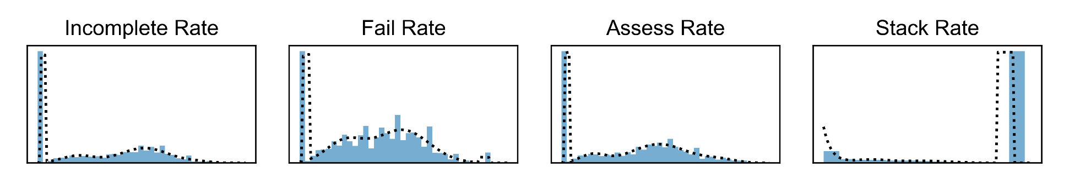

Distributional Modelling – II

Slide 47
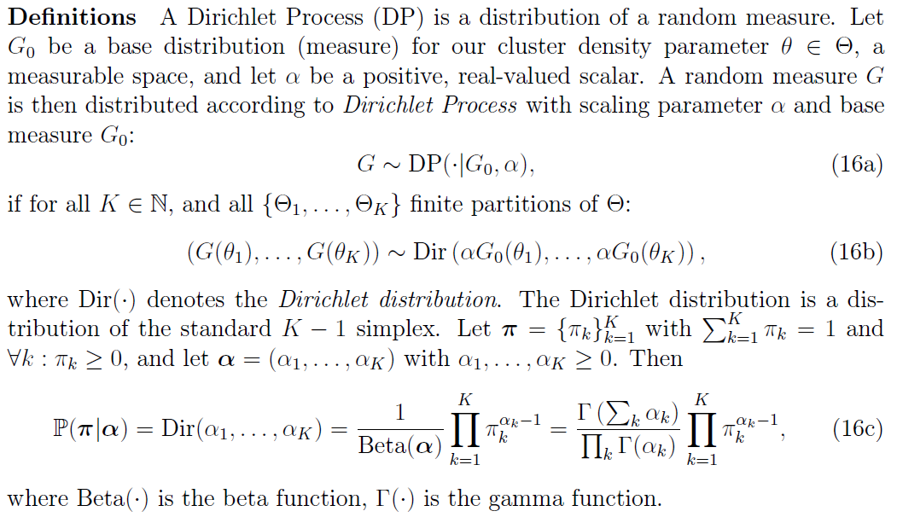
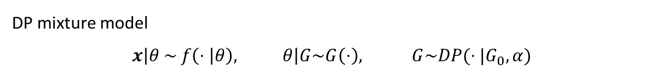
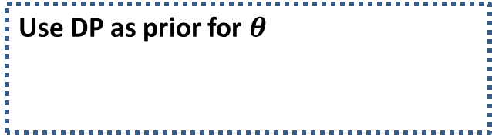
Dirichlet Process Mixture – I
DP mixture model
$$x\left|θ \sim f\left(⋅ | θ\right), θ\right|G\sim G\left(⋅\right), G\sim DP(⋅|G_{0},α)$$
Use DP as prior for $θ$

Slide 48
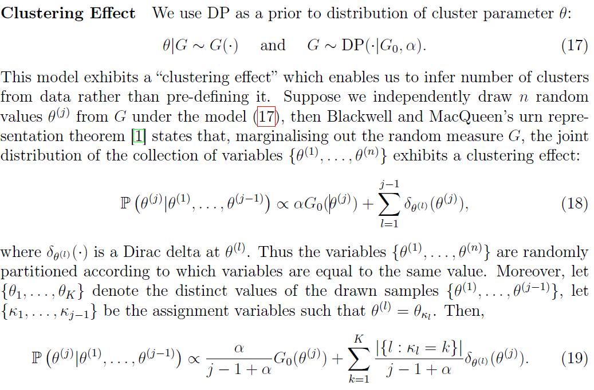
Dirichlet Process Mixture – II

Slide 49
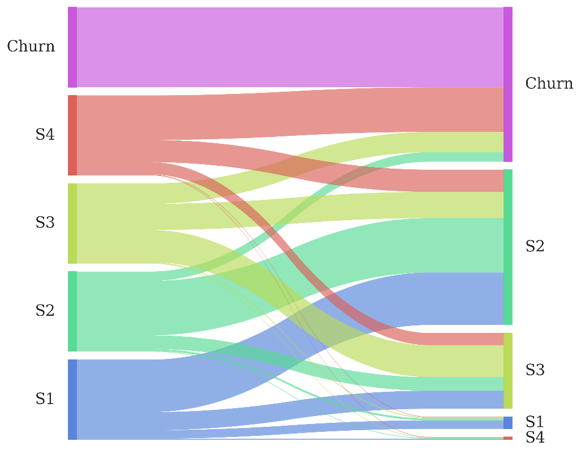
Temporal Transition of States
S2 is the largest destination state, which makes sense as S2 represents a “normal” state in which the churn probability is approximately the same as population average.
Barely pupils transit from other states to S4 (the riskiest state). This seems imply that the reason for strong intention of churn might be purely external and irrelevant to customer experience at Whizz, since there is little chance of transiting to S4.

Slide 50
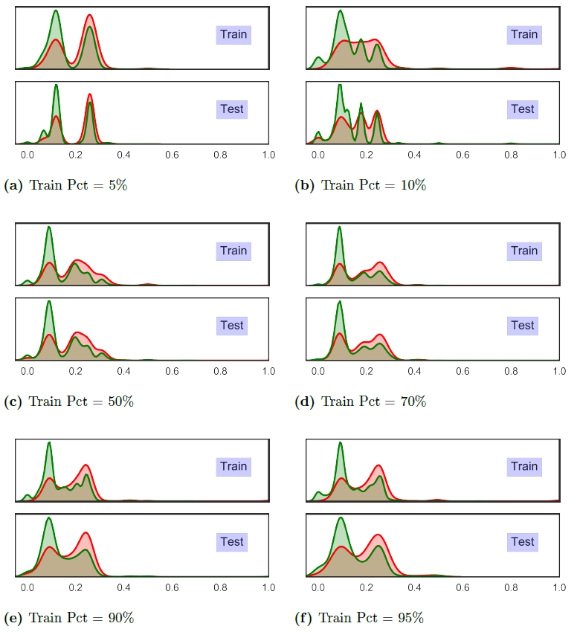
Overfitting

