Slide 1


User Cancellation Avoidance

Slide 2
Agenda

Slide 3



Motivation and Goal
Retained customers create higher revenues
Making a sell to a new customer costs up to 5 times more.
Customer retention strategies targeting on high risk customers
Motivation
Goal – Churn modelling
Who?
Identify customers most prone to cancel subscription
Assess likelihood
Why?
Analyse critical reason triggering cancellation
Make bespoke retention policy

Slide 4


Business Settings at Whizz
Cancellation Mechanism
Contractual
Pupils subscribe to access Whizz products on a 1-month or 1-year contract
Voluntary
Subscribers make the choice to leave the service at the end of the subscription; otherwise auto-rolled
Data Records
Time period: 2014-Jan-01 – 2018-Apr-20
Pupil
Subscription
Lesson History
Features
Churn outcome
(renew/cancel)
Pupil ID
Date of birth
Pupil ID
Start date
End date
Lesson ID
Pupil ID
Time
Mark
…
5685 pupils
28025 subscriptions
~1.6 million lesson activities

Slide 5
Customer Journey
Pupils’ activities are split into monthly time periods with each customer-month represented by features and churn outcome.
Mar
Apr
May
Jun
Jul
Aug
Customer A
Calendar month
Customer B
Customer C
1
2
3
4
5
6
Customer A
Customer month
Customer B
Customer C
We further assume customers’ behaviours in a customer month are independent from their behaviours in other customer months.

Slide 6
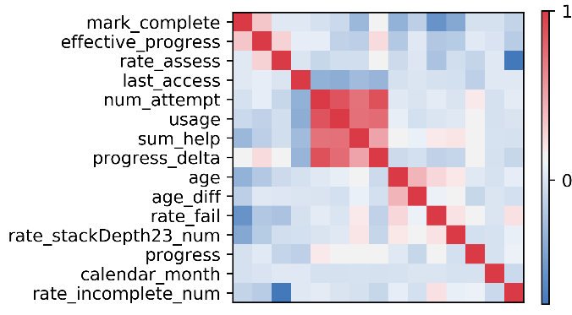
Methodology
Key Assumptions
Churners and non-churners exhibit different behaviours generated by some hidden states
Each hidden state produces different sets of behaviours
Customers’ behaviours are independent from others’
Pipeline
Feature Extraction
Extract features to represent customers within a specific customer month.
Feature Distributional Modelling
Assess distributions, correlations, etc.
Clustering
Fit mixture model;
Assess churn rate.
Analytics and Prediction
Interpret clusterings

Slide 7
A Closer Look at Clustering…
Different users have different data available. For example, inactive users will have no records in features like marks, pass rates, etc.
Rather than interpolating missing information, we divide customers by activity level.
Churn Rate
G1
Inactive
22.99%
(6417)
Inactive
No activity
G2
No-assess
16.94%
(425)
There’s activity but no assessment
G3
Fine
10.21%
(11019)
Most Active
There’s activity and assessment taken

Slide 8
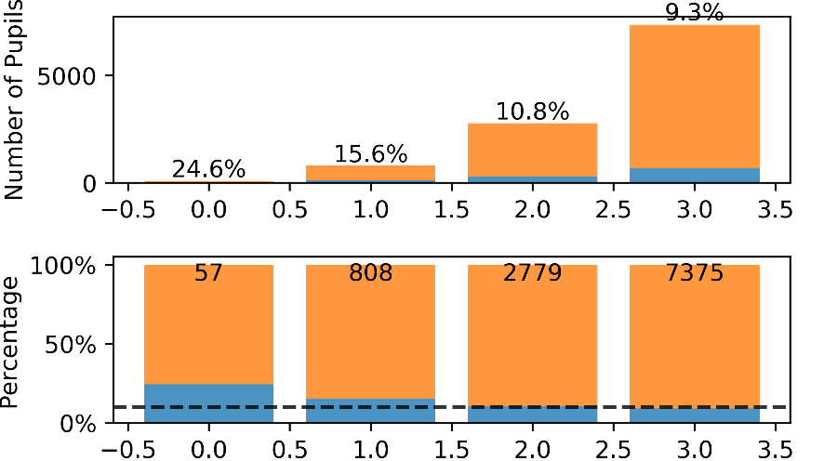
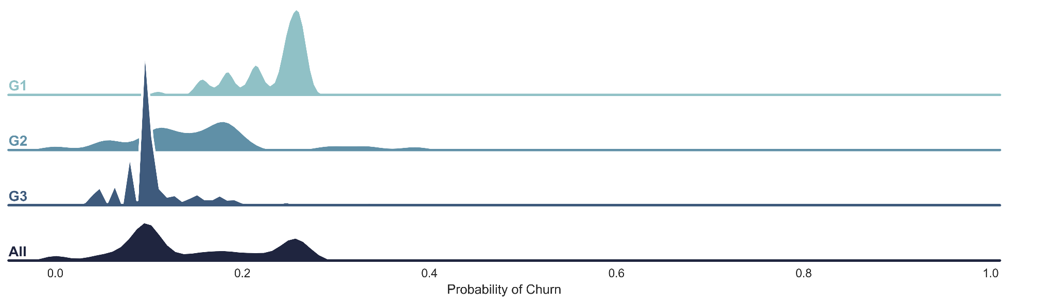
Cluster Churn Rates
Clusters Identified in G3 using 11 features
Observations:
The purely behaviour based model infer 4 clusters:
the highest churn rate is 2.5 times higher than the lowest one,
and 2.2 times higher than the group average.
It is more challenging to identify users of higher churn probability:
The higher rate the smaller cluster is found.
From Cluster Churn Rate to Churn Probability of Individual Pupil

Slide 9
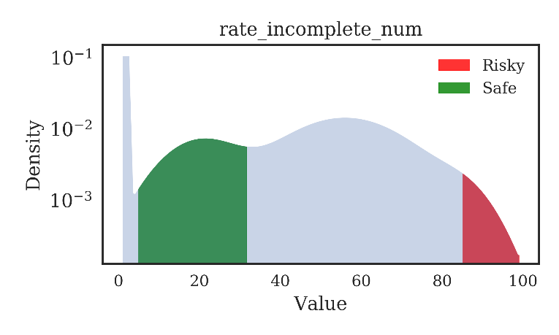
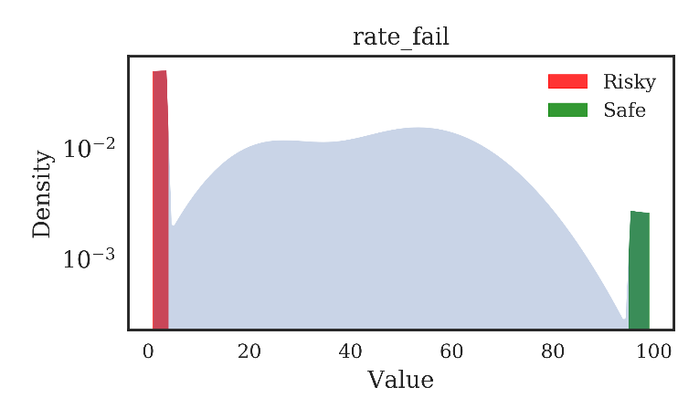
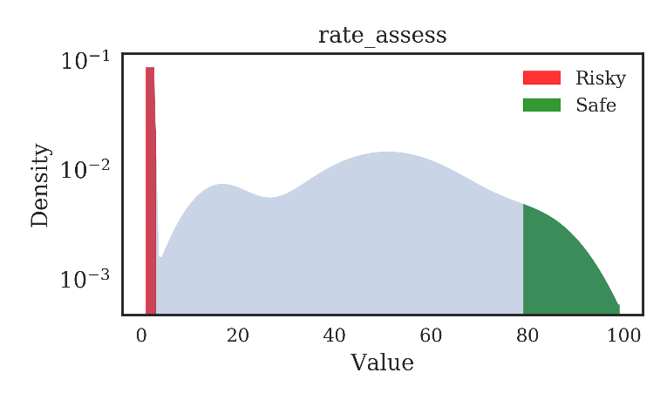
Feature Analysis

Slide 10
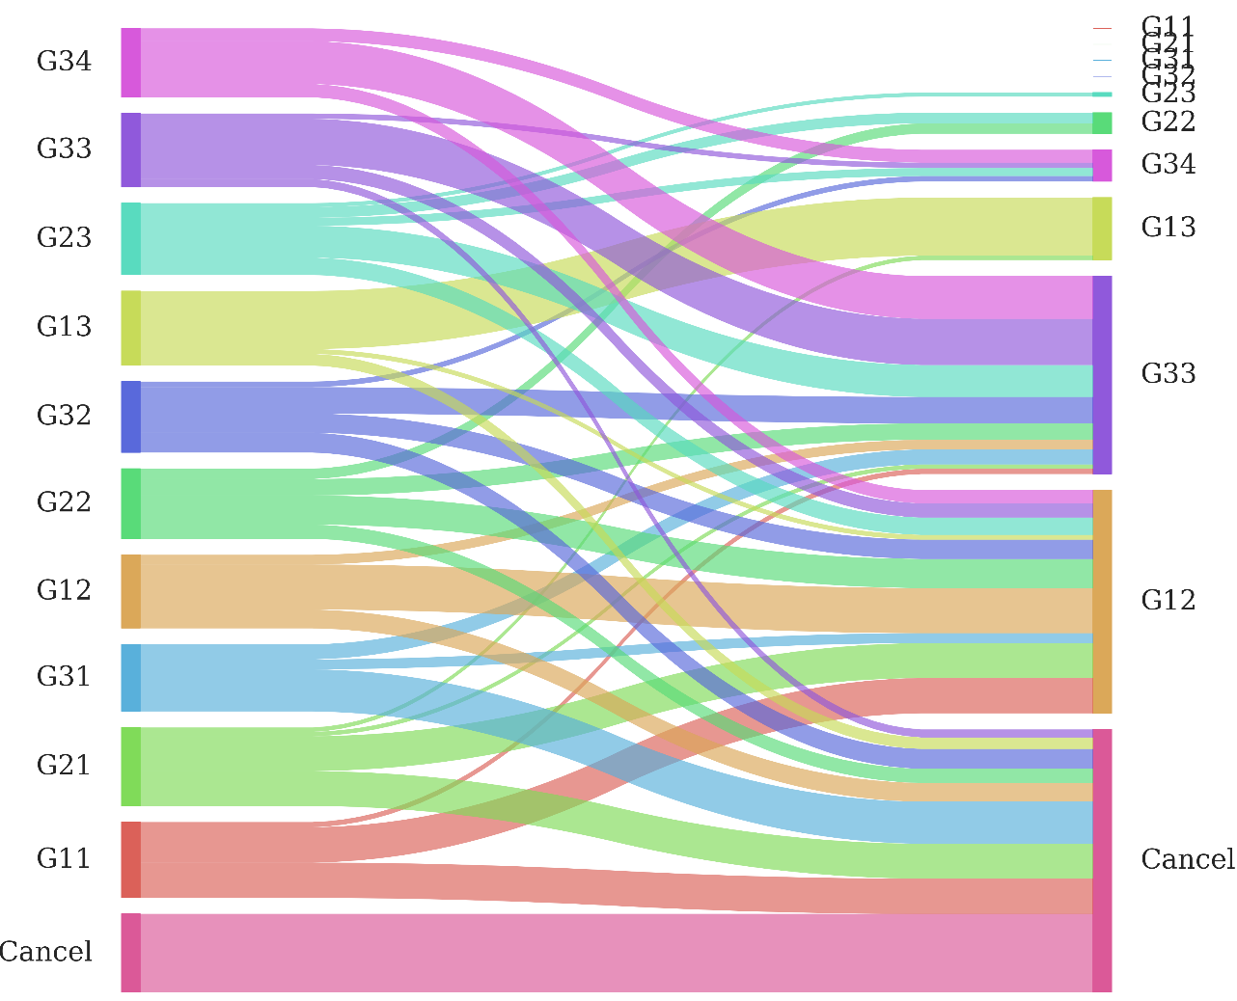
Temporal Transition of States
Low Churn
Low Churn
High Churn
High Churn

