Slide 1
Dublin, Ireland
Analysis of Postal Districts

Slide 2
Background for this analysis
Dublin is the capital of Ireland. It is situated on a bay on the east coast, at the mouth of the River Liffey.
The city is divided into 22 postal districts.
There are more than 8000 listings for Dublin City on Airbnb.
Any first-time visitor should know which is the best district for short stay with all the amenities nearby.
With Dublin city becoming congested, multiple new residential and commercial developments have started outside the Dublin 1 and 2 districts.
This analysis will provide ample information for starting a new venture where very less venues are available.

Slide 3
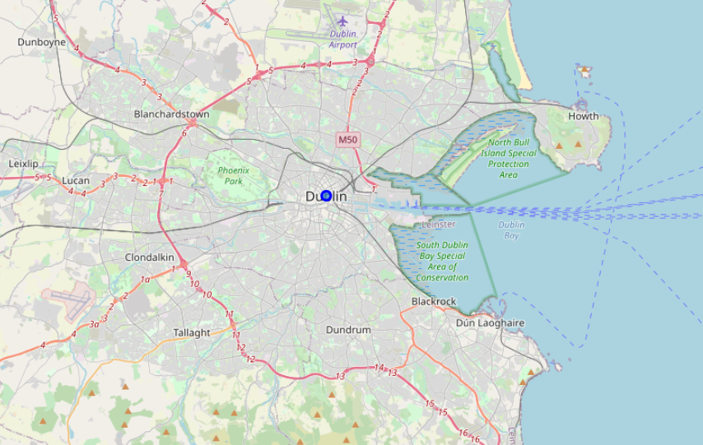
Dublin Area

Slide 4
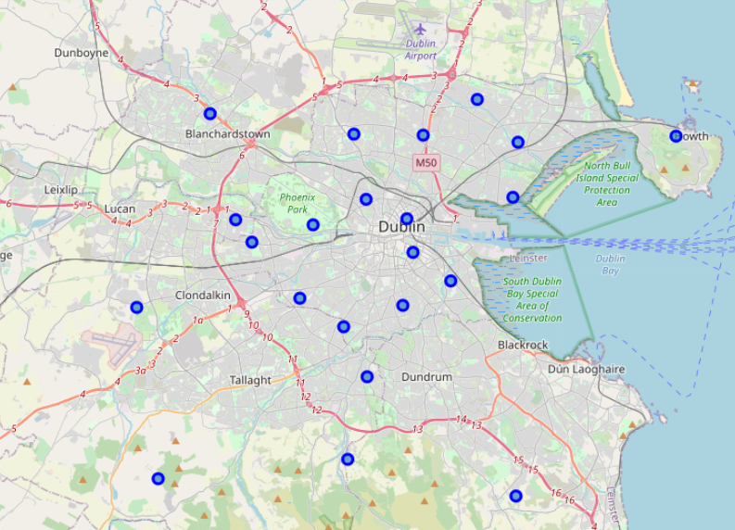
Dublin Postal Districts

Slide 5
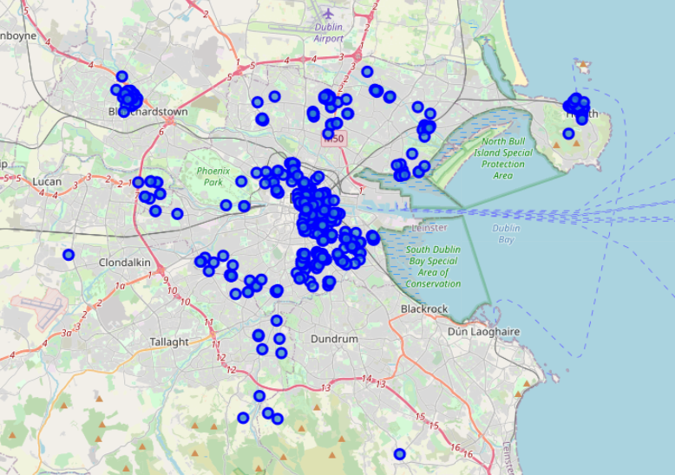
Venues in each postal districts
The map shows clusters in some of the districts such Dublin 1, Dublin 2, Dublin 6 and Dublin 15. Dublin 1 and Dublin 2 are in city centre and highly populated with both business and residences. Dublin 15 and Dublin 6 has large shopping centres. Dublin 13 is a harbour point with many seafood restaurants and cafes.

Slide 6
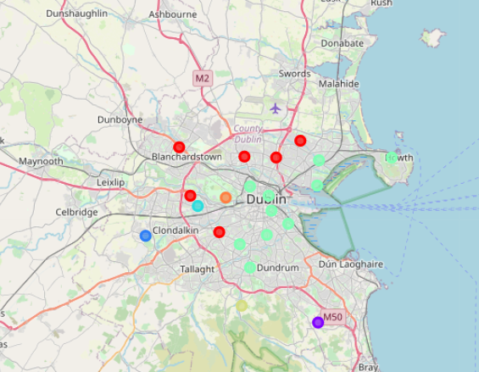
Clusters after KNN clustering

Slide 7
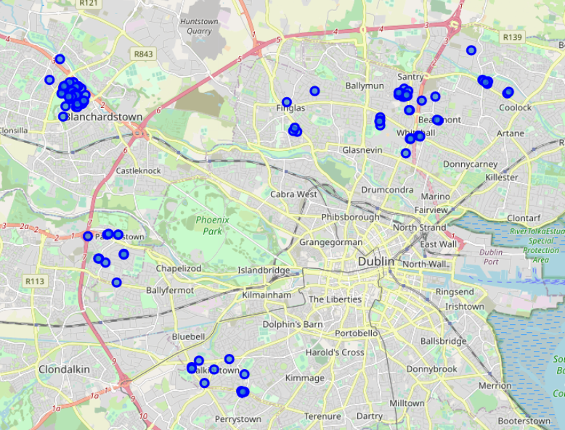
Cluster 1
Cluster 1 have 6 postal districts, with top venues as supermarket, coffee shops. These districts are outside city centre limits and with good residential denseness and small and medium business

Slide 8
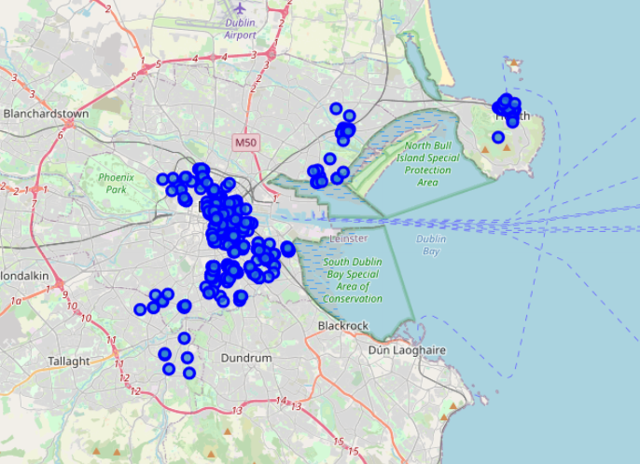
Cluster 5
Cluster 5, the biggest cluster that covers Dublin city centre. Similarities of the venues has clustered these districts together.

Slide 9
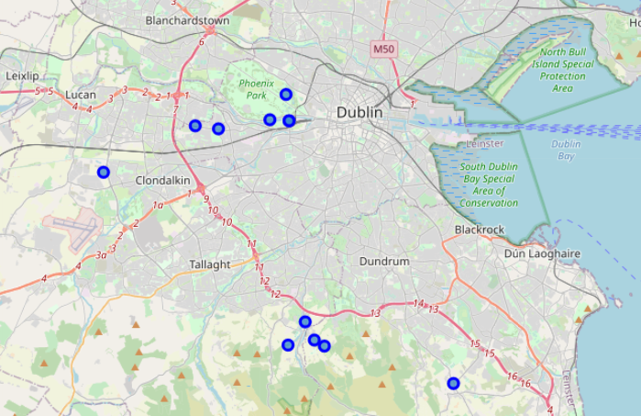
Other Clusters
These clusters are residential areas with good potential for starting new businesses

Slide 10
Conclusion and Future Direction
The cluster analysis provided a good view of the postal districts in Dublin. Districts in dense, high population areas were clustered together. Clusters with just one districts are large areas which have industrial estates and less residentials, so they show opportunities for starting small to medium businesses. The large clusters are having opportunities for smaller businesses like café, coffee shops. Also, these larger clusters are tourist attractions. The analysis can provide information to first time visitors to city, where to book there Airbnb with all major venues nearby.
This report can be advanced further by getting population and number of houses data in the postal districts and combined with venues can give a 360-degree view of the area. Also, adding crime data, it can help to find better district to buy a house for living, with all amenities nearby.

