Slide 1
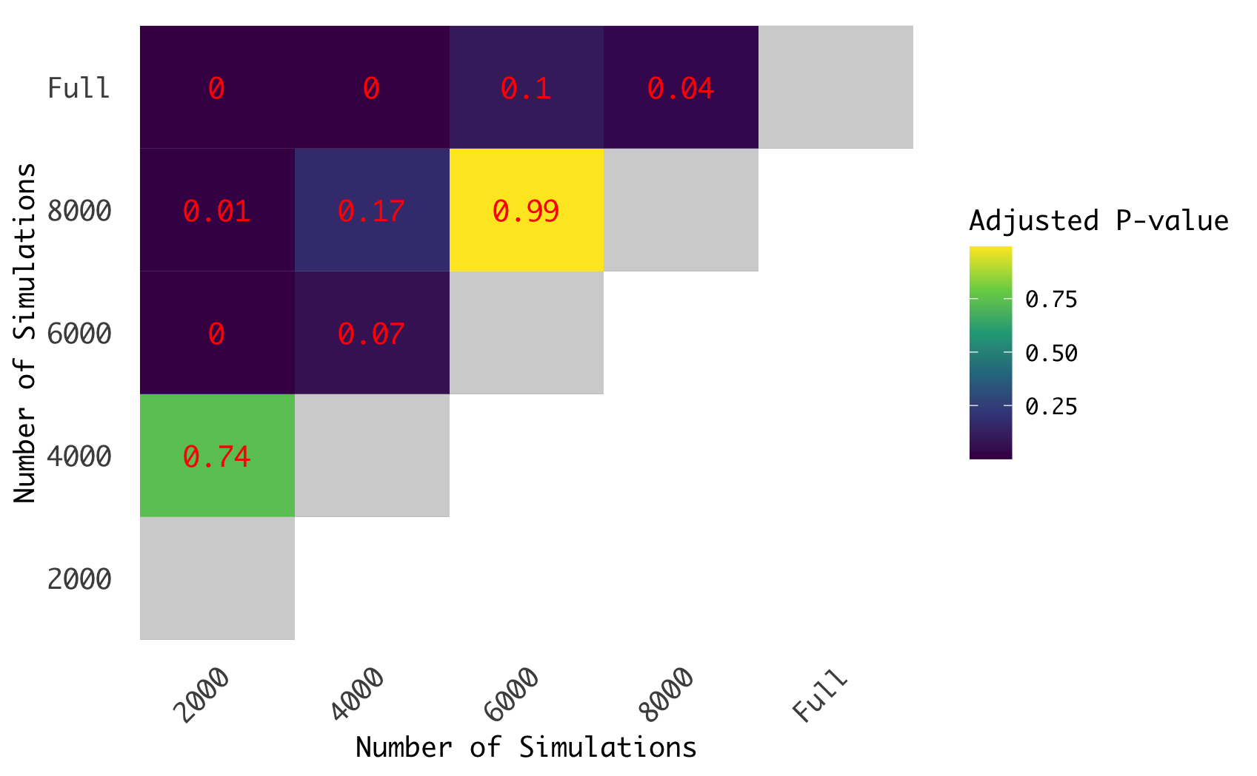
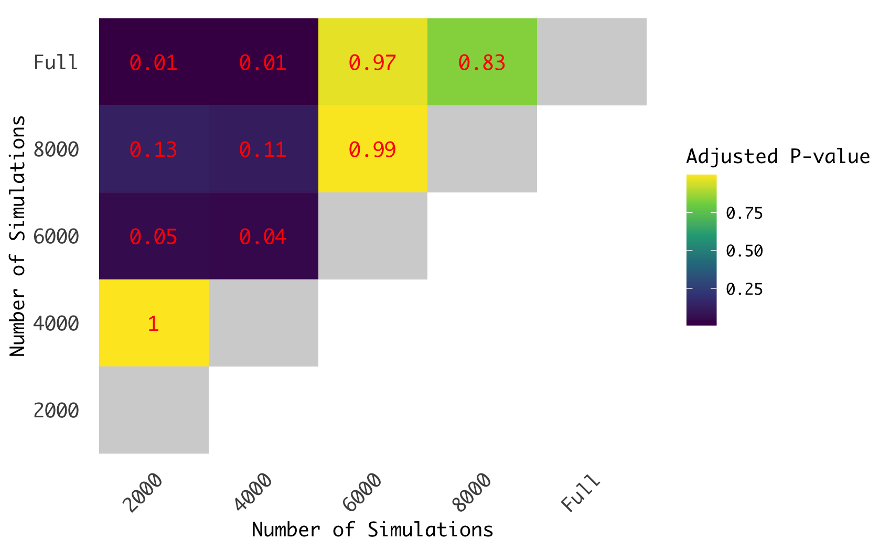
a.
b.
Effect of Kernel Size on Loss
Effect of Kernel Size on Accuracy

