Slide 1
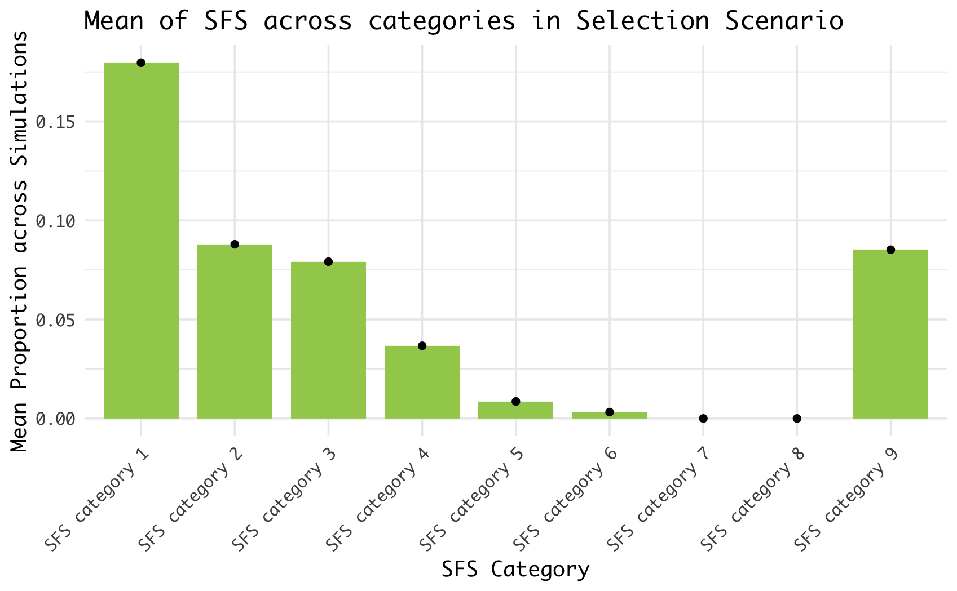
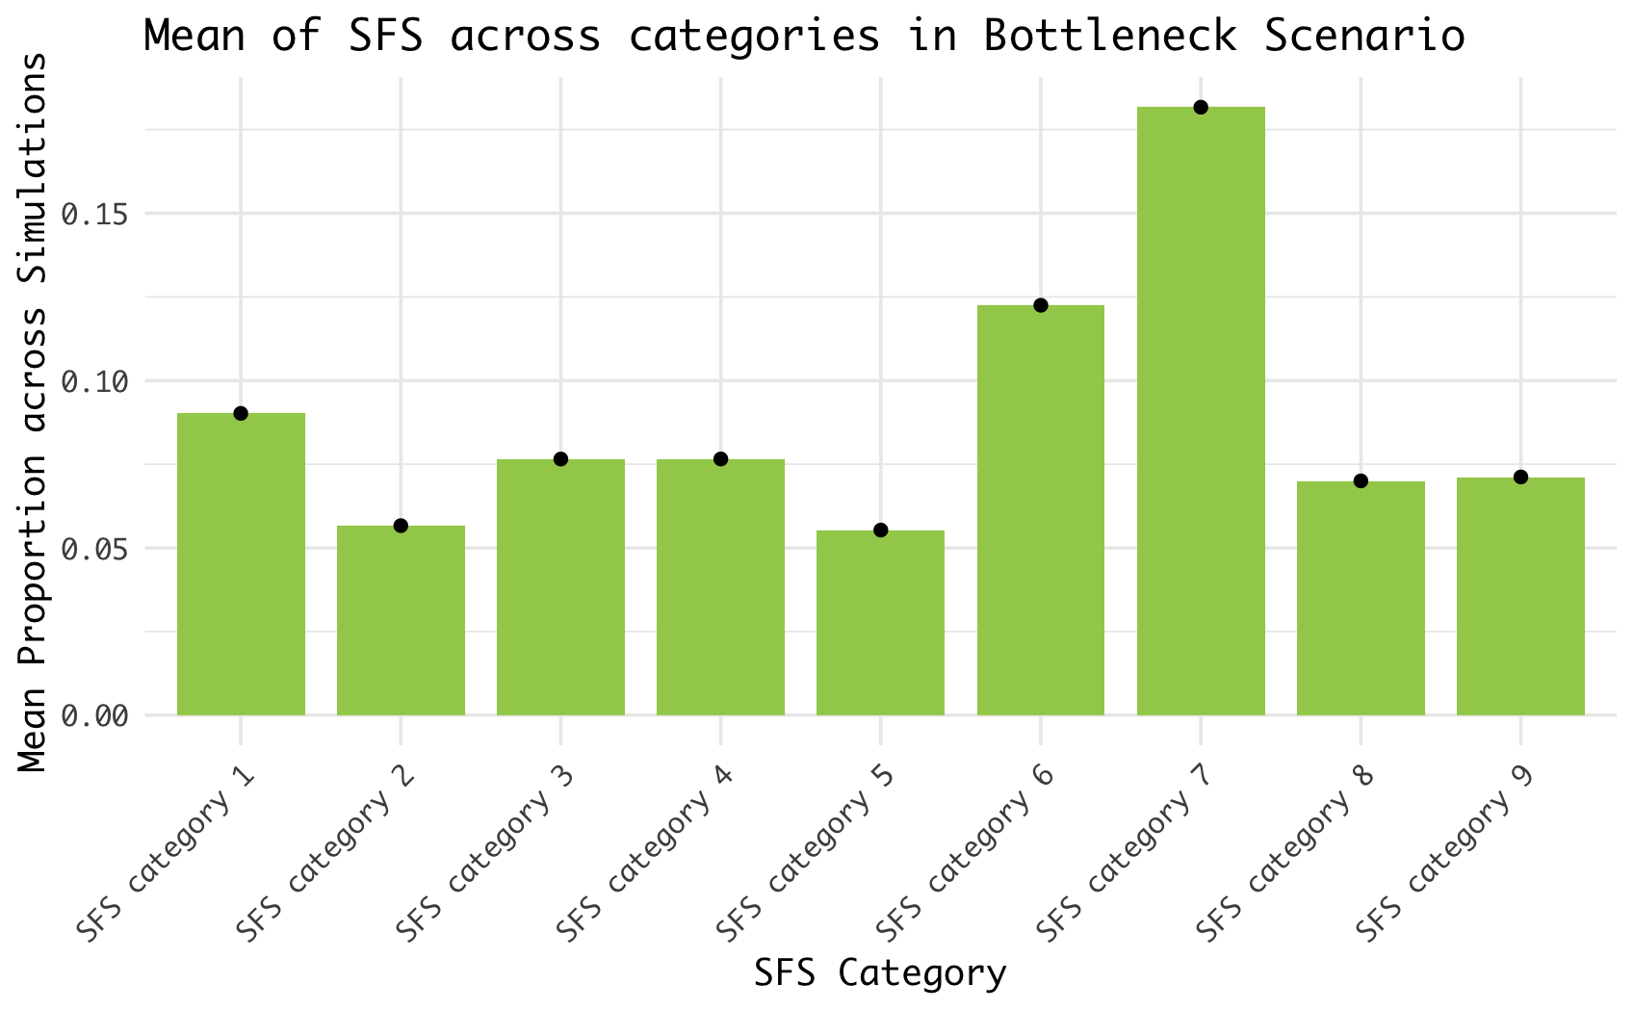
a.
b.
Mean of SFS across categories in Selection Scenario
Mean of SFS across categories in Bottleneck Scenario

