Slide 1
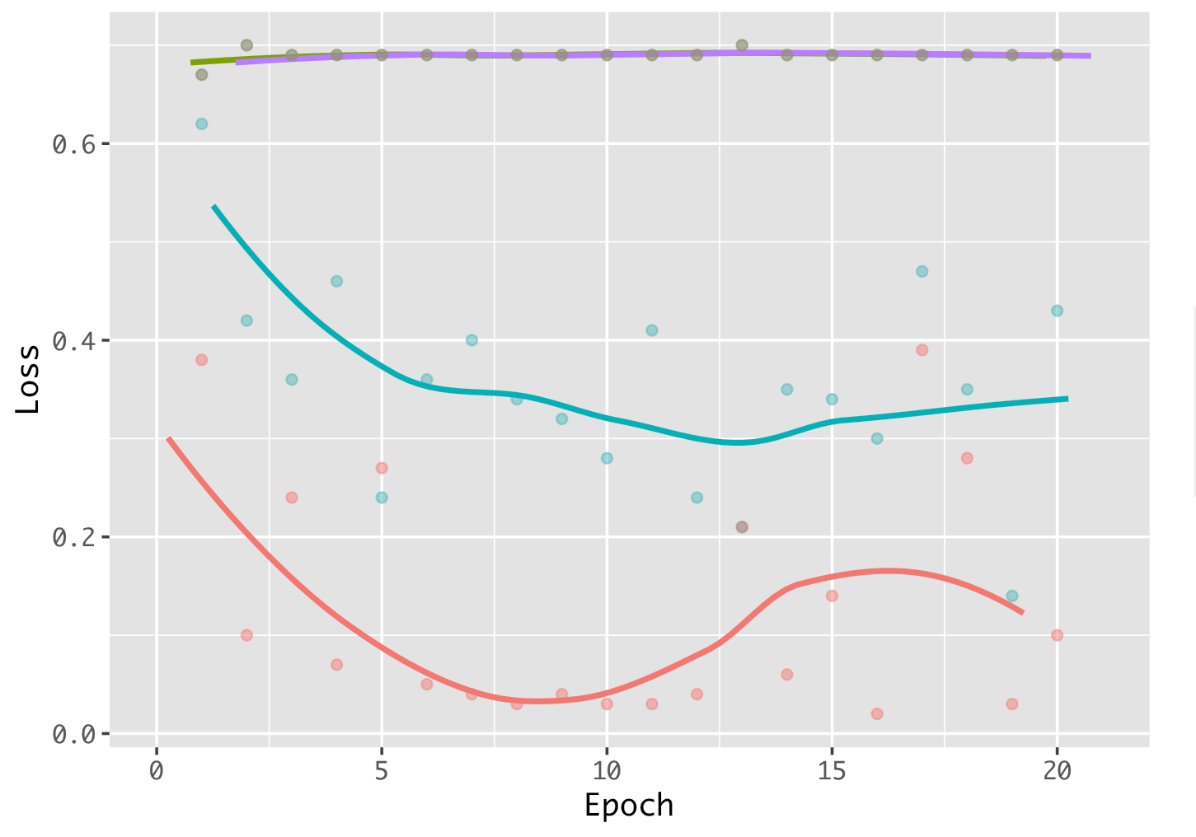
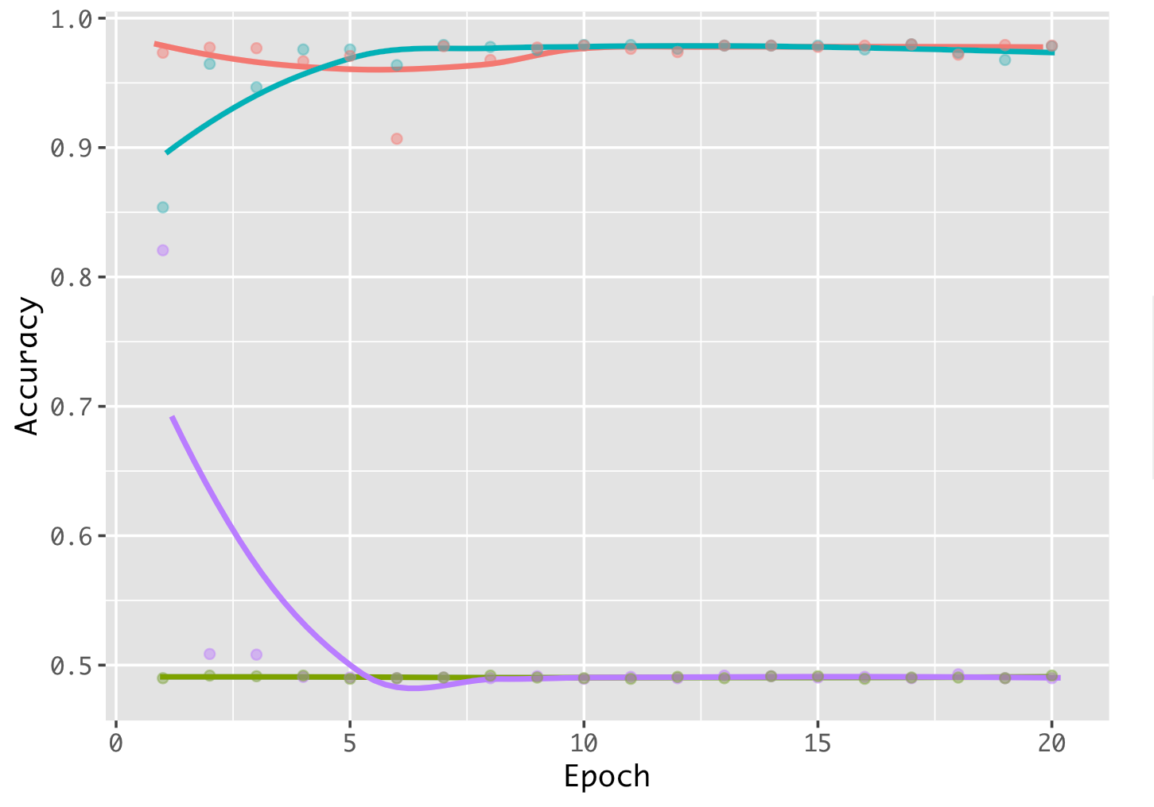
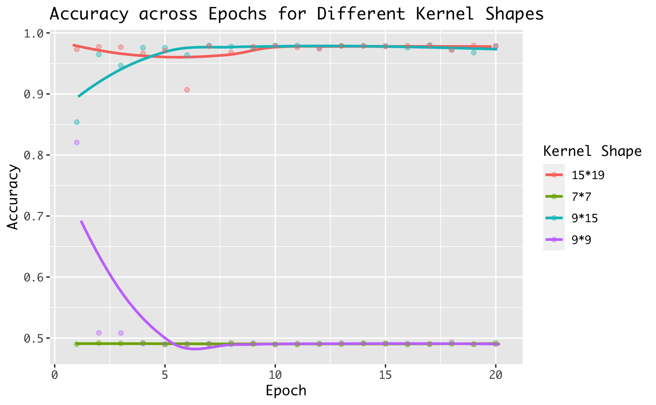
a.
b.
Loss across Epoch for Different Kernel Shape
Accuracy across Epoch for Different Kernel Shape

